Slide 1
Halloween Science
Pumpkin Genetics

Slide 2
Learning Objective
To understand why pumpkins can look different.
Success Criteria
To describe the factors that can affect the appearance of pumpkins.
To define key words relating to genetic inheritance.
To use a Punnett square to predict the probability of particular characteristics being inherited.

Slide 3
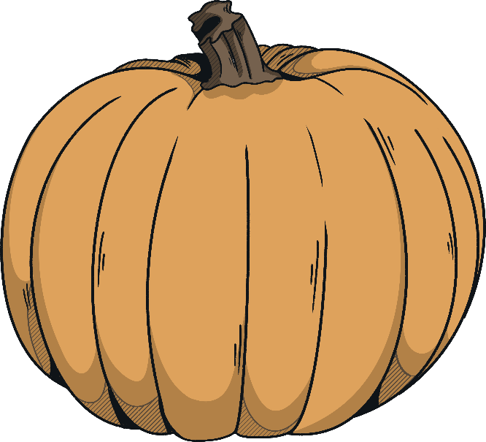
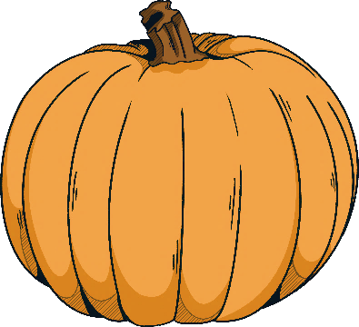
Starter: True or False?
1
Pumpkins are 70% water.
False (90%)
2
A pumpkin has on average 500 seeds.
True
3
Every single part of a pumpkin is edible.
True

Slide 4
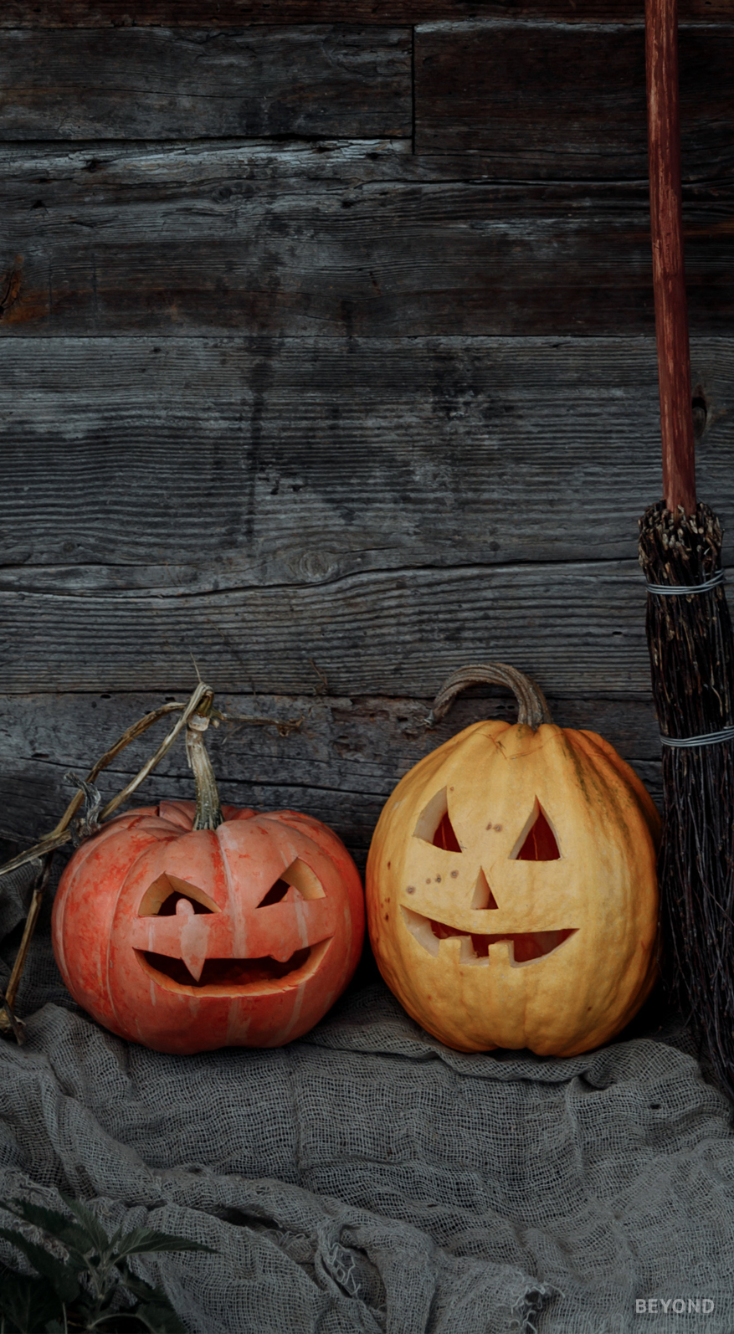
Why Do We Carve Pumpkins at Halloween?
Pumpkins are commonly carved into jack-o'-lanterns around Halloween, particularly in the USA.
The tradition of making jack-o’-lanterns at Halloween actually originated in Ireland in the 1800s, as a way of warding off evil spirits. Early records suggest that turnips and other vegetables were often used instead of pumpkins.
Pumpkins are now a common sight as decorations on doorsteps and windowsills at Halloween.

Slide 5
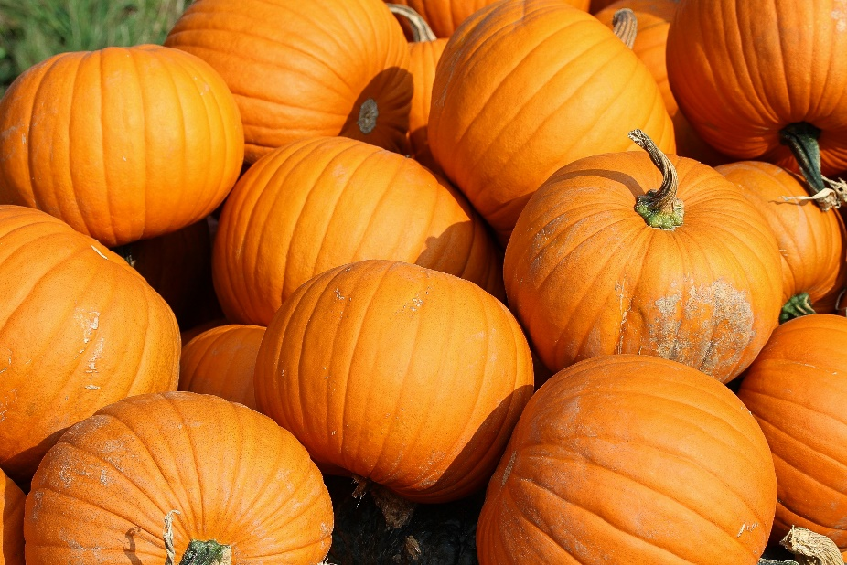
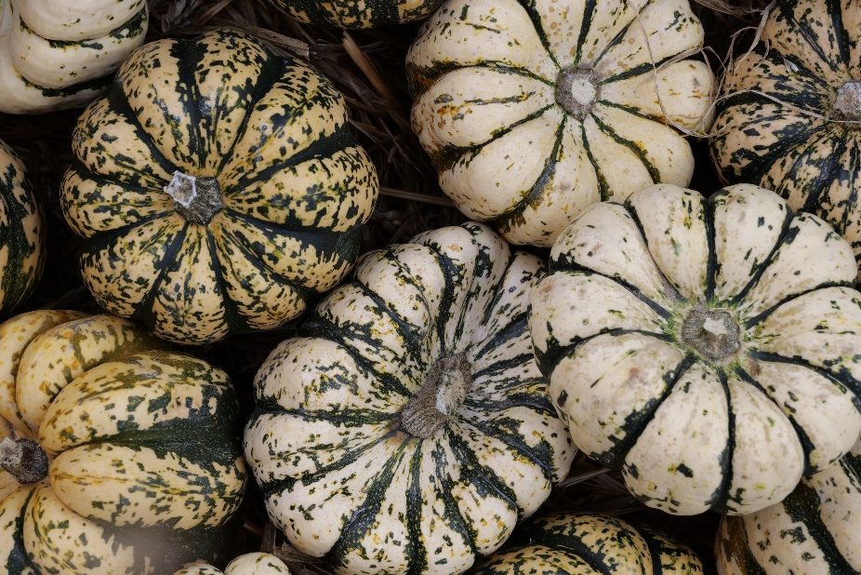
Pumpkin Characteristics
Pumpkins are usually orange in colour, but they can also be white or green!

Slide 6
Pumpkin Characteristics
What do you think has caused these pumpkins to look different? Make a list in pairs.
Some possible reasons include:
different growing times
availability of sunlight
availability of water
amount of space
genetics

Slide 7
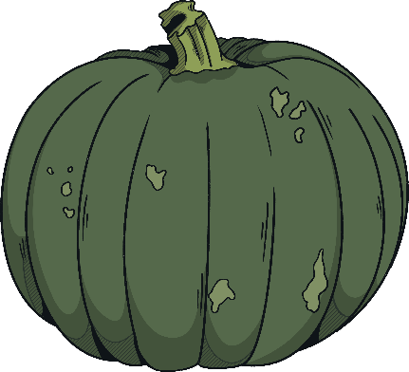
Variation
Variation is the difference in the characteristics of individuals in a population.
Some of the variation within a species is environmental and some is genetic. Genetic variation is the result of genes inherited from each parent. Different forms of the same gene are known as alleles.
The combination of alleles that are inherited from each parent is known as the genotype. The genotype of an organism determines the characteristics that are expressed, known as the phenotype.

Slide 8
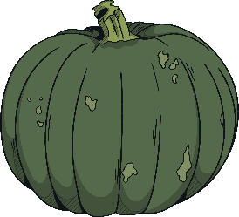
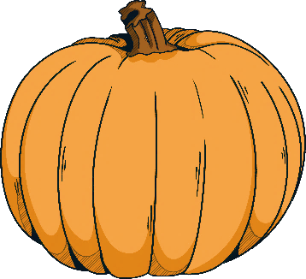
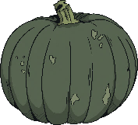
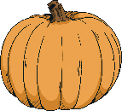
Variation
Pumpkins may have different alleles for characteristics such as size and colour.
A dominant allele is always expressed, even if only one copy is present.
A recessive allele is only expressed if two copies are present.
We use different letters to represent the different alleles. Dominant alleles are represented by capital letters and recessive alleles are represented by lower case letters. Organisms produced by sexual reproduction receive one allele from each parent, so the genotype is made up of two letters.
The letter chosen to represent the alleles normally comes from the recessive phenotype, but you can choose any letter. It makes sense to choose a letter for which you can easily tell the difference between the capital and lower case forms.

Slide 9
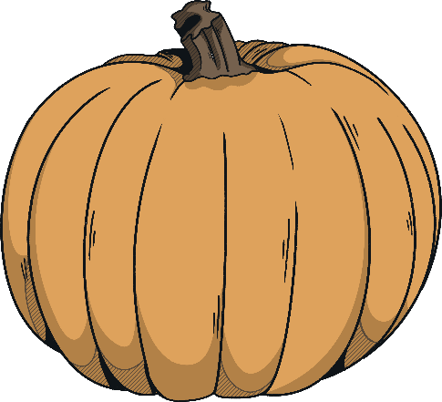
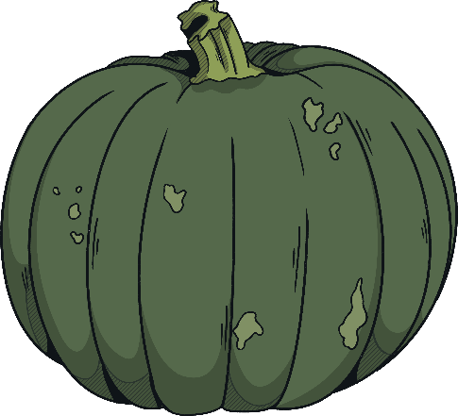
Variation
Let’s look at an example. The pumpkins below are different in colour. The gene for colour has two alleles: orange and green.
The orange allele is dominant so can be represented by a capital letter G. The small allele is recessive so is represented by a lower case g.
A pure orange pumpkin has the genotype GG.
A pure green pumpkin has the genotype gg.
Both pumpkins have two copies of the same allele, so they are homozygous. If they had two different alleles (Gg), they would be heterozygous.

Slide 10
Genetic Crosses
We can use a genetic cross to determine the probability of an organism having a particular phenotype.
One way of determining the outcome of a genetic cross is to construct a Punnett square diagram.
alleles from parent 1
alleles from parent 2

Slide 11
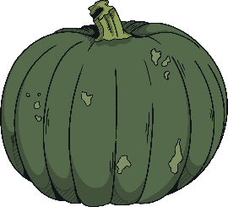
Genetic Crosses
For example, if a homozygous orange pumpkin is crossed with a homozygous green pumpkin, we can use a Punnett square to work out the probability of the offspring being orange.
Step 1: Fill in the alleles of each parent around the edges of the Punnet square.
Step 2: Fill in the possible combinations of alleles inside the Punnett square.
Step 3: Work out the proportion of each combination of alleles in the Punnett square.
 | G | G
g
g
100% of the genotypes are Gg so there is a 100% chance that the offspring will be orange.
Gg
Gg
Gg
Gg

Slide 12
Your Turn
A heterozygous orange pumpkin is crossed with a homozygous green pumpkin. Determine the probability that the offspring will be orange.
 | G | g
g | Gg | Gg
g | gg | gg
heterozygous orange pumpkins
homozygous green pumpkins
There is a 50% chance that the offspring will be orange. The ratio of orange pumpkins to green pumpkins is 1:1.

Slide 13
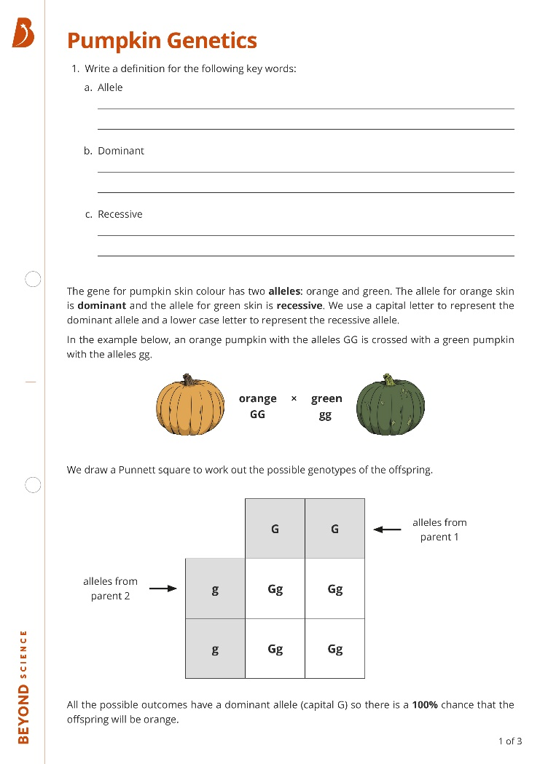
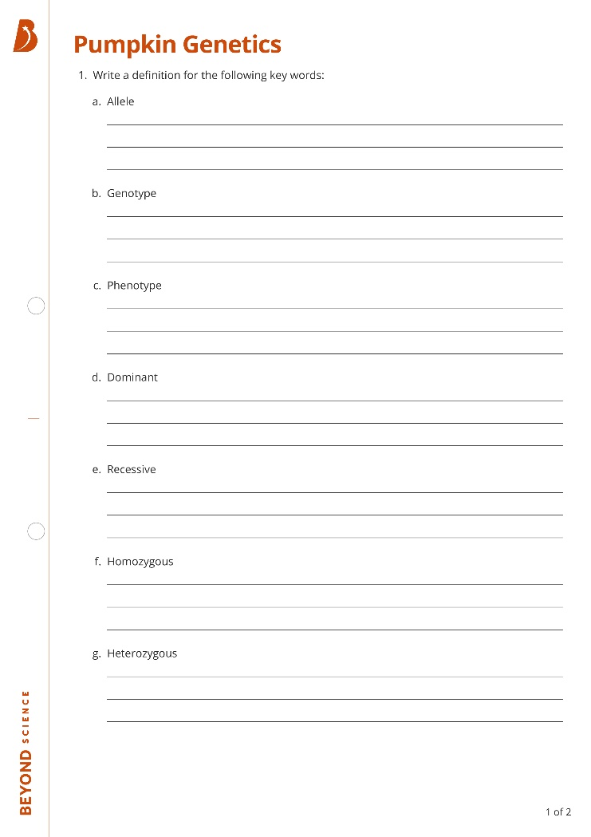
Your Turn
Complete the worksheet to check your understanding of genetic variation in pumpkins.

Slide 14
Plenary: Spot the Mistakes
Variation is the differences between individuals in a population. Variation can be elemental environmental and genetic.
Organisms produced by sexual reproduction receive one copy of each gene from each parent. Different forms of the same gene are called
aliens alleles. There are dominating dominant and recessive versions.
The genotype of an organism determines its phenoprint phenotype. For example, if an organism is heterozygous homozygous for the recessive allele, the recessive characteristic will be expressed. The probability that the offspring will inherit a particular characteristic can be determined using a puppet Punnett square.
Variation is the differences between individuals in a population. Variation can be elemental and genetic.
Organisms produced by sexual reproduction receive one copy of each gene from each parent. Different forms of the same gene are called
aliens. There are dominating and recessive versions.
The genotype of an organism determines its phenoprint. For example, if an organism is heterozygous for the recessive allele, the recessive characteristic will be expressed. The probability that the offspring will inherit a particular characteristic can be determined using a puppet square.
Variation is the differences between individuals in a population. Variation can be elemental and genetic.
Organisms produced by sexual reproduction receive one copy of each gene from each parent. Different forms of the same gene are called
aliens. There are dominating and recessive versions.
The genotype of an organism determines its phenoprint. For example, if an organism is heterozygous for the recessive allele, the recessive characteristic will be expressed. The probability that the offspring will inherit a particular characteristic can be determined using a puppet square.

