Slide 1
The Monkey's Paw

Slide 2
What might the details about the father hint about the future events in the plot? Paragraph 1

Slide 3
The father seems like the type of person who might take risks or do dangerous things.

Slide 4
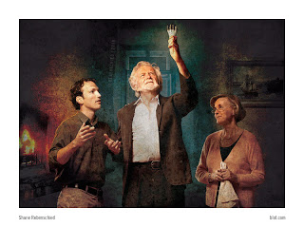
How does the information about the Whites’ guest help build suspense? Paragraph 13

Slide 5
The author uses foreshadowing to prepare the reader for strange and unexpected events.

Slide 6
What does this lesson suggest about the story’s theme? Paragraph 26

Slide 7
It suggests the theme about the dangerous and interfering with fate.

Slide 8
How do you think the paw might affect the main character’s relationships? Paragraph 35-44

Slide 9
The family might develop different points of view about what to do with the paw.

Slide 10
How have the Whites’ views of the paw changes? Paragraph 58- 61

Slide 11
The paw’s movement scares Mr. White. Herbert still seems confident that the paw is powerless. Mrs. White is about the nervous about the husbands reaction but tries to assure him that he imagined the paw’s movement.

Slide 12
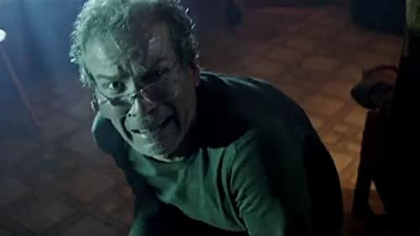
What are some possible causes of the man’s behavior ? Paragraph 76

Slide 13
The man’s action create suspense and suggest that he has bad news, and something bad may have happened to Herbert.

Slide 14
Why do you think the author includes this description ? Cite evidence to support your ideas. Paragraph 96- 100

Slide 15
The description slows the pacing of the story, suggesting a calm lull, before an increase in tension.

