Slide 1
Past Continuous

Slide 2
At three o'clock yesterday afternoon, they were sitting at an outdoor café.

Slide 3
For an action which was in progress at a stated time in the past, and we don’t mention when the action started or finished

Slide 4
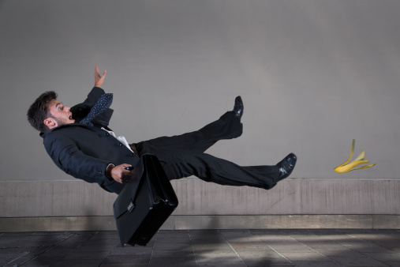
He was walking when he slipped on a banana skin.

Slide 5
For an action which was in progress when another action interrupted it.

Slide 6
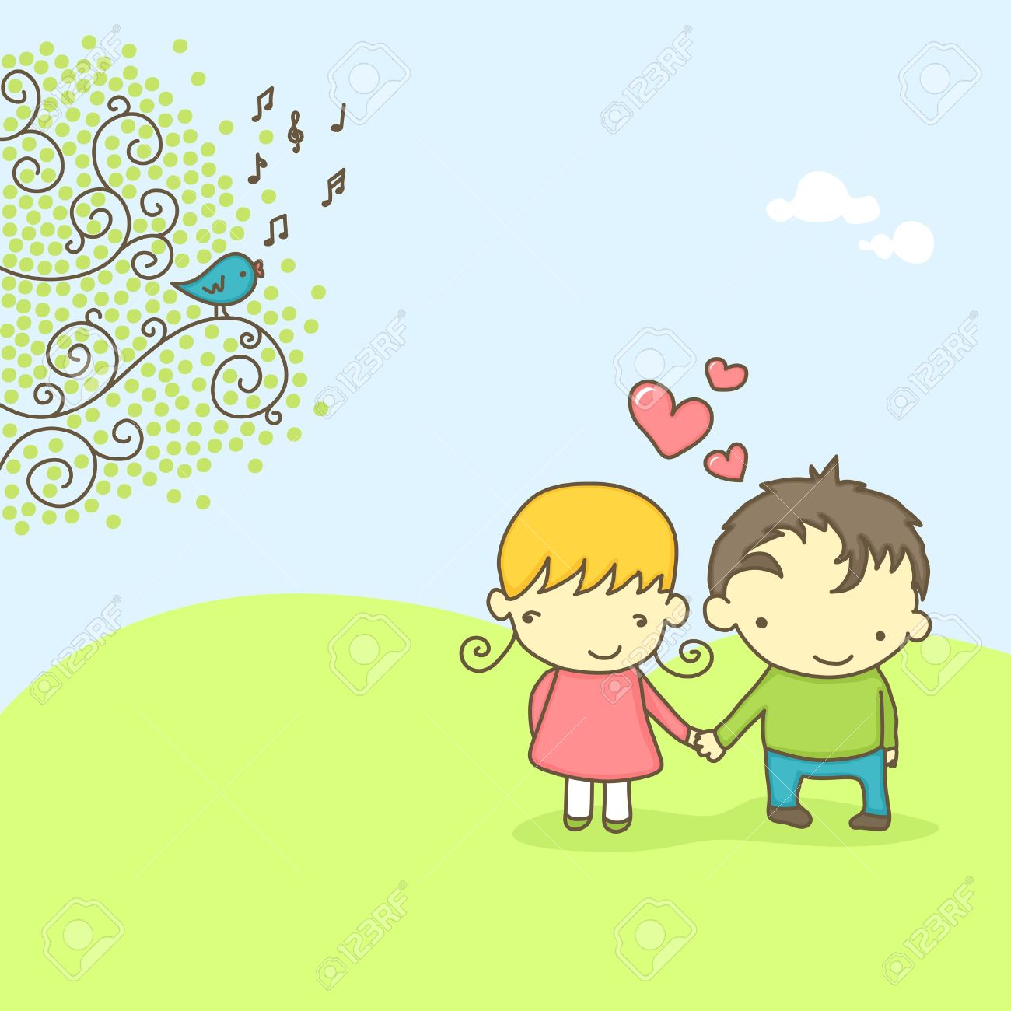
Todd and Alex were walking through the forest.
The sun was shining and the birds were singing.

Slide 7
To describe the atmosphere , the setting etc. in the introduction to a story before we describe the main events.

Slide 8
Mr. Bean Pair work
https://www.youtube.com/watch?v=kJS9ViONCRc
https://jeopardylabs.com/play/past-simple-vs-past-continuous15
grammar in general
https://jeopardylabs.com/play/8th-grade-grammar-jeopardy-8

Slide 9
Group Work

Slide 10
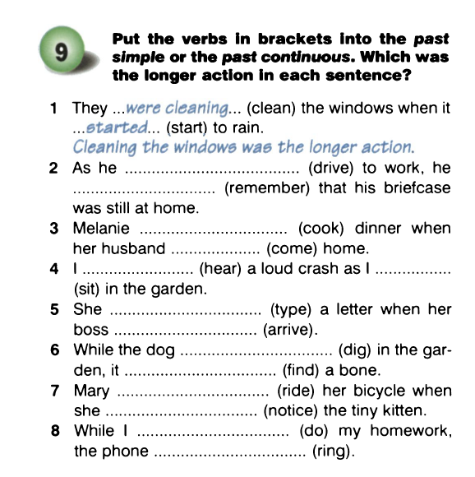

Slide 11
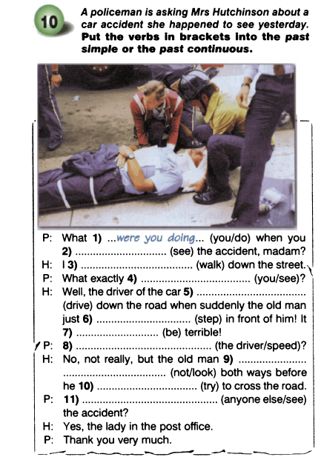

Slide 12
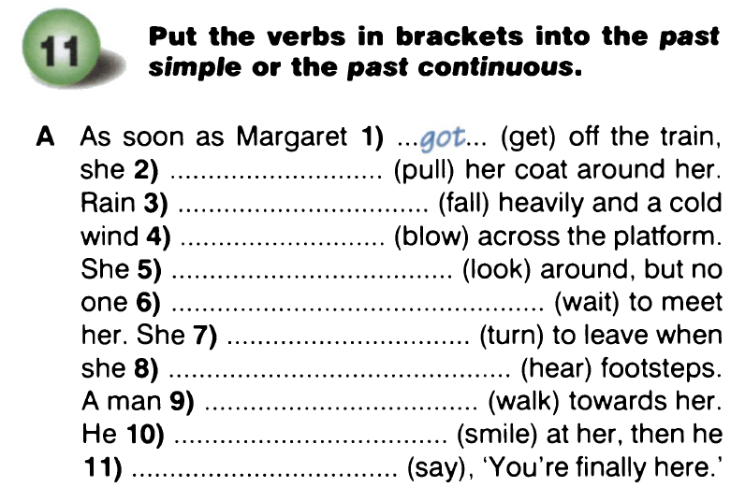

Slide 13
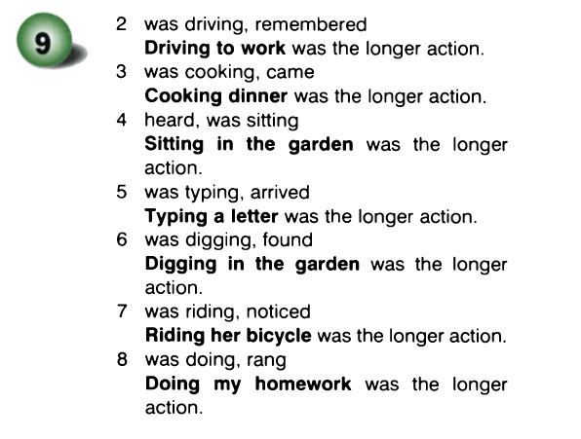
Answer Key

Slide 14
