Slide 1
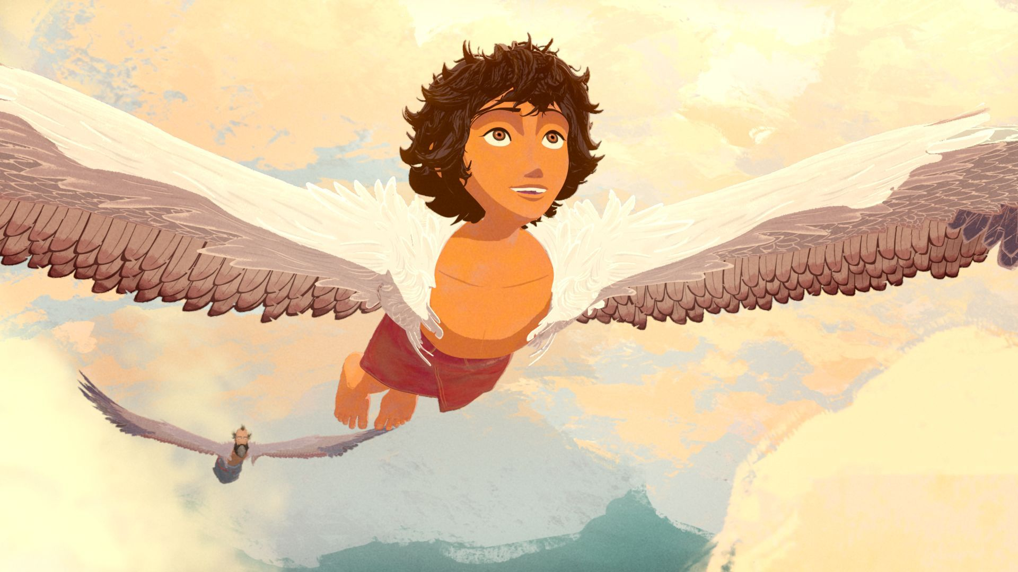
Icarus

Slide 2
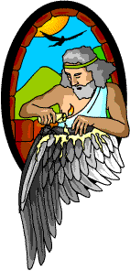
Reread paragraph 3 and 4 . Mark words and phrases that show that Daedalus is happy about the work he and his son are doing.

Slide 3
Their interaction suggests that fathers were responsible for the well- being of their children and that children were obedient and followed their father instructions.

Slide 4
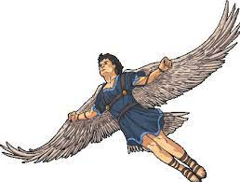
What might Daedalus warning suggest about one theme of this myth?

Slide 5
You should listen to people who are older and wiser than you.

Slide 6
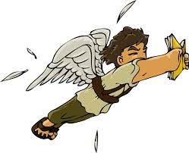
Why Dedalus gave his son warning to keep at a moderate high?

Slide 7
They were about to try something dangerous, so it was important to be safe and careful.

Slide 8
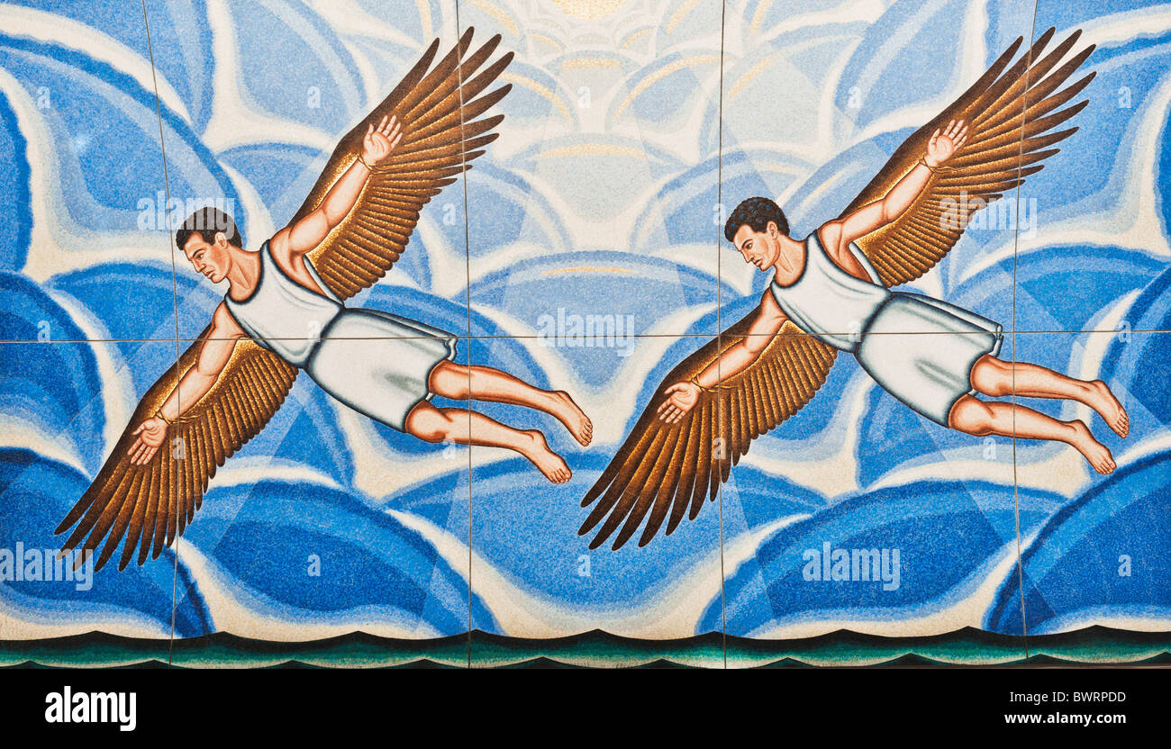
Icarus and Daedalus tested their flying ability before setting out across the sea. Explain

Slide 9
The flight required physical strength and navigation skills.

Slide 10
What attitudes did the ancient Greeks have about nature?

Slide 11
Ancient Greeks respected nature and turned to it for inspiration.

Slide 12
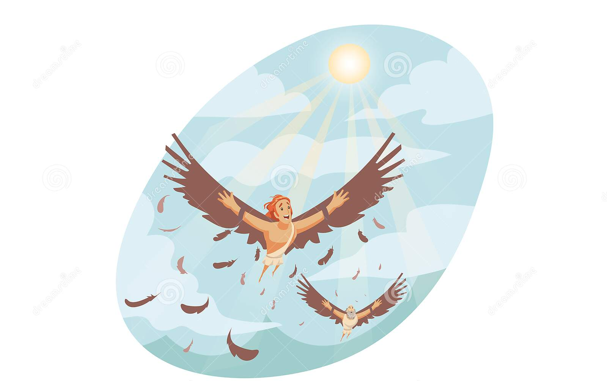
Why did Icarus keep flying higher and higher?

Slide 13
He got so excited about flying tat he forgot his father’s instructions.

Slide 14
Do you think Daedalus ever flew again after he escaped from the island and king Minos?

Slide 15
I don’t think so, because flying would have reminded him of his lost son.

Slide 16
What is the theme of the story?

Slide 17
One theme of the story is moderation is the safest way to live life. Another theme is people should not attempt to do what they are not intended do.

Slide 18
How does this myth, as a whole, illustrate the idea of “words of wiser”?

Slide 19
The myth emphasizes the idea of acting in moderation and of listening tosomeone who has authority over you.

