Slide 1

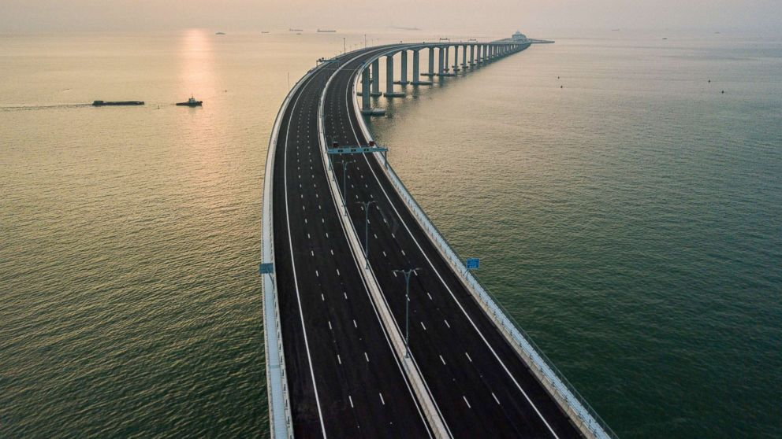
Overcoming Earth’s obstacles
Reading comprehension before reading https://www.youtube.com/watch?v=yIZcXmHbFGQ

Slide 2

Understand Ex. C page 20

Slide 3
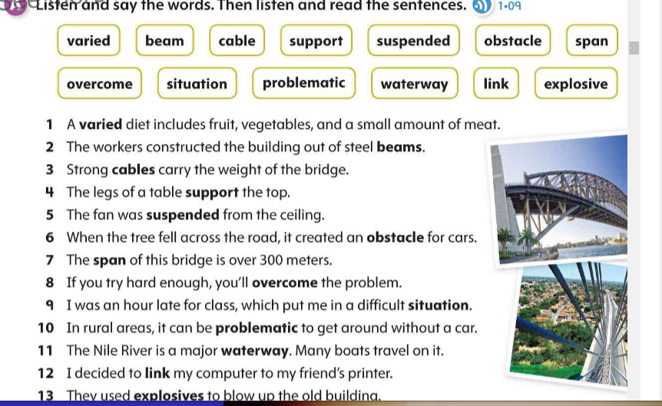

Slide 4

Q. 1 Three factors an engineer considers before building a bridge or a tunnel a) the distance to be traversed. b)the composition of soil at the site. C) what needs to be transported across or through.

Slide 5
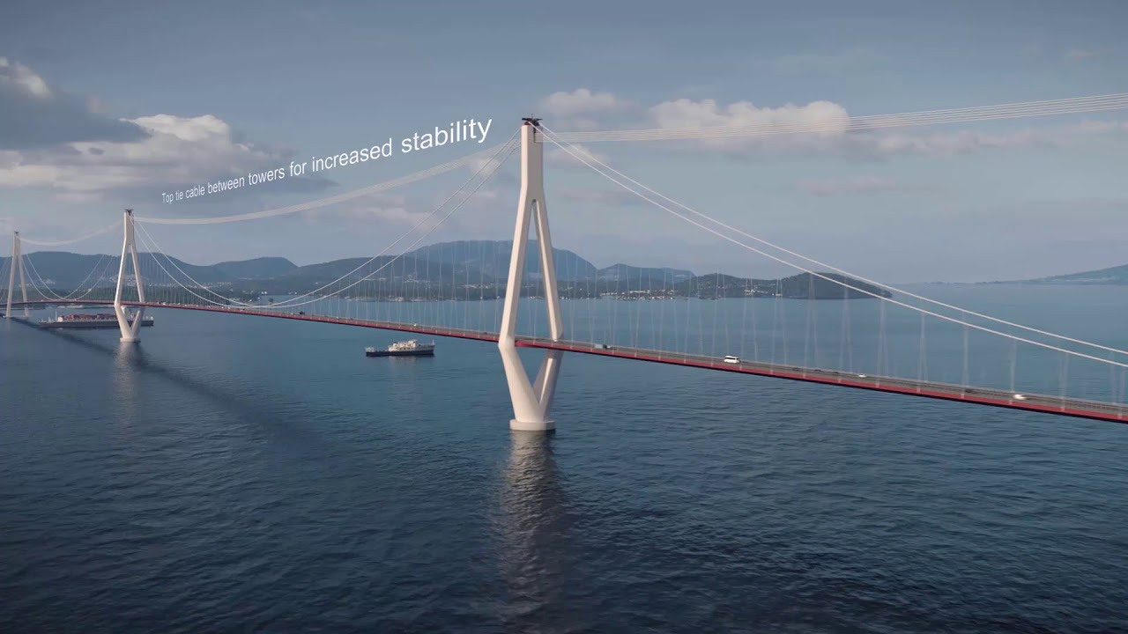
Q. 2 suspension bridges are used to cover long distances.

Slide 6
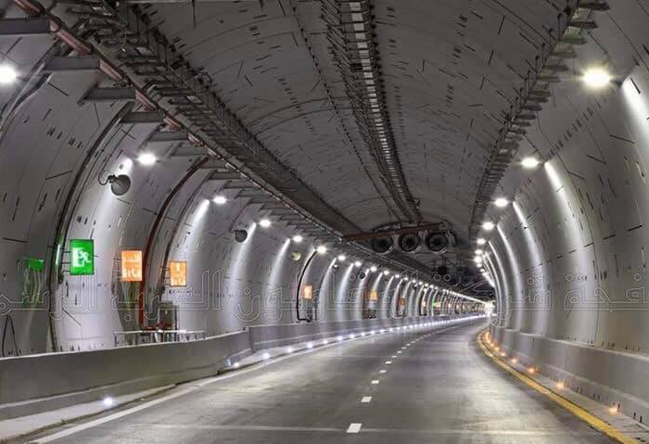
Q.3 They should build a tunnel because it can protect from the weather and carry heavy weights.

Slide 7
Ex. D page 20
Look at the words , then use them to complete the sentences.
Commonly/ suspension/ factors/ load bearing/ stacks/ aqueducts

