Slide 2
1. Varied 2. beam 3. cable 4. support 5. suspended 6. obstacle 7. span 8. overcome 9. situation 10. problematic 11. waterway 12. link 13. explosive

Slide 3
Varied Adj: having many different kinds of things or activities.

Slide 4
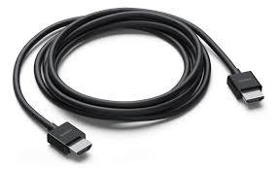
1. Varied 2. beam 3. cable 4. support 5. suspended 6. obstacle 7. span 8. overcome 9. situation 10. problematic 11. waterway 12. link 13 explosive

Slide 5
Cable a set of wires, covered by plastic, that carries electricity, signals, etc

Slide 6
1. Varied 2. beam 3. cable 4. support 5. suspended 6. obstacle 7. span 8. overcome 9. situation 10. problematic 11. waterway 12. link 13 explosive

Slide 7
suspended hanging from something

Slide 8
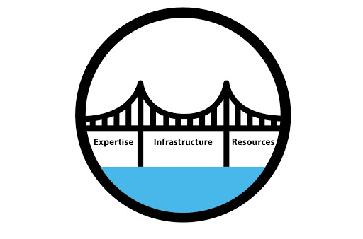
1. Varied 2. beam 3. cable 4. support 5. suspended 6. obstacle 7. span 8. overcome 9. situation 10. problematic 11. waterway 12. link 13 explosive

Slide 9
Span noun: the length of something from one end to the other.

Slide 10
1. Varied 2. beam 3. cable 4. support 5. suspended 6. obstacle 7. span 8. overcome 9. situation 10. problematic 11. waterway 12. link 13 explosive

Slide 11
Situation noun: the things that happening in a particular place or time.

Slide 12
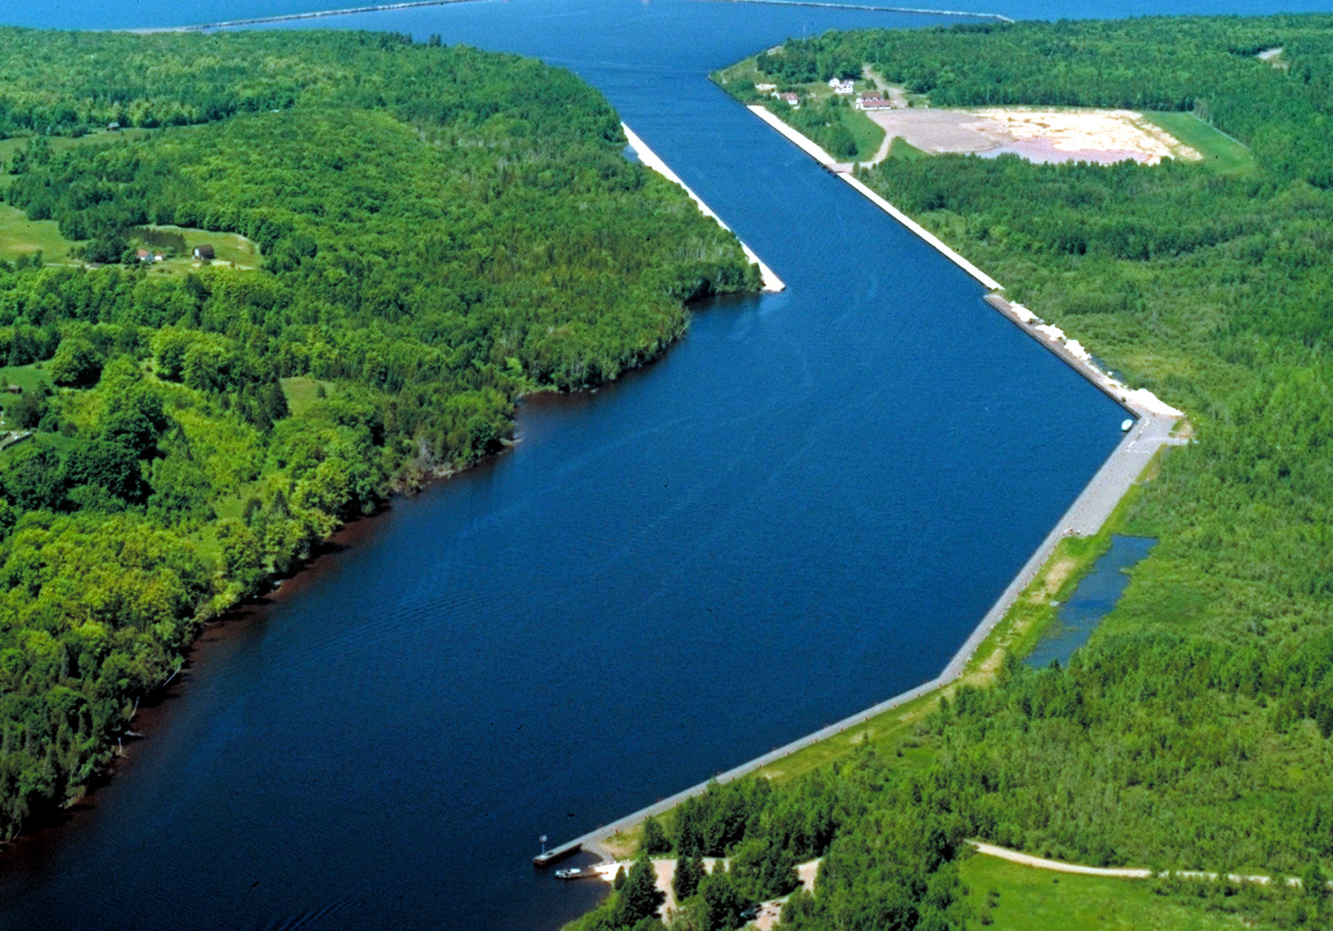
1. Varied 2. beam 3. cable 4. support 5. suspended 6. obstacle 7. span 8. overcome 9. situation 10. problematic 11. waterway 12. link 13 explosive

Slide 13
Waterway Noun: a river, etc. along which boats or ships can travel

Slide 14
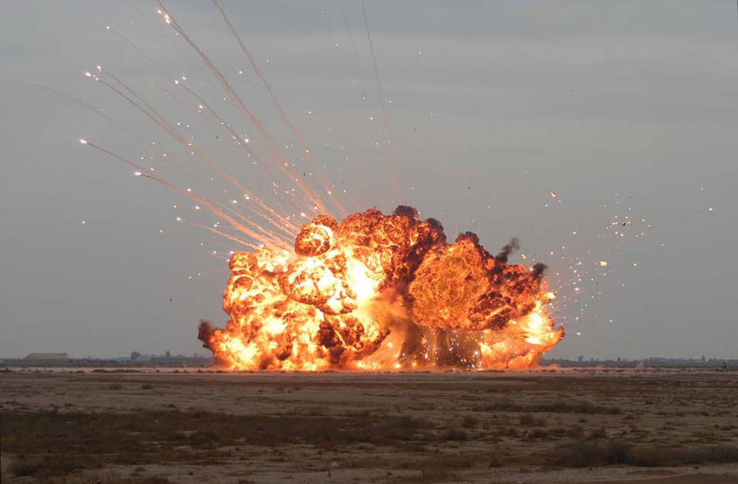
1. Varied 2. beam 3. cable 4. support 5. suspended 6. obstacle 7. span 8. overcome 9. situation 10. problematic 11. waterway 12. link 13 explosive

Slide 15
Explosive noun: a substance that can explode.

Slide 16
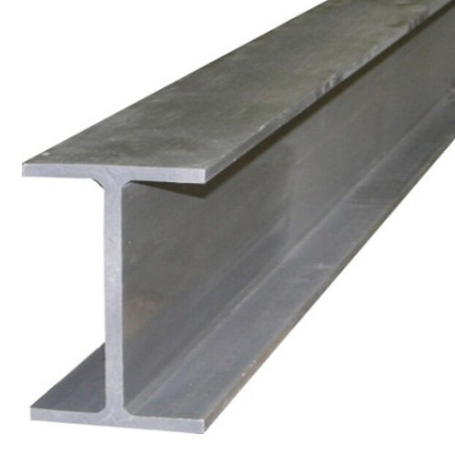
1. Varied 2. beam 3. cable 4. support 5. suspended 6. obstacle 7. span 8. overcome 9. situation 10. problematic 11. waterway 12. link 13 explosive

Slide 17
Beam A long piece of wood, metal, etc. that is used to support weight, for example in the floor or ceiling of a building.

Slide 18
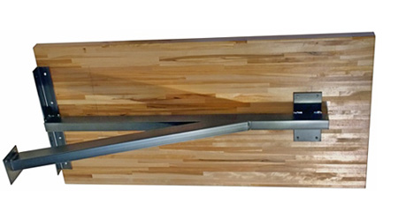
1. Varied 2. beam 3. cable 4. support 5. suspended 6. obstacle 7. span 8. overcome 9. situation 10. problematic 11. waterway 12. link 13 explosive

Slide 19
support verb: 1. to carry the weight of someone or something 2. to help someone or something by saying that you are agree with them.

Slide 20
1. Varied 2. beam 3. cable 4. support 5. suspended 6. obstacle 7. span 8. overcome 9. situation 10. problematic 11. waterway 12. link 13 explosive

Slide 21
Obstacle noun: something that makes it difficult for you to go somewhere or do sth.

Slide 22
1. Varied 2. beam 3. cable 4. support 5. suspended 6. obstacle 7. span 8. overcome 9. situation 10. problematic 11. waterway 12. link 13 explosive

Slide 23
overcome verb: to manage to control or defeat someone or sth.

Slide 24
1. Varied 2. beam 3. cable 4. support 5. suspended 6. obstacle 7. span 8. overcome 9. situation 10. problematic 11. waterway 12. link 13 explosive

Slide 25
link adj: relating to the limbic system of the brain.

Slide 26
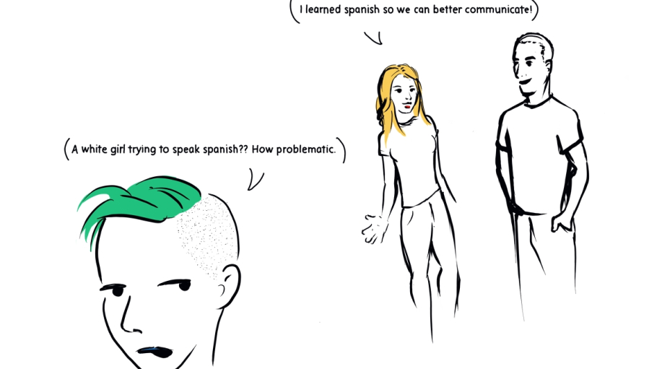
1. Varied 2. beam 3. cable 4. support 5. suspended 6. obstacle 7. span 8. overcome 9. situation 10. problematic 11. waterway 12. link 13 explosive

Slide 27
problematic presenting a problem or difficulty.

