Slide 1

Homophones
Ex. D page 23

Slide 2


The difference between sight and site https://www.youtube.com/watch?v=V86F9oiqRZw

Slide 3


The difference between desert and dessert https://www.youtube.com/watch?v=OyTIFXOuduo

Slide 4


The difference between knew and new https://www.youtube.com/watch?v=vMP25SMibZg

Slide 5

The difference between accept and except https://www.youtube.com/watch?v=y3te-7ekGo8

Slide 6
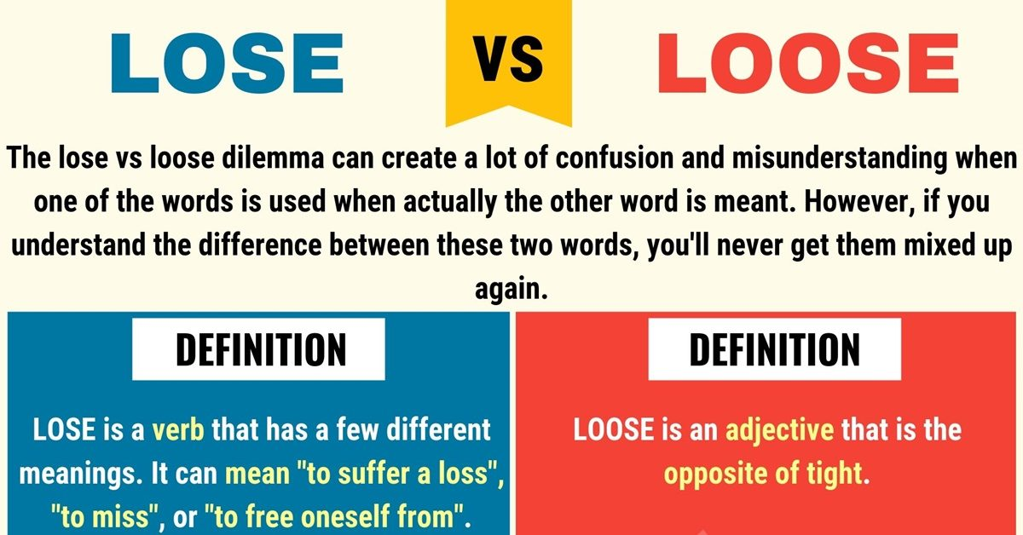
The difference between lose and loose https://www.youtube.com/watch?v=229AN2lE3cA&t=18s

Slide 7


Knew: Verb, means had information in your mind.
New: already existing but seen, experienced, or acquired recently or now for the first time.

Slide 8
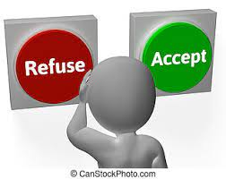

Accept: to say “yes "to something.
Except: not including something or someone.

Slide 9

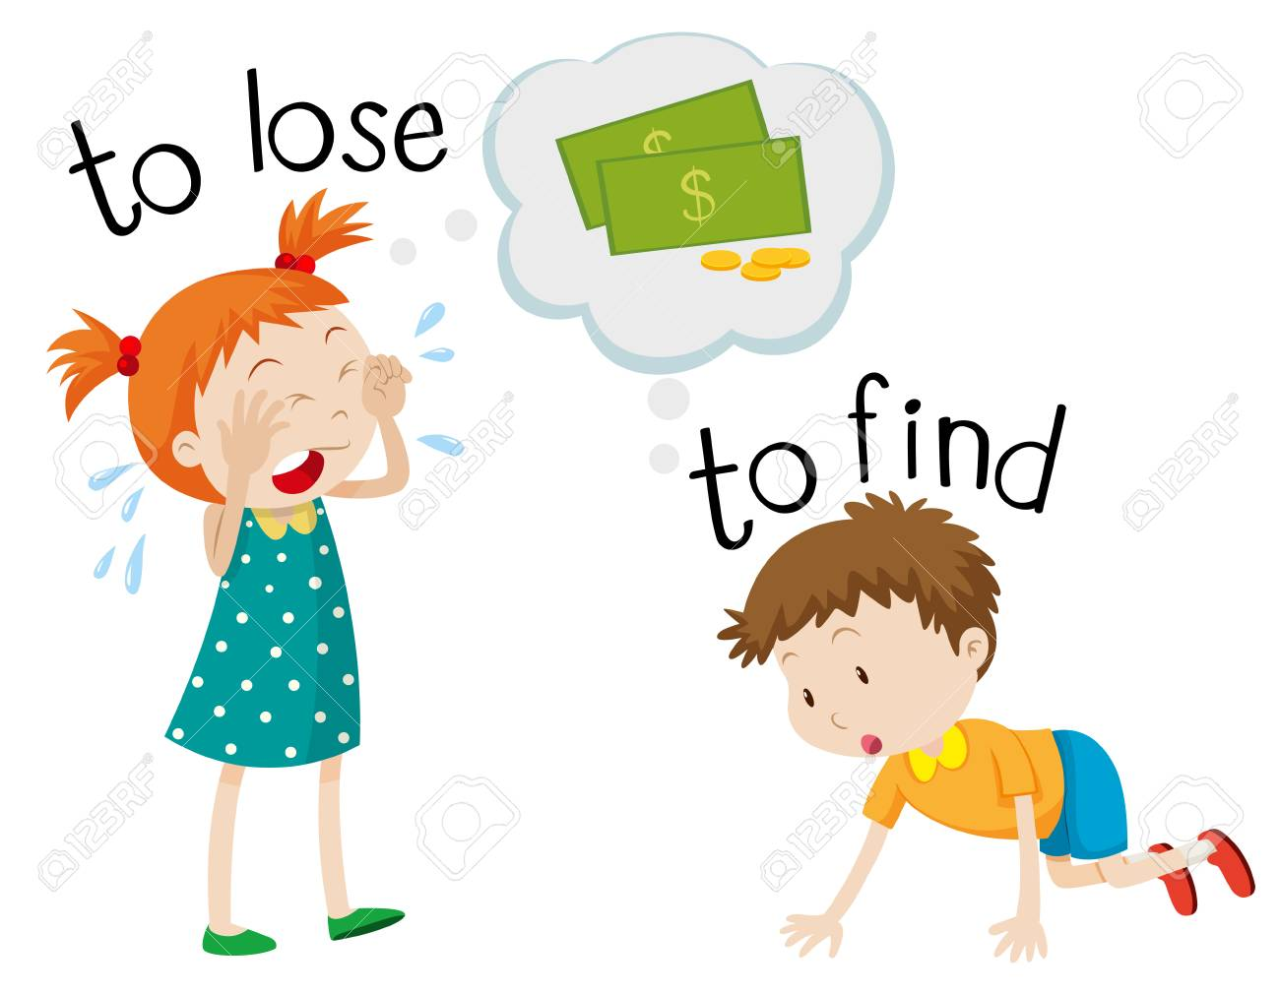
lose and loose lose: to stop having something that you had before loose: Adj, not tied up.

Slide 10


desert : noun, a large area of land , covered with sand, that is hot and has little water.
Dessert: noun, something sweet that is eaten after the main part of a meal.

Slide 11


sight : noun, something that you can see.
Site: noun, a piece of land that is used for building on or for another special purpose.

