Slide 1
Lesson :
The periodic table
Objective:
Describe the periodic table in terms of the arrangement of elements.

Slide 2

What is Matter?
Matter is anything that has mass and takes up space .
Scientists broke all matter into its smallest parts – ATOMS .
A substance that has just one kind of atom is called an ELEMENT .

Slide 3
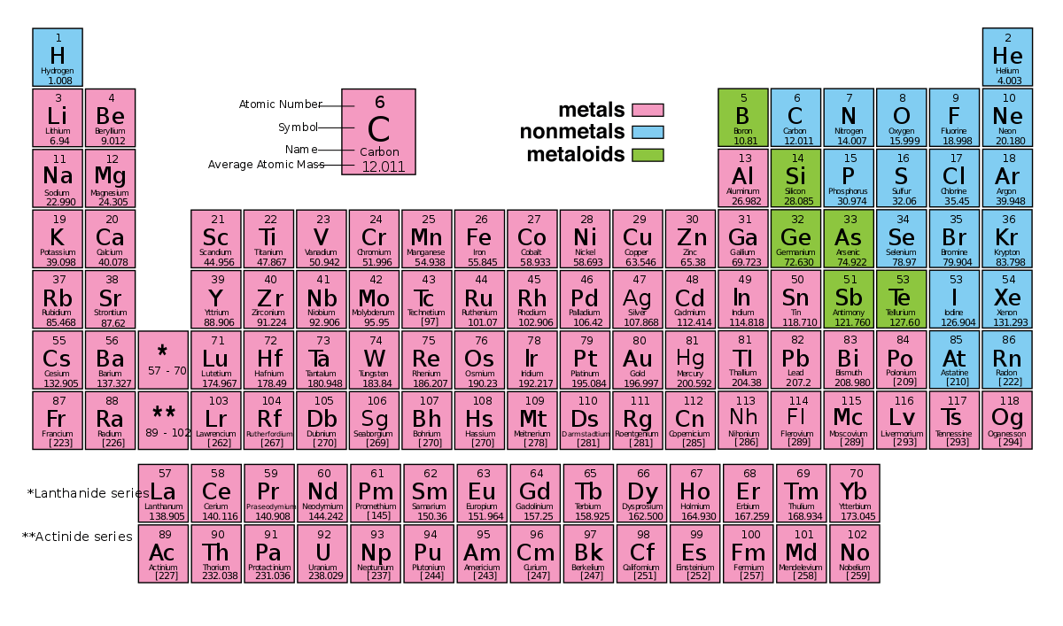
Elements are arranged in the periodic table

Slide 4
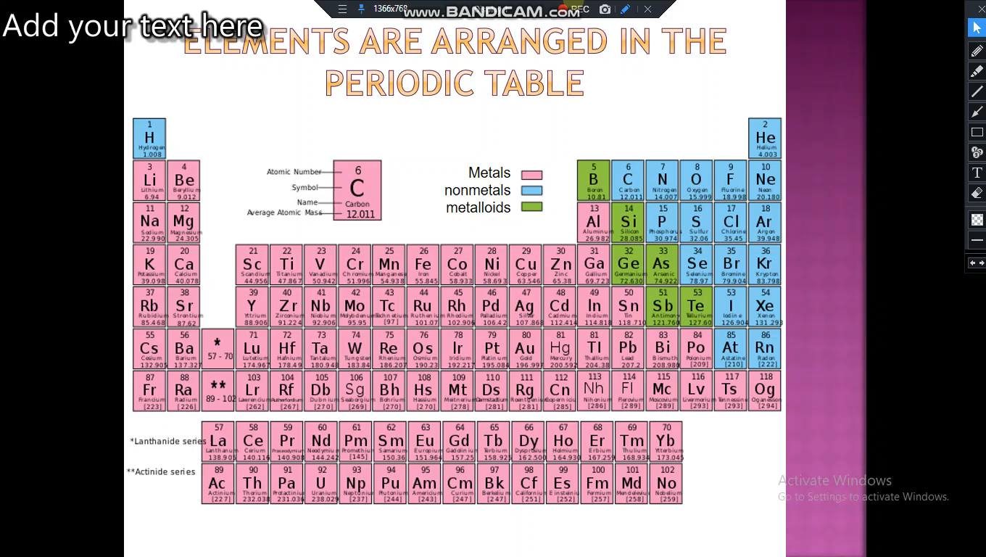

Slide 5
The periodic table
Elements are placed in the periodic table.
The main features of the periodic table:
The horizontal rows are called periods.
The vertical columns are called groups.
The main groups are numbered from 1 to 8 going from left to right
There are 8 groups and 7 periods.

Slide 6
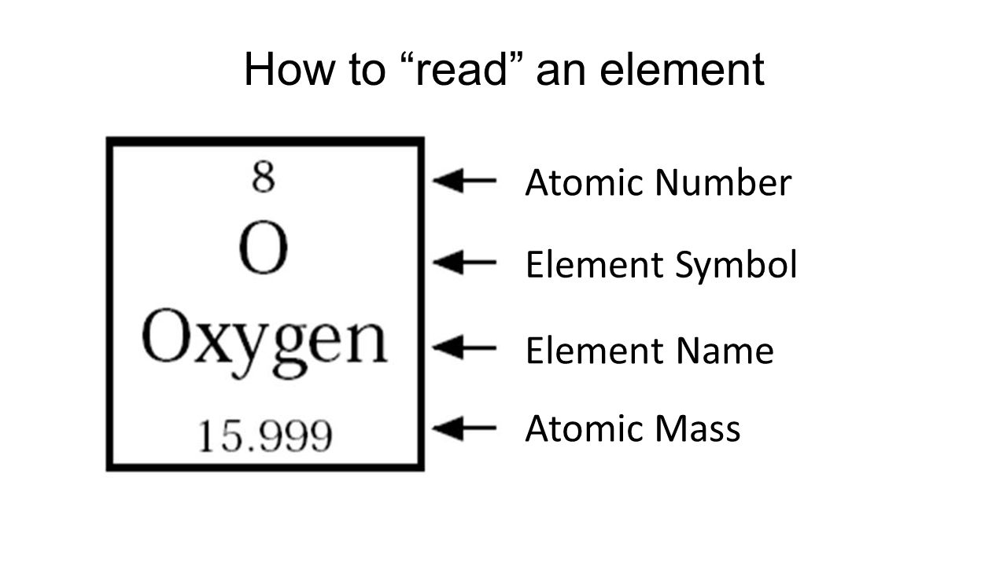

Slide 7
Hydrogen | H | Sodium | Na
Helium | He | Magnesium | Mg
Lithium | Li | Aluminum | Al
Beryllium | Be | Silicon | Si
Boron | B | Phosphorus | P
Carbon | C | Sulfur | S
Nitrogen | N | Chlorine | Cl
Oxygen | O | Argon | Ar
Fluorine | F | Potassium | K
Neon | Ne | Calcium | Ca

Slide 8
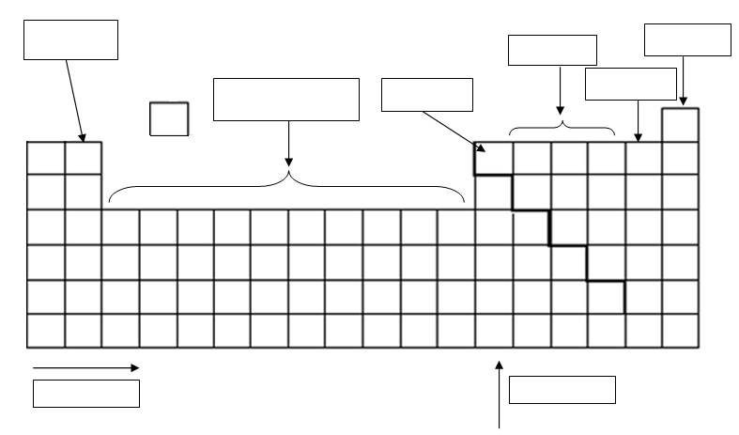
Label the shown parts of the periodic table using the following words:
Halogens, Metalloids, Metals, Noble gases, Nonmetals, Transition metals, Period, Group.

Slide 9
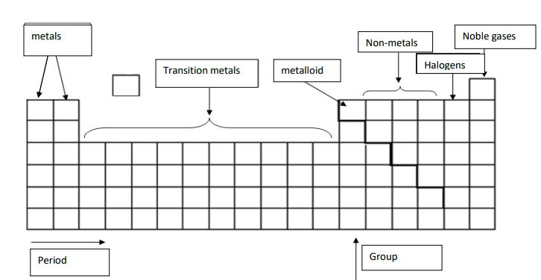

Slide 10
Questions
Give the symbol of the following elements:
Sodium:
Calcium:
Lithium:
Potassium:
Carbon:
Chlorine:
Nitrogen:

Slide 11
Questions
Give the symbol of the following elements:
Sodium: Na
Calcium: Ca
Lithium: Li
Potassium: K
Carbon: C
Chlorine: Cl
Nitrogen: N

Slide 12
Questions
Give the name of the following elements:
F:
P:
Ne:
Ar:
Si:
B:
S:

Slide 13
Questions
Give the name of the following elements:
F: Fluorine
P: Phosphorus
Ne: Neon
Ar: Argon
Si: Silicon
B: Boron
S: Sulfur

Slide 14
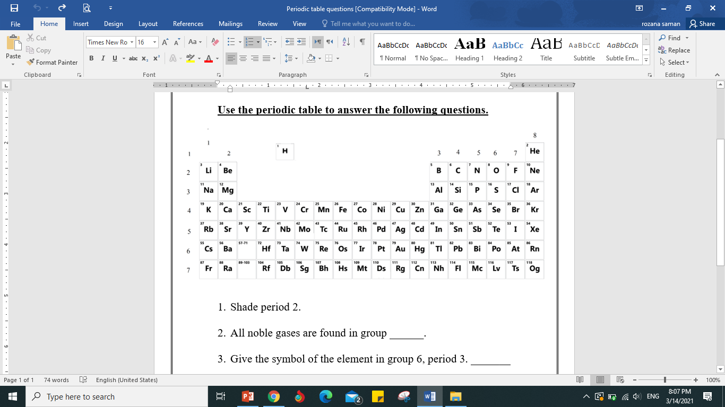
Use the periodic table to answer the following questions.

Slide 15
Shade period 2.
All noble gases are found in group ______.
Give the symbol of the element in group 6, period 3.
Give the symbol of two metals;

Slide 16
Shade period 2.
All noble gases are found in group ___8___.
Give the symbol of the element in group 6, period 3. S
Give the symbol of two metals; Mg, Li

Slide 17
Name one metalloid; __________. What is its symbol?
What is group 7 called in the periodic table?
What is the name of the element with atomic number 19?
What is the atomic number of carbon ?
Which period is Calcium in?

Slide 18
Name one metalloid; Boron What is its symbol? B
What is group 7 called in the periodic table? Halogens
What is the name of the element with atomic number 19? Potassium
What is the atomic number of carbon ? 6
Which period is Calcium in? period 4

Slide 19
Watch this video about the periodic table.
https://www.youtube.com/watch?v=uPkEGAHo78o
The periodic table song:
https://www.youtube.com/watch?v=rz4Dd1I_fX0

