Slide 1
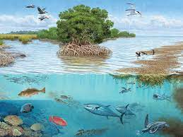
Ecosystems

Slide 2
Ecosystem
Definition:
  An area in which living things interact with one another and with nonliving things.
Includes biotic, or “living” components.
Biotic factors that affect an ecosystem include:
- the food supply
- numbers of predators and prey
- diseases and parasites.
Includes abiotic, or “non-living” components such as the soil, the temperature and the water supply

Slide 3
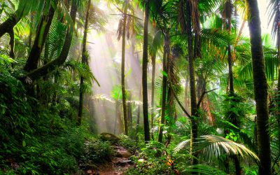
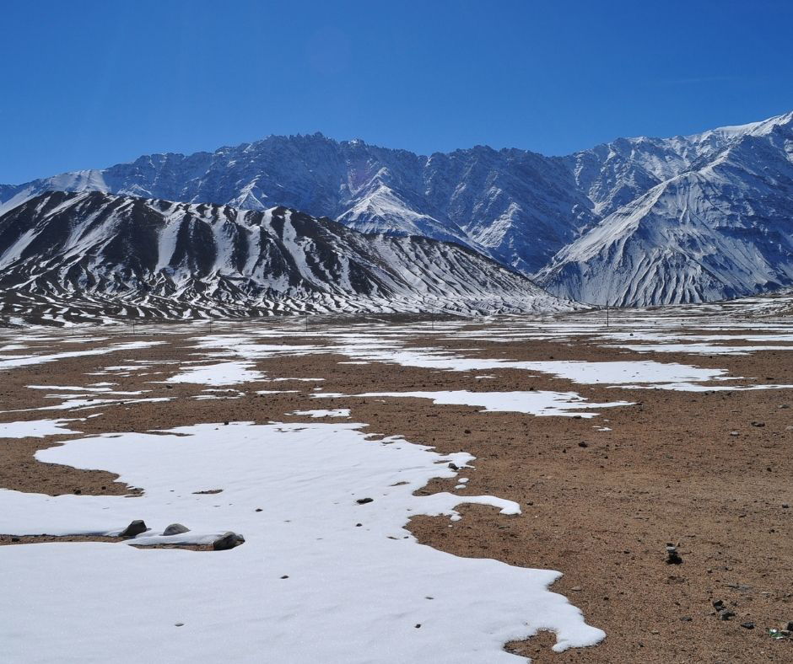
Ecosystems on land
Tropical rain forests
Tropical rainforests grow where there is a lot of rain, a lot of sun, and a warm temperature all year round. These ideal growing conditions mean that tropical rainforests are home to many different species of plants and animals. They have a very high biodiversity.
Biodiversity is a measure of the biological variety of an area.
Deserts
Deserts are very dry areas where there is very little water. There are hot deserts, and cold deserts where the water is frozen. Deserts are tough Ecosystem for living organisms.

Slide 4
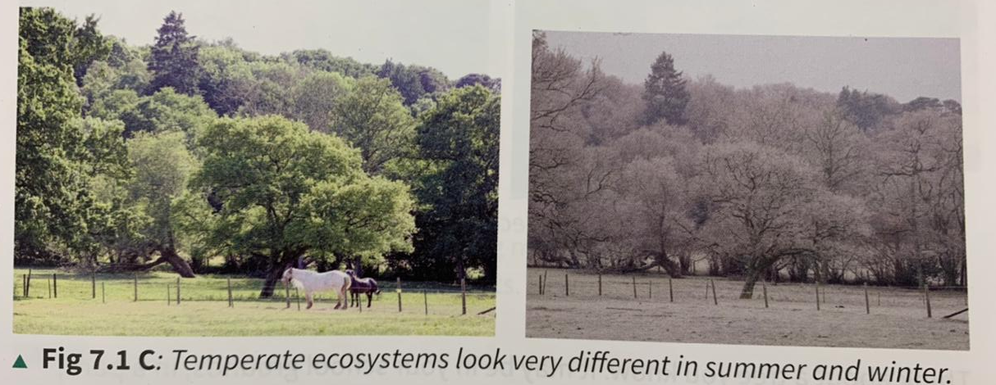
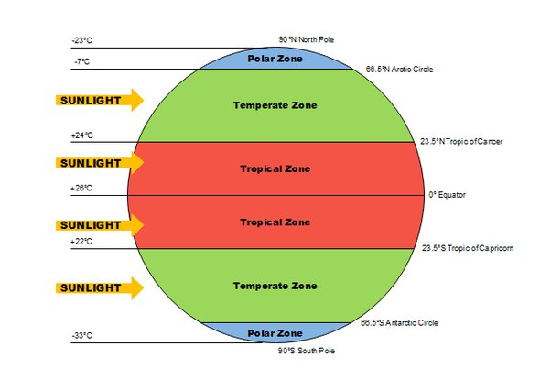
Temperate woodlands
In temperate parts of the world, temperature and light levels change a lot during the year within the same ecosystem. In summer, there is plenty of sunlight, warmth and water. In the winter, it is cold and the days are short so, even if there is plenty of water, plants struggle to grow. Temperate ecosystems change a lot throughout the year . They have many more plant and animal species than deserts, but far fewer than tropical rainforests.

Slide 5
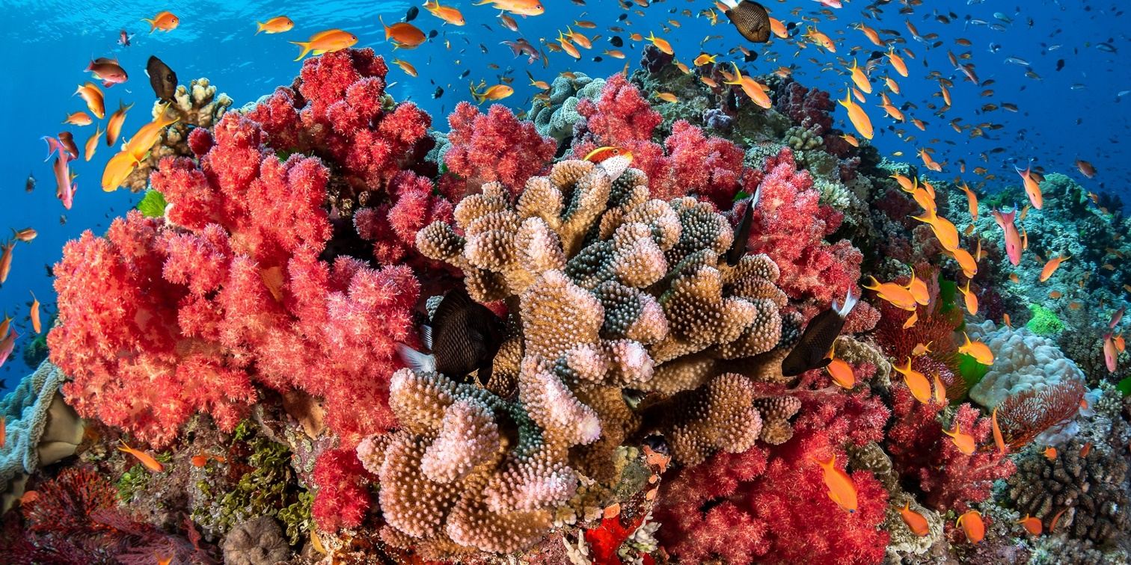
Aquatic ecosystems
Coral reefs
Coral reefs are the tropical rainforests of the sea. These amazing ecosystems are only found in warm, clean, relatively shallow seas.
They are home to huge numbers of species of animals.

Slide 6
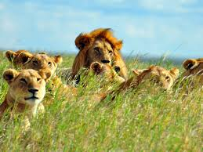
Habitats

Slide 7
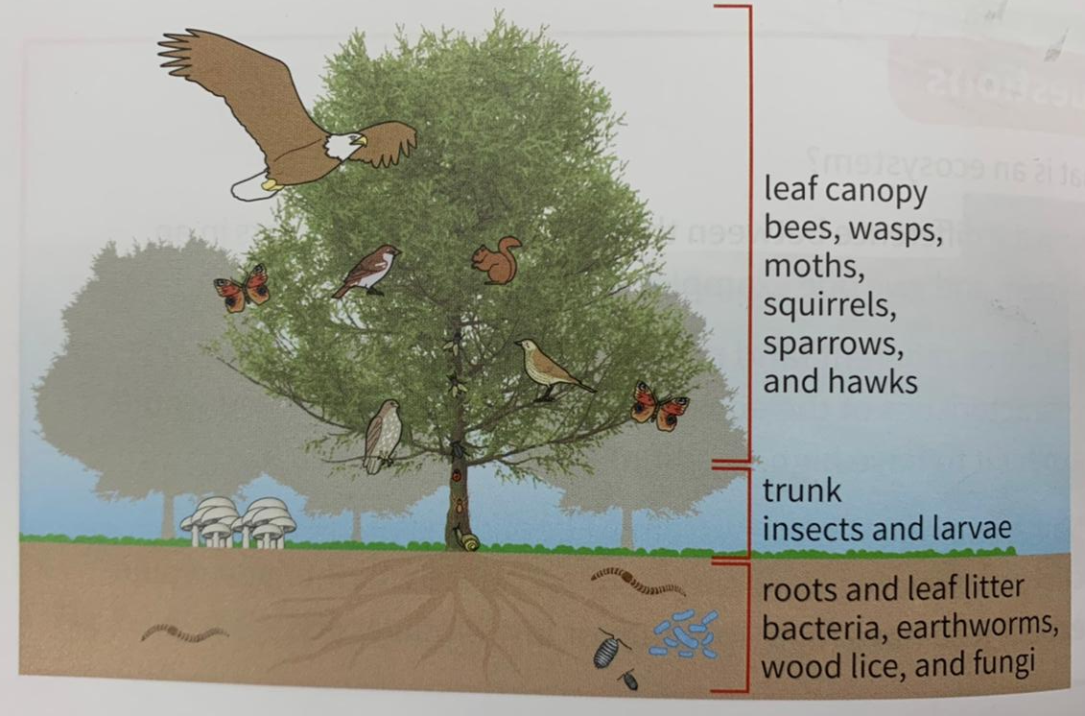
Habitats within an ecosystem
Each ecosystem, big or small, provides many different habitats.
The habitat of an organism is its home.
A tree as a habitat
A single tree provides many habitats: the branches with their leaves, flowers
and fruit, the trunk with its bark, and the roots below the surface, spreading
through the soil - they are all home to different organism.

Slide 8
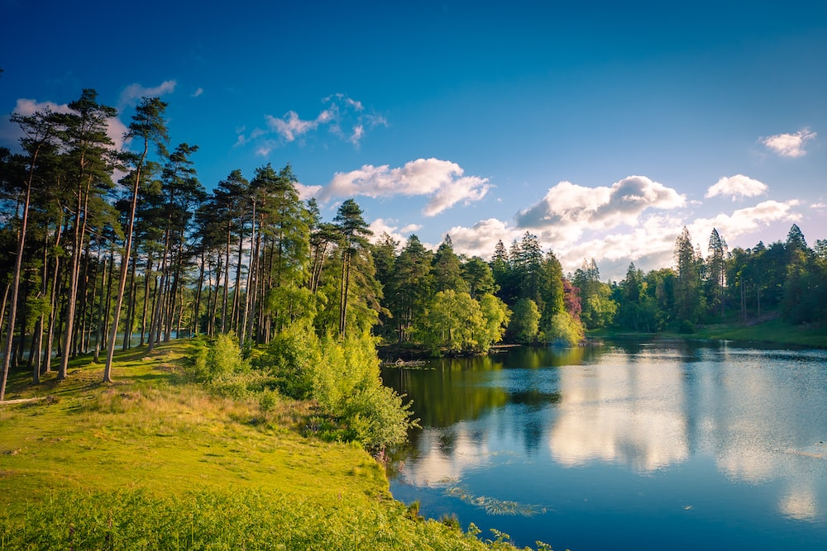
Big ecosystems support many habitats.
Lakes
A lake has different habitats at all levels through the water. The amount of
light and the temperature affect what species live there. The bottom of a
lake has habitats under stones and among the water weeds. The edge has
habitats ranging from reed beds to shingle shores.

Slide 9
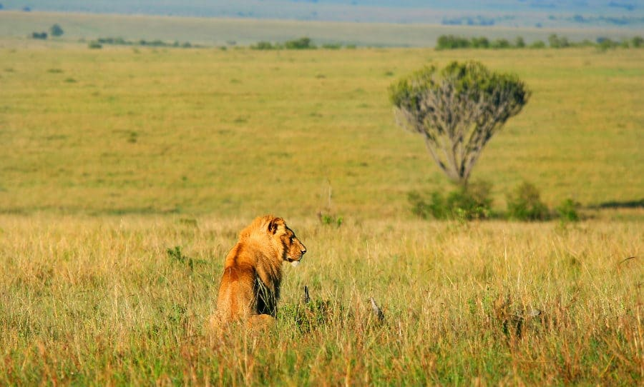
African savannah
The African savannah is a famous ecosystem. Habitats there range from the huge grasslands which are home to large animals such as zebra, lions, and elephants, to the dung these millions of animals produce. Dung is a rich habitat in many ecosystems. It is home to bacteria and fungi, the decomposers and many worms and insects, including several beetle species.

Slide 10
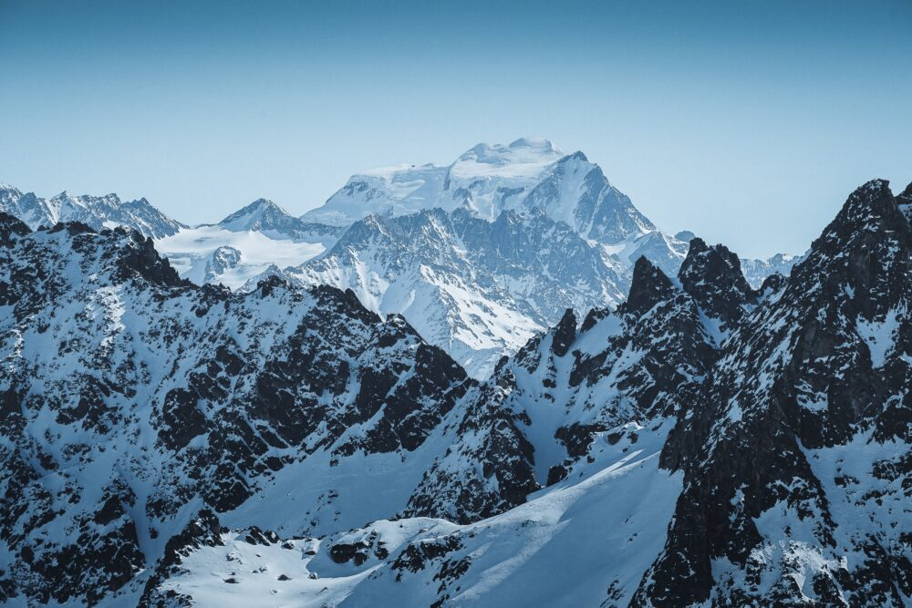
Alpine mountains
An alpine mountain ecosystem is high and cold. Its habitats include bare rock, flat and sloping surfaces, sunny areas, and shady areas. Organisms and habitats range from tiny plants on sheltered surfaces to birds of prey nesting on high ledges.

Slide 11
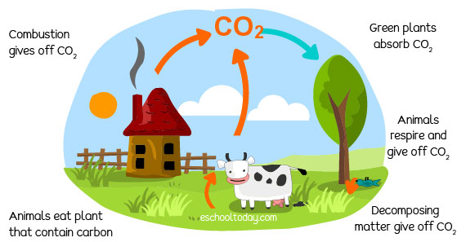
The carbon cycle
https://www.youtube.com/watch?v=p3R-dB9K4ss

Slide 12
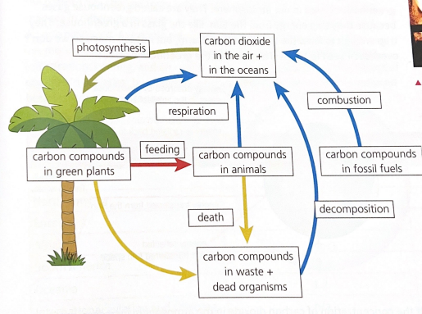
The Carbon Cycle
The carbon cycle in nature is a series of processes that move carbon between living organisms and the physical environment. It returns carbon dioxide from organisms to the atmosphere, to be taken up and used again in photosynthesis. It involves several processes.
Carbon is removed from the atmosphere by photosynthesis. It passes into other organisms through feeding. It is returned to the atmosphere through respiration, decomposition, and combustion.

Slide 13
Respiration
Respiration takes place in all living organisms. Glucose molecules are
broken down using oxygen, producing carbon dioxide (CO2) and water.
This releases energy to be used by cells.
Photosynthesis
Photosynthesis takes place in the green parts of plants and in algae. It uses energy from light, trapped by chlorophyll in the chloroplasts. Carbon dioxide is taken in from the air and combined with water to produce glucose and oxygen. This in turn is used to build the biomass of plants.

Slide 14
Feeding
Animals feed. They eat plants or other animals. They take in the biomass of plants, break it down, and build it back up into animal biomass. Carbon is passed from one organism to another in this way. Some is released into the environment through respiration at the same time.
Decomposition
Decomposition is the process carried out by the decomposers. Microorganisms such as bacteria and fungi feed on the waste materials produced by animals, the dead leaves produced by plants, and the dead bodies of animals and plants. They break them down, releasing carbon dioxide back into the atmosphere.

Slide 15
Combustion
Combustion is the scientific word for burning. When a substance burns, it reacts with oxygen in the air. In combustion, the energy transferred heats the surroundings and produces light. Many fuels, from wood to fossil fuels, are carbon compounds. When these fuels burn, they produce carbon dioxide and water which are released into the atmosphere.

