Slide 1
The Verb “to have”

Slide 2
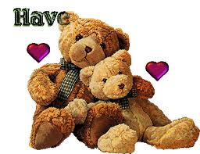
THEY CAN BE...
HAVE or
HAS

Slide 3

HAVE
SUBJECTS
I HAVE
YOU HAVE
WE HAVE
THEY HAVE

Slide 4
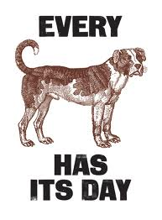
HAS
SUBJECTS
HE HAS
SHE HAS
IT HAS

Slide 5
EXERCISE
have
  I________ a yellow pencil.
  She ______two dogs.
We ______a blue car.
The chimpanzee______a big tail.
has
have
has

Slide 6
have
Luis and Peter_____ a small parrot.
We _______ a new English teacher. I hope she's nice.
My boss _______ such a bad temper.
I never _______ breakfast in the morning because I'm never hungry.
have
has
have

Slide 7
have
The houses all _______ blue windows.
An elephant _______ four legs and a big trunk.
Many poor people _______ no money to spend.
The child _______ red hair and very white skin.
has
have
has

Slide 8


