Slide 1
Types of Business organization
In the private sector

Slide 2
Public & private sector organisations
  Public sector organisations are those owned and run by the government.
  Their main objectives will be to provide a service for the general public.
  Example: the National Health Service (NHS)
  Private sector organisations are those owned and run by any private individuals
  These types of firms will generally set as their main objectives to maximise sales and profit.
  Example: Tesco, Sainsbury’s, Sony, Ford

Slide 3
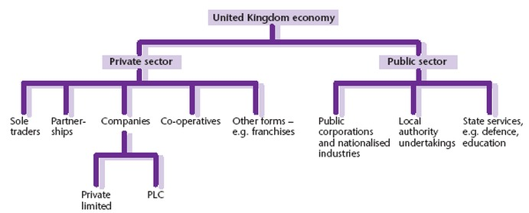
Public & private sector organisations

Slide 4
There are several main forms of business organization in the private sector
Sole traders
Partnerships
Private limited companies
Public limited companies
Franchises
Joint ventures

Slide 5
Reasons for choosing different forms of business
Ownership: Who owns the business.
Business size.
Legal regulations: legal requirements to set up the business.
Capital: the money invested into a business by the owners
Liability: who is responsible for the business’s debts.(limited liability /unlimited liability)
Separate legal identity. (incorporated businesses / unincorporated businesses)

Slide 6
Definitions to learn
Limited liability: debts incurred by business may be paid only from the amount the owners invested.
Unlimited liability: debts incurred by business may be paid from owner’s personal assets.
Incorporated businesses: are companies that have separate legal status from their owners.(the company will continue if one of the owners die).
Unincorporated businesses: is one that does not have a separate legal identity.

Slide 7


Slide 8
Sole trader: is a form of business owned and operated by just one person
Sole trader is the most common form of business organization because there are few legal requirements to set it up.(few legal regulations must be followed).
Advantages | Disadvantages
Owner in complete control | The business is not a separate legal unit .no continuity).
No sharing of profits | Unlimited liability .

Slide 9

This Photo by Unknown Author is licensed under CC BY-SA-NC

Slide 10
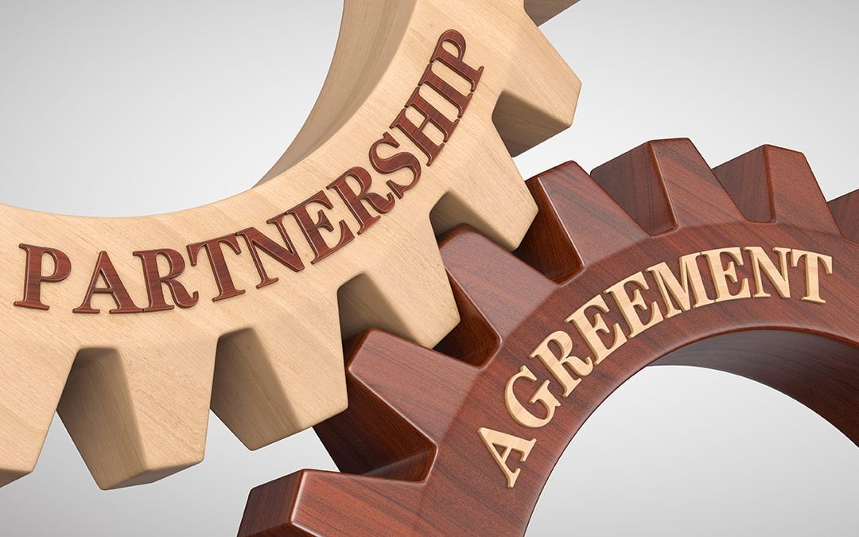

Slide 11
Partnership: is a form of business in which two or more people agree to jointly own a business.
The partners will contribute to the capital of the business and will share any profits made.
A partnership can be set up very easily.
Verbal agreement: to ask someone you know to become your partner in the business.
Partnership agreement: is the written document between business partners. Its not essential but its always recommended because without this document the partners may disagree on who put most capital in the business and who is entitled to more of the profits.

Slide 12
Advantages | Disadvantages
Able to raise capital from partners | Unlimited liability
Responsibilities shared | Unincorporated business(The business is not a separate legal unit): if one of the partners died , the partnership would end.
More ideas from new partner(s)
Partners motivated to work hard because they would benefit from the profits.

Slide 13
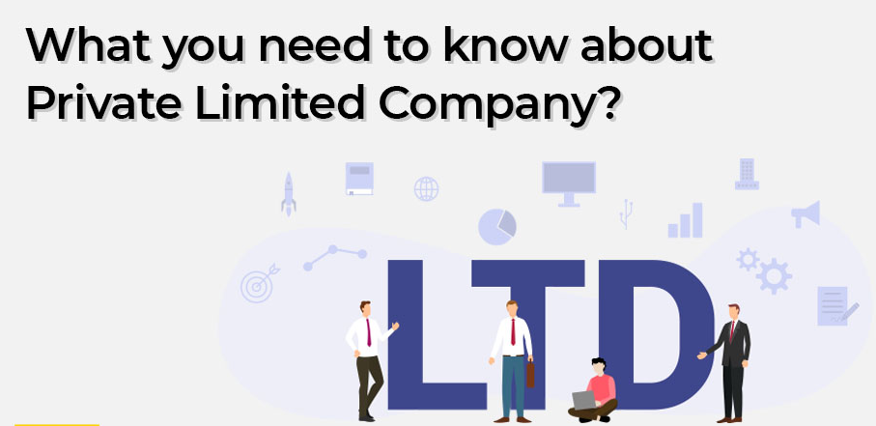

Slide 14
Private limited companies (LTD): are businesses owned by shareholders but they cannot sell shares to the public(only friends and relatives)
Shareholders : are the owners of a limited company . They buy shares which represent part-ownership of the company.
Advantages | Disadvantages
Raise capital from sale of shares | Cannot sell shares to public
Limited liability for shareholders | Legal formalities
Separate legal identity (continuity) | Accounts are less secret than either for a sole trader or partnership
 | Not easy to transfer shares

Slide 15


Slide 16
Public limited companies (PLC):are businesses owned by shareholders but they can sell shares to the public and their shares are tradeable on stock exchange.
Public limited companies are not in the public sector of industry.
Advantages | Disadvantages
Can sell shares to public | Legal formalities
Limited liability | Disclosure of accounts and other information
Continuity | Divorce between ownership and control (shareholders own , mangers and directors control)
Rapid expansion possible | Expensive to go public

Slide 17
Control and ownership in public limited companies
In all sole trader businesses and partnerships the owners have control over how their business is run (decisions ,achievements and aims). This also the case in the most private limited companies which have relatively few shareholders so they can ensure that their decisions are passed at all meetings .With public limited companies the situation is different because there are thousands of shareholders , so its impossible for all of these people to be involved in taking decisions – although they are all invited to attend the:
Annual General Meeting : is a legal requirement for all companies . Shareholders may attend and vote who they want to be on the board of directors for the coming year.

Slide 18
Franchise: is a business upon the use of the brand names ,promotional logos and trading methods of an existing successful business
The franchisee buys the license to operate this business from the franchisor .
Franchise ex: McDonald’s
 | To the franchisor | To the franchisee
Advantages | The management of the outlets is the responsibility of the franchisee | The franchisor pays for advertising
 | All products sold must be obtained from the franchisor | The chances of business failure are much reduced because a well-known products is being sold

Slide 19
 | To the franchisor | To the franchisee
Disadvantages | Poor management of one franchised outlet could lead to a bad reputation for the whole business. | Less independence than with operation a non-franchised business.
 | The franchisee keeps profits from the outlet. | License fee must be paid to the franchisor and possibly a percentage of the annual turnover.

Slide 20
Joint Venture: is where two businesses or more start a project together, sharing capital, risks and profits
Advantages of joint ventures | Disadvantages of joint ventures
Sharing of costs – important for expensive projects such as new aircraft | The profits have to be shared with the joint venture partner.
Risk are shared | Disagreement over important decisions might occur

Slide 21
Business organizations in the public sector
A public corporation is a business in the public sector is owned and controlled by the state (government).
Advantage of public corporations:
Important public services , non-profitable but still be made available to the public.
Disadvantage of public corporations:
There are no private shareholders to insist on high profits and efficiency.

Slide 22
GOOD LUCK

