Slide 1
Manic Media
Unit 2

Slide 2
What does MANIC mean?
Very excited or anxious in a way that causes a lot of physical activity

Slide 3
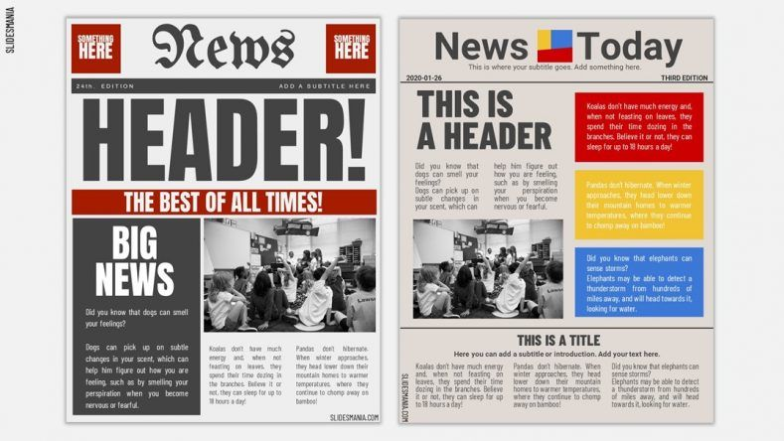
Layout of a newspaper

Slide 4
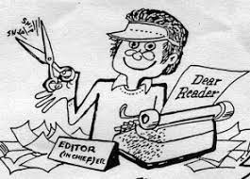
Editor-in-chief
The boss of the newspaper team, responsible for important decisions.

Slide 5
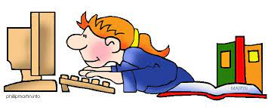
News editor
Decides which stories are the most important and how much room each one has.

Slide 6
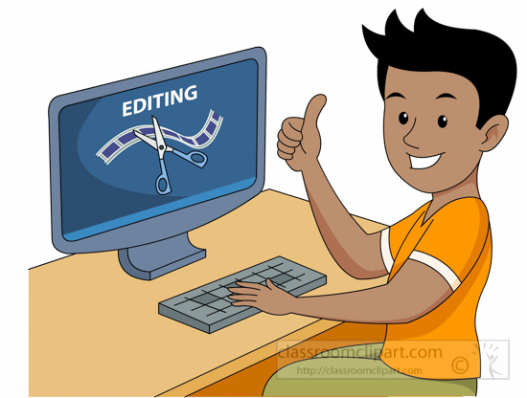
Picture editor
Chooses photographs that give the right message and decides on their size

Slide 7
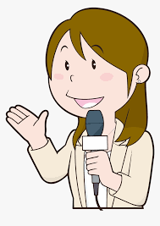
Reporter
Goes out to find information and writes the story

Slide 8
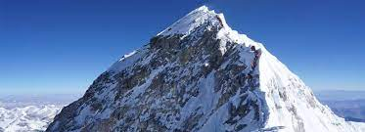
Nepal safari camp ends elephant-back tours
What is Nepal famous for more than anything else?

Slide 9
Nepal safari camp ends elephant-back tours
Nepal has eight of the World’s highest peaks and for a long time has been a mountaineer’s dream location.

Slide 10
The meaning of the words in boldface.
p. 24

Slide 11
Cruel (adj.)
→ causing suffering or pain.

Slide 12
High-profile operators
→ attracting a lot of attention and interest from the public and newspapers, television, etc.

Slide 13
Excursions
→ a short journey usually made for pleasure, often by a group of people.

Slide 14
TripAdvisor (website)
→ the world's largest travel guidance platform*, helps hundreds of millions of people each month** become better travelers, from planning to booking to taking a trip.

Slide 15
Humane (adj.)
→ Kind-hearted.

Slide 16
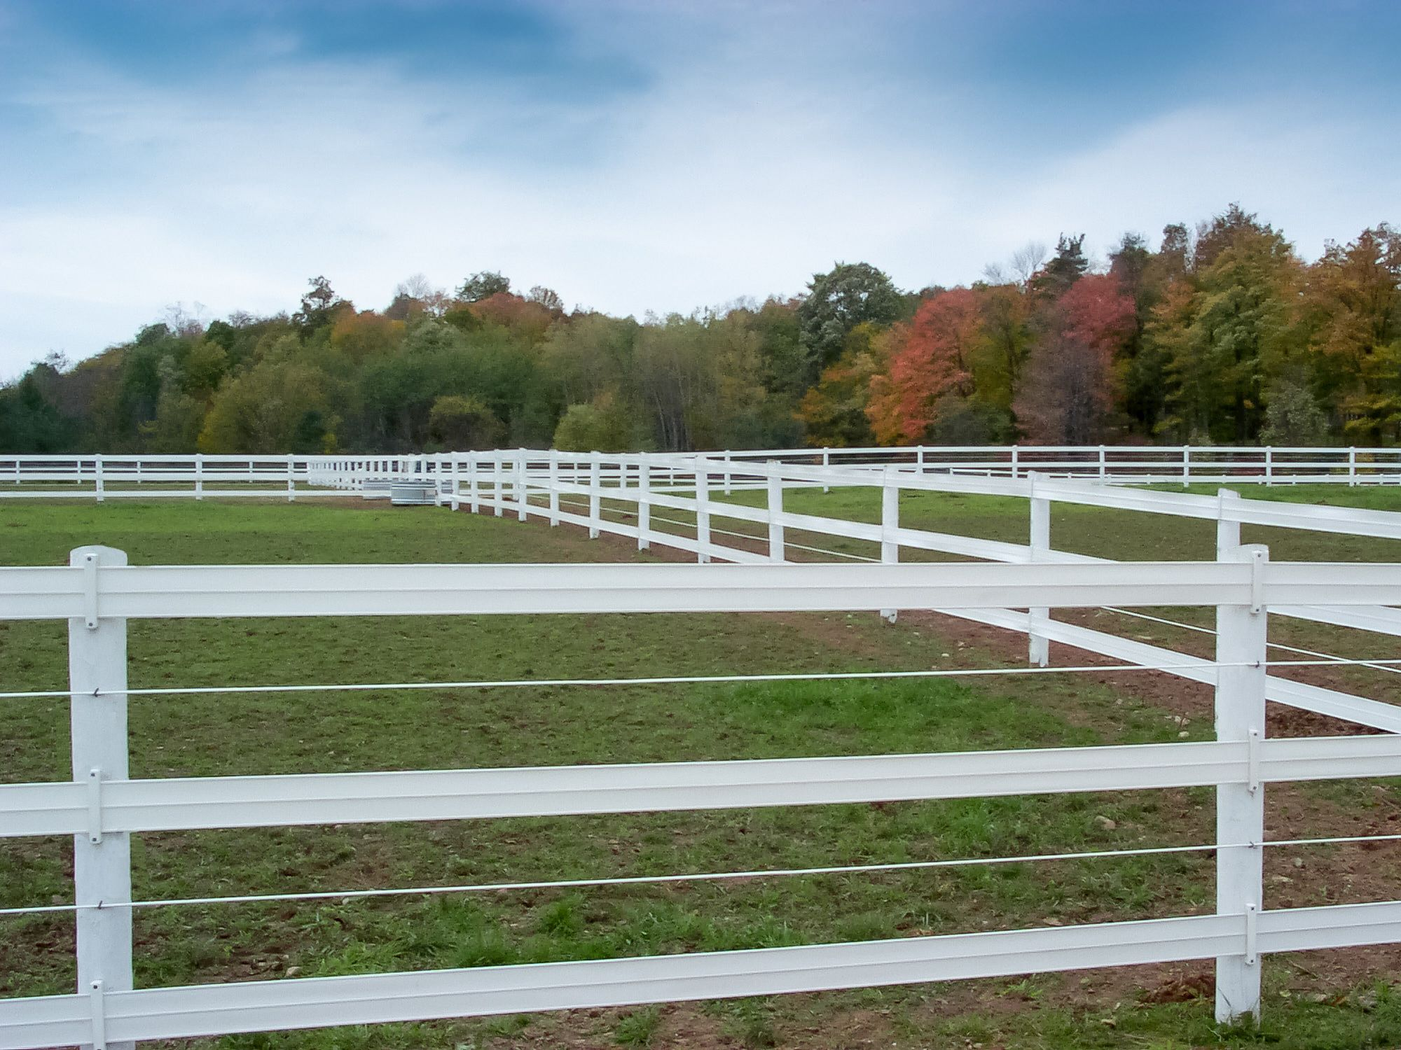
Paddocks
→ a field of any size that is used for farming

Slide 17
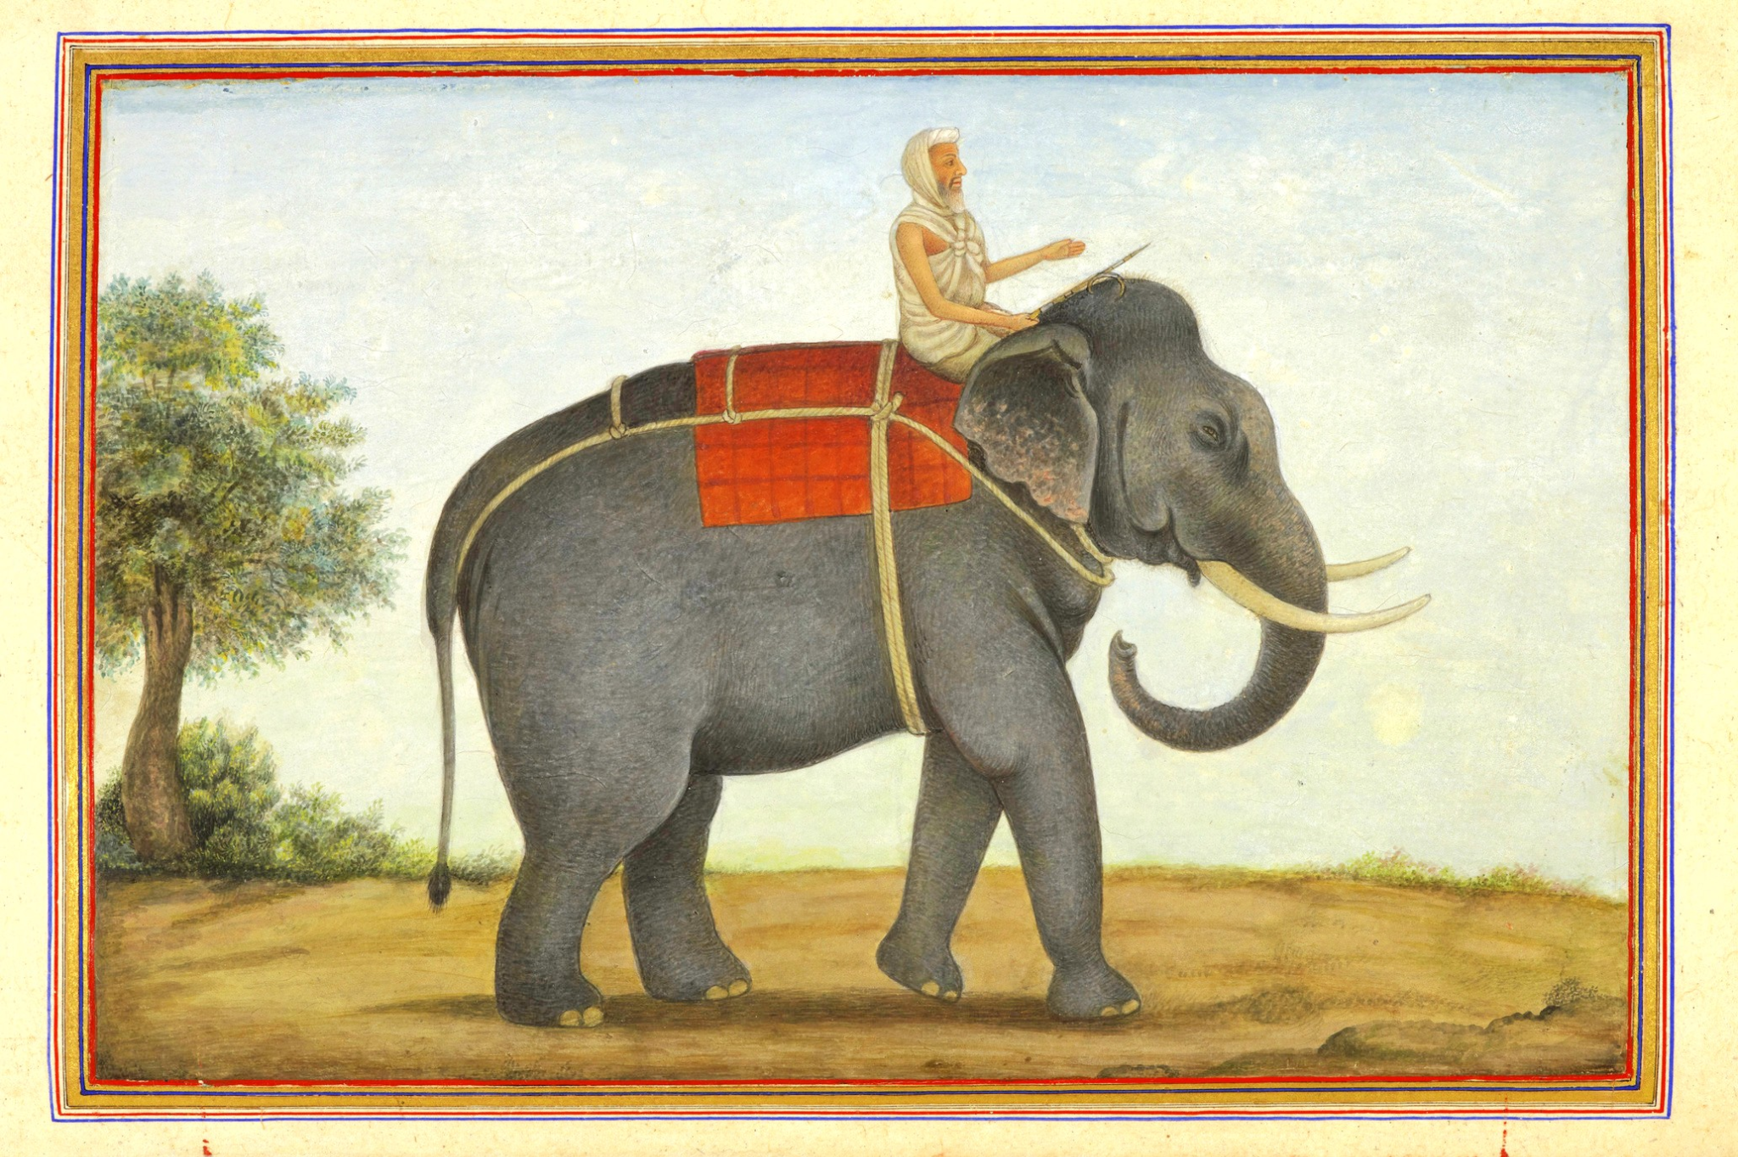
Mahouts
→ a person who rides, controls, and cares for a working elephant

Slide 18
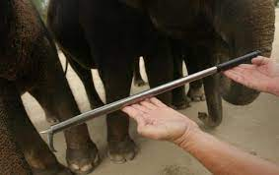
Bullhooks
→ a curved device used for catching or holding things

Slide 19
Honorary (adj.)
→ Given as an honor

Slide 20
Natural (adj.)
→ Done or produced by nature; not by humans or machines.

Slide 21
Captive (adj.)
→ taken prisoners

