Slide 2
Simple Present Tense
We use the simple present tense when we are writing about something that is repeated, is always true or is happening in a future time.
Eva wakes up at half past seven every morning.
Repeated
I ride my bike every weekend.
I walk to school.
Always or generally true
The sun sets in the west.
They live in a city.
I speak Urdu.
Happening in a future time
The bus leaves at 9 o’clock.
The film starts at half past three.

Slide 3
The Rules
Can you match the correct form of the irregular verb ‘to be’ to each pronoun?
am
are
I _____
You _____
He / She / It _____
We _____
You _____
They _____
are
am
is
are
are
are
are
are
are
is
What do you notice about the verb forms?

Slide 4
The Rules
Can you match the correct form of the irregular verb ‘to run’ to each pronoun?
run
run
I _____
You _____
He / She / It _____
We _____
You _____
They _____
run
run
runs
runs
run
run
run
run
run
run
What do you notice about the verb forms?

Slide 5
The Rules
Can you match the correct form of the irregular verb ‘to sing’ to each pronoun?
I _____
You _____
He / She / It _____
We _____
You _____
They _____
sing
sing
sing
sing
sings
sing
sing
sing
sing
sing
sing
sings
What do you notice about the verb forms?

Slide 6
The Rules
The form of the verb depends on the subject.
run
sing
I you we they
laugh
jump
runs
sings
he she it
(third person singular)
laughs
jumps
Can you make a simple present tense sentence with these words?

Slide 7
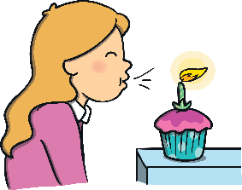
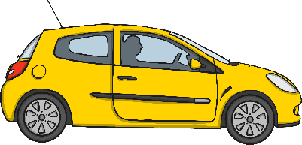
The Rules
The spelling of the verb depends on the ending of the verb.
Verbs ending in:
-o, -ch, -sh, -ss, -s, -x or -z
Add -es
Examples:
fix
- wishes
– fixes
go
– goes
wish
buzz
- buzzes

Slide 8
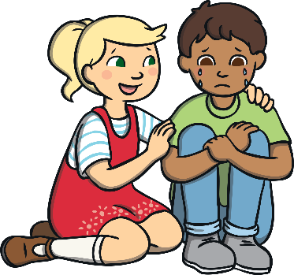
The Rules
The spelling of the verb depends on the ending of the verb.
Verbs ending in:
Consonant and -y
Remove –y and add -ies
Examples:
carry
– carries
cry
- tidies
– cries
tidy

Slide 9
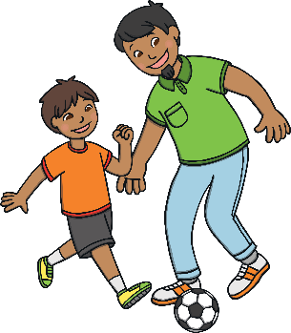
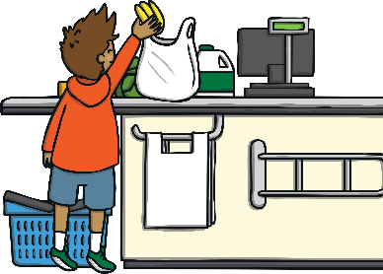
The Rules
The spelling of the verb depends on the ending of the verb.
Verbs ending in:
Vowel and -y
Just add -s
Examples:
say
– says
play
- buys
– plays
buy

Slide 10
Are these simple present sentences correct or incorrect?

I rides my bike around the field.
Is this correct?

She knows the answer.
Is this correct?

They jumps on the bouncy castle.
Is this correct?
Can you write the correct sentences?

Slide 11
Spin the spinners! Write a sentence about the topic selected by the first spinner with one of the pronouns shown by the second spinner. Underline the simple present verb.
If you spin ? then try to write two sentences using both sets of pronouns!
I
you
we
they
he
she
it
daily routine
favourite colour
transport to school
home
?
spin!
spin again!
and again!
one more time!
For example: We walk to school. She lives in Manchester.

Slide 12
This sentence has been mixed up. Can you put it in the right order?
teeth her She brushes a twice day.
Show answer
She brushes her teeth twice a day.
Challenge
Can you write your own mixed-up sentence for your partner?

Slide 13
This sentence has been mixed up. Can you put it in the right order?
speaks He French home. at
Show answer
He speaks French at home.
Challenge
Can you write your own mixed-up sentence for your partner?

Slide 14
This sentence has been mixed up. Can you put it in the right order?
joke. funny laugh a They at
Show answer
They laugh at a funny joke.
Challenge
Can you write your own mixed-up sentence for your partner?

Slide 15
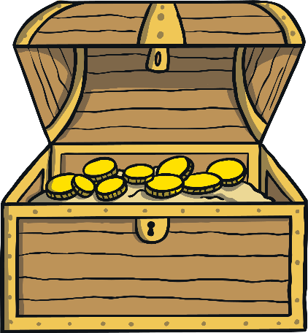
Can you sort the sentences? Put the correct simple present tense sentences into the treasure chest and the incorrect ones in the rubbish bin.
Can you think of a sentence of your own that you could put into the treasure chest?
Simple Present Tense
Rubbish
I likes tennis.
She watchs the TV.
Emily sings loudly.
She fixes the broken tap.
We jump together.
Aisha speaks Farsi.

