Slide 1
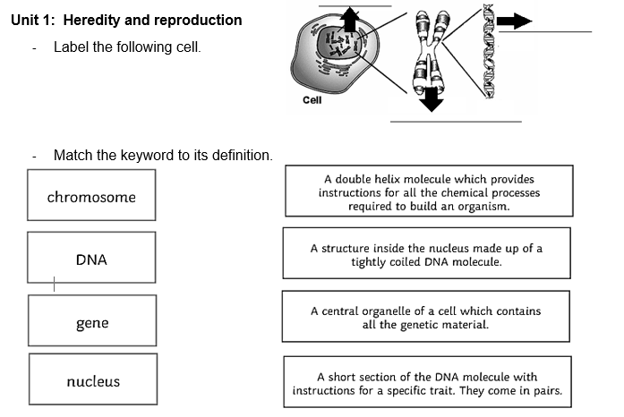
Pretest
Photo courtesy of (@flickr.com) - granted under creative commons licence – attribution
Photo courtesy of (@flickr.com) - granted under creative commons licence – attribution
Photo courtesy of (@flickr.com) - granted under creative commons licence – attribution

Slide 2
Answers
nucleus
DNA
chromosome

Slide 3
https://www.youtube.com/watch?v=x7Z8UMEyZ9Y

Slide 4
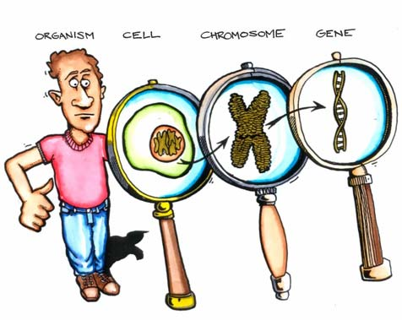
Genetic Material
Cells contain genetic material that determines the hereditary characteristics in living things.
Photo courtesy of (@flickr.com) - granted under creative commons licence – attribution
Photo courtesy of (@flickr.com) - granted under creative commons licence – attribution
Photo courtesy of (@flickr.com) - granted under creative commons licence – attribution

Slide 5
Genetic Material
Chromosomes are thread-like structures made up of DNA. Chromosomes are found in the nucleus of animal and plant cells.
Different species of living things have different number of chromosomes. For example, humans have 46 chromosomes.
Photo courtesy of (@flickr.com) - granted under creative commons licence – attribution
Photo courtesy of (@flickr.com) - granted under creative commons licence – attribution
Photo courtesy of (@flickr.com) - granted under creative commons licence – attribution

Slide 6
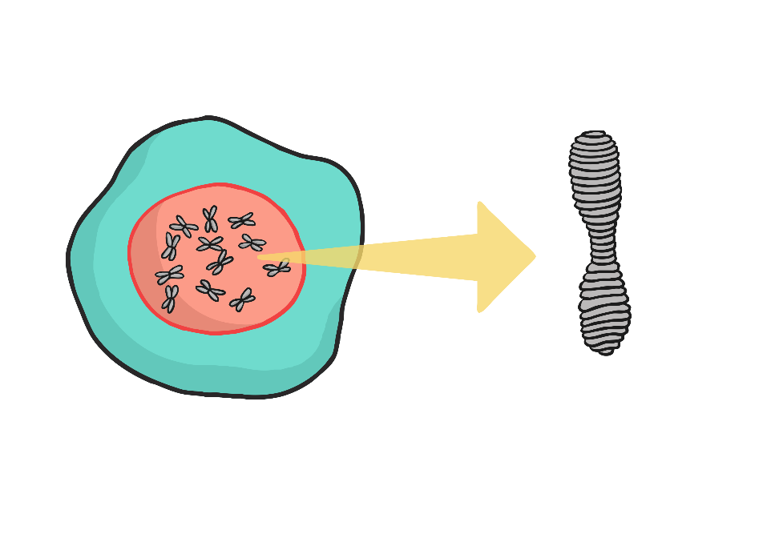
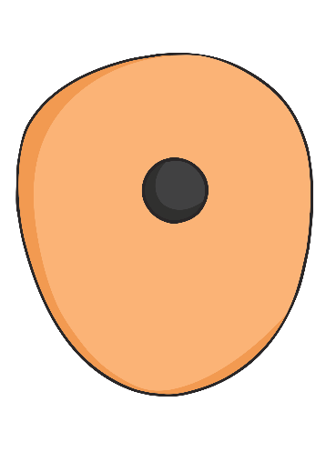
DNA
DNA is organised into structures called chromosomes within the cell.
Cell
Nucleus
Chromosome
DNA
Photo courtesy of (@flickr.com) - granted under creative commons licence – attribution
Photo courtesy of (@flickr.com) - granted under creative commons licence – attribution

Slide 7
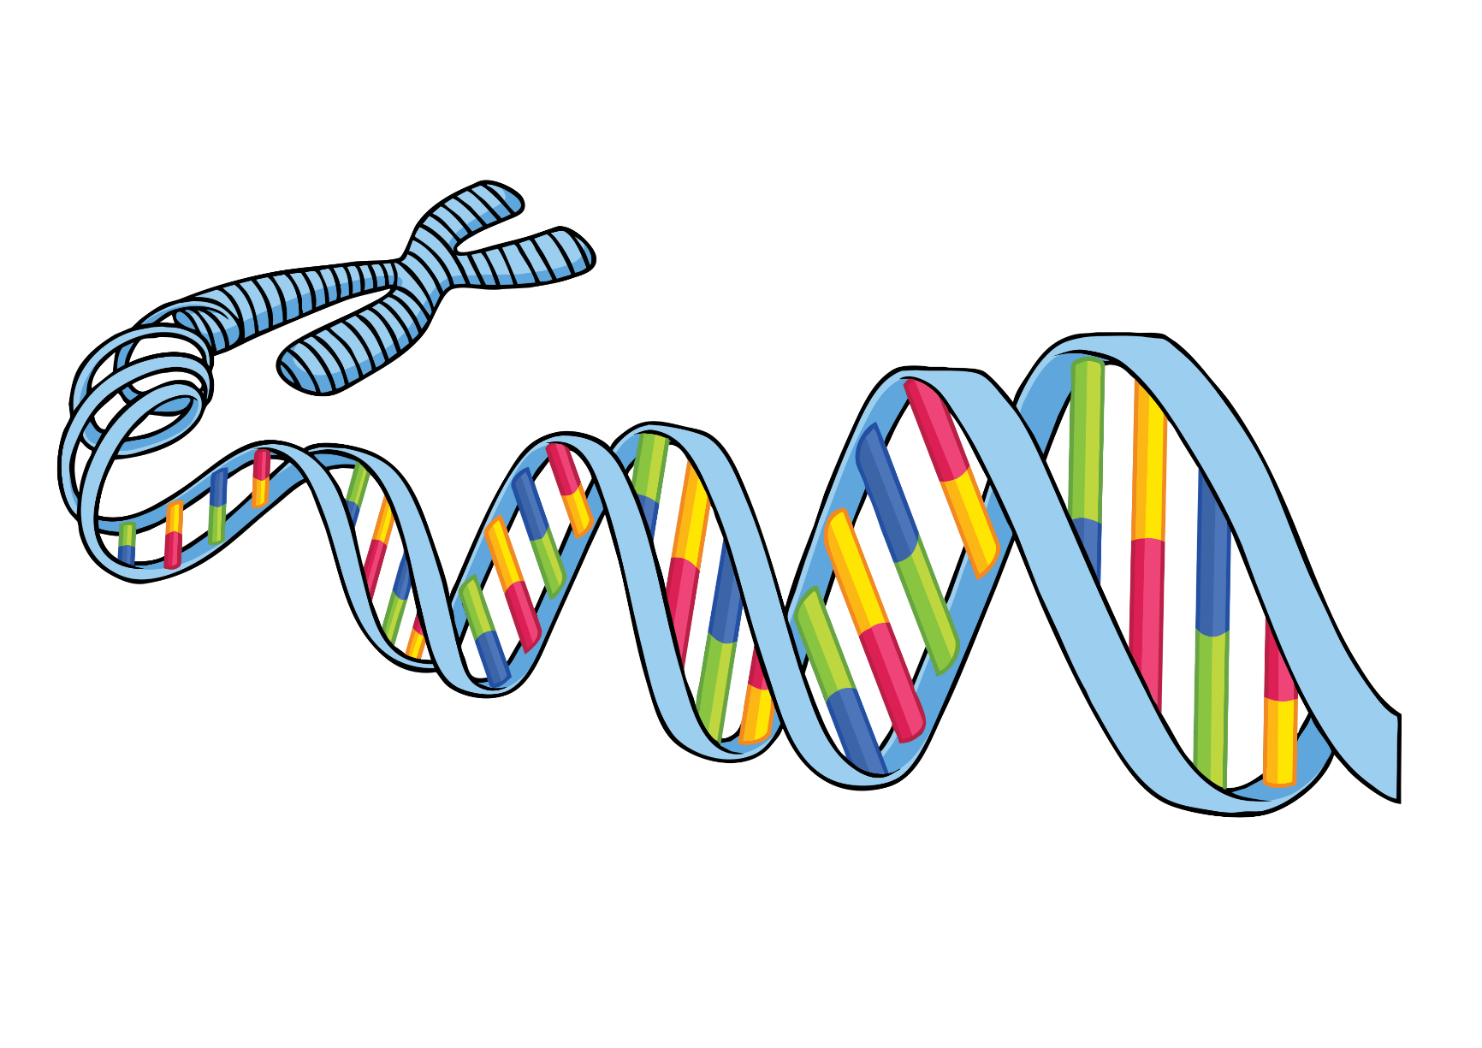
DNA
When DNA works correctly, it helps keep the body functioning properly. DNA helps cells to make the substances called proteins, which the cells need to live. DNA also allows living things to reproduce. The genes in DNA pass along physical traits from parents to children.
Sometimes there are mistakes in DNA. These mistakes are called mutations. They can cause diseases and other problems.
Photo courtesy of (@flickr.com) - granted under creative commons licence – attribution
Photo courtesy of (@flickr.com) - granted under creative commons licence – attribution

Slide 8
DNA
DNA (short for deoxyribonucleic acid) is the single most important molecule in living cells.
Photo courtesy of (@flickr.com) - granted under creative commons licence – attribution
Photo courtesy of (@flickr.com) - granted under creative commons licence – attribution
Photo courtesy of (@flickr.com) - granted under creative commons licence – attribution

Slide 9
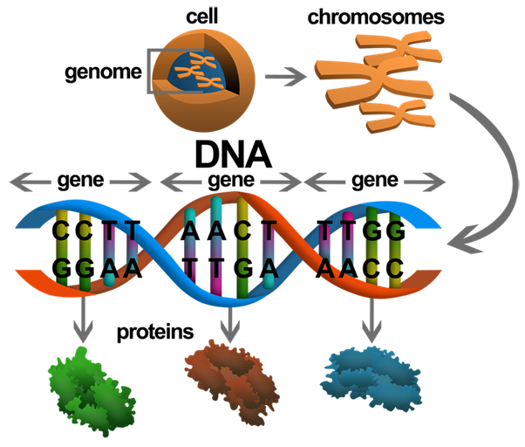

Slide 10
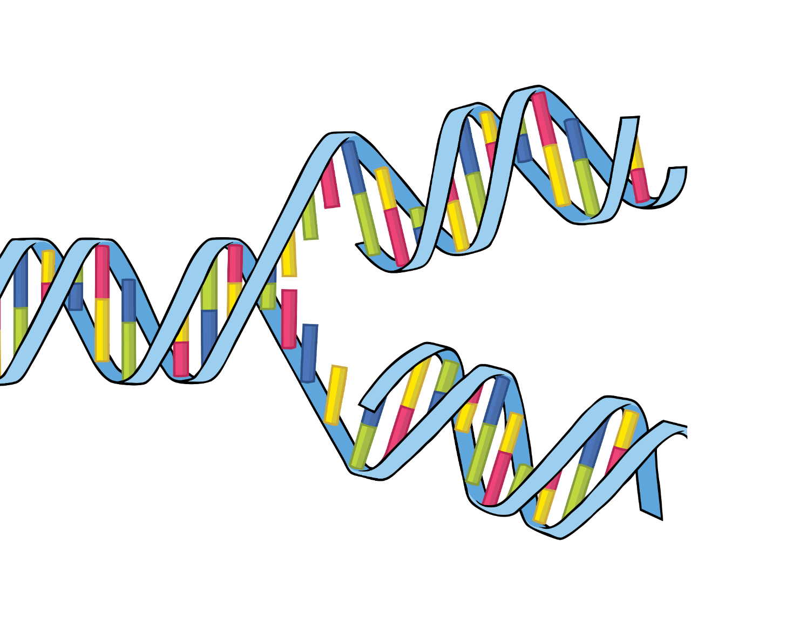
DNA
If you were to write down the codes for all the chemicals in your DNA, it would fill about 200 phone books - about 3 billion letters!
.
.
Photo courtesy of (@flickr.com) - granted under creative commons licence – attribution
Photo courtesy of (@flickr.com) - granted under creative commons licence – attribution

Slide 11
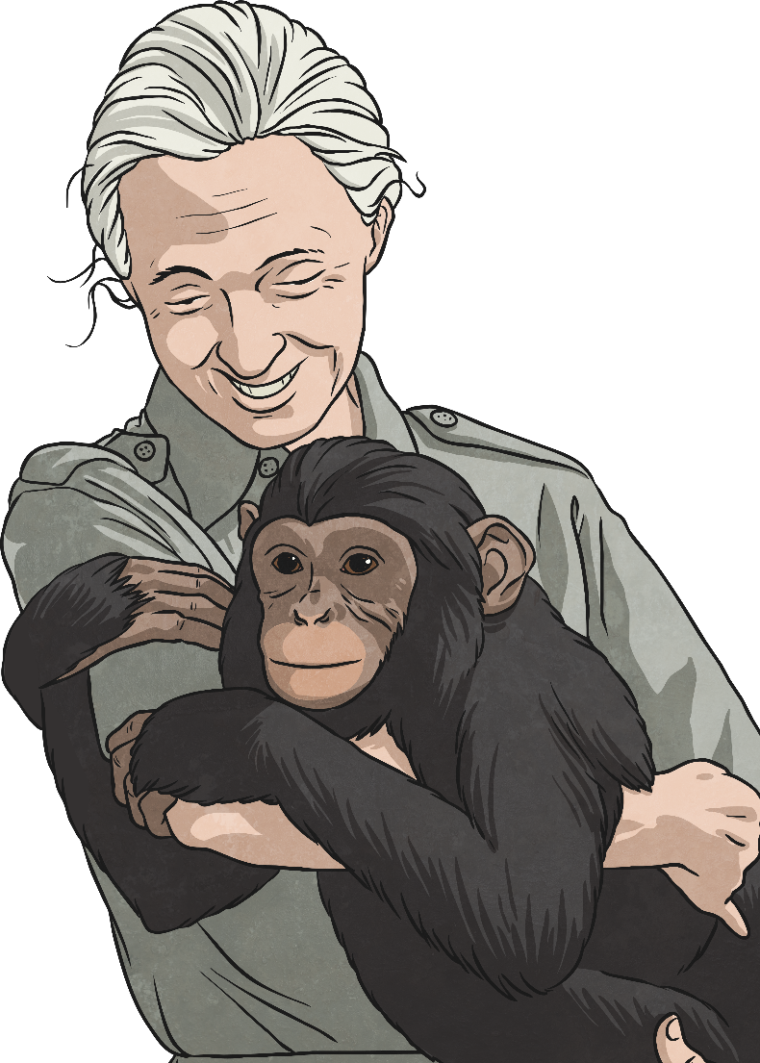
DNA
Around 99.1% of our genes are in common with the chimpanzee, which is our closest relative on earth.
Photo courtesy of (@flickr.com) - granted under creative commons licence – attribution
Photo courtesy of (@flickr.com) - granted under creative commons licence – attribution

Slide 12
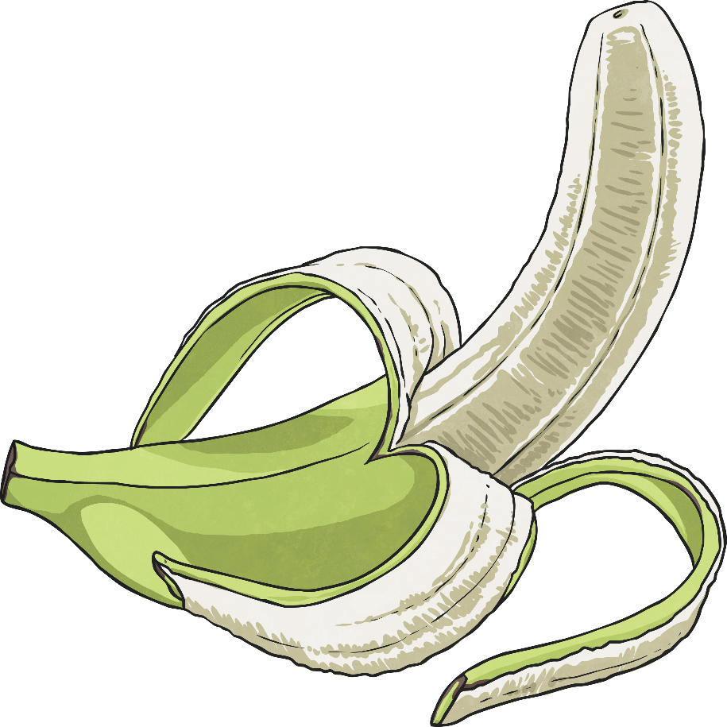
DNA
About 50 percent of human DNA is the same as the DNA found in bananas!
Photo courtesy of (@flickr.com) - granted under creative commons licence – attribution
Photo courtesy of (@flickr.com) - granted under creative commons licence – attribution

Slide 13
DNA
About 99.9 percent of the DNA of every person on the planet is exactly the same.
It's that 0.1 percent that makes us all unique.
Photo courtesy of (@flickr.com) - granted under creative commons licence – attribution
Photo courtesy of (@flickr.com) - granted under creative commons licence – attribution

Slide 14
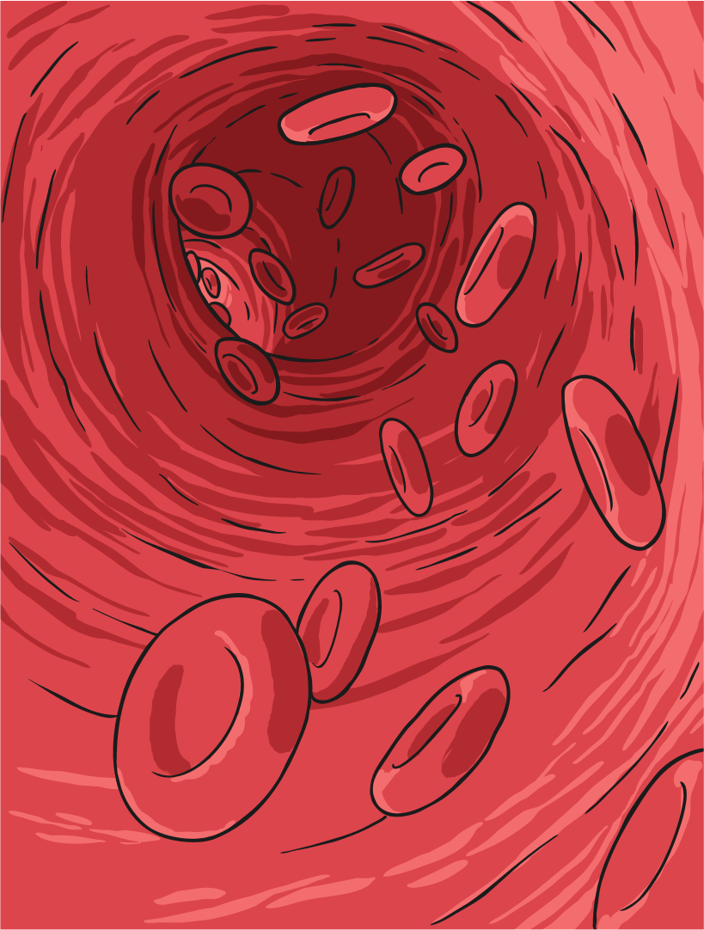
DNA
In the past, people thought that physical and mental characteristics were passed on genetically through our blood.
However, the red blood cells have no DNA!
Photo courtesy of (@flickr.com) - granted under creative commons licence – attribution
Photo courtesy of (@flickr.com) - granted under creative commons licence – attribution

Slide 15
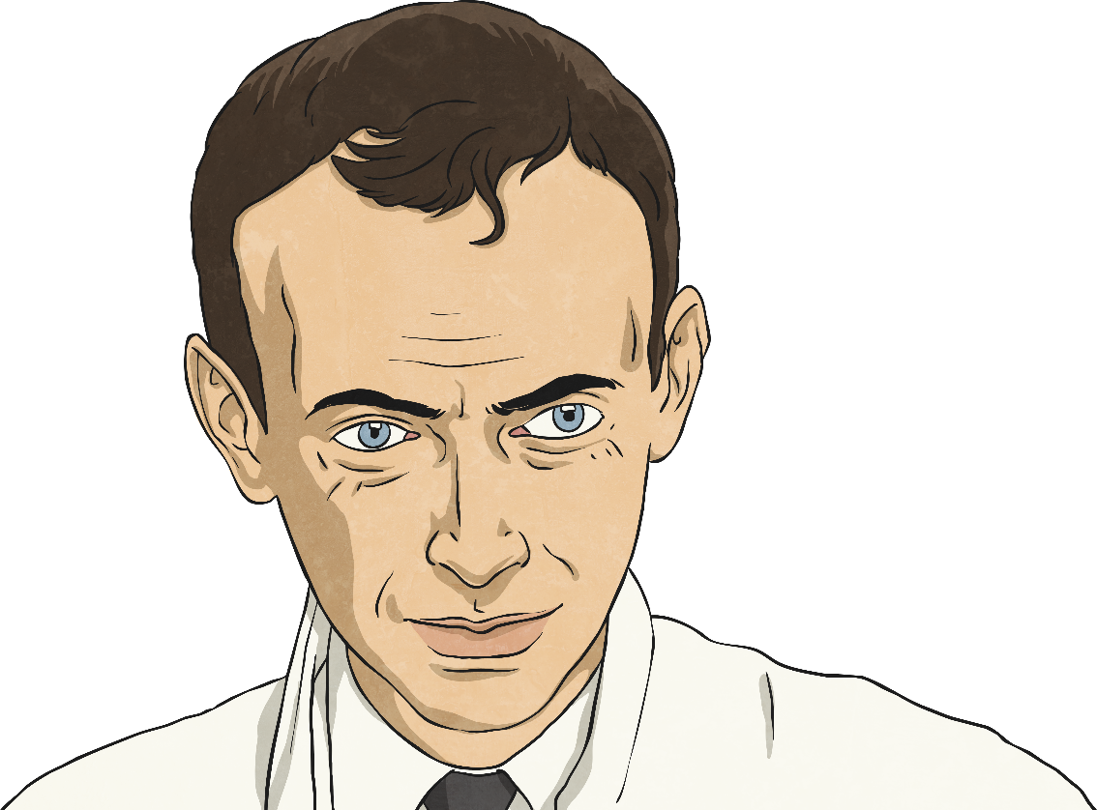
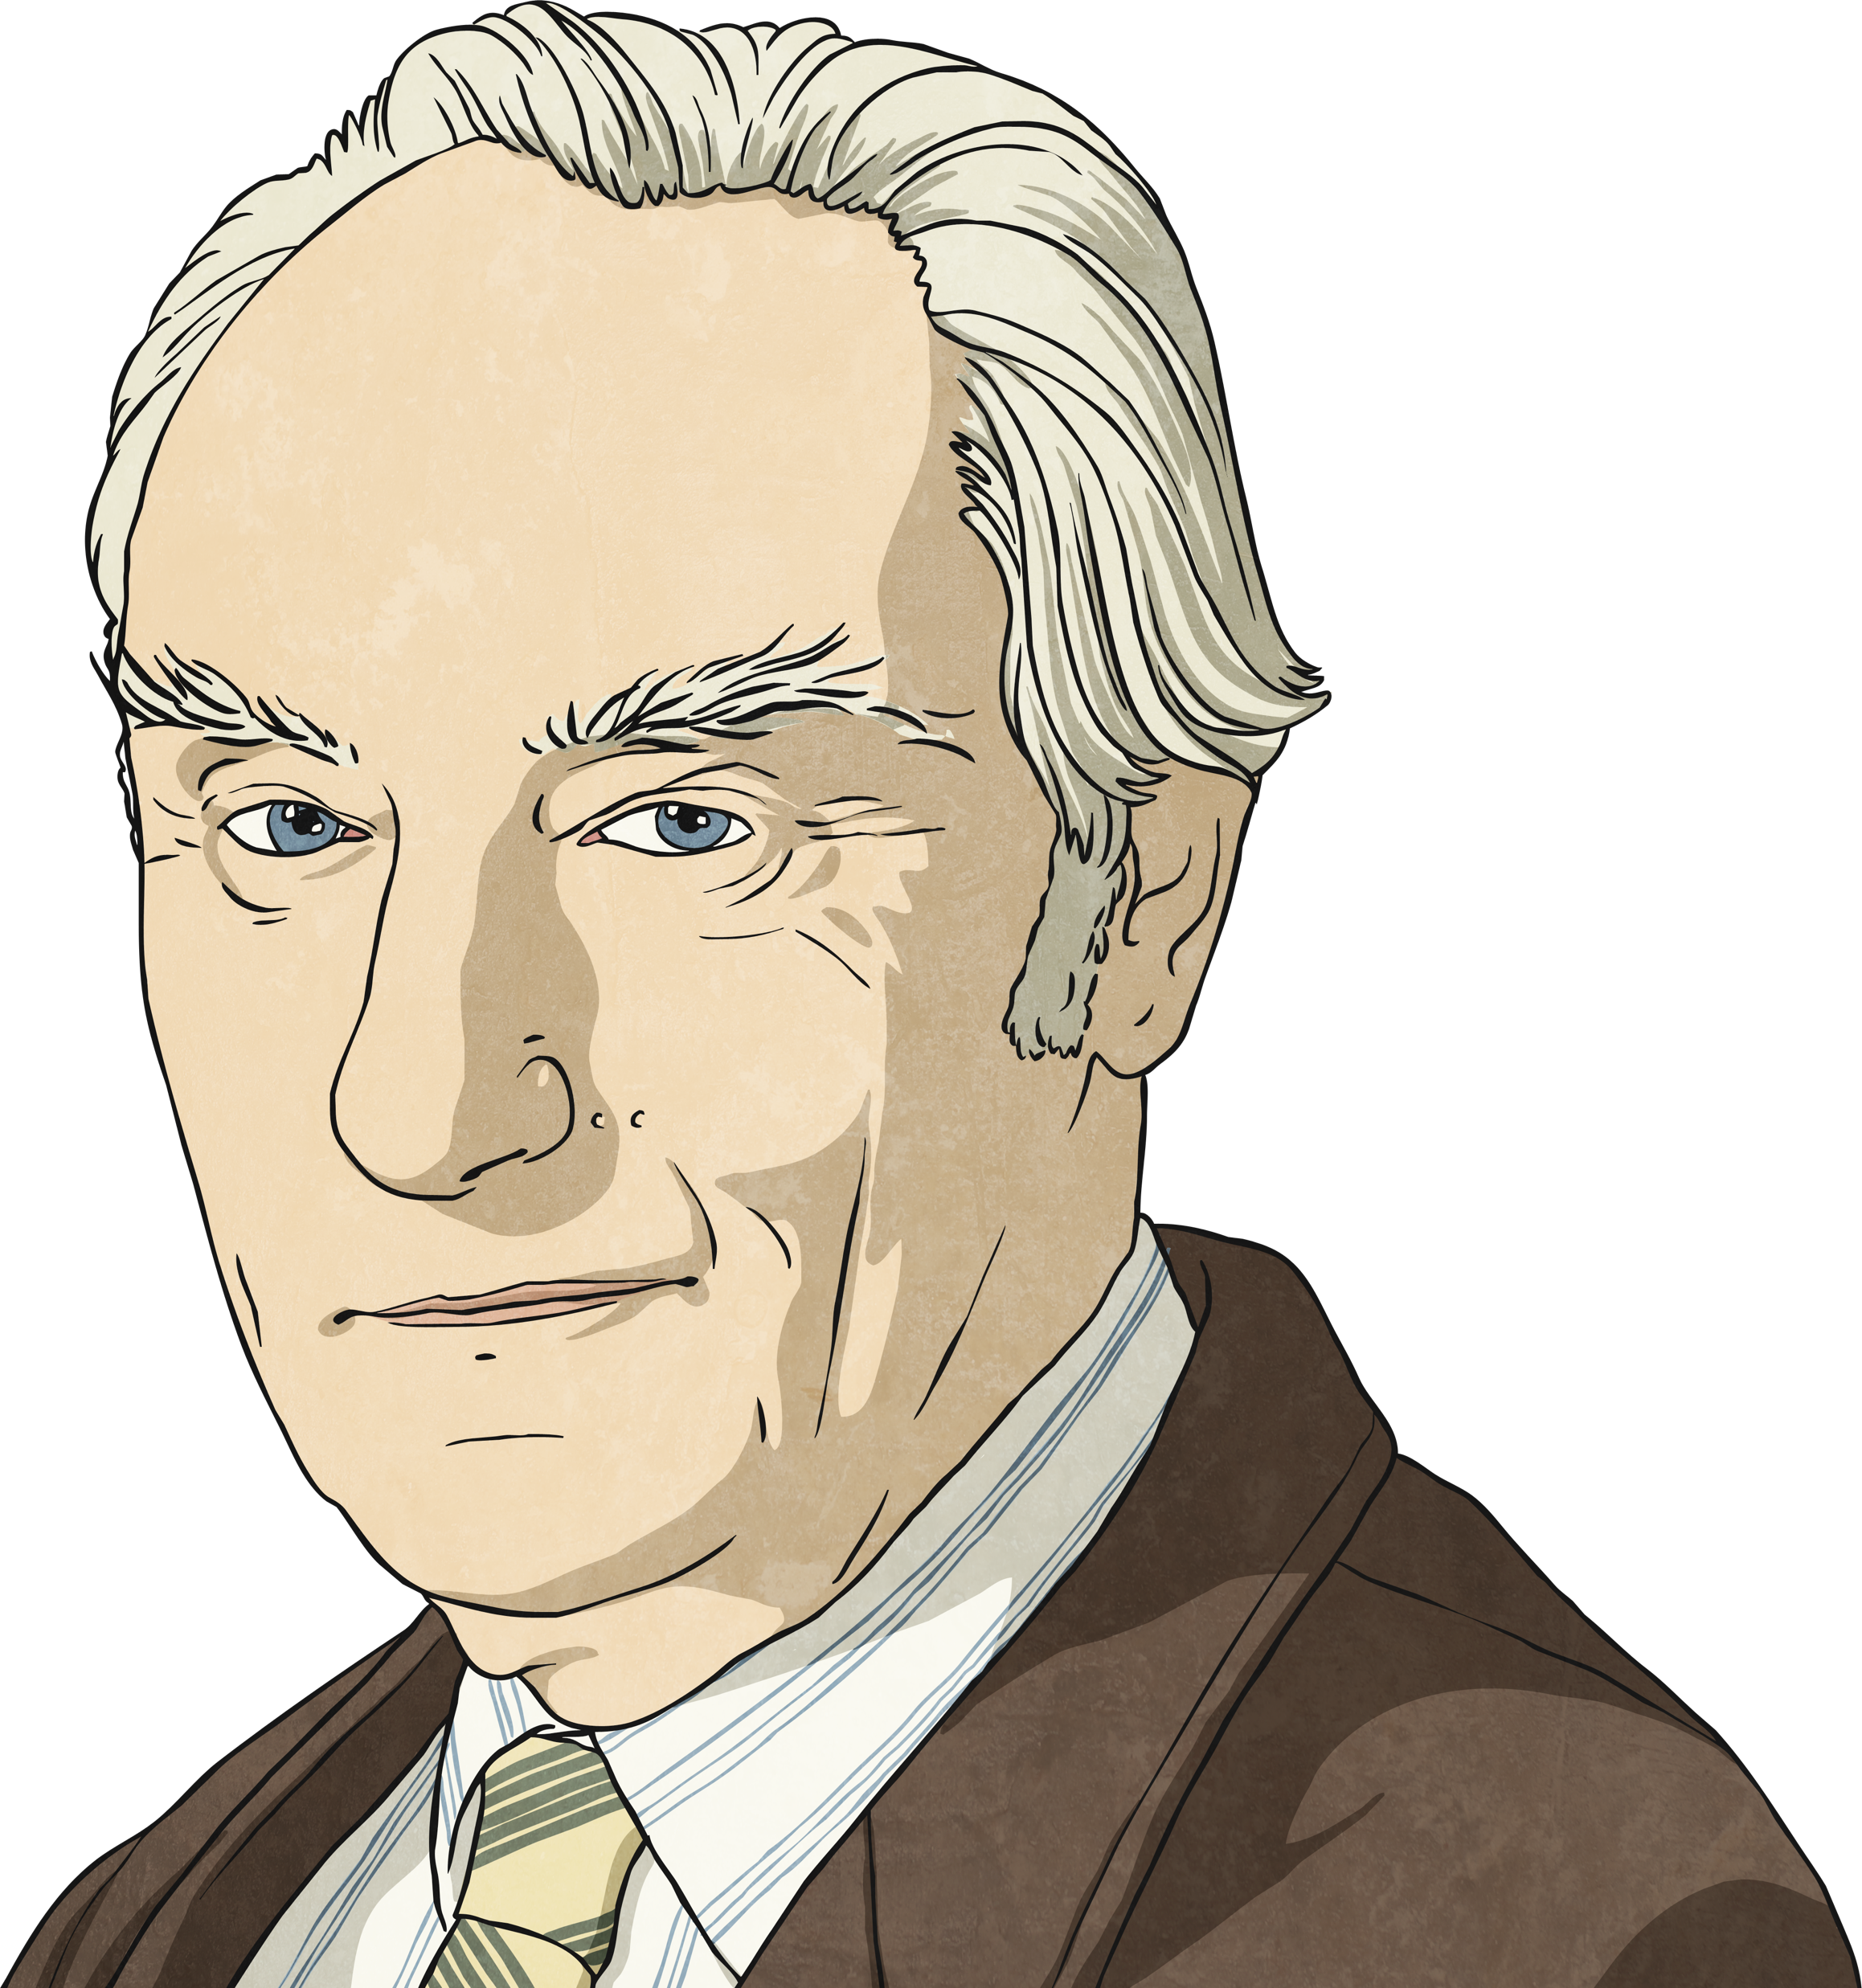
DNA
The double helix structure of DNA was discovered by Dr. James Watson and Francis Crick in 1953.
Photo courtesy of (@flickr.com) - granted under creative commons licence – attribution
Photo courtesy of (@flickr.com) - granted under creative commons licence – attribution
Dr. James Watson
Francis Crick

Slide 16
DNA
DNA was first isolated and identified by Swiss biologist Friedrich Miescher in 1869.
.
Photo courtesy of (@flickr.com) - granted under creative commons licence – attribution
Photo courtesy of (@flickr.com) - granted under creative commons licence – attribution

