Slide 1
+
star
fish
starfish

Slide 2
+
bee
honey
honeybee

Slide 3
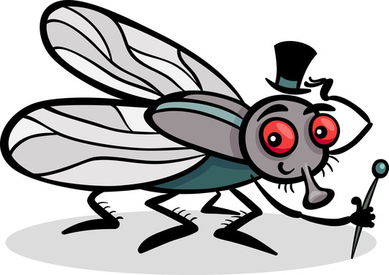
+
butter
fly
butterfly

Slide 4
+
sun
flower
sunflower

Slide 5
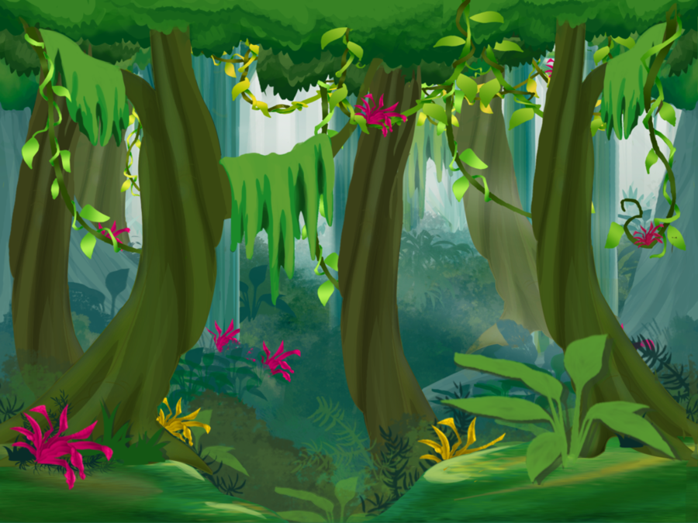
+
rain
forest
rainforest

Slide 6
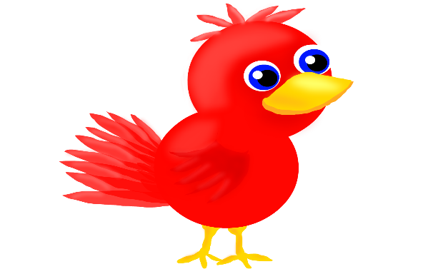
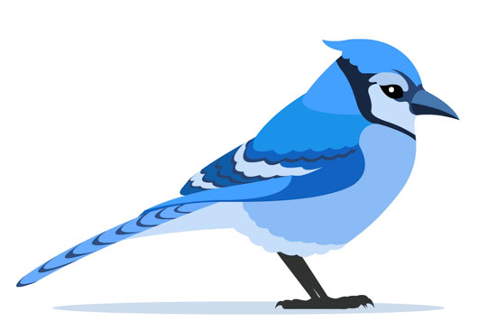
+
blue
bird
bluebird

