Slide 1
How to Write about an Object in the Universe:

Slide 2
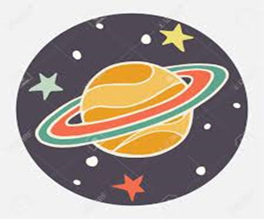
1. Choose one object in the universe you want to write about. ( make it the title)
Saturn

Slide 3
2. Start with an opening sentence telling what the object is.
The moon is an object that moves around the Earth.
An asteroid is usually one of the many small planets that go around the sun.
A comet is a mass of ice and dust that moves around the sun.
A meteorite is a rock from outer space that hits the earth’s surface.
The Milky Way is a band of light made up of a huge number of stars, it includes the sun and its planets.

Slide 4
3. Ask how your object looks like.
What does ____________look like?

Slide 5
4. Say how your object looks like.
The moon is a round object that shines at night by light reflected by the sun.
Asteroids have irregular shapes.
A comet looks like a bright star with a tail.
A meteorite looks like a sponge, with lots of holes.
The Milky Way looks like milk.

Slide 6
5. Write an interesting fact about your object using exclamations.(!)
The moon is the fifth largest moon in the solar system!
“Ceres” is the largest known asteroid!
Scientists so far have discovered about 4000 comets!
Millions of meteorites travel through Earth every day!
There are so many stars in the Milky Way that it makes it look like milk!

Slide 7
6. Write a prediction about your object.
Regular people will travel to __________ someday.
Scientist will discover new things about _________.
Scientist will do more researches about ___________.

Slide 8

7. Put all your ideas together and write your paragraph.

Slide 9
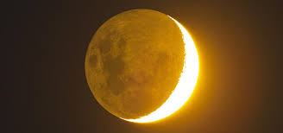
The Moon
The moon is an object that moves around the earth. What does the moon look like? The moon is a round object that shines at night by light reflected by the sun. The moon is the fifth largest moon in the solar system! Regular people will travel to the moon someday.

Slide 10
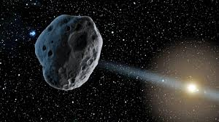
Asteroids
An asteroid is usually one of the many small planets that go around the sun. What does an asteroid look like? Asteroids have irregular shapes. Ceres is the largest known asteroid! Scientists will discover more asteroids in the future.

Slide 11
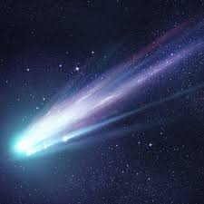
Comets
A comet is a mass of ice and dust that moves around the sun. What does a comet look like? A comet looks like a bright star with a tail. Scientists so far have discovered about 4000 comets! Scientists will discover more comets in the future.

Slide 12
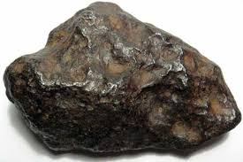
Meteorites
A meteorite is a rock from outer space that hits the Earth’s surface. What does a meteorite look like? A meteorite looks like a sponge, with lots of holes. Millions of meteorites travel through Earth every day! Scientist will discover new things about meteorites.

Slide 13
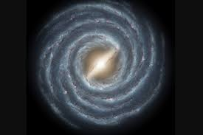
The Milky Way Galaxy
The Milky Way is a band of light made up of a huge number of stars, it includes the sun and its planets. What does the Milky Way look like? The Milky Way looks like milk. There are so many stars in the Milky Way that it makes it look like milk! Scientist will do more researches about the Milky Way Galaxy.

