Slide 1
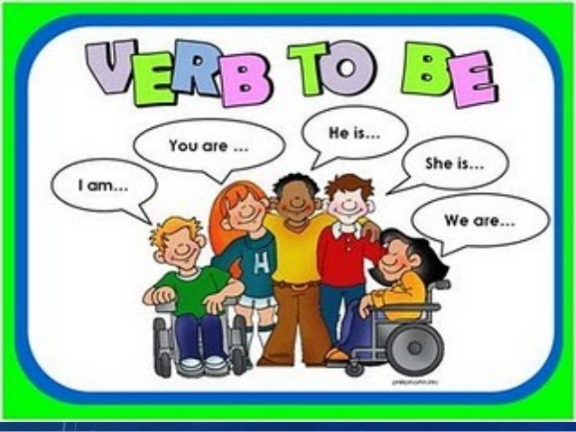

Slide 2
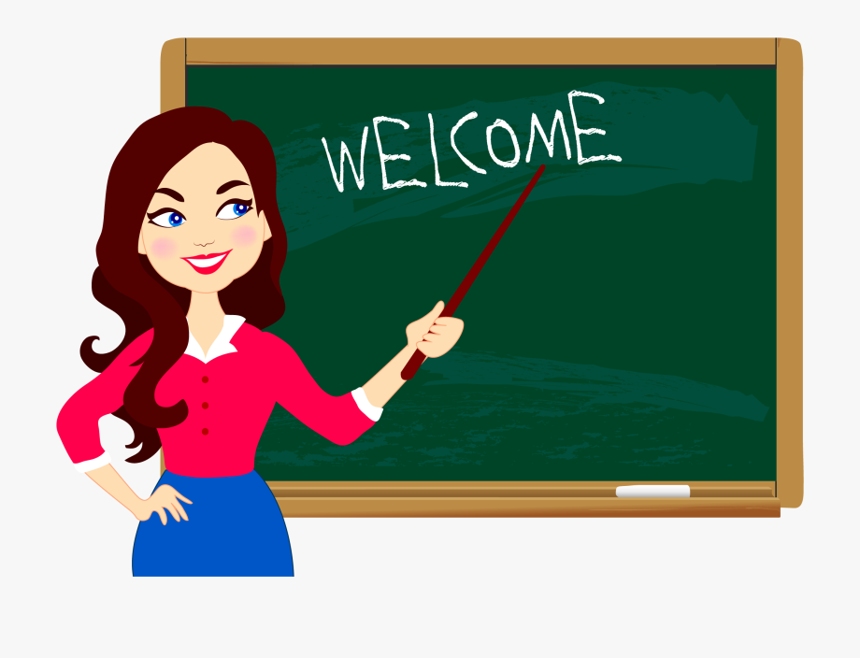
I am a teacher.
I ‘m a teacher.

Slide 3
You are a student.
You ‘re a student.

Slide 4
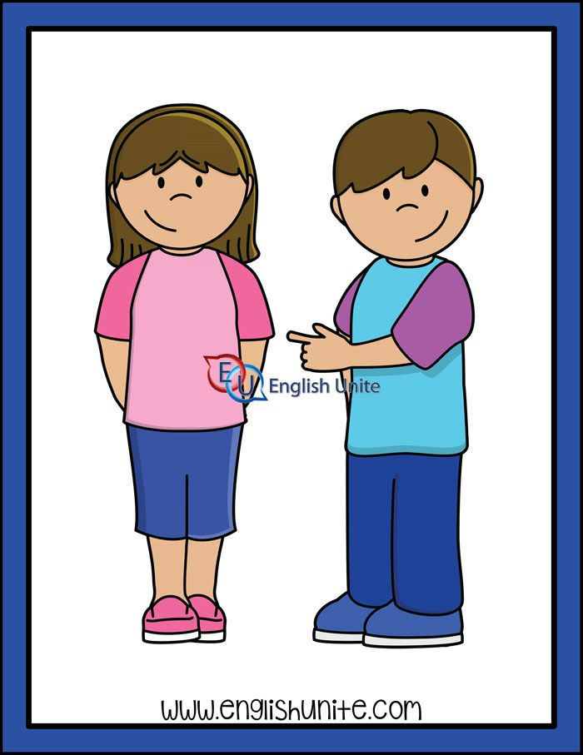
She is my sister.
She ‘s my sister.

Slide 5
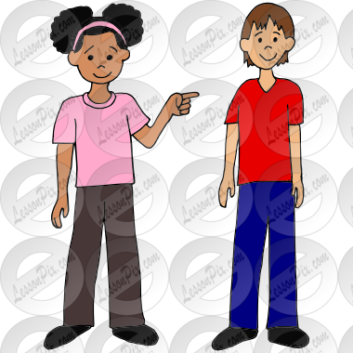
He is my brother.
He ‘s my brother.

Slide 6
They are my friends.
They ‘re my friends.

Slide 7
We are reading.

Slide 8
Verb to be
am
is
are
I
He, she, it
We, They,You

