Slide 1

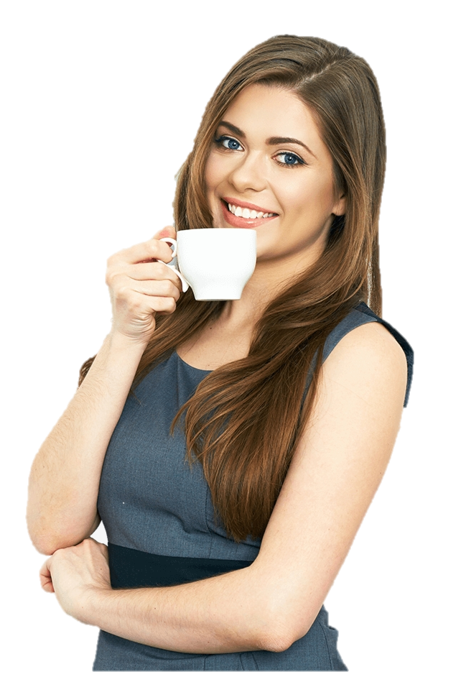
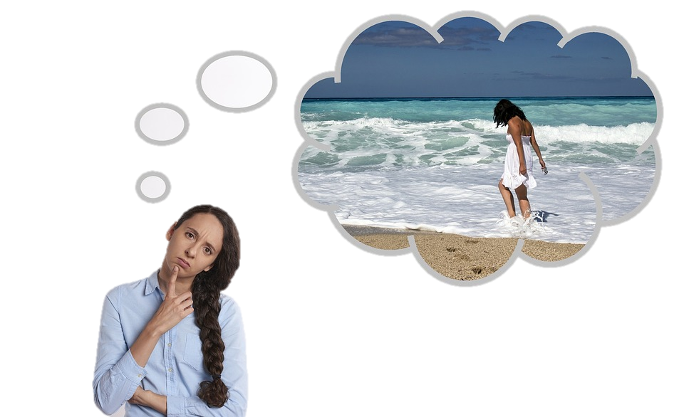
THINK
stative
active
have an opinion
=consider
She is thinking about her summer holidays
Marina thinks coffee is great

Slide 2
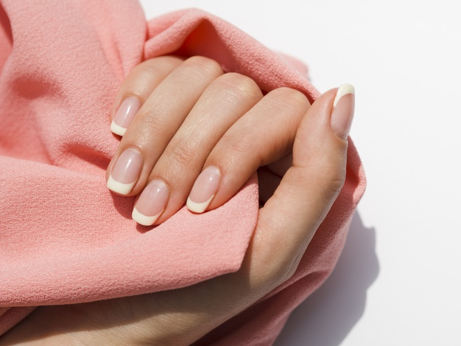

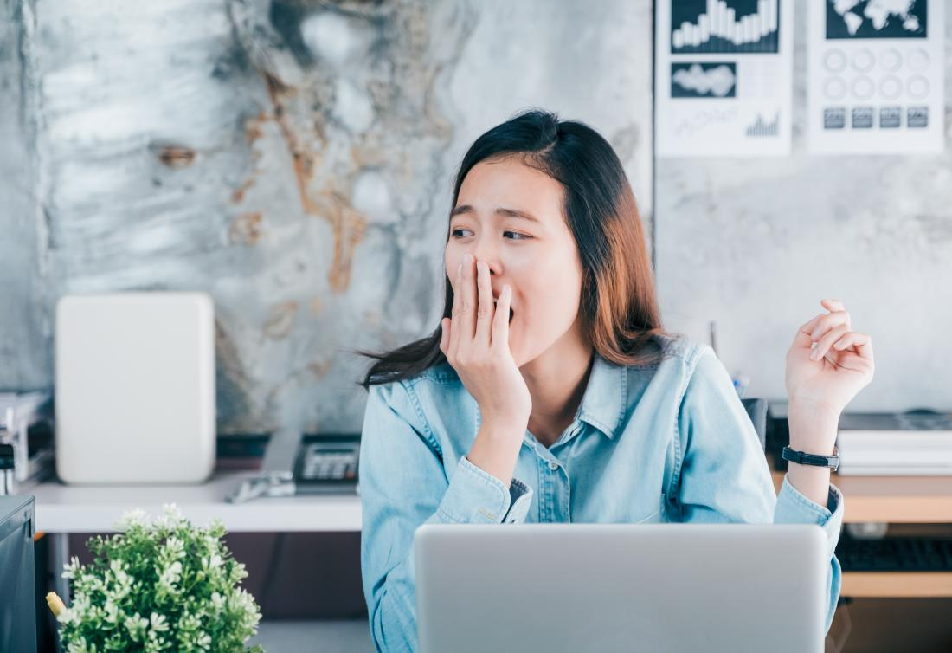
FEEL
stative
active
when we talk about your opinion;
= understand
experiencing emotions or health issues; when we touch smth
I feel you = (I understand you)
I feel that it’s a great idea!
I’m feeling tired lately
A tailor is feeling fabric

Slide 3
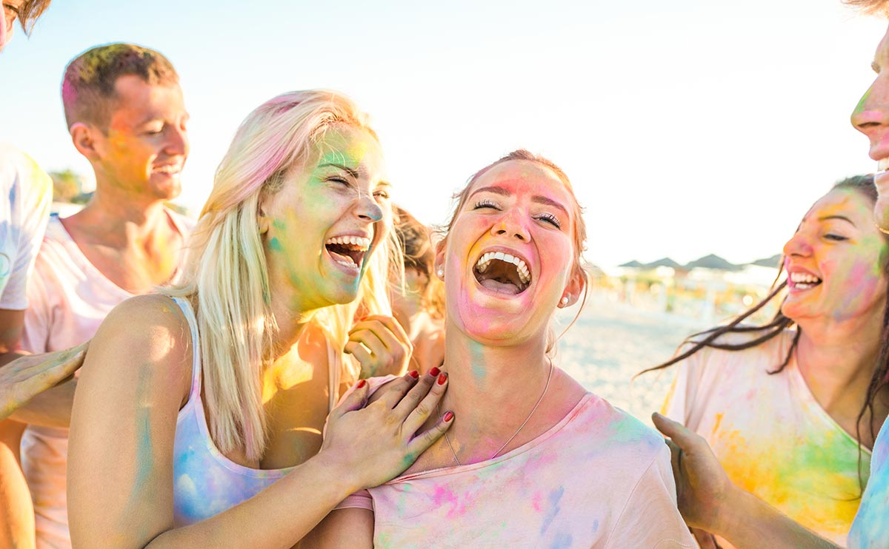
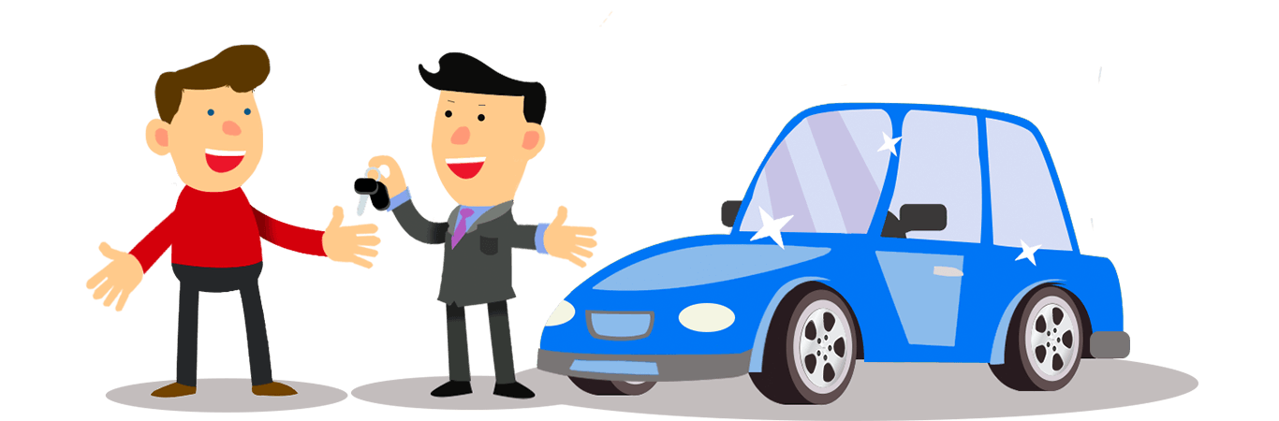
HAVE
stative
active
when it’s part of an expression
=own; possession
Julie has a car
They have a dog
Maria is having fun

Slide 4
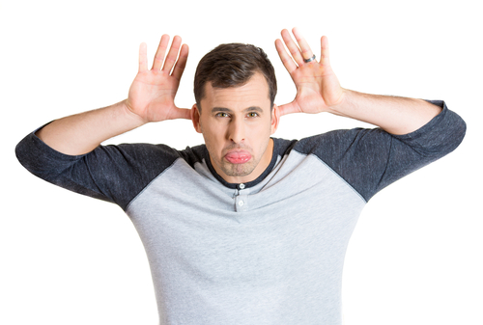
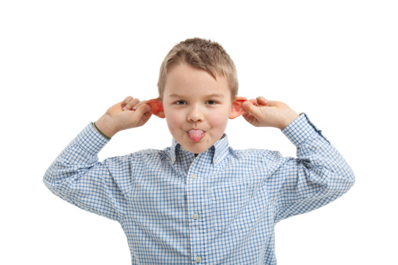
BE
stative
active
always has the same characteristic
has temporary quality for some period of time
He is being immature
He is immature

Slide 5
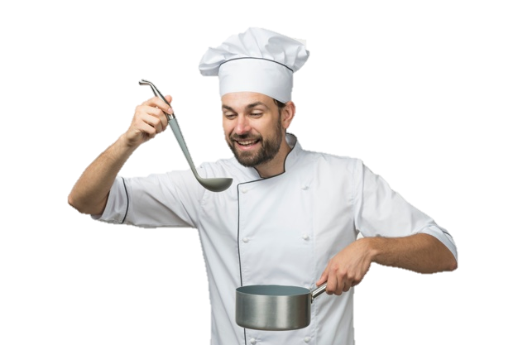
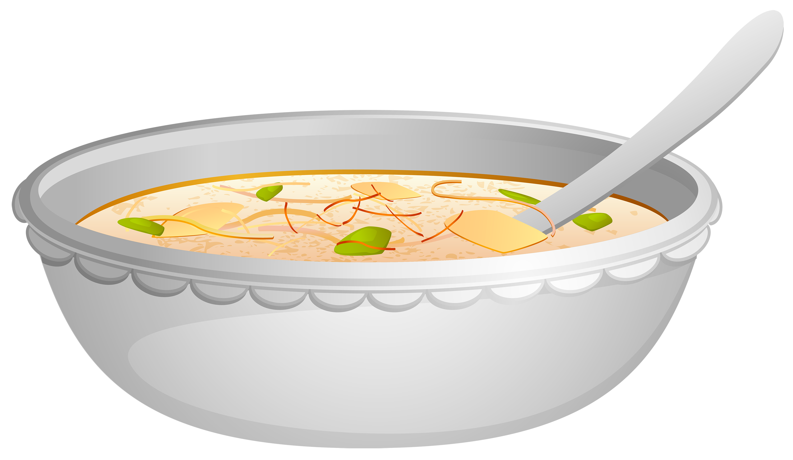
TASTE
stative
active
when “taste” talks about the action of tasting
when it describes a flavour
He is tasting soup
This soup tastes delicious

Slide 6
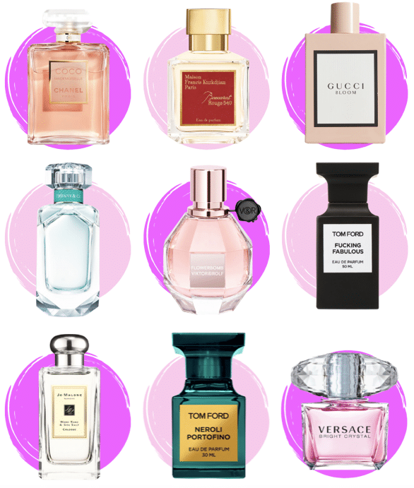
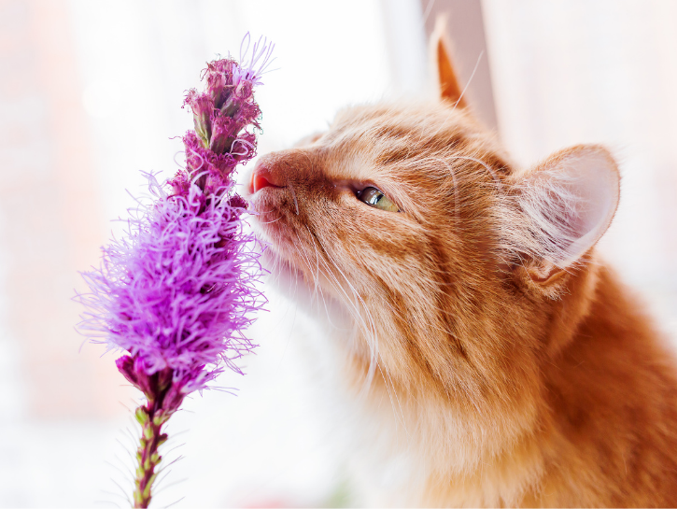
SMELL
stative
active
when a person uses the nose to smell smth
when it describes a quality
of smell
A cat is smelling flowers
Your perfume smells wonderful

Slide 7
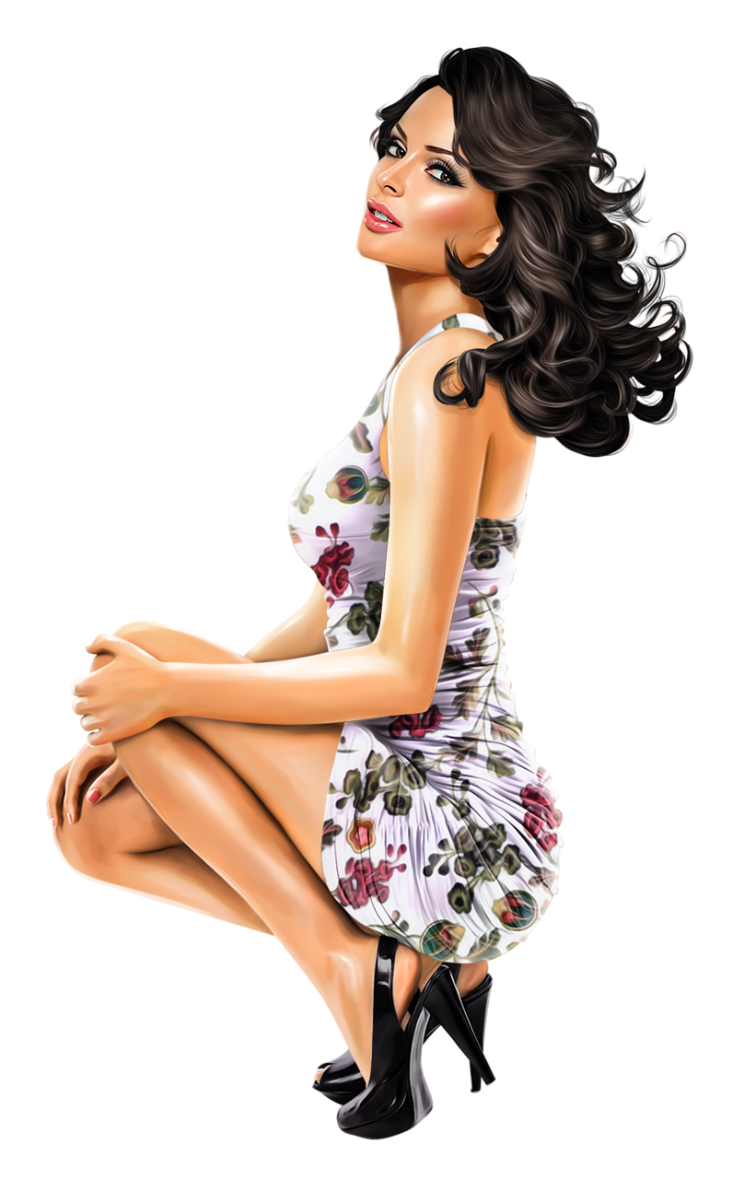
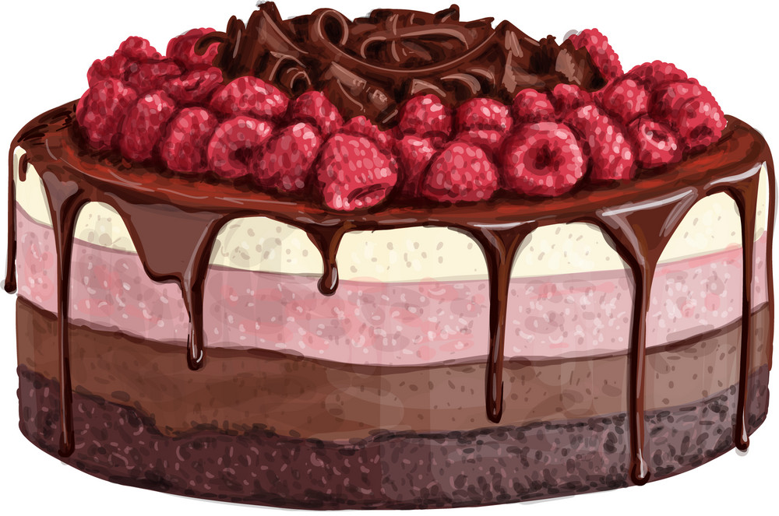
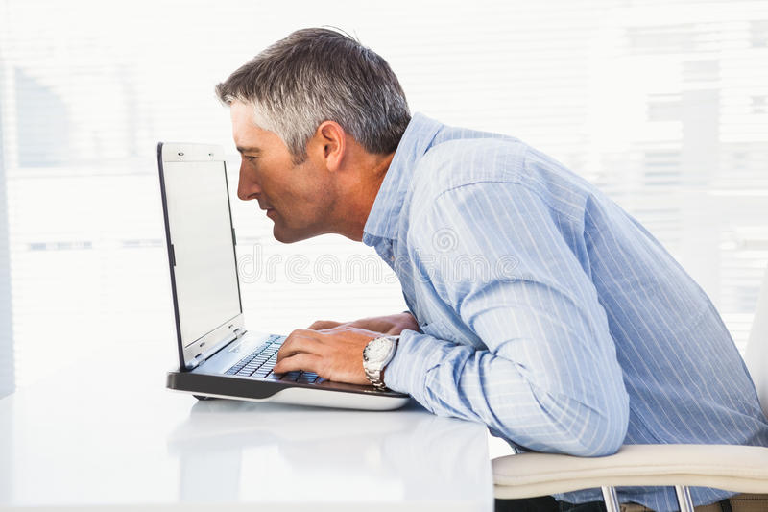
LOOK
stative
active
Directing your eyes to smth;
Phrasal verbs
(look at; for; after)
appearance
You look gorgeous
This cake looks tasty
He is looking at a computer screen

Slide 8
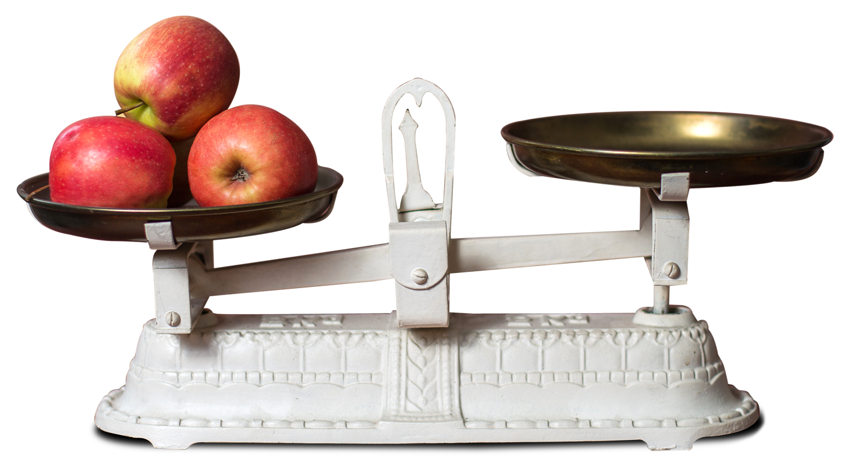
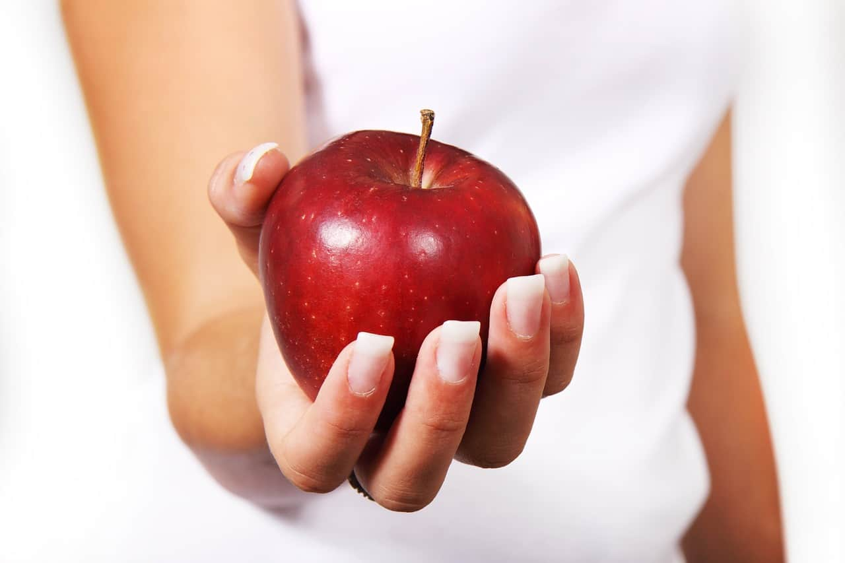
WEIGH
stative
active
when we perform an action of weighing
Fact of the weight
An apple weighs 100 gr
A seller is weighing apples

Slide 9
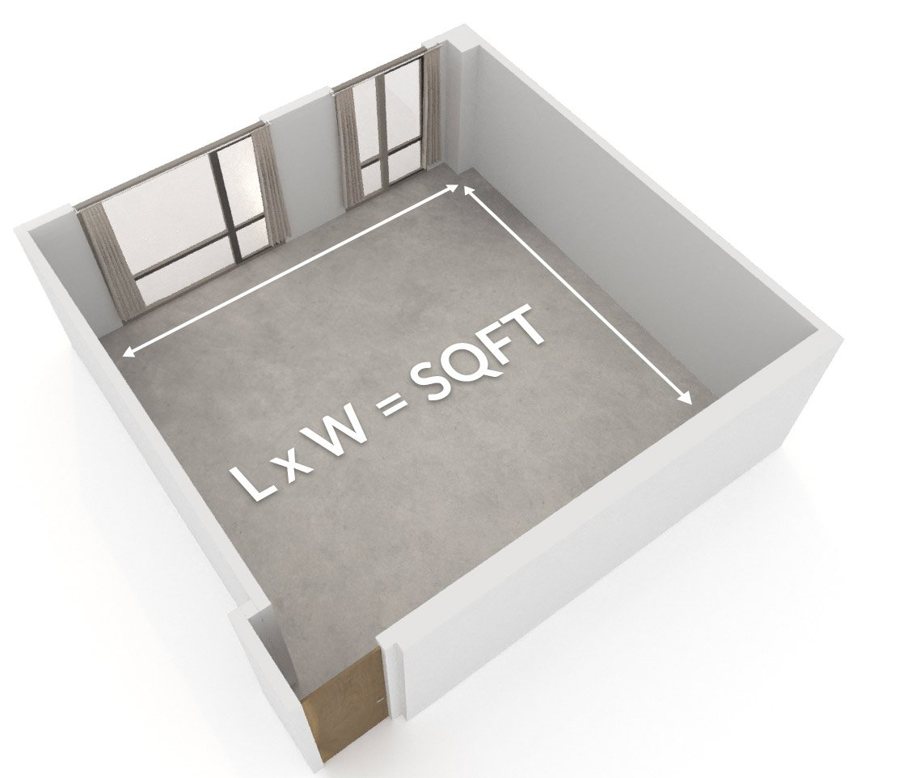

MEASURE
stative
active
when we perform an action of measuring
Fact of the measurement
The architect is measuring the flat
The room measures 5 meters by 7 meters

Slide 10
Complete the sentences with the verbs in Present Simple or Present Continuous
I (have/ am having) a great time.
I ( see/ am seeing) the manager this afternoon.
What (do you think/ are you thinking) about?
I (feel/ am feeling) she's making a mistake.
Why (do you look/ are you looking) at me like that?
She (has/ is having) plenty of money right now.
I (think/ am thinking) you're right.
He (appears/ is appearing) at the Fortune Theatre next week.
I (feel/ am feeling) very tired today.
I (see/ seeing) what you're trying to say.
It (looks/ is looking) as if it's going to rain.
She (appears/ is appearing) to have a problem.

Slide 11
Complete the sentences with the verbs in Present Simple or Present Continuous
I (don't believe / I'm not believing) that you cooked this meal yourself.
Come on, let's order. The waiter (comes/ is coming).
Kate (doesn't want/ isn’t wanting) to have dinner now. She isn't hungry.
The head chef is ill, so he (doesn't work/ isn't working) today.
The bill (seems/ is seeming) very high to me.
We've had an argument, so we (don’t speak/ aren't speaking) to each other at the moment.
My mum (thinks/ is thinking) my diet is awful these days.
(Do we need/ Are we needing) to go shopping today?
Can I call you back? I (have/ am having) lunch right now.
I didn't use to eat oily fish, but now I (love/ am loving) it!
What (do you cook/ are you cooking)? It smells delicious!

Slide 12
Complete the sentences with the verbs in Present Simple or Present Continuous
We (don't have/ aren't having) a car.
He (doesn't have/ isn’t having) a car at the moment.
(Do you recognize/ Are you recognizing) the man in that photo? It's our old maths teacher.
Can you answer the phone? I (talk/ am talking) on my mobile.
I'm sorry, I don't understand. What (does this word mean/ is this word meaning) ?
You look worried. What (do you think/ are you thinking about)?
I'm not sure if we're going skiing this weekend. It (depends/ is depending) on the weather.
I (think/ am thinking) that people today eat too much unhealthy food.
She (doesn’t come/ isn't coming) with us tonight because she's tired.

Slide 13
Choose the correct options to complete the sentences
1. — (Do you see/ Are you seeing) the bus number?
— No, I (don't see/ am not seeing) well. I ( see/ 'm seeing) a doctor tomorrow to get my eyes checked.
2. This dessert (looks/ is looking) mouthwatering! I'm sure it (tastes/ is tasting) delicious!
3. — What (do you think/ are you thinking) of this book? Is it a good present for her?
— I (think/ am thinking) it's perfect! She's keen on reading science fiction.
4. — Why are you so excited?
— I (think/ 'm thinking) about my upcoming trip!
5. — Are you eating ice cream?
— No, I ( taste/ 'm just tasting) it, mum!

Slide 14
Complete the sentences with the verbs in Present Simple or Present Continuous
Maria (is/ is being) a student. She (lives and studies/ is living and studying) in Moscow.
Now she (wants/ is wanting) to take a language course somewhere in Britain.
She (doesn't know/ isn’t knowing) what to choose.
At the moment, she (chooses/ is choosing) a place and a school.
At one of the schools, the course (includes/ is including) not only English lessons but some sport activities.
Of course, it (costs/ is costing) more, but Maria (likes/ is liking) sport, so the program (seems/ is seeming) to be really attractive to her.
So, now she (needs/ is needing) to save some more money because she (doesn't have/ isn’t having) much.
She (looks/ is looking) at the advertisement and (thinks/ thinking) how she can do it.
She (hopes/ is hoping) she will find the possibility to fulfil her dream.

Slide 15
Choose the Present Simple or Present Continuous form of the verbs to complete the sentences
Are you thirsty? (Do you want/ Are you wanting) some water?
Don't switch off the laptop! I ( use/ 'm using) it!
Don't close the browser! I (need/ am needing) it!
— What's wrong? Why ( do you look/ are you looking) at me like that?
— Nothing! It's just that you (look/ are looking) so good in your new dress!
— The salad (smells/ is smelling) delicious!
— Thank you! And it (contains/ is containing) only fresh and natural ingredients!
I read this book in my childhood but now I (don't remember/ am not remembering) the names of the characters.

Slide 16
Complete the text. Use the Present Simple or Present Continuous
Otto (is/ is being) twelve years old. He (currently leans/ is currently learning) English at school. He (loves/ is loving) learning foreign languages a lot and (thinks/ is thinking) that English is a useful language. He (has/ is having) some homework to do. That's why he (sits/ is sitting) here in front of his computer. He (wants/ is wanting) to pass the school English test.
Right now he (tries/ is trying) to find an exercise on the superlative form of adjectives. He (thinks/ is thinking) about these rules but, unfortunately, he (doesn't remember/ isn’t remembering) them very well. Is it "farest" or "farthest"? He finally finds the rules and exercises on the Internet. It isn't easy, but Otto (has/ is having) fun with the quiz. He (hopes/ is hoping) he (understands/ is understanding) the superlative a little better at the end of the exercise.

