Slide 1
Business Growth

Slide 2
Why the owners of a business may want to expand the business
The possibility of higher profits for the owners.
More status and prestige for the owners and managers.(higher salaries often paid to managers who control bigger businesses)
Lower average costs.
Larger share of its market.

Slide 3
Different ways in which businesses can grow
Internal Growth (Organic Growth).
External Growth (takeover or a merger ):
Horizontal Integration.
Vertical Integration (forward or backward).
Conglomerate Integration.

Slide 4
Internal Growth
Occurs when a business expands its existing operations.
Example:
A restaurant owner could open other restaurants in other towns.
This type of growth is often paid for by profits from the existing business.
this type of growth is often quite slow but easier than external growth

Slide 5
External Growth
Is when a business takes over or merges with another business. Its often called integration.
A takeover or acquisition: is when one business buys out the owners of another business.
A merger : is when the owners of two businesses agree to join their businesses together to make one business.
There are 3 types of external growth

Slide 6
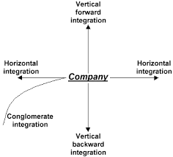

Slide 7
1. Horizontal Integration
Is when one business Merges or takes over another one in the same industry and at the same stage of production.
Example :
Disney integration: ABC→→→Pixar→→→ESPN
One of the Horizontal Integration benefits:
The merger reduces the number of competitors in the industry.

Slide 8
2.Vertical Integration
Is when one business merges with or takes over another one in the same industry but at a different stage of production.
Vertical integration can be forward or backward.
Forward Vertical Integration :when a business integrates with another business which is at a later stage of production (closer to the tertiary stage).
Backward Vertical Integration: when a business integrates with another business which is at an earlier stage of production (closer to the primary & secondary stage)

Slide 9
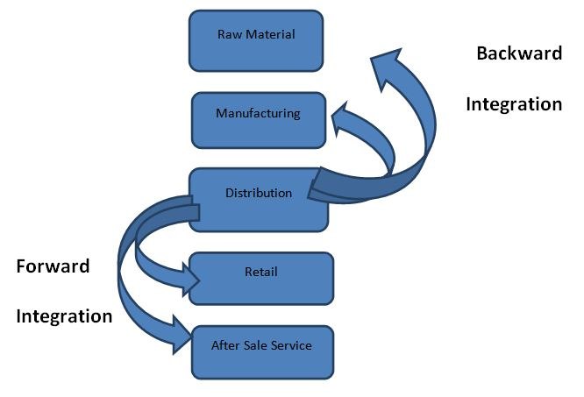
One of the Vertical integration benefits:
Forward Integration: Information about the consumers needs can be now obtained directly by the manufacturer.
Backward Integration: costs of components and supplies for the manufacturer could be controlled.
Example:

Slide 10
3.Conglomerate Integration (diversification)
Is when one business merges with or takes over a business in a completely different industry.
Example:
A business Building Houses merges with a clothing business
One of the diversification Benefits:
The business now has activities in more than one industry . This might reduces the risk taken due to any future challenges .

Slide 11
Time for Competition
Lets kahoot !!

Slide 12
Problems linked to business growth and how these might be overcome
Problem resulting from expansion | Possible ways to overcome problem
Larger business is difficult to control | Operate the business in small units
Larger business leads to poor communication | Use latest IT equipment and telecommunications
Expansion costs so much that business is short of finance | Expand more slowly- use profits from slowly expanding to pay to further growth.
Integrating with another business introduce different management styles or ways of doing things | Introducing a different style of management requires good communication with the workforce

Slide 13
Why some businesses remain small
The type of industry the business operates in: such as hairdressers and plumbers…etc. these businesses offer personal services and specialized products. If they were to grow too large , they will find it difficult to offer personal service demanded by consumers.
Market size: if the market total number of customers is small the businesses are likely to remain small. ex: shops in rural areas
Owner’s objectives: some business owners prefer to keep their business small than running larger businesses .
new businesses are at greater risk of failing than existing , well established businesses.

Slide 14
Causes of business failure
Lack of management skills :Lack of experience can lead to bad decisions.
Changes in the business environment :such as new technology , powerful new competitors and major economic changes.
Liquidity problems or poor financial management: shortage of cash means that workers, suppliers, landlords cannot be paid what they are owed.
Over-expansion: when a business expands too quickly it can lead to big problems of management and finance.
New businesses are at greater risk of failing than existing , well established businesses.

