Slide 1
Spine-chilling suspense

Slide 2
What do we mean by Suspense?
It is a state or feeling of excited or anxious uncertainty about what may happen.
Synonyms: Tension, Anxiety
Antonyms: Serenity, Calmness

Slide 3
What are the main features of Suspense?
Cliff-hangers: a term used in episodes/chapters of a serial in order to leave the audience in suspense not to miss the next episode/chapter.
Dilemmas: difficulty, problem.
Scary moments.
Humour.
Satire: mockery

Slide 4
Creating suspense-the power of suggestion p.7
What we find out | What we don’t find out
Why it is hiding in the shadows | Details about the creature’s appearance
Why it moves slowly | Who are in the crowd
Whether it has evil intent | Its name
 | How old it is
 | What noise it makes
 | Where it has come from

Slide 5
Clinging to the edge p.8
What is the “yeh-teh”/”yeti”?
→ It is a creature from the culture or mythology of the Himalayan mountains of Nepal and Tibet.
What does it look like?
→ It is described as a huge hairy, ape-like creature.
Where does it live?
→ It lives in the high snowy mountains.
It is sometimes called as the “abominable snowman”.

Slide 6
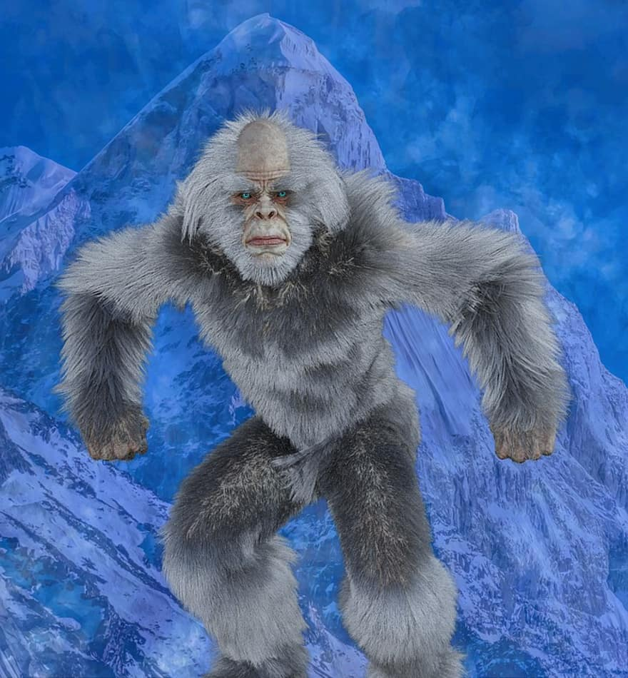
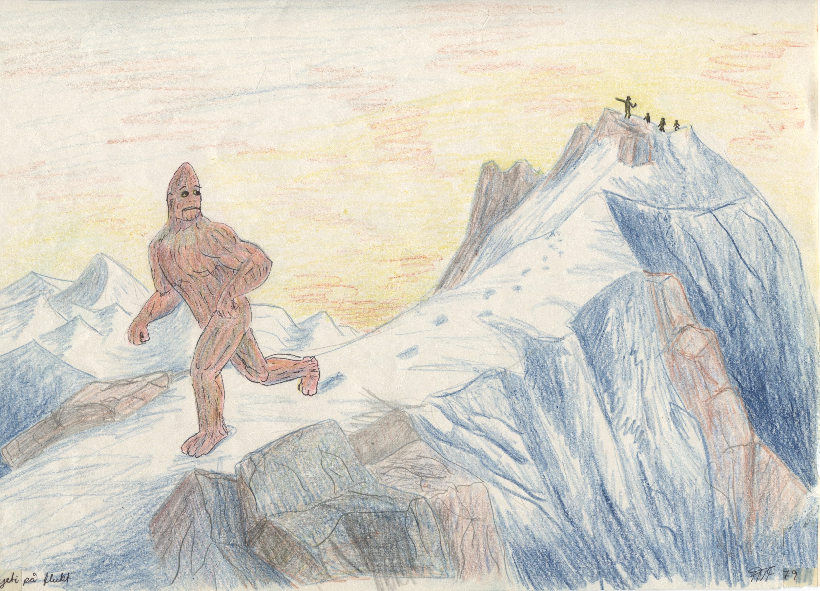

Slide 7
taut

Slide 8
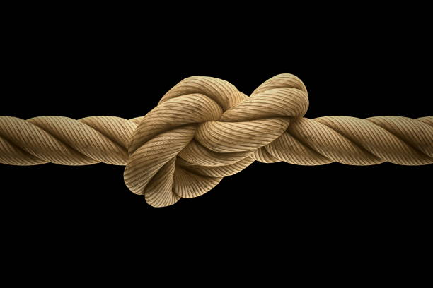
Tightly drawn

Slide 9
snaked

Slide 10
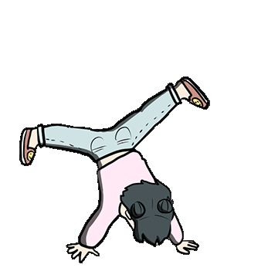
moved/to move

Slide 11
looped

Slide 12
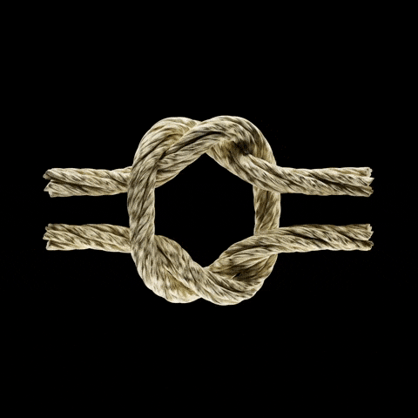
A ribbon, rope folded upon itself.

Slide 13
clamped

Slide 14
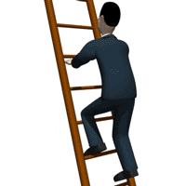
Gripped, clenched

Slide 15
hugging

Slide 16
snuggling

Slide 17
Calf muscles

Slide 18
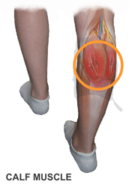

Slide 19
ache

Slide 20
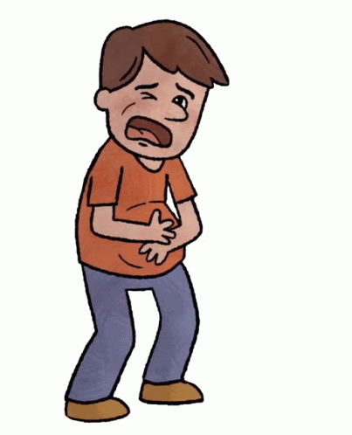
Hurt, pain

Slide 21
tremble

Slide 22
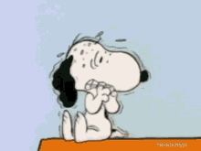
shake

Slide 23
froze

Slide 24
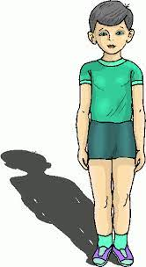
Rooted, glued

Slide 25
Clung

Slide 26
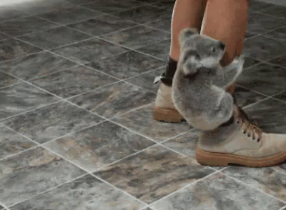
Hold on tightly

