Slide 2
What is a Persuasive Text?
A persuasive text is a piece of writing used to share the writer's point of view. It is an opinionated and argumentative form of writing.
A persuasive text is intended to convince readers to believe in an idea or opinion. When we write in this style we want the reader to agree with us. That means we need to use strong language to convince the reader that our opinion is the right one.

Slide 3
Features of a Persuasive Text
A persuasive text…
argues a case for or against a point of view or belief
includes an opening statement which states the writer's point of view or position
provides three reasons or arguments, in paragraph form, which are supported by evidence
ends with a concluding statement that restates and reinforces the opening position.

Slide 4
Language of a Persuasive Text
The language used to write a persuasive text should include…
present tense
personal pronouns
general and abstract nouns relating to the topic of the text
evaluative adjectives that give weight to the author’s argument (dangerous, noisy, terrible)
modal verbs and adverbs to reinforce the author’s position (should, must, will)
connectives and sequencing words to give order and structure to the arguments and evidence
Other language features that may be used include rhetorical questions, exaggeration, repetition and exclamation marks.

Slide 5
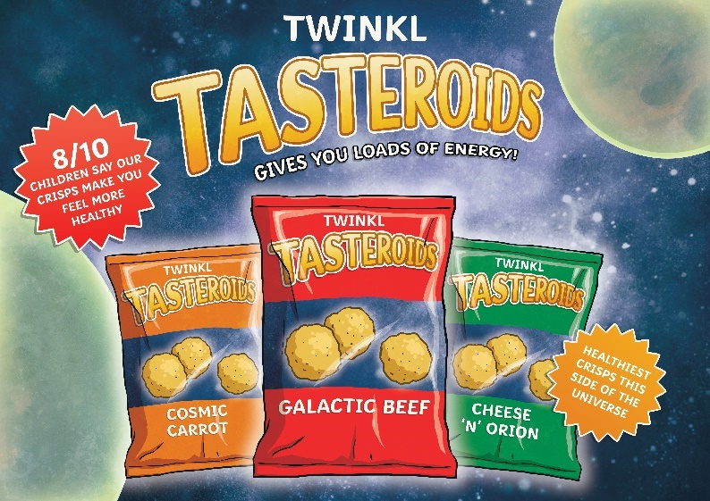
Types of Persuasive Texts
brochures
letters
debate
speeches
literary criticism
review
argument
exposition
articles
discussion
advertisement
essays

Slide 6
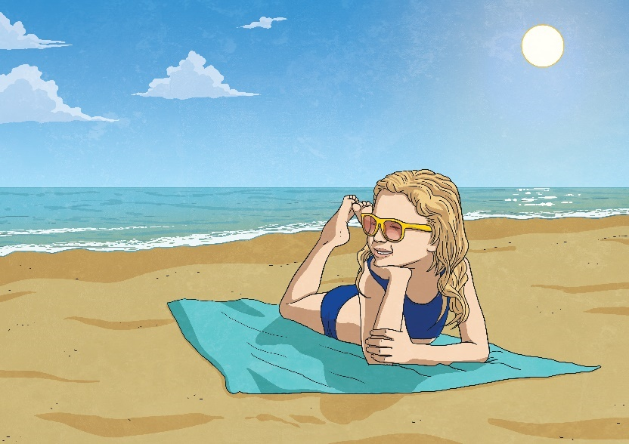
Example
Summer Is the Best Season Of the Year
Summer is without a doubt the best season of the year. I strongly believe that it is better than all of the other seasons because summer is the perfect time for fun family adventures, the tastiest foods and of course the very best weather.
Firstly, summer is great for spending time outside. The weather is warm and sunny which is absolutely perfect for visits to the beach or for swimming in a pool. You might also like to go for a bike ride or play a game of cricket outside in the sunshine.

Slide 7
Example Continued
Additionally, summer here in Australia includes Christmas, which means lots of added time with family and friends. The school holidays are also a great time to get away for a family holiday, to discover new things and new places.
Finally, I am sure you can agree that summertime is the perfect time for delicious treats like ice-cream or frozen slushy drinks. These tasty treats are not nearly as enjoyable in the colder seasons.
In conclusion, summer offers the best sunny weather, the perfect opportunity for spending fun time with friends and family outdoors, as well as super yummy frozen treats for everyone to enjoy. It is clear that summer is most definitely the best season of the year.

