Slide 1
Present Continuous
[am / is / are] + verb +ing
t

Slide 2
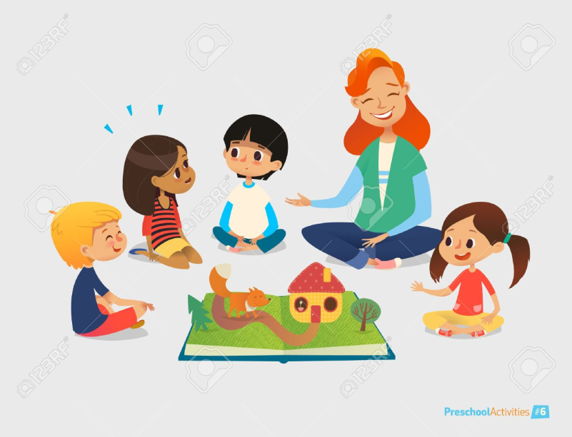
Uses
1. Now, at the time of speaking:
- You are learning English now.
- You are not swimming now.
- Are you sleeping?
- I am sitting.
- I am not standing.
- Is he sitting or standing?
- They are reading their books.
- They are not watching television.
- What are you doing?

Slide 3
Uses
2. Around the time of speaking:
- I am studying to become a doctor.
- I am not studying to become a dentist.
- I am reading the book Tom Sawyer.
- I am not reading any books right now.
- Are you working on any special projects at work?
- Aren't you teaching at the university now?

Slide 4
Uses
3. Near future plan (personal arrangement):
- I am meeting some friends after work.
- I am not going to the party tonight.
- Is he visiting his parents next weekend?
- Isn't he coming with us tonight?

Slide 5
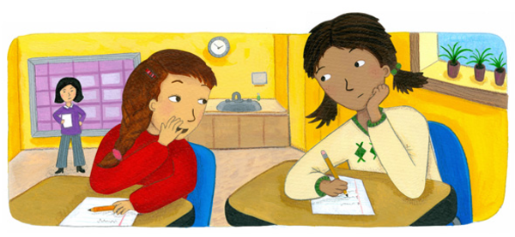
Uses
4. To express annoyance:
- You are always talking in class.

Slide 6
Key words
Now
At present
At this moment
Still
Still now

