Slide 1




Slide 2

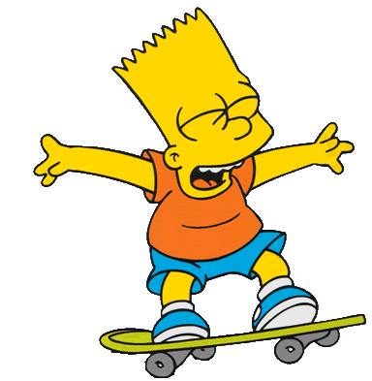
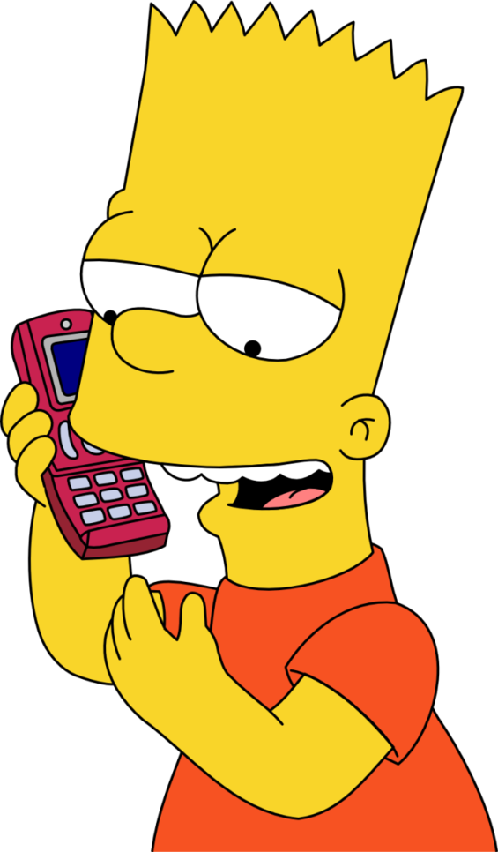
1/10
goes skating
Bart usually___________________
but he ________________________ now.
CHECK
NEXT
is talking on the phone

Slide 3

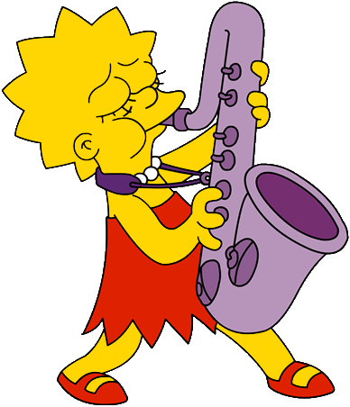
2/10
reads books
Lisa often__________________
but she _________________________ now.
CHECK
NEXT
is playing the saxophone

Slide 4
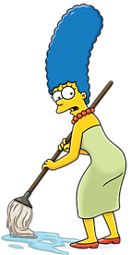
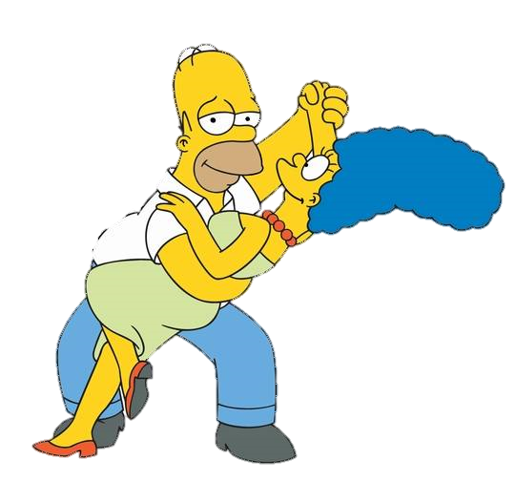
3/10
mops the floor
Marge often__________________ in the morning
but she ______________________right now.
CHECK
NEXT
is dancing with Homer

Slide 5
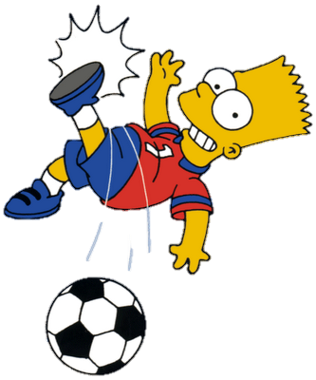
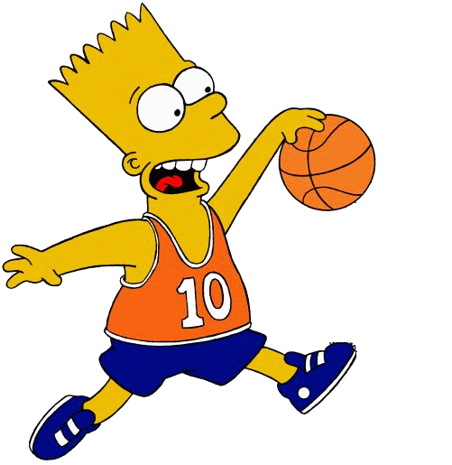
4/10
plays football
Bart sometimes___________________
but he _______________________ now.
CHECK
NEXT
is playing basketball

Slide 6
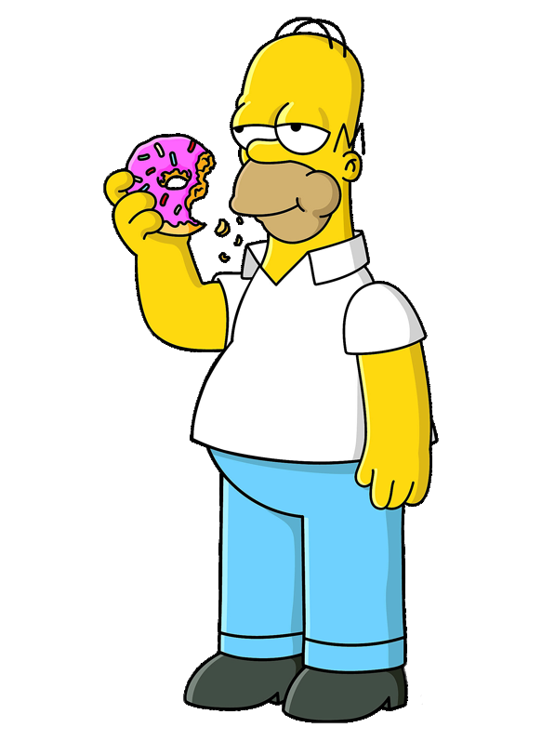
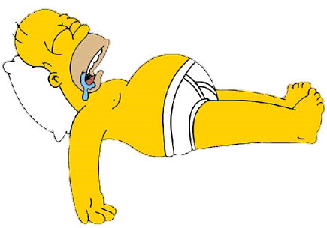
5/10
sleeps
Homer sometimes __________ in the morning
but he _______________________ now.
CHECK
NEXT
is eating a doughnut

Slide 7
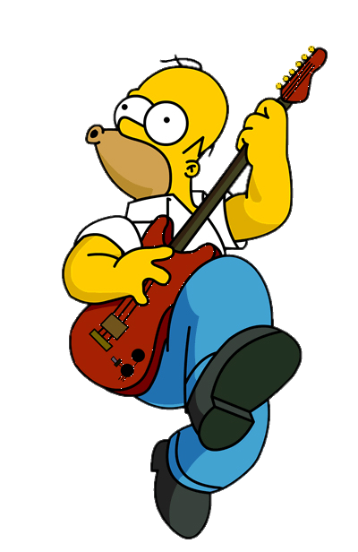

6/10
uses a computer
Homer often ____________________
but he ______________________ right now.
CHECK
NEXT
is playing the guitar

Slide 8
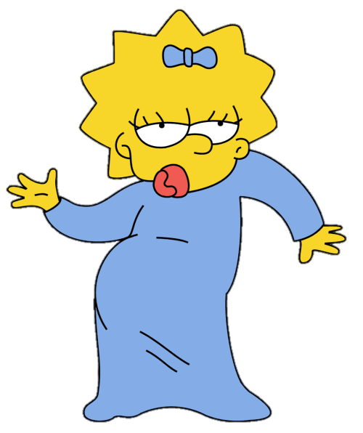
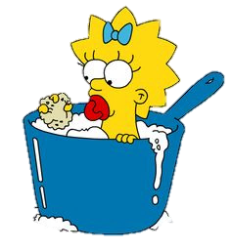
7/10
has a bath
Maggie ________________everyday
but she ________________ right now.
CHECK
NEXT
is dancing

Slide 9
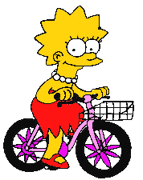

8/10
writes
Lisa ___________on her diary everyday
but she _____________________ now.
CHECK
NEXT
is riding her bike

Slide 10
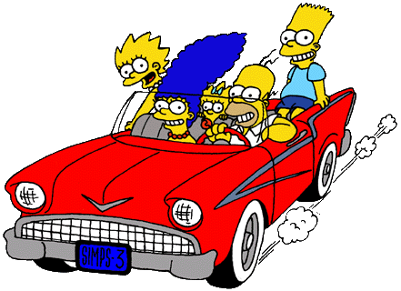
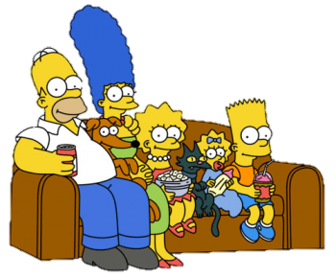
9/10
travel
The Simpsons sometimes _________ to the beach
but they _________________ at home now.
CHECK
NEXT
are watching TV

Slide 11

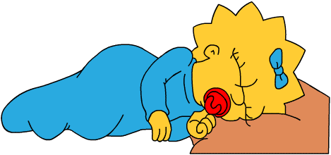
10/10
sleeps
Maggie always___________ well at night
but she _____________ at the moment.
CHECK
EXiT
is crying

