Slide 1
Present continuous
affirmative, negative & question
are they doing
What _____________ (they/do)?

Slide 2
Present continuous
affirmative, negative & question
‘s playing
He _________ (play) baseball.

Slide 3
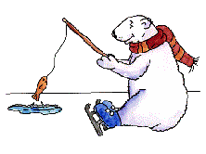
Present continuous
affirmative, negative & question
isn’t eating
The bear ____________ (not/eat).

Slide 4
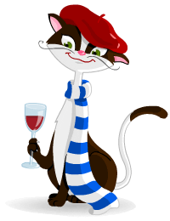
Present continuous
affirmative, negative & question
isn’t drinking
The French cat _____________
(not/drink) water.

Slide 5
Present continuous
affirmative, negative & question
‘s playing
She ___________(play) golf.

Slide 6

Present continuous
affirmative, negative & question
What _____________ (the bull/do)?
‘s the bull doing

Slide 7
Present continuous
affirmative, negative & question
isn’t making
She _____________ (make/dinner)

Slide 8
Present continuous
affirmative, negative & question
What ______________ (he/do)?
is he doing

Slide 9

Present continuous
affirmative, negative & question
Is the phone ringing
__________________
(the phone/ring)?

Slide 10
Present continuous
affirmative, negative & question
‘s checking
He ______________ (check)
her teeth.

Slide 11
Present continuous
affirmative, negative & question
aren’t walking
They ______________ (not/walk)
in the country.

Slide 12
Present continuous
affirmative, negative & question
is arriving
Mrs. Green ____________ (arrive) at the hotel.

Slide 13
Present continuous
affirmative, negative & question
Is she swimming
_________________ (she/swim) ?

Slide 14
Present continuous
affirmative, negative & question
isn’t watching
She ____________ (not/watch) television.

Slide 15
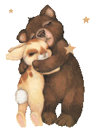
Present continuous
affirmative, negative & question
aren’t fighting
They _____________ (not/fight)

Slide 16
Present continuous
affirmative, negative & question
Is he working
_______________ (he/work)?

Slide 17
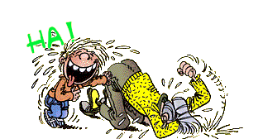
Present continuous
affirmative, negative & question
The boys _____________ (laugh)
are laughing

Slide 18
Present continuous
affirmative, negative & question
isn’t drinking
She _____________ (not/drink) tea?

Slide 19

Present continuous
affirmative, negative & question
is escaping
The burglar ___________ (escape).

Slide 20
Present continuous
affirmative, negative & question
‘re walking
They ____________ (walk)
in the country.

Slide 21
Present continuous
affirmative, negative & question
Who _______________
(she/examine)?
is she examining

Slide 22
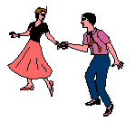
Present continuous
affirmative, negative & question
are dancing
John & Julie ___________ (dance).

