Slide 1
Flowcharts
Algorithms
Python

Slide 2
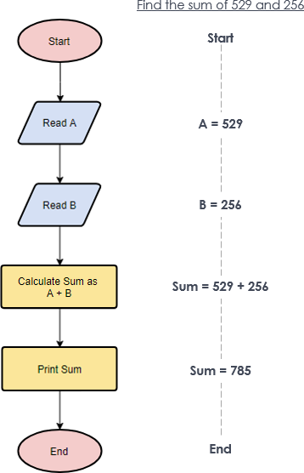
Flowchart definition :
A diagram that shows the step-by-step progression through a procedure or system, especially using connecting lines and a set of conventional symbols.
A set of symbols put together with commands that are followed to solve a problem .

Slide 3
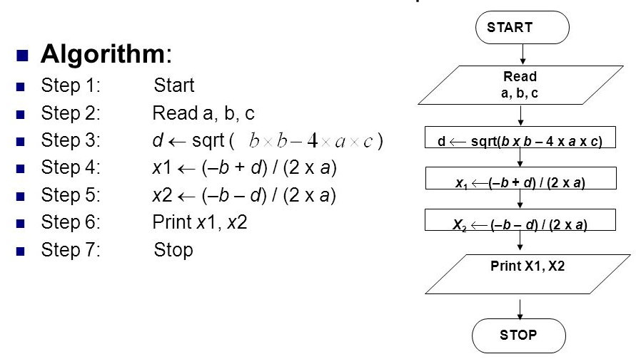
What is the difference between Algorithms and Flowcharts?
Algorithms and flowcharts are two different tools used for creating new programs, especially in computer programming. An algorithm is a step-by-step analysis of the process, while a flowchart explains the steps of a program in a graphical way

Slide 4
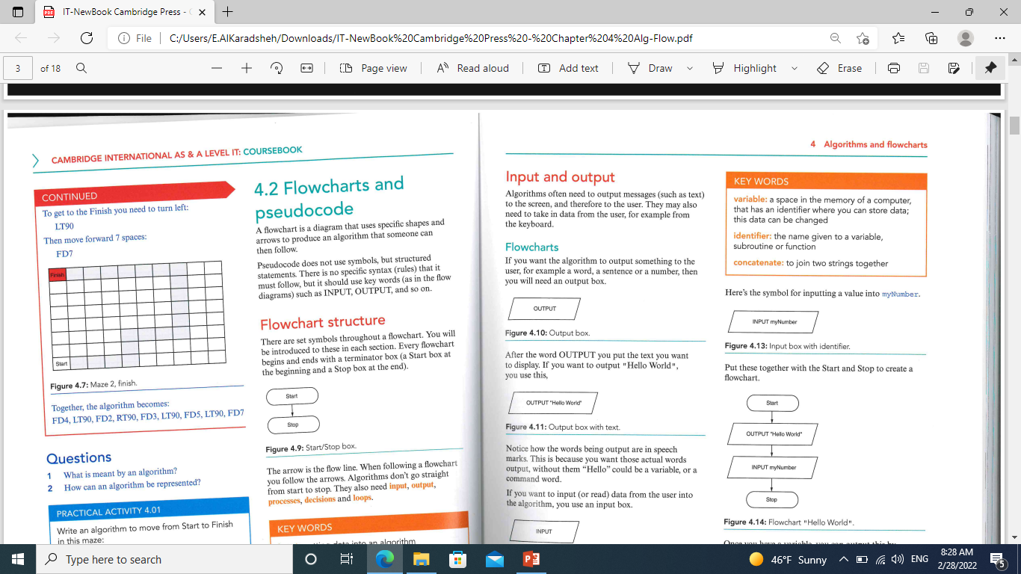
Flowcharts and Pseudocode
A flowchart is a diagram that uses specific shape and arrows to produce an algorithm that someone can then follow.
Pseudocode does not use symbols, but structured statements. There is no specific syntax (rules) that it must follow, but it should use key words.
Flowchart structure: Every flowchart begins and ends with a terminator box (a starter box at the beginning and a Stop box at the end).

Slide 5
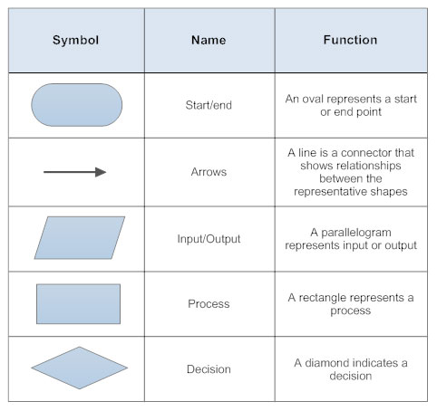
The arrow is the flow line. When following a flowchart you follow the arrows. Algorithms don’t go straight from start to stop. They also need input, output, processes, decisions and loops.

Slide 6
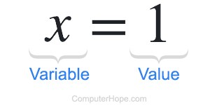
Variables :
Variables: a space in the memory of computer, that has an identifier where you can store data; this data can be changed.
Identifier: the name given to a variable, subroutine of function.

Slide 7
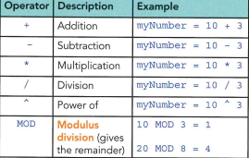
Mathematical Operators:

Slide 8
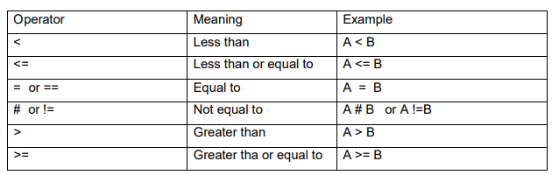
Relational (Comparison) Operators

