Slide 1
https://wordwall.net/ar/resource/21643456

Slide 2
5
3
4
3

Slide 3
>

Slide 6
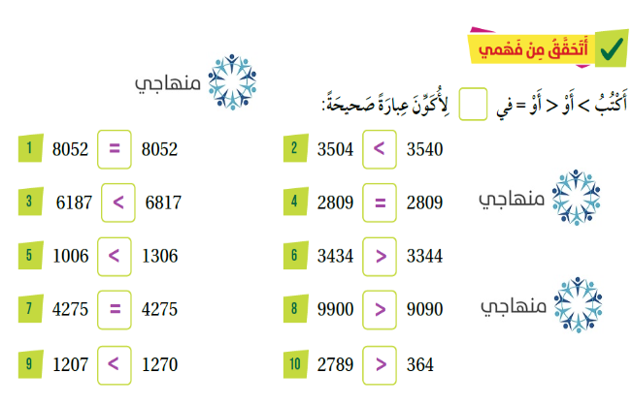

Slide 8
