Slide 1
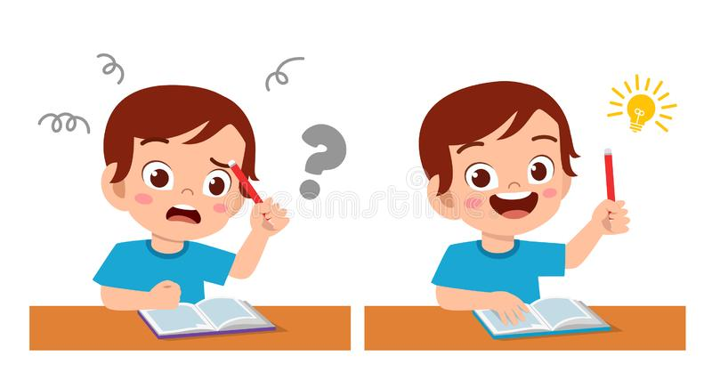
Jolly Phonics
Tricky Words

Slide 2
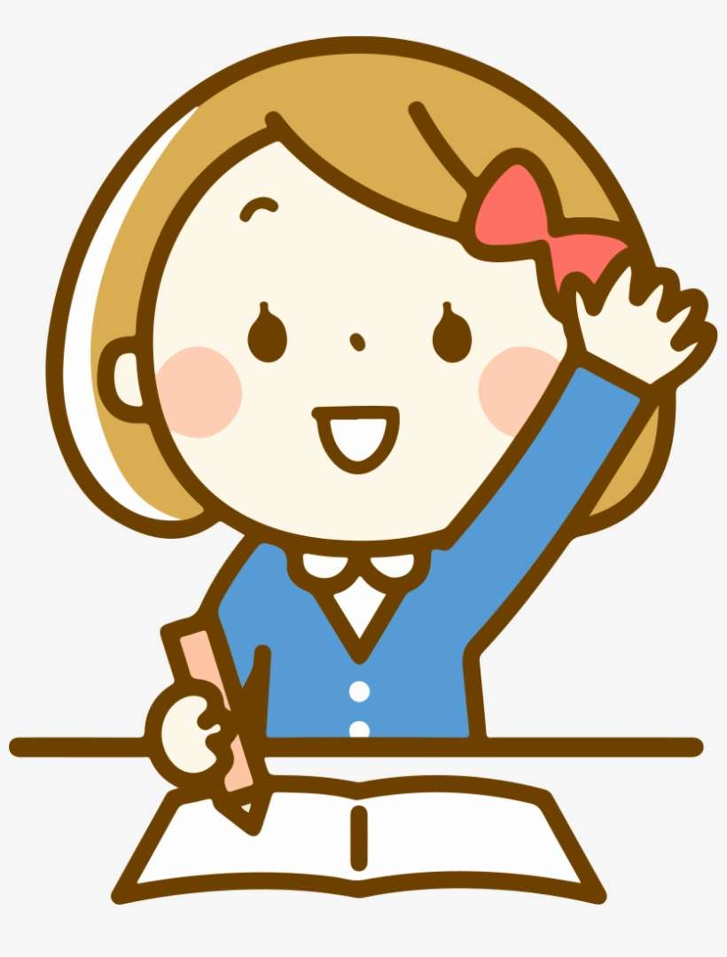
Let’s review some words together!

Slide 3
I

Slide 4
the

Slide 5
he

Slide 6
do

Slide 7
she

Slide 8
me

Slide 9
where
was

Slide 10
we

Slide 11
to

Slide 12
be

Slide 13
are

Slide 14
all

Slide 15
you

Slide 16
come

Slide 17
your

Slide 18
so

Slide 19
some

Slide 20
said

Slide 21
here

Slide 22
no

Slide 23
they

Slide 24
there

Slide 25
by

Slide 26
go

Slide 27
one

Slide 28
my

Slide 29
only

Slide 30
old

Slide 31
like

Slide 32
have

Slide 33
live

Slide 34
give

Slide 35
little

Slide 36
down

Slide 37
what

Slide 38
when

Slide 39
why

Slide 40
where

Slide 41
who

Slide 42
which

Slide 43
Great job!

