Slide 1
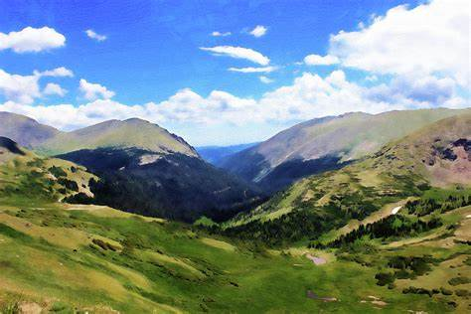
BIOMES
UNIT ONE

Slide 2
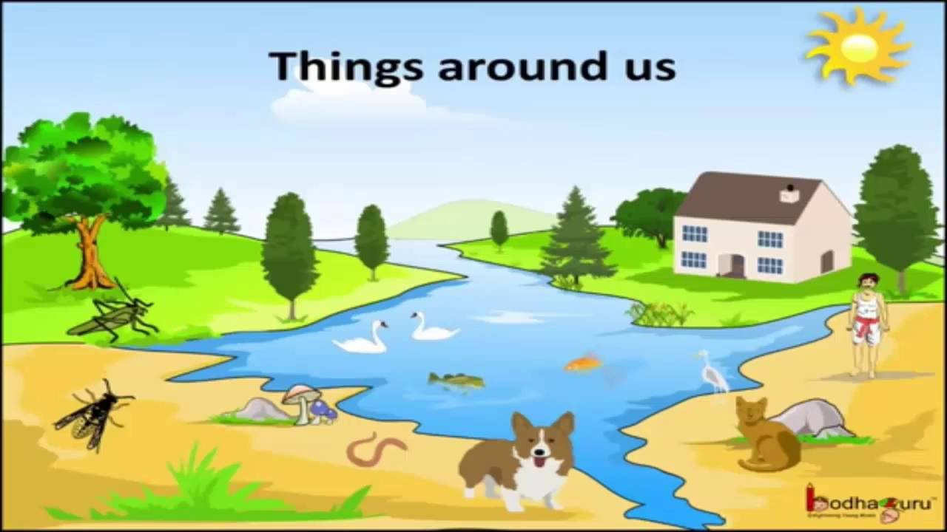

Slide 3
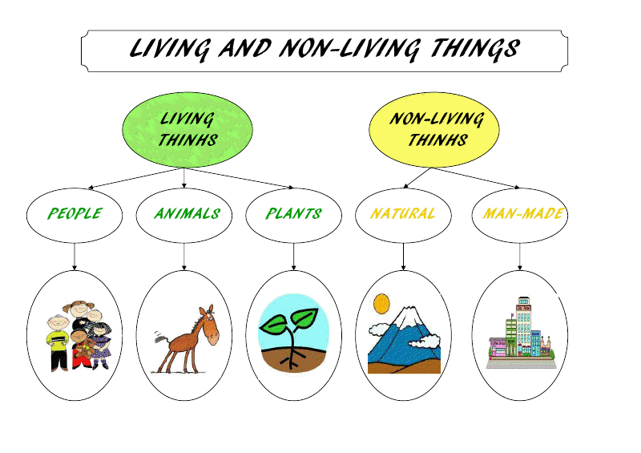

Slide 4
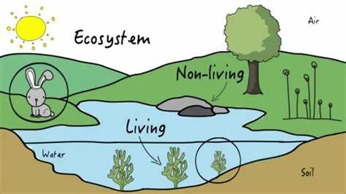
Ecosystem
Includes all things, living and nonliving, that interact with one another in an area of land.
It can be as small as the area under the rock or as large as a mountain.

Slide 5
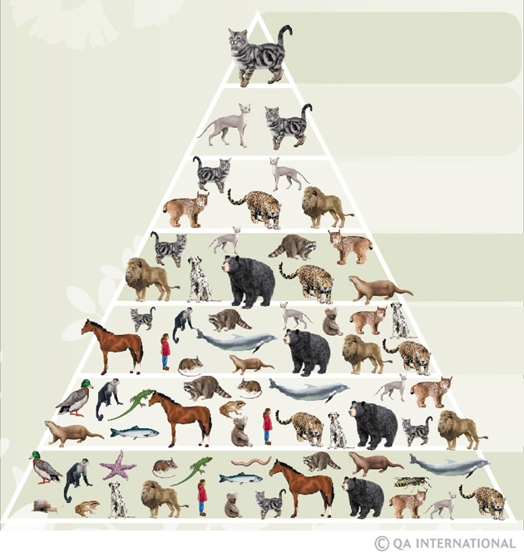
A species of any animal or plant survives because it adapts to the habitat where it lives.
A species is a group of plants or animals with the same characteristics.

Slide 6
Biome
A biome is made up of different ecosystems found together in a single geographical zone that share the same climate conditions.
The five major life biomes are:
1- Tundra
2- Forests
3- Grasslands
4- Deserts
5-Aquatic biomes
Some of these have moderate conditions, others have extreme conditions like Tundra and Deserts.

Slide 7
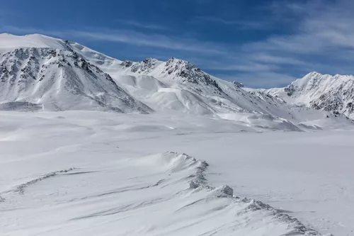
1. Tundra

Slide 8
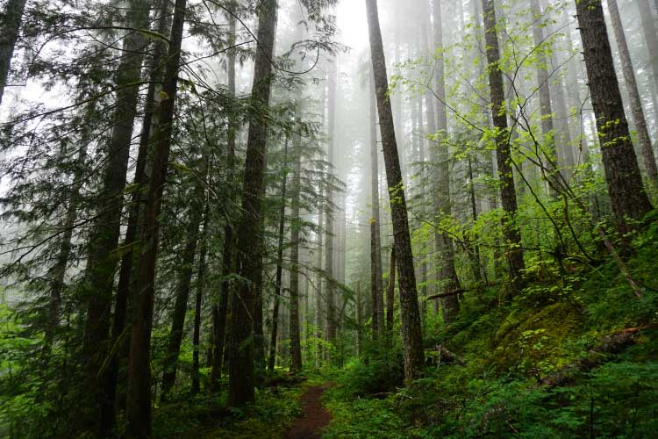
2. Forests:

Slide 9
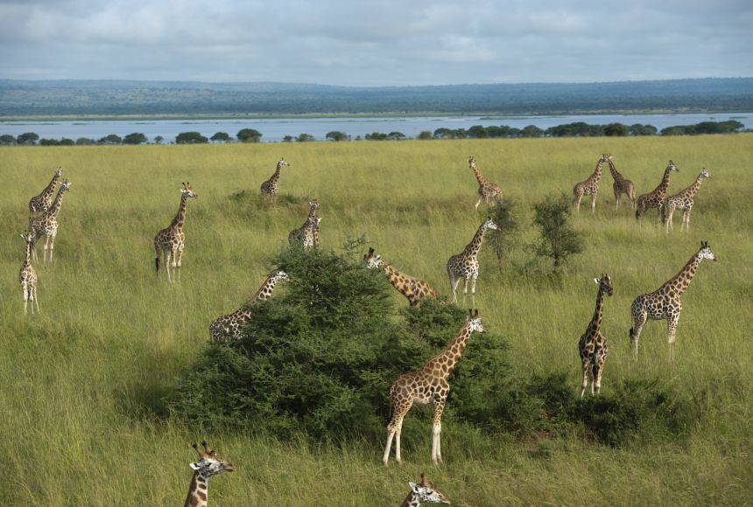
3. Grasslands:

Slide 10
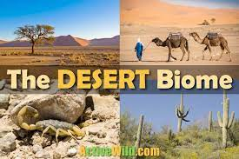
4. Deserts:

Slide 11
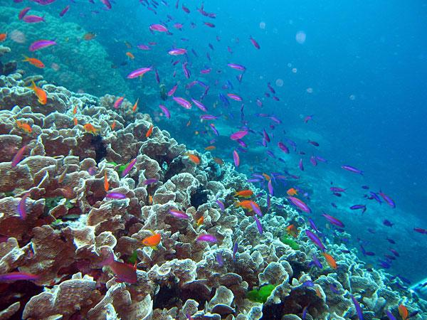
5. Aquatic Biomes:

Slide 12
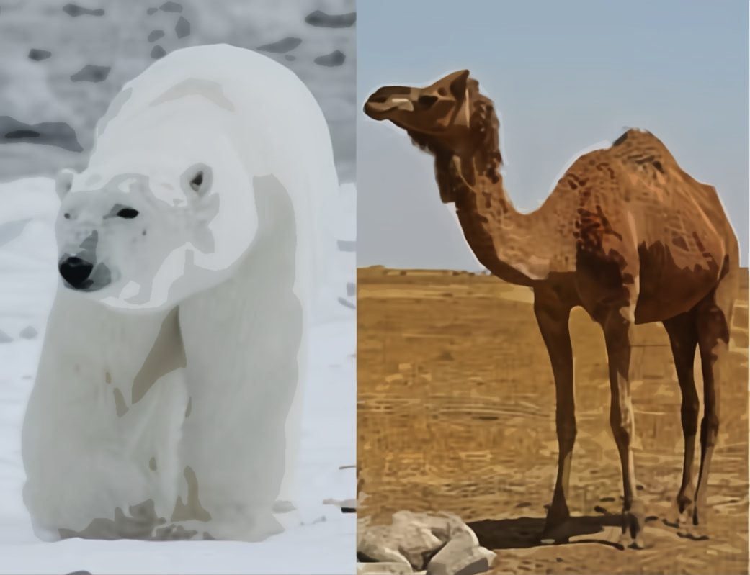
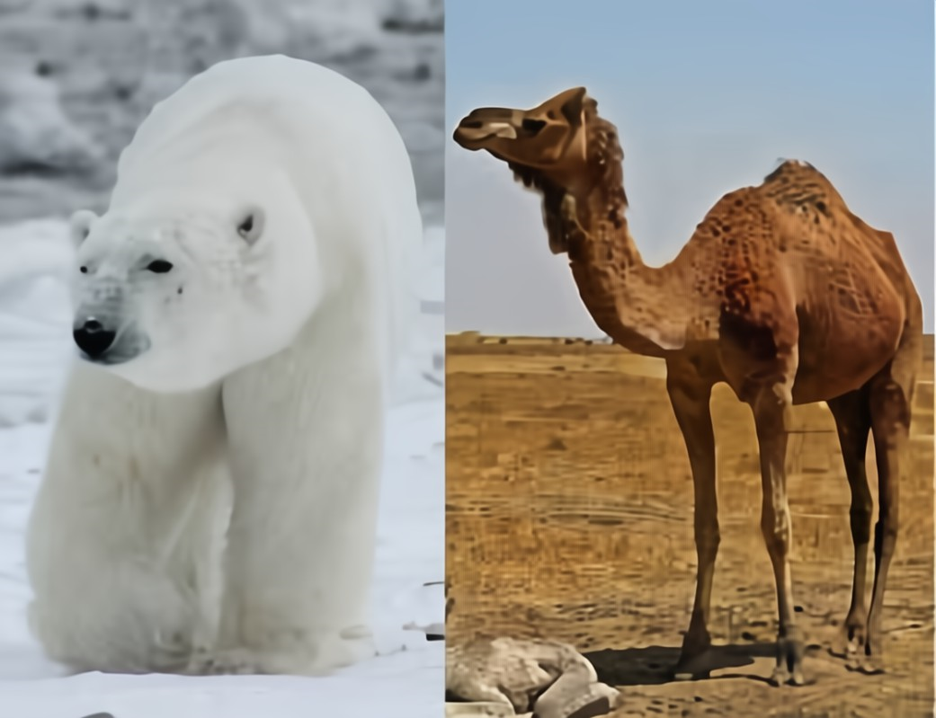
Examples of extreme conditions and comparison between Tundra and Deserts:
Desert
Tundra
Hot and dry.
Temperatures rarely go above freezing.
Very little amount of water.
Windy and sandstorms.
A lot of the prey lives in the ocean.
Long distances between food and water supplies.
Very bright sunlight reflecting off the snow.

Slide 13
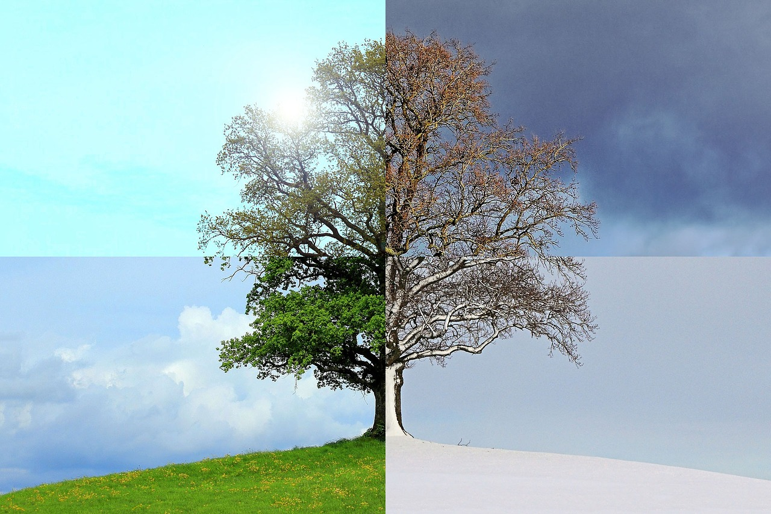
What is adaptation?
Adaptation is the physical characteristic of an organism that helps it to survive better in the surrounding environment.

Slide 14
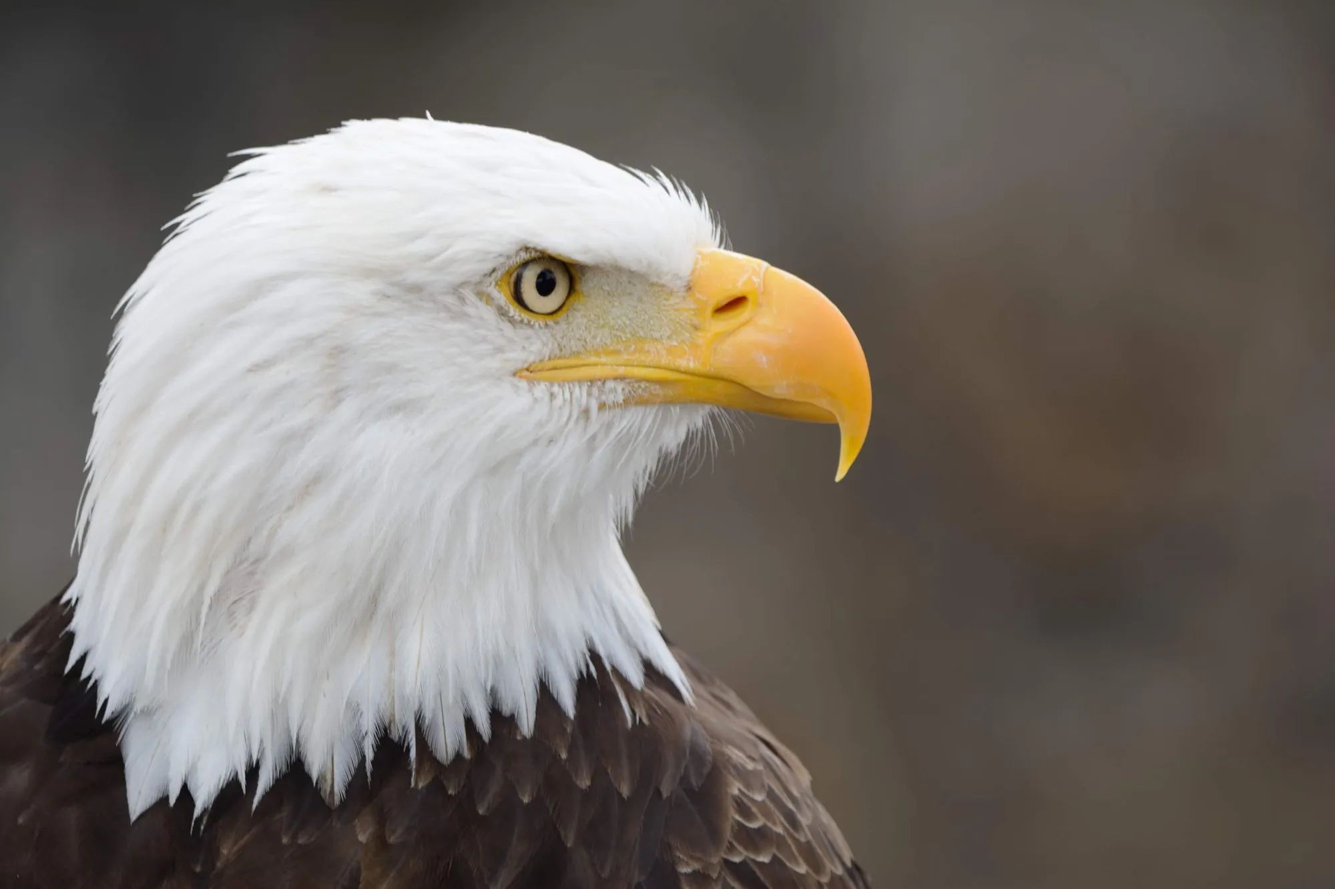
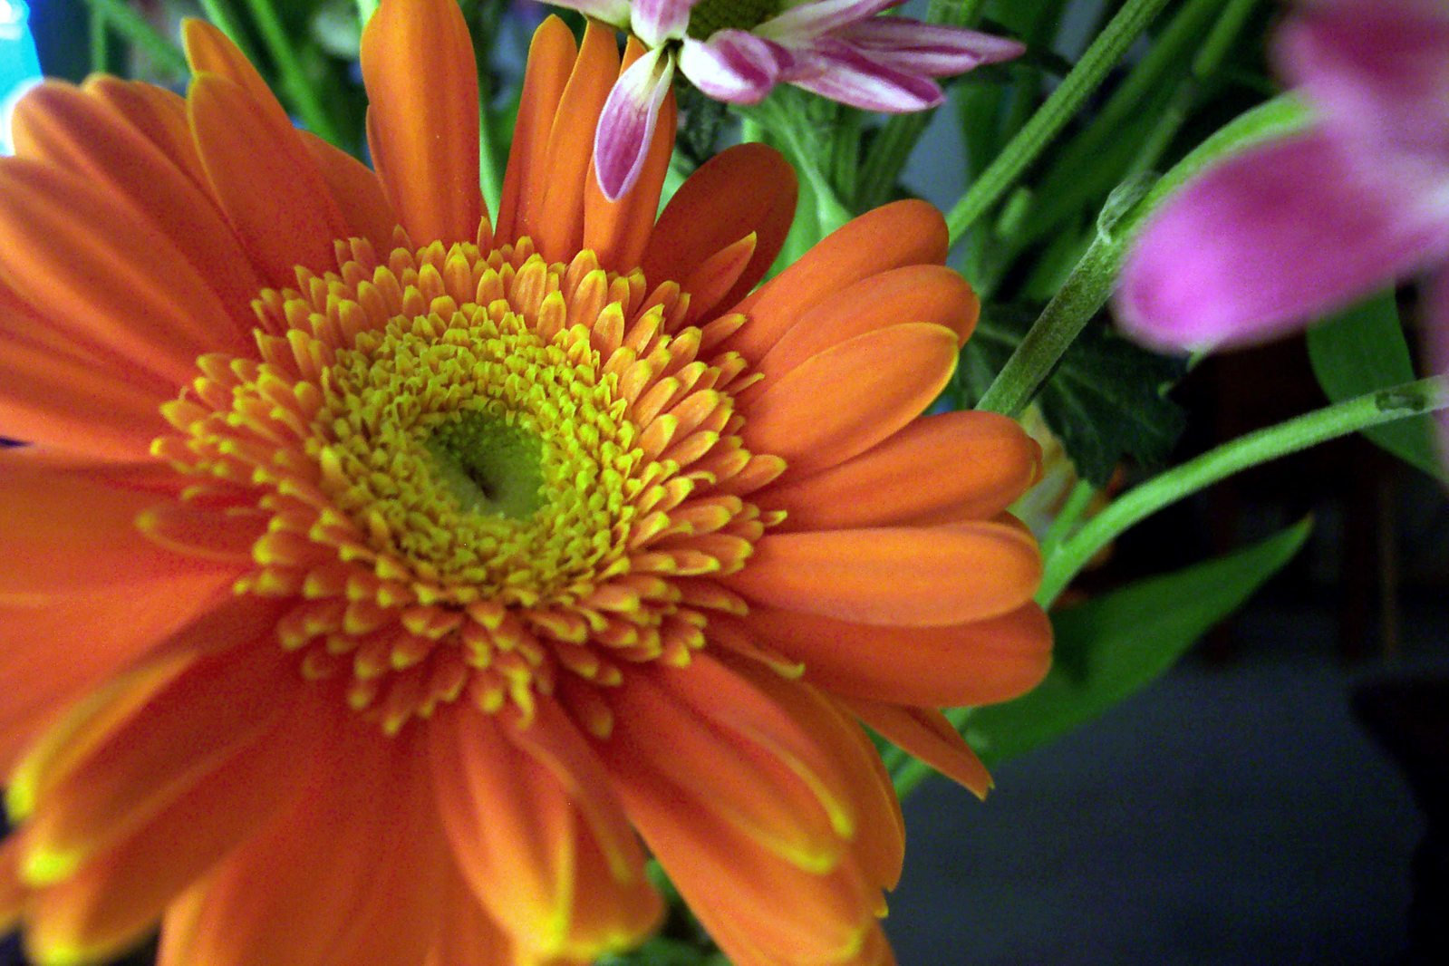
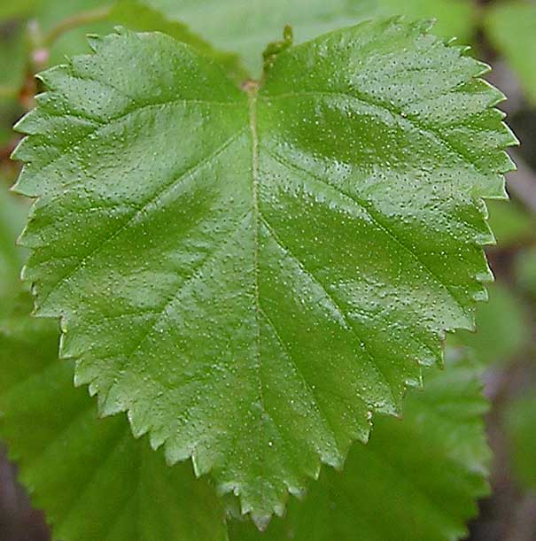
Examples of adaptations that some animals or plants have:
Birds have different shaped beaks according to their diet,
examples: a long curved beak is for eating nectar from flowers,
where a curved sharp beak is for eating flesh (meat).
In plants, the bright colored petals of the flower
attract insects for pollination.
In plants, most leaves surfaces are flat to take the
maximum amount of light needed to make their food.

Slide 15
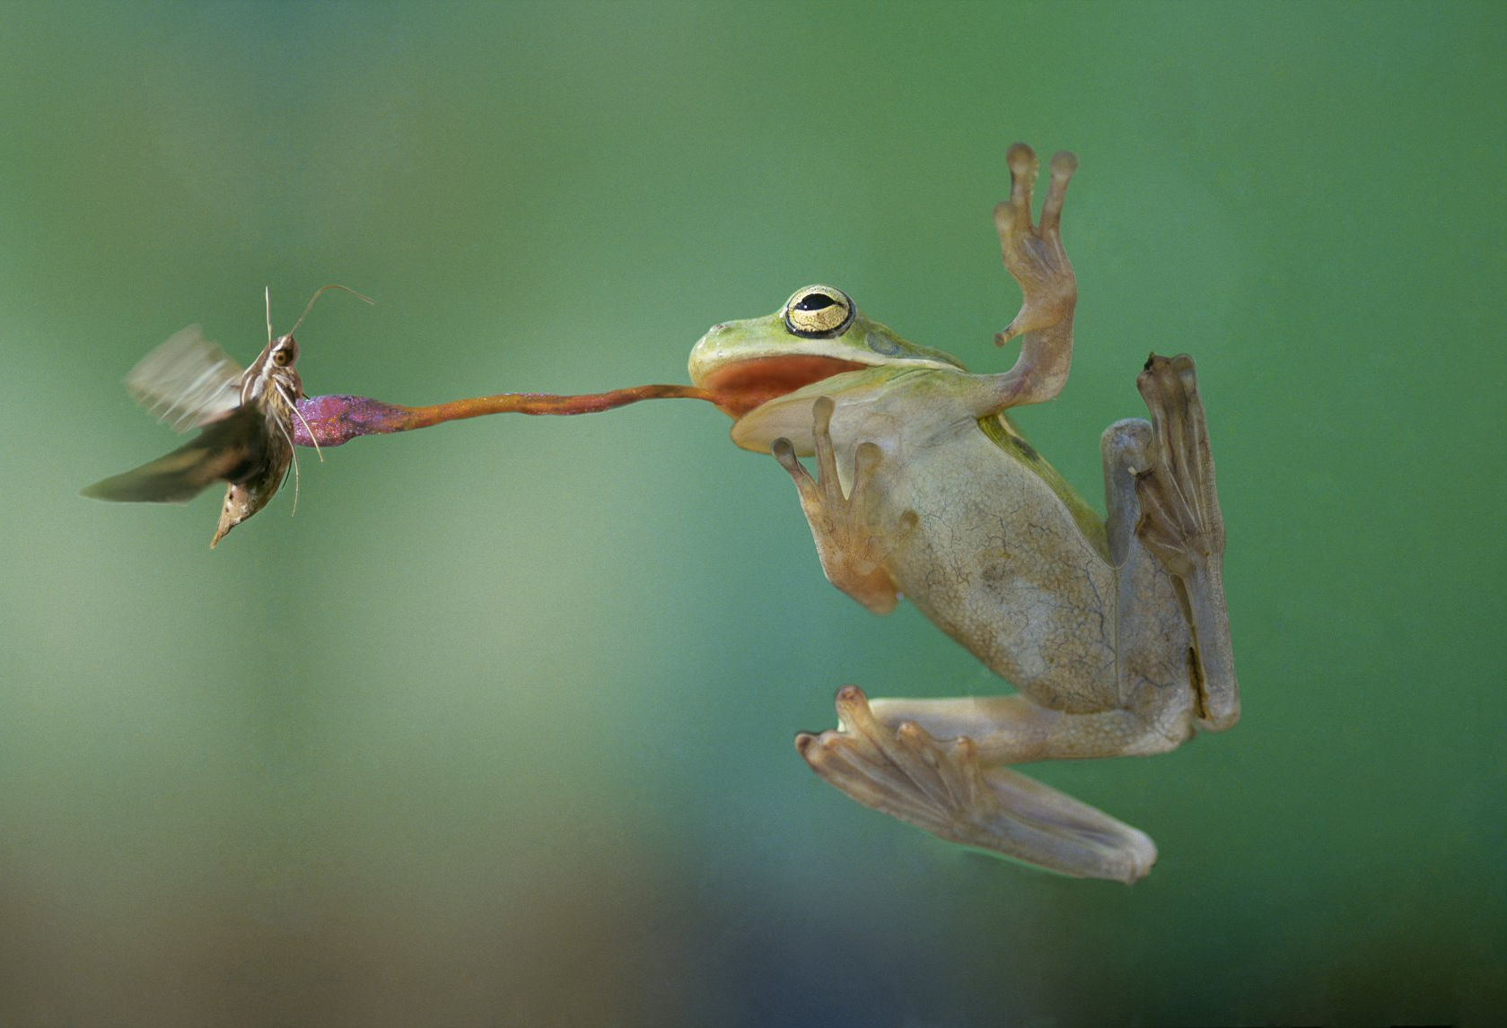
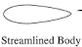
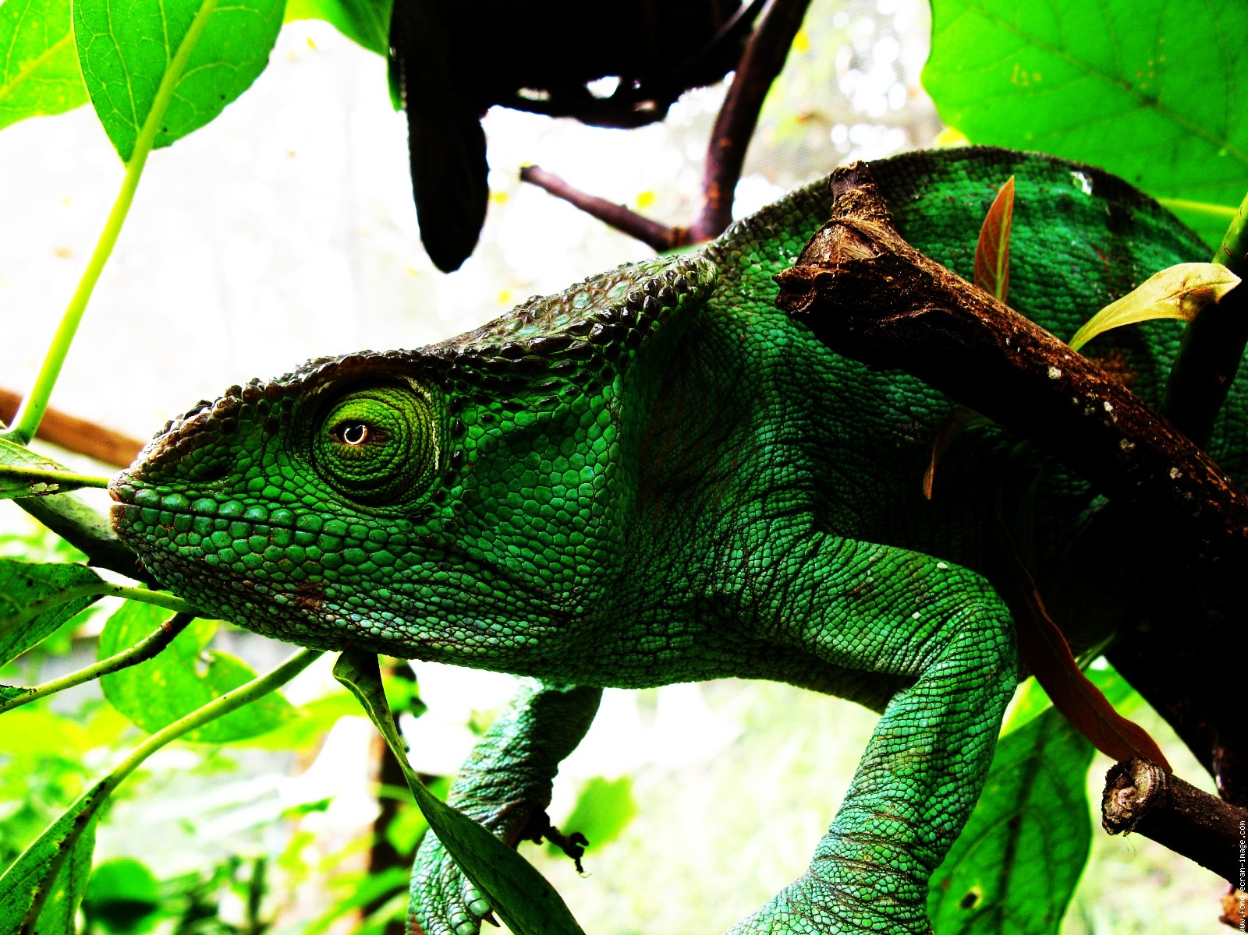
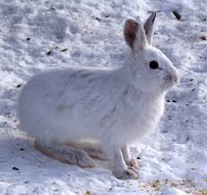
A frog has long sticky tongue that
helps it to catch insects.
Birds have streamlined body shape to
fly easily.
Camouflage is an adaptation that
allows an organism to hide in the
surrounding.
Examples: a white rabbit hides in
the snow.

Slide 16
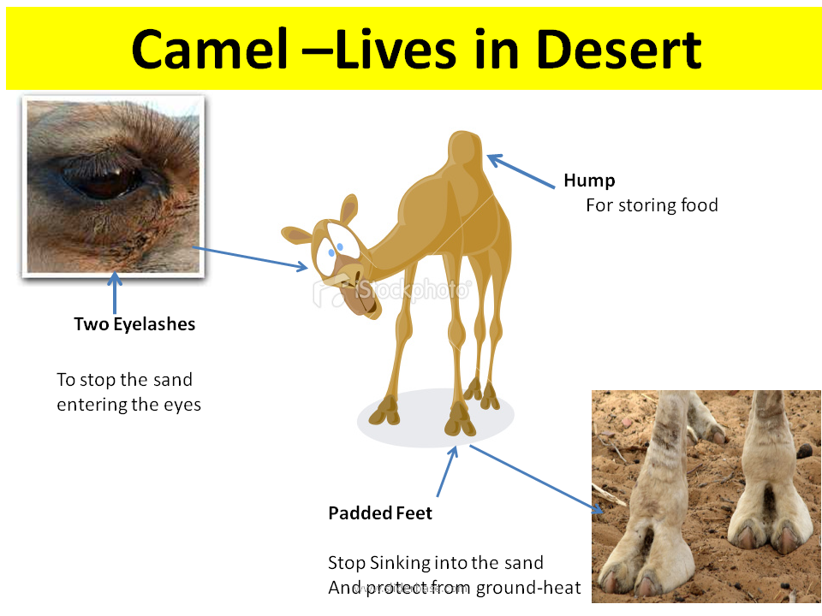
Adaptations of a Camel
For storing fat.
To protect their eyes from the sand.
Thick fur:
To protect against the sun’s heat during the day and to provide warmth during night.
To help walking in the sand.

Slide 17
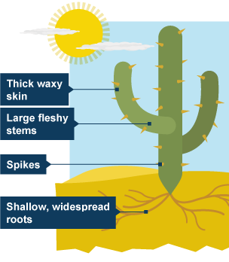
Cactus adaptation:
Cactus have spines instead of leaves. These minimize the surface area and so reduce water loss.
Cactus have widespread root systems that can collect water from a large area.
- Cactus have large stems that can store water.

Slide 18
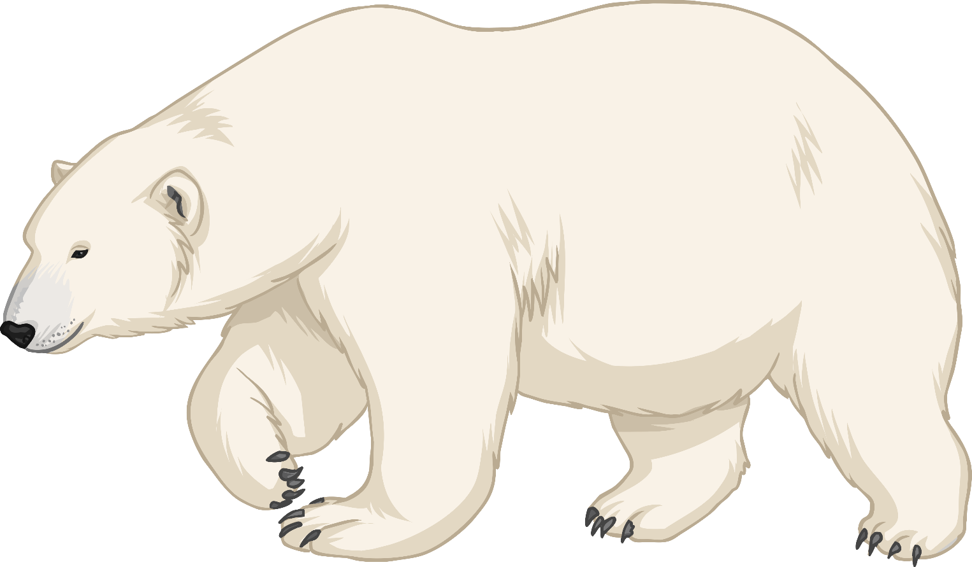
Adaptations of a Polar Bear
Transparent fur to camouflage in the snow
Long, thick, curved claws so it can walk on snow.
Thick layers of fur and body fat to keep it warm.
Large paws so it can walk on the snow.

