Slide 1
The Key to Writing Suspense

Slide 2
Ellipses
An ellipse is a series of three dots used to show an omission from written text. It can be used in writing to create suspense.
Full quotation: "Today, after hours of careful thought, we voted the bill."
With ellipsis: "Today … we voted the bill."

Slide 3
More Examples:
I stood at the doorway to the strange old house … I Don't remember entering … the hallway reeked of something I couldn't quite place.
Activity: Imagine you are in the house and you walk into the kitchen. Write a paragraph describing what you see and include ellipses in several places.

Slide 4
Word Cloud
This can be the part of the presentation where you can introduce yourself, write your email…

Slide 5
01
cliff-hanger
A tense and exciting ending to an episode of a story.

Slide 6
02
half-hearted
Not very keen or enthusiastic.

Slide 7
03
Murder-suspense whodunit
A psychological thriller story.

Slide 8
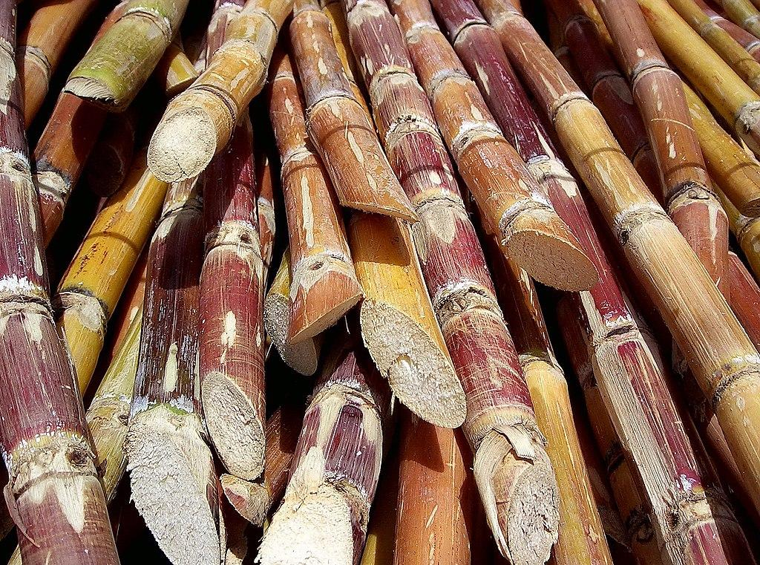
04
Sugar cane
The plant from which sugar is obtained.

Slide 9
Hyphens
Hyphens join two or more words to show that they have a combined meaning, creating compound nouns, adjectives or verbs.
Such as:
Fire-fighter
Part-time
Test-drive
These words are always hyphenated.

Slide 10
Activity:
Which of the following are fixed compounds (they have to be hyphenated) and which are not?
short-term
sun-shine
peanut-butter
full-scale
old-fashioned
re-collect
rock-hard
deep-fried
mail-box

Slide 11
Elements of Suspense/Building Suspense
Simple Sentences
2. Compound Sentences
3. Complex Sentences
4. Ellipses
5. Hyphenated compound
6. Time pressure
7. Likeable hero(ine)
9. cliff-hanger
8. Familiar setting
10. Questions
11. Dilemma
12. anticlimax

