Slide 1
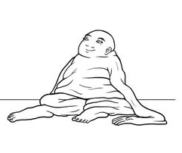
Meet Phil

Slide 2
Pretest

Slide 4
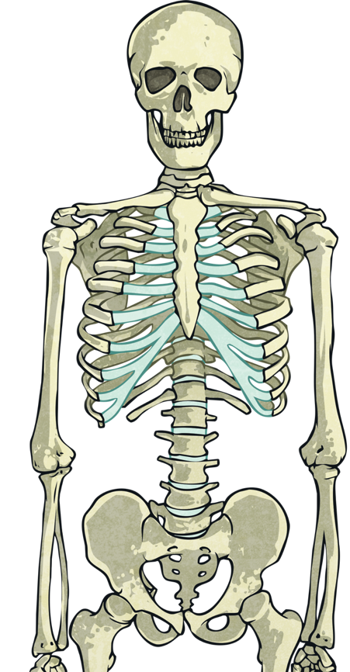
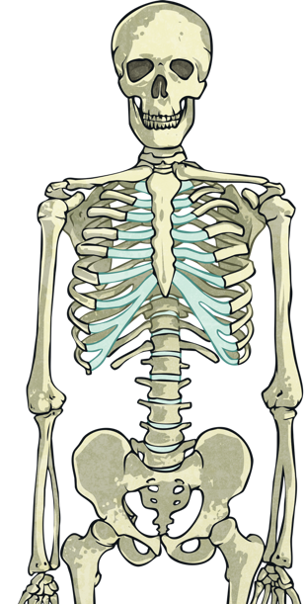
What is a skeleton?
Every human and animal is born with a skeleton. A skeleton is made up of bones, cartilage and joints.
Our skeleton grows as we get older.

Slide 5
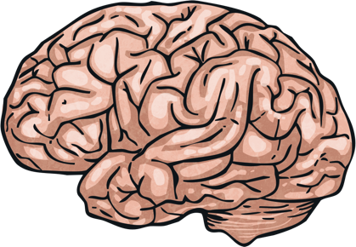
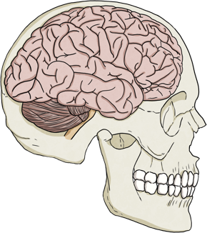
Why do we need a skeleton?
Our skeleton helps us to do many things.
It supports the body
It protects the organs
It allows movement
It produces blood cells
Can you think of the structure that protects our brain?
That’s right, it’s the cranium!

Slide 6
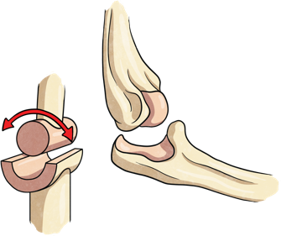
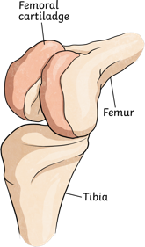
Parts of the skeleton
The skeleton is made up of different parts. Click on the images to find out more information on the parts mentioned below.
Bones
Joints
Cartilage

Slide 7
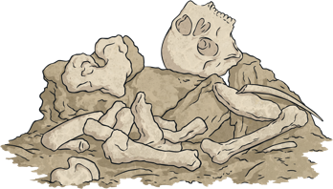
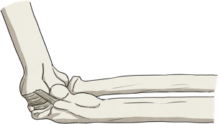
Bones
Bones make up a lot of the skeleton. They are alive and always growing. We have many different bones in our bodies.
Bones are made up of hard minerals, such as calcium. The outside of a bone is smooth and hard and the inside of a bone is a spongy and porous material. At the centre of a bone is the bone marrow.
A baby is born with around 300 bones and as the baby grows into an adult the bones fuse together and the number of bones an adult then has is 206.
Back

Slide 8
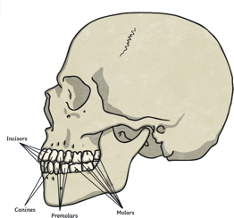
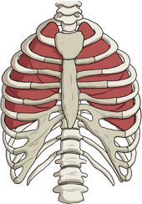
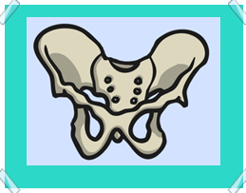
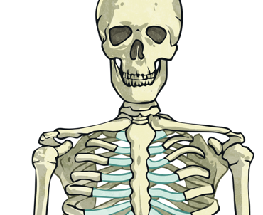
Some bones in the skeleton include:
Back
Cranium and jaw
Femur
Ribs and sternum
Clavicle
Humerus
Pelvis

Slide 9
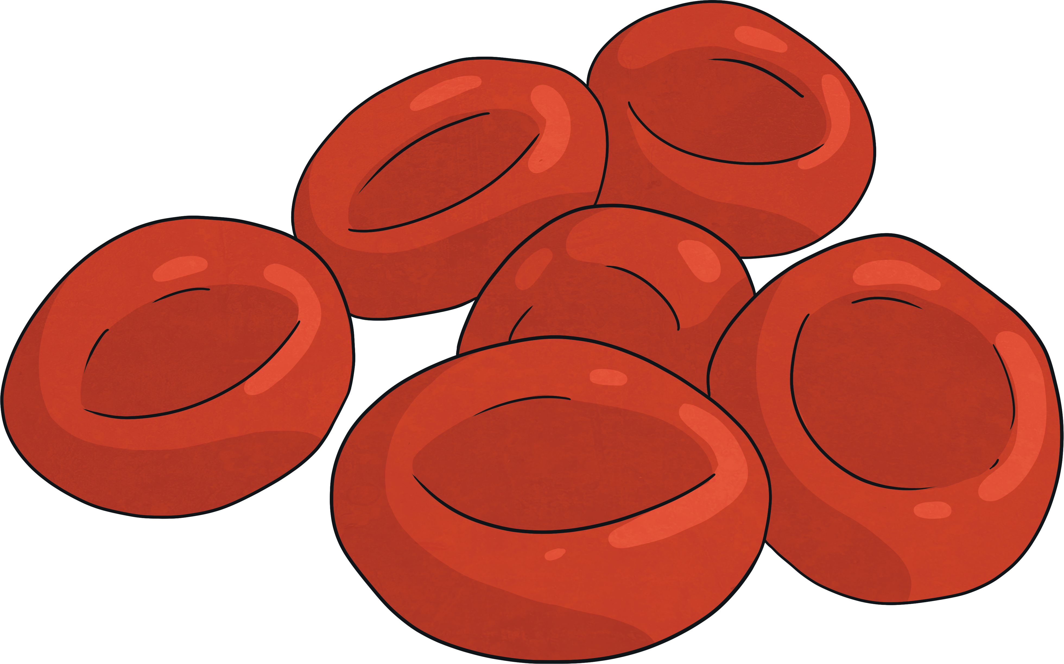
Bone Marrow
The red bone marrow inside bones is responsible for producing red cells, white cells and platelets, all of which are essential for a healthy body.
Red blood cells carry oxygen to tissues and organs.
White cells help fight infections.
Platelets aid with blood clotting.
The highest number of red blood cells are formed in flat bones.
Bone marrow transplant help people with medical conditions that prevent making blood cells.

Slide 10
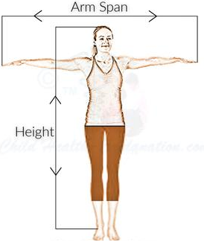
Using bone measurements
If you stretch your arms as wide as you can and measure your arm span, this will probably be similar to your height.
Height = (length of femur (m) x 2.6) + 65
Back

