Slide 2
Short sound Ee

Slide 3
At the beginning of the words
egg elephant

Slide 4
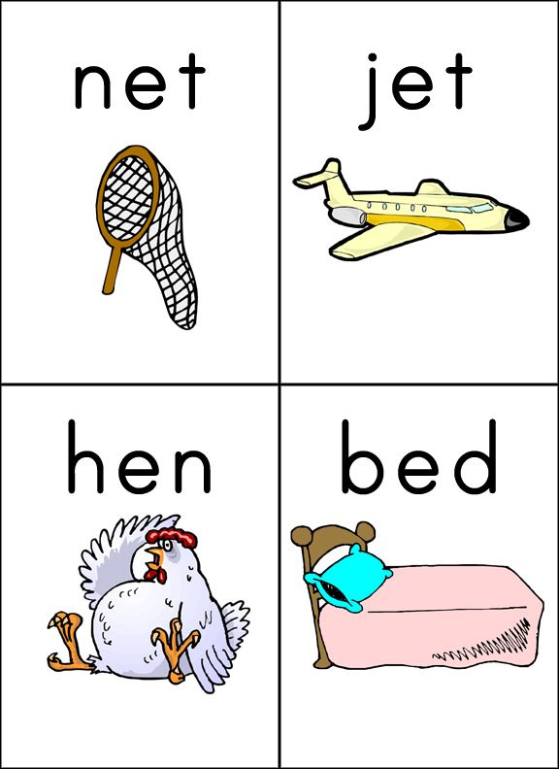
In the middle of the words

Slide 5
long sound Ee

Slide 6
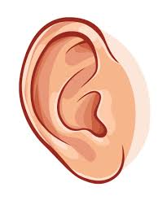
At the beginning of the words
ear eagle

Slide 7
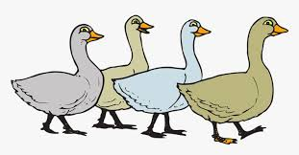
In the middle of the words
tree geese green

