Slide 1
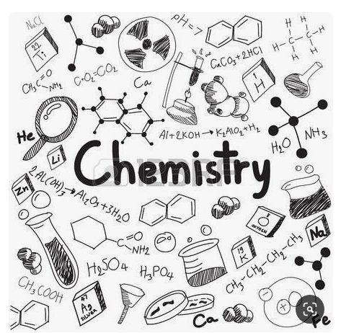

Lesson: (states of matter)
Grade: 6CS

Slide 2
What is matter?
The three states of matter
Matter is anything that has mass and takes up space .
What is matter made from?
The different types of matter (stuff) that things are made from are materials.
All materials are made up of ting particles.
Solid
Liquid
Gas

Slide 3
Substance or material
Most materials are mixtures. Ex: Wood, soil and most rocks.
But some materials are not mixtures. They have just one type of matter.
A material that has one type of matter is called a substance. Ex: Silver, sugar, diamond, pure water.

Slide 4
What are properties
Every substance has its own properties. The properties of a substance describe what it is like and what it does.
The properties of a substance depend on five factors:
What its particles are like
How its particles are arranged
How its particles move
How far apart the particles are
How strongly its particles hold together

Slide 5
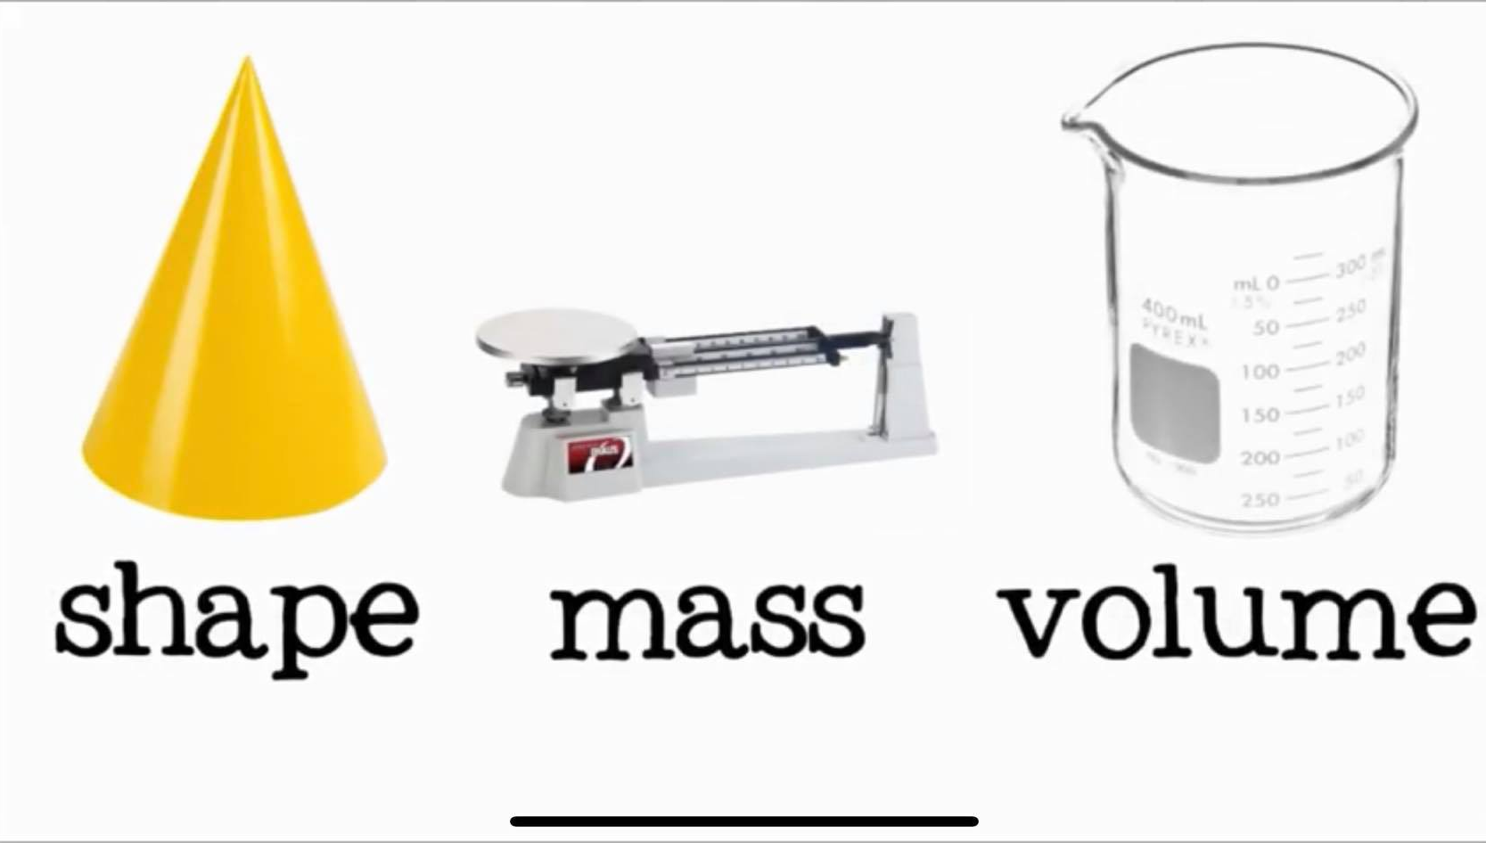
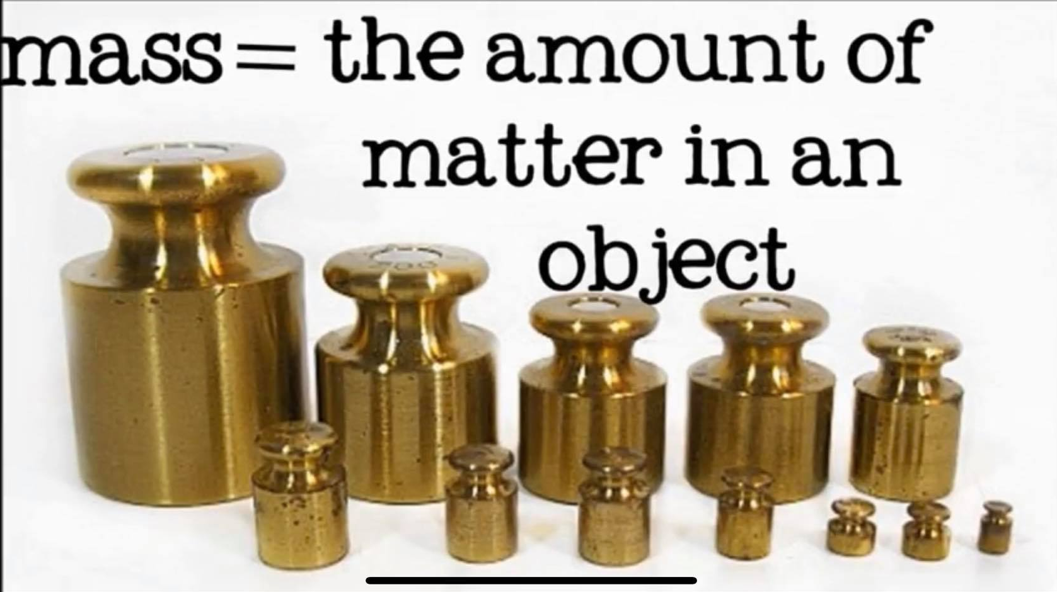
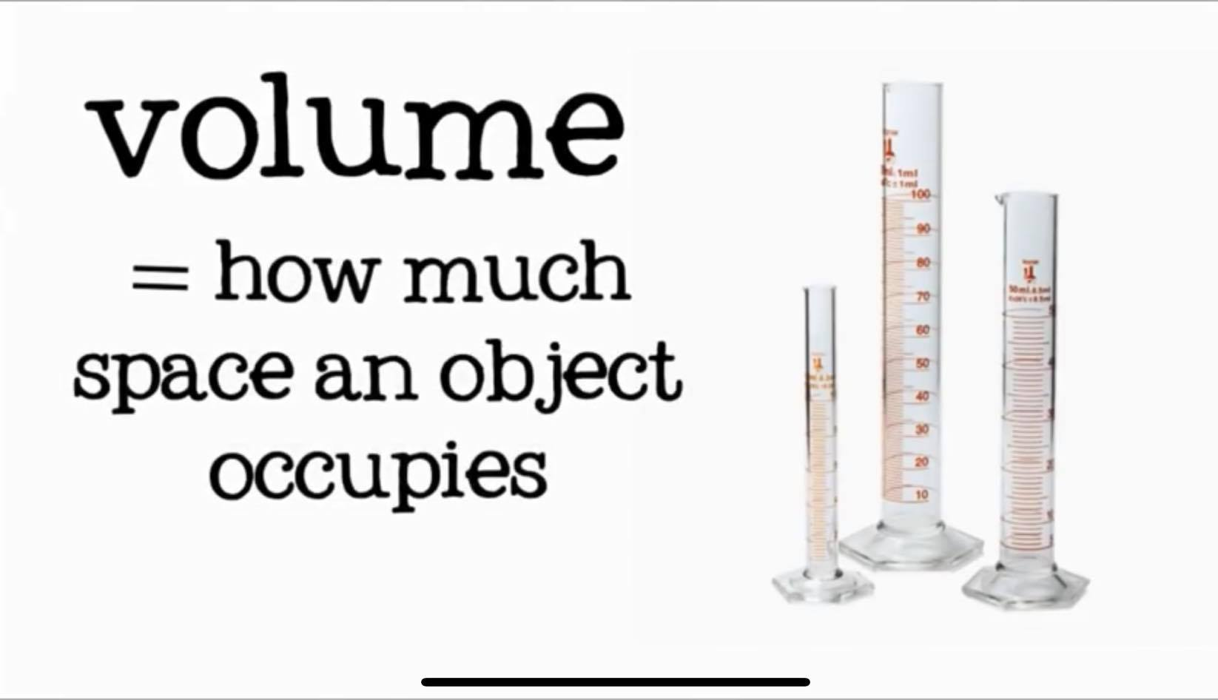

Slide 6
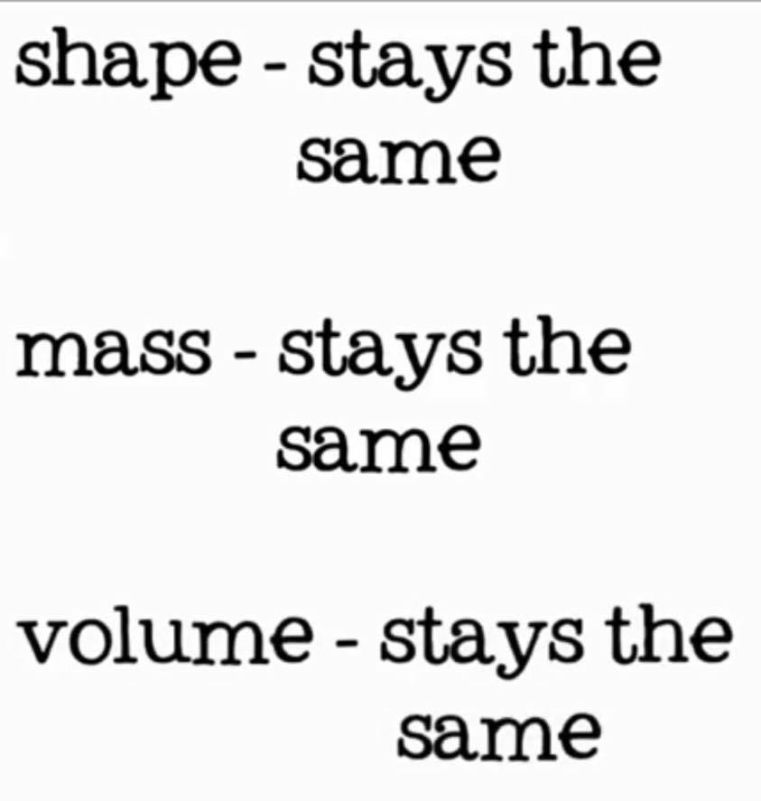

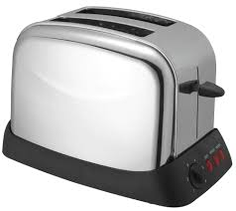
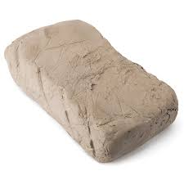
Solids
A solid is matter that has definite size and shape.
They could be hard
Or soft

Slide 7
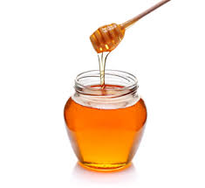
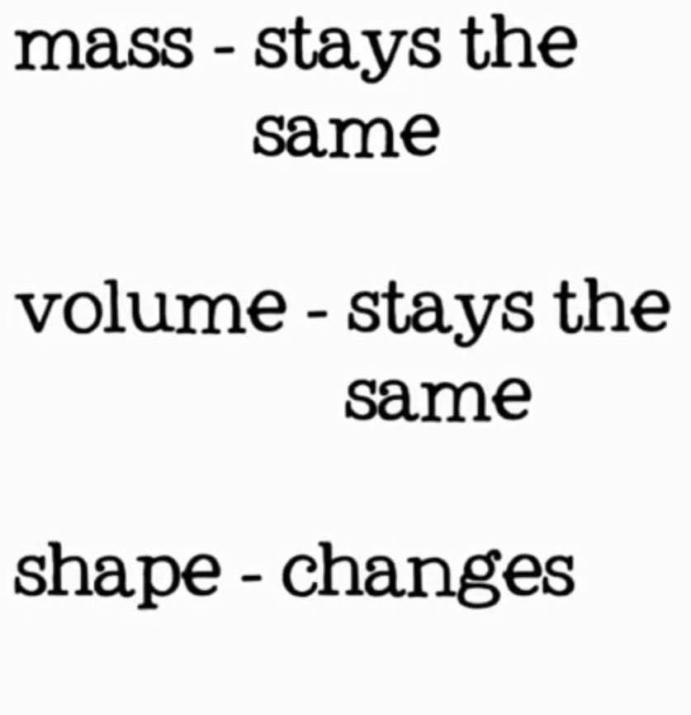
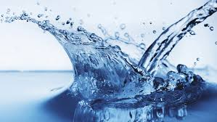
Liquids
A liquid takes the shape of any container.
They could be thick
Or thin

Slide 8
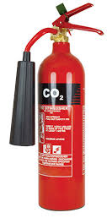

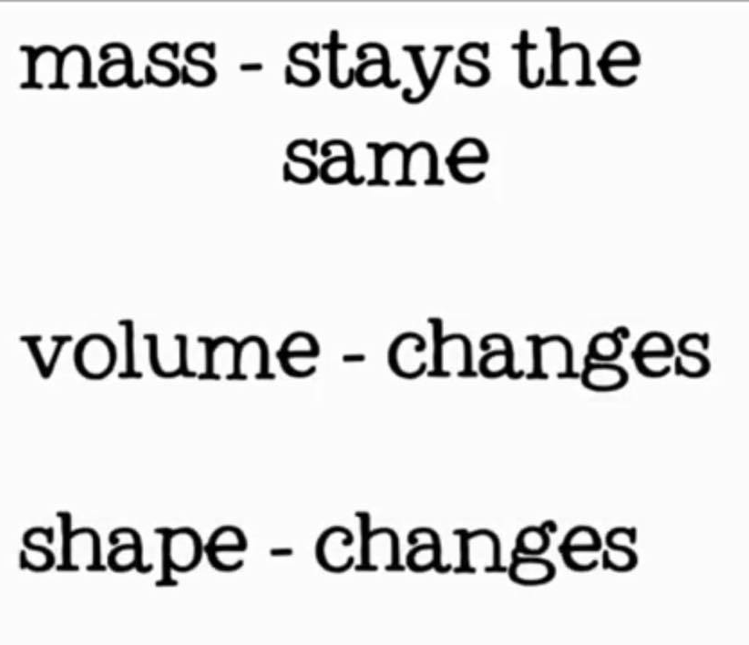
Gas
Gas is a matter that has no definite shape.
Gases take the shape of whatever container they are in .

Slide 9
Shape | Volume | Mass
Fixed | Fixed | Fixed (doesn’t change) | Solid
changes | Fixed | Fixed | Liquid
changes | changes | Fixed | Gas

Slide 10
How are particles arranged in a solid, a liquid and a gas?

Slide 11
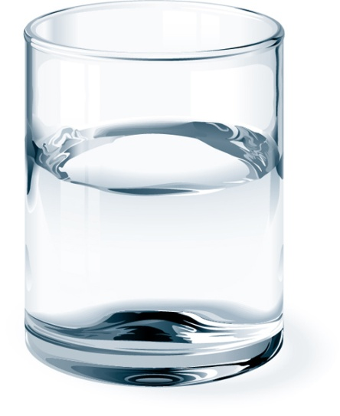
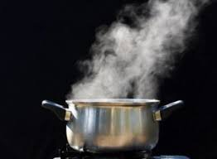
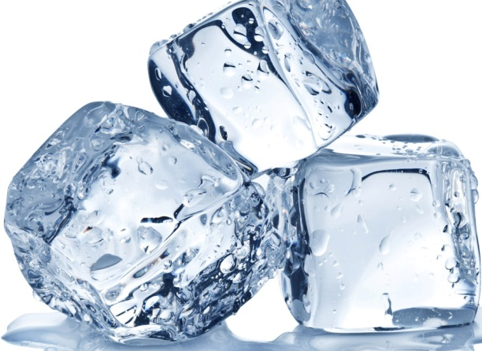
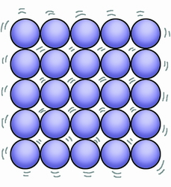
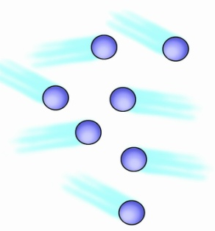
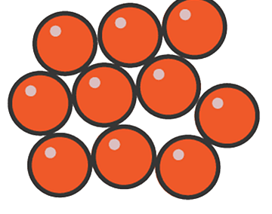
Solid
Liquid
Gas

Slide 12
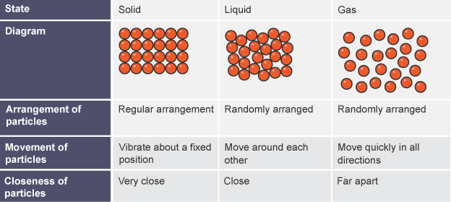

Slide 13
Vacuum
A vacuum is a space in which there are no particles of matter.
Space is often described as a vacuum, but it still has a few particles in it that are spread out over great distances from each other.

Slide 14
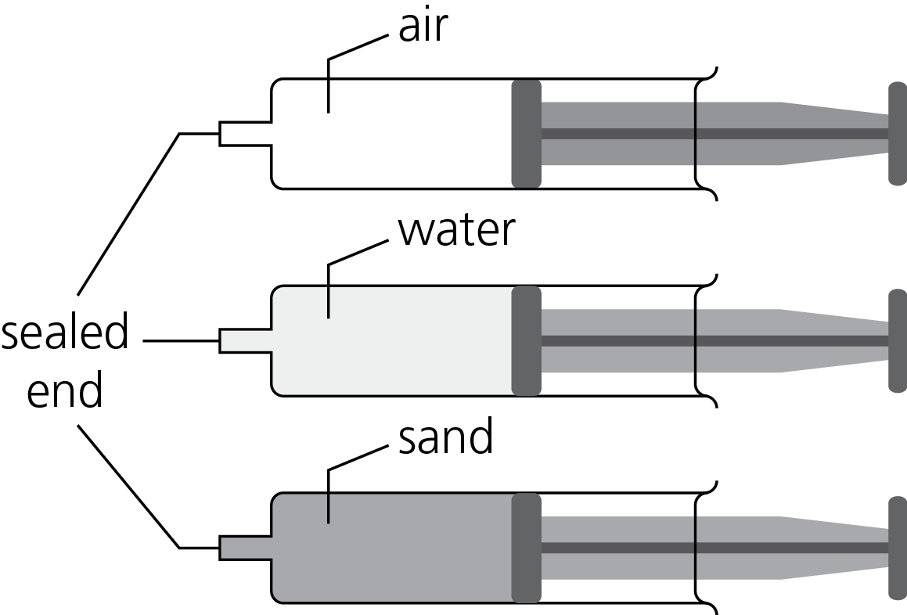
Compression: Decrease in volume of any object or substance from applied stress.
A student presses the plungers on the syringes in the diagram.
Complete the table to describe his observations.
Use ideas about particles to explain his observations.
State | Observations | Explanation using ideas about particles
Solid | Only a tiny bit | The particles are already touching each other
Liquid | Only a tiny bit | The particles are already touching each other
Gas | Can be compressed | There are some gaps in between the particles so they can get closer to each other

Slide 15
Lesson : (Boiling, evaporating and condensing)

Slide 16
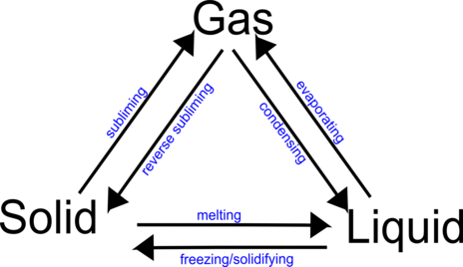
What is Changing State?
Changing state is the process of turning solid into gas or liquid by changing its temperature. Everything we see, touch or smell is made of matter. States of matter can not be destroyed but can be turned into another with the addition or removal of heat.

Slide 17
Physical change
A change in which the original substance remains as it is and no new substance is formed .
Examples :
Freezing
Melting
Boiling
Evaporation
Condensation
Sublimation

Slide 18
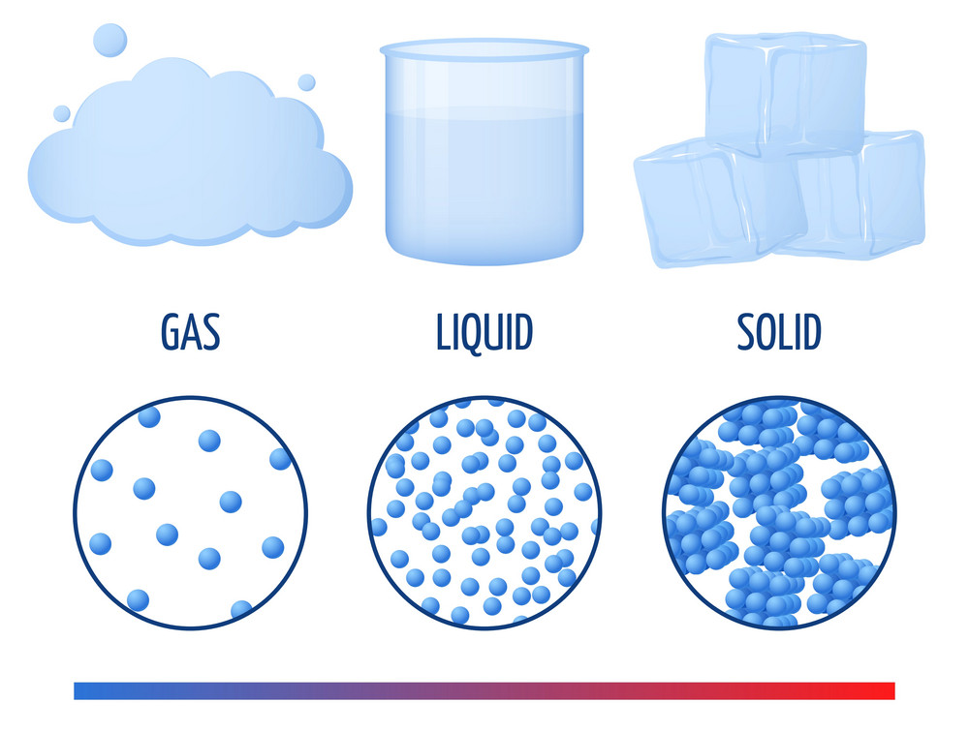
Changing the State of Water's Matter
The state of water at room temperature is liquid. However, we can change the state of its matter by changing the temperature. Cooling water to 0ºC turns the water into ice, which is solid. This is called the freezing point.
Water can also be turned into vapor, which is gas, by heating it up to 100ºC. This is called the boiling point. Both boiling and freezing points come at different temperatures for different substances.

Slide 19

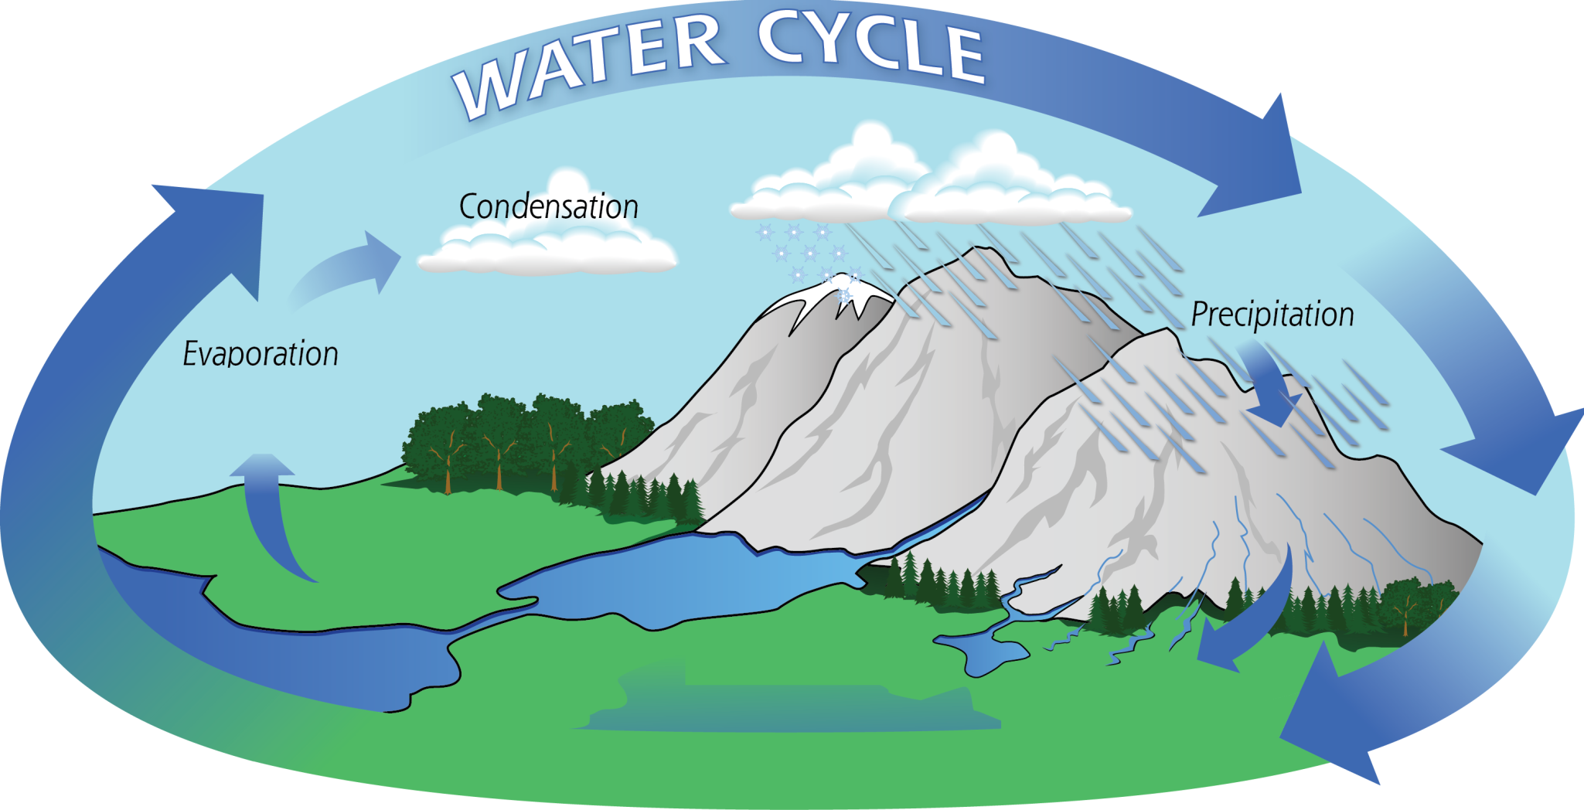

Slide 20
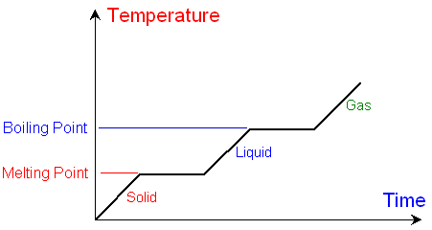
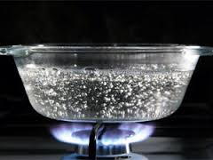
Boiling
Liquid Gas

Slide 21
Boiling
Boiling is the process by which a liquid turns into a vapor when it is heated to its boiling point.
The boiling point is the temperature at which boiling occurs for a specific liquid.
How Does boiling Occur?
https://www.youtube.com/watch?time_continue=7&v=Py0GEByCke4&feature=emb_title

Slide 22
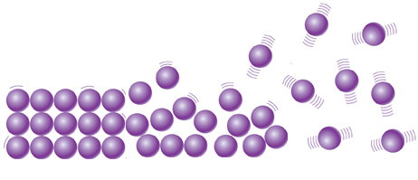
The particle theory
When a liquid is heated all the particles receive more energy and move more quickly. The fastest particles escape from the liquid surface forming a gas or they collect in the liquid to form bubbles, then the bubbles rise to the surface and burst into the air.
Increasing Temperature

Slide 23
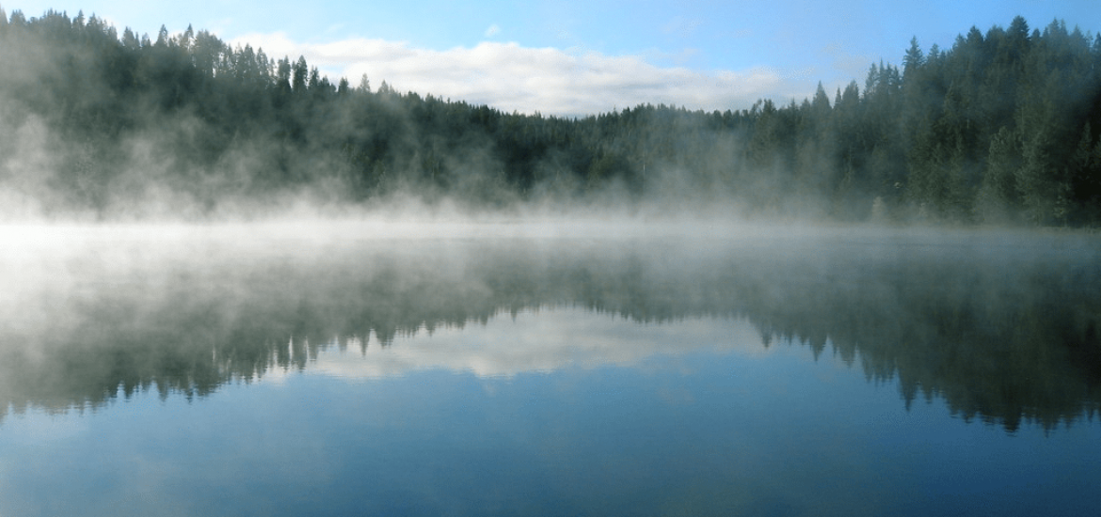
Evaporation
Evaporation happens when a liquid substance becomes a gas. When water is heated, it evaporates. The particles move and vibrate so quickly that they escape into the atmosphere as water vapor. Heat from the sun, or solar energy, powers the evaporation process.

Slide 24
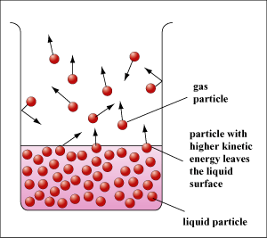
Evaporation
Water will evaporate at almost any temperature with two requirements:
There must be room in between the molecules of air above the water ( doesn’t already have water vapor in it).
The water molecules must have enough energy to escape from the surface of a liquid.

Slide 25
Examples of Liquid to Gas
Water to steam - water is vaporized after being boiled on a stove or kettle, forming thick steam.
Water evaporation - during hot days, water evaporates from a pool or rain puddle.

Slide 26
Evaporation | Boiling
A process in which a substance changes its state from the liquid state to the gas state without boiling | A process in which a substance changes its state from the liquid state to the gas state
Slow | Fast
No bubbles formed | Bubbles are formed
Takes place only from the exposed surface of the liquid | Occurs throughout the liquid
Occurs at all temperatures | Occurs at a definite temperature – Boiling point

Slide 27
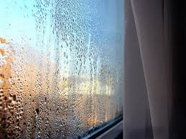
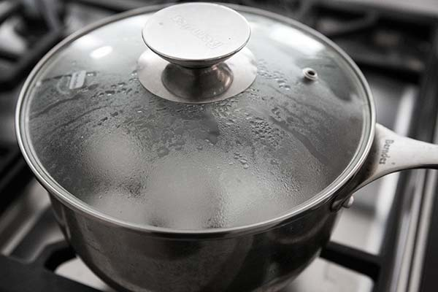
Condensation
Gas Liquid
Warm , moist air + Cold object = Condensation
Notes:
air

Slide 28
Examples of Gas to Liquid
Water vapor to dew - vapor turns from gas to liquid, such as morning dew on the grass.
Water Vapor to liquid water - vapor makes glasses foggy after moving into a warm room from the cold.

Slide 29
Lesson: (Melting, freezing and subliming)

Slide 30
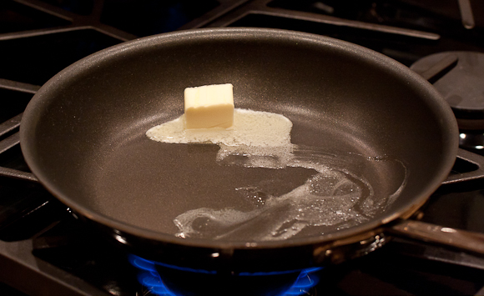
Melting
Melting is a process that results in the phase transition of a substance from a solid to a liquid. This occurs when the internal energy of the solid increases, typically by the application of heat , which increases the substance's temperature to the melting point.
The melting point of a substance is the temperature at which it changes state from solid to liquid.

Slide 31
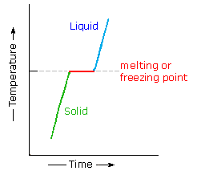
When the solid starts to melt until it has completely turned into a liquid its temperature doesn’t rise. All the heat energy is used to separate the particles so they can flow over one another.
When considered as the temperature of the reverse change from liquid to solid, it is referred to as the freezing point.

Slide 32
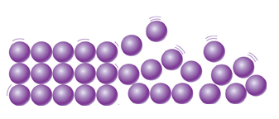
The particle theory
When a solid is heated all the particles receive more energy and move more strongly and push each other a little further apart. If the solid is heated further, the energy makes the particles vibrate so strongly that they slide over each other and become a liquid.
Heat

Slide 33
Examples of Solid to Liquid
Rocks to lava - rocks in volcanos can be heated until they become molten lava.
Metal to molten liquid - metals can be molten down and reforms into solid.
Ice to water - ice returns to its water form after being left in temperatures above freezing

Slide 34
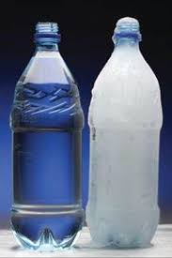
Freezing
Freezing is a phase transition where a liquid turns into a solid when its temperature is lowered below its freezing point.

Slide 35
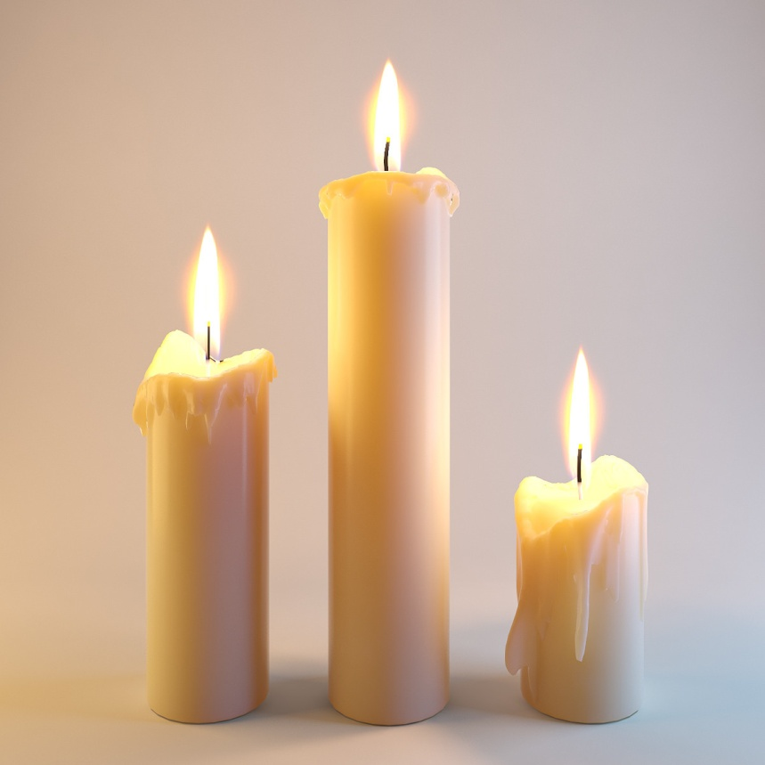
Other substances can freeze into solids at temperature much higher or lower than the freezing point of water.
For example, when molten wax runs down the side of a candle it freezes and becomes a solid before it reaches the bottom.

Slide 36
Examples of Liquid to Solid
Water to ice - when water becomes cold enough it freezes and turns to ice.

Slide 37
Sublimation
Sublimation is the transition of a substance directly from the solid to the gas state, without passing through the liquid state.
The reverse process of sublimation is deposition or desublimation, in which a substance passes directly from a gas to a solid phase.

Slide 38
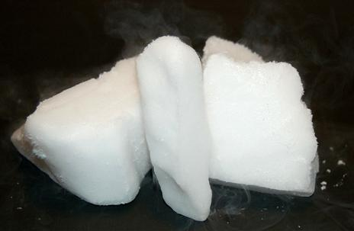
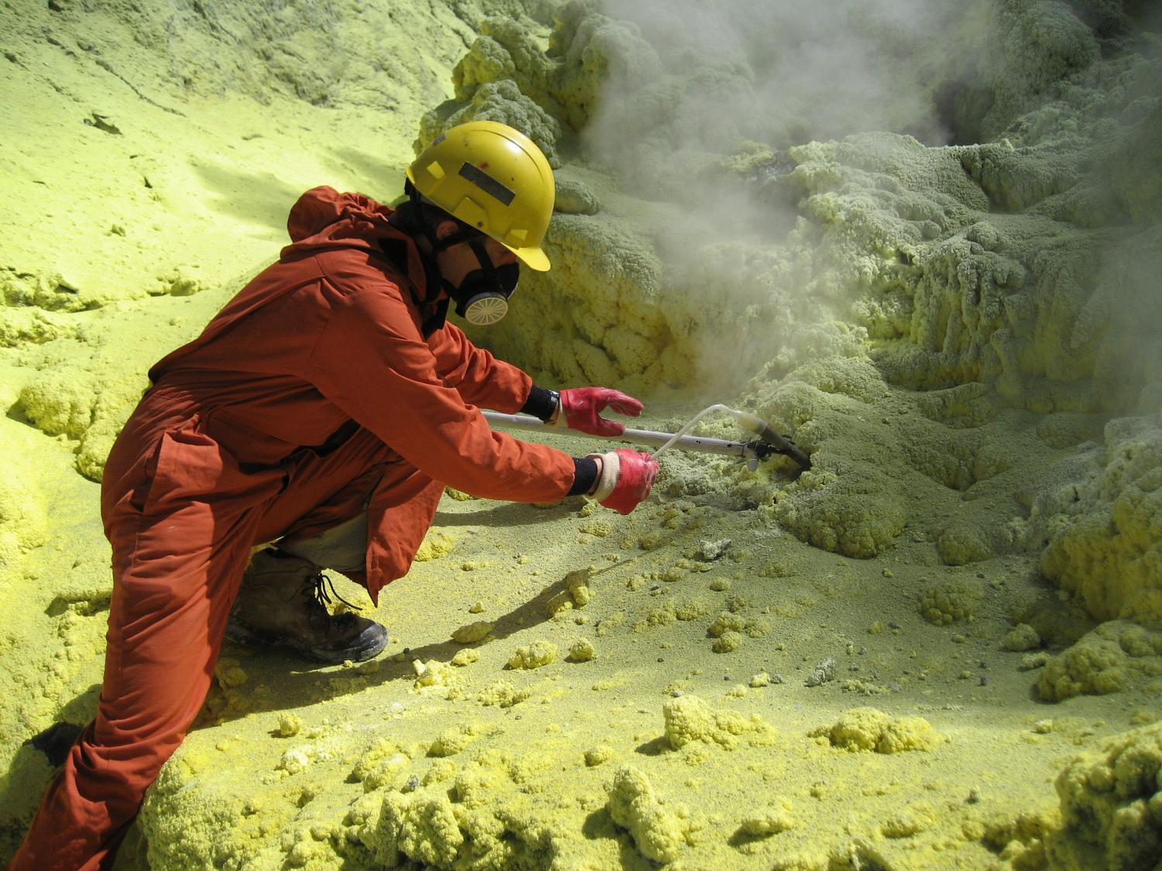
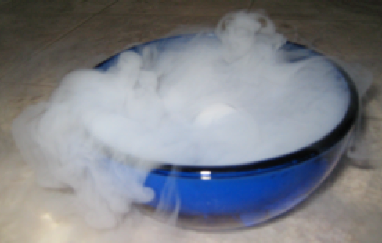
Sublimation- desublimation
Solid Gas
Gas Solid

Slide 39
Examples of Solid to Gas
Dry ice sublimation - carbon dioxide is called 'dry ice' and sublimates when at room temperature.

Slide 40
(Activity 1) Fill in the table below.
State | Solids | Liquids | Gases
Particle theory | The particles are ___________ attracted to each other and they ___________ in fixed position. | The particles are ___________ attracted to each other and they ___________ slowly over one another. | The particles are ___________ attracted to each other and they move ____________________ .

Slide 41
(Activity 1) Fill in the table below.
State | Solids | Liquids | Gases
Particle theory | The particles are very strongly attracted to each other and they vibrate in fixed position. | The particles are strongly attracted to each other and they slide slowly over one another. | The particles are very weakly attracted to each other and they move very fast in all directions.

Slide 42
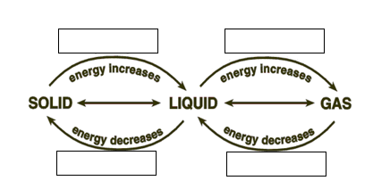
(Activity 2) How can matter change from one state to another?

Slide 43
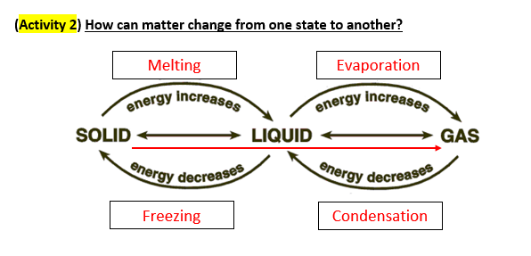
sublimation

