Slide 1

Living things in their environment

Slide 2
Videos:
https://www.youtube.com/watch?v=eGG7hyx_HlA ecosystem
https://www.youtube.com/watch?v=T5XhbhqOL_c trophic levels

Slide 3
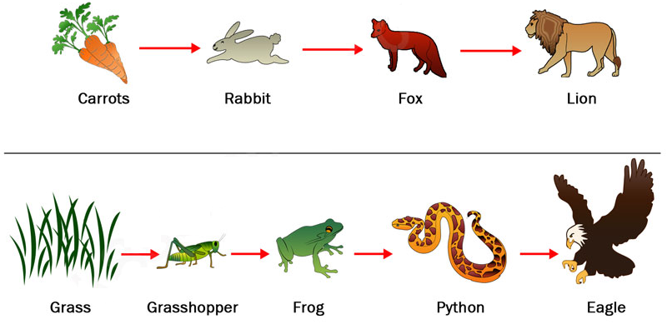
What is a food chain?
It is a series in which food and energy move from one organism to another.

Slide 4
The three categories of the food chain are…
Producers
Consumers
Decomposers
They are all dependent on each other.

Slide 5
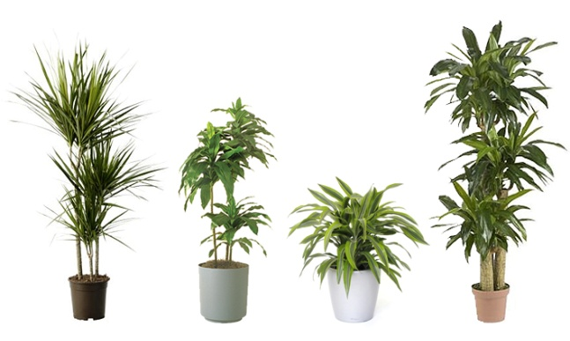
Producers
Producers get their energy from the sun.
They make their own food through a process called photosynthesis.
Plants that make their own food are usually green in color. The green color tells us that they have chlorophyll.

Slide 6
Consumers
Consumers are organisms that cannot make their own food, they eat the food that producers make or they eat other organisms.
There are three types of Consumers:
Carnivores
Herbivores
Omnivores.
It is all about what you eat!

Slide 7
Animals are classified according to their feeding styles into:
Herbivore: an animal that only eats plants.
Carnivore: an animal that only eats other animal.
Omnivore: an animal that eats both plants and animals.
Food chain: a diagram that shows the way some organisms in a habitat are linked to each other through feeding.
The arrows represent the flow of energy, the producers absorb light energy and produce biomass (the energy in living organisms).

Slide 8
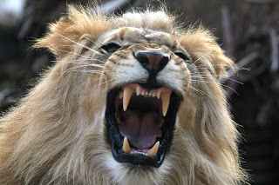
Carnivores ( Eat only animals )
Carnivores typically have sharp teeth to help catch prey and tear the meat when they eat. Carnivores must often hunt and kill their food.
Examples: lions, tigers, cats, wolves, owls, polar bears, and sharks.

Slide 9
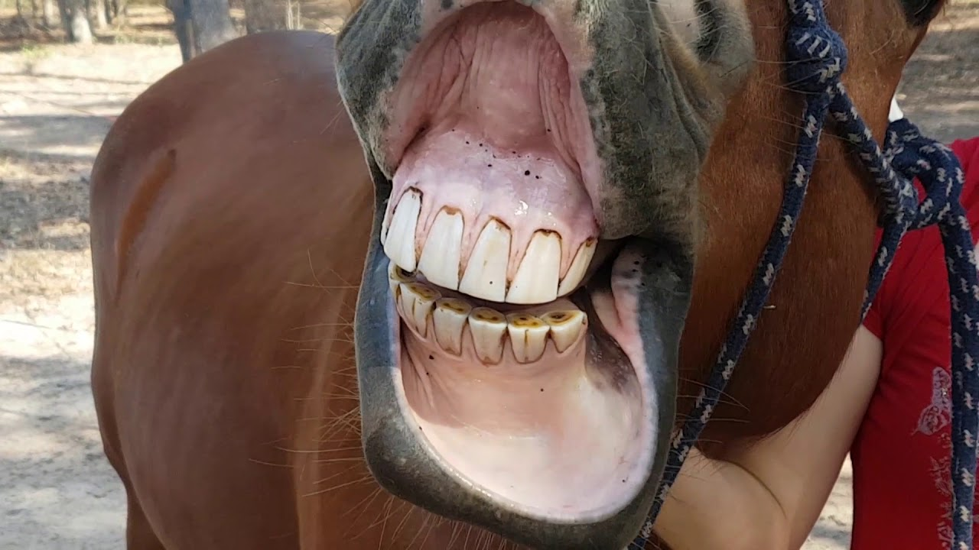
Herbivores ( Eat only plants )
Herbivores typically have round, flat teeth. They use their large, ridged molars for grinding the plants.
Examples: sheep, deer, giraffe, elephants, cows, and rabbits.

Slide 10
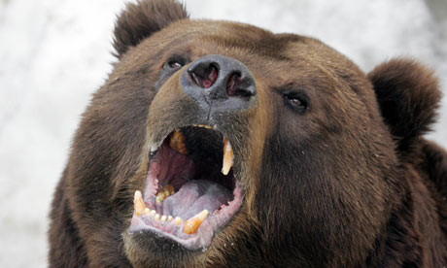
Omnivores ( Eat both plants and animals)
Omnivores have both types of teeth—flat, round teeth and longer, sharp teeth.
Examples: humans, brown bears, hens, pigs and birds.

Slide 11
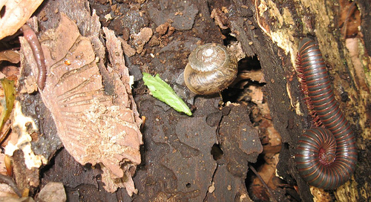
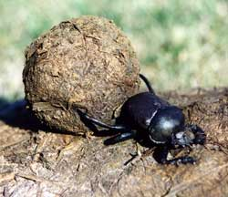
Decomposers
Decomposers are very tiny animals (microorganisms) that eat waste and the remains of dead plants and animals.
They break down the waste and remains into simple chemicals and nutrients. These chemicals can be used again by other living things.
Examples: Mushrooms, Bacteria, Worms, Bugs and snails.

Slide 12
Making use of the decomposers
People need a lot of food and produce a lot of bodily waste. We use decomposers to help us solve both of these problems.
• Making compost: we use decomposers to break down our kitchen and garden waste. In the right conditions, bacteria and fungi break this down into a brown, soil-like substance called compost. Adding compost to your soil puts back nutrients, so your plants grow bigger and better.
• Treating sewage: microorganisms decompose the waste and break it down so it does not damage the environment.

Slide 13
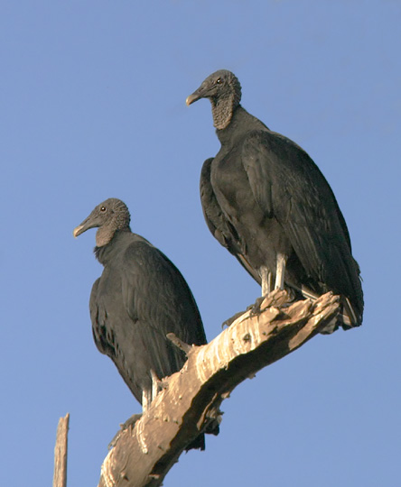
Scavengers
Another type of consumer is a scavenger.
Scavengers eat the bodies of other dead animals.
Vultures are large birds that are scavengers.

Slide 14
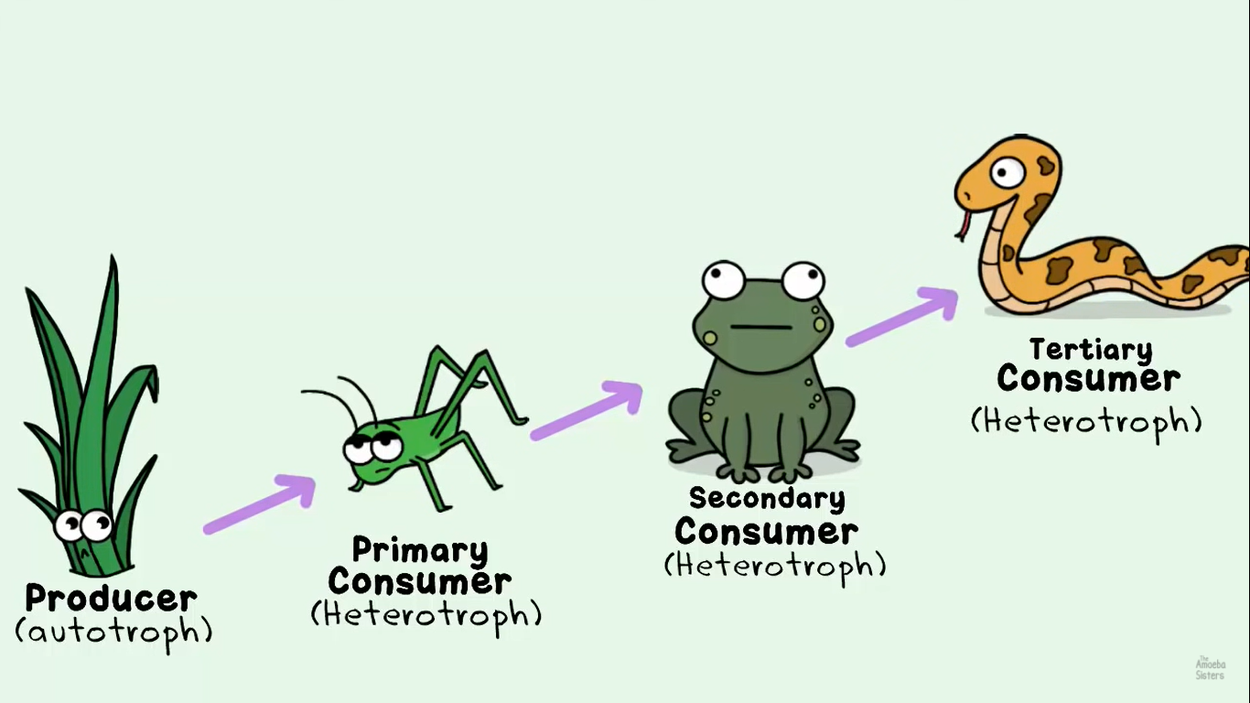

Slide 15
In a food chain, organisms are classified according to their role into:
Producer: an organism that produces food at the beginning of a food chain.
Consumer: an animal that eats plants, other animals or both.
Primary consumer: an animal that eats plants (this maybe a herbivore or an omnivore)
Secondary consumer: an animal that eats primary consumers (this maybe a carnivore or an omnivore)
Tertiary consumer: an animal that eats secondary consumers (this maybe a carnivore or an omnivore)
Quaternary consumer: an animal that eats tertiary consumers.
Top carnivore: an animal at the end of the food chain.

Slide 16
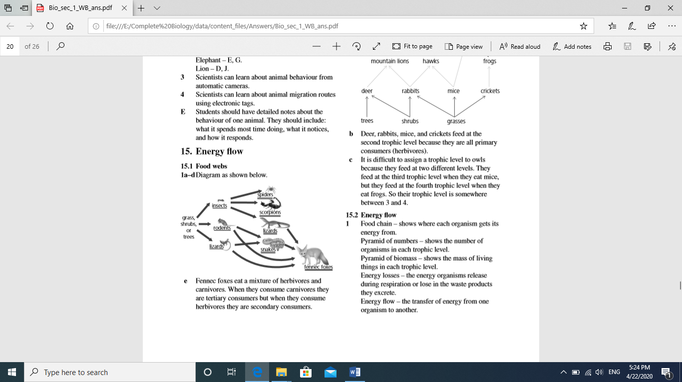
Example 1 : The diagram shows part of a desert food web:

Slide 17
1. Circle the producer in the food web.
2. Name all the consumers :
3. Underline all the primary consumers.
4. Double underline all the secondary consumers.
5. What type of consumer is a fennec fox? circle the correct answer
Tertiary consumer Secondary consumer Both of them
6. Some lizard species are herbivores, others are carnivores. Write two food chains, one for each type of lizard.

Slide 18
Example 1 : The diagram shows part of a desert food web:

Slide 19
1. Circle the producer in the food web.
2. Name all the consumers :
insects , rodents , lizards ,spiders ,scorpions , lizards ,snakes ,foxes
3. Underline all the primary consumers.
4. Double underline all the secondary consumers.
5. What type of consumer is a fennec fox? circle the correct answer
Tertiary consumer Secondary consumer Both of them
6. Some lizard species are herbivores, others are carnivores. Write two food chains, one for each type of lizard.
Grass shrubs or trees lizards foxes ( herbivore )
Grass shrubs or trees insects lizards foxes (carnivore )

Slide 20
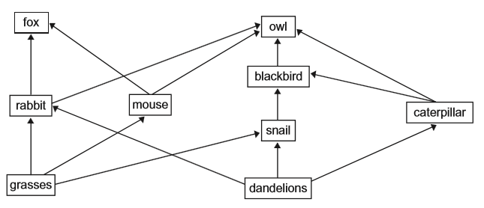
Example 2 :
The diagram shows a food web in areas of grassland.

Slide 21
a. Classify the organisms in the table below.
Producers | herbivores | carnivores

Slide 22
b. Write three food chains from this food web.
c. One year the snail population increased in the grassland area.
How could an increase in the number of snails cause the caterpillar population to change?

Slide 23
a. Classify the organisms in the table below.
Producers | herbivores | carnivores
Grasses Dandelions | Rabbit Mouse Snail Caterpillar | Fox Owl Blackbird

Slide 24
b. Write three food chains from this food web.
Grasses rabbit fox
Dandelions caterpillar owl
grasses mouse fox
c. One year the snail population increased in the grassland area.
How could an increase in the number of snails cause the caterpillar population to change?
The caterpillar population will decrease because both of them feed on dandelions

Slide 25
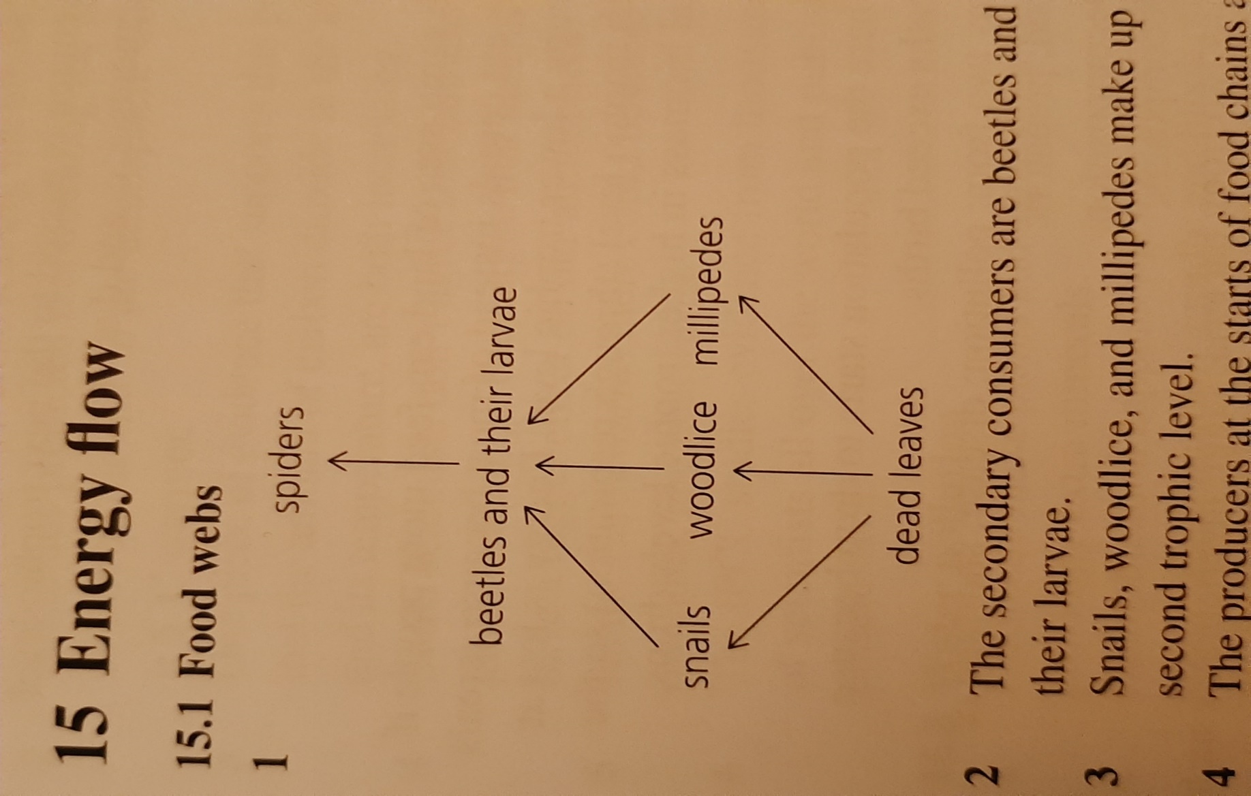
Example 3 : Look at the food web then answer the questions:
1. Which of the animals are primary consumers?
2. Which of the animals are secondary consumers?
3. What types of living thing are the producers at the start of food chains?
4. Explain what the arrows in a food web represent ?

Slide 26
Example 3 : Look at the food web then answer the questions:
1. Which of the animals are primary consumers?
snails , woodlice and millipedes
2. Which of the animals are secondary consumers?
beetles and their larvae
3. What types of living thing are the producers at the start of food chains?
dead leaves
4. Explain what the arrows in a food web represent ?
the energy flow

Slide 27
Trophic levels :
The position of a living thing in a food chain is called its trophic level.
The producers 1st trophic level
Primary consumers ( herbivores ) 2nd trophic level
All the animals at higher trophic levels are carnivores.

Slide 28
Trophic levels :
Biomass decreases with each trophic level. There is always more biomass (stored energy) in lower trophic levels than in higher ones.
Biomass: the amount of material in a plant (or any living creature).
Plants produce biomass through photosynthesis.

Slide 29
In any habitat, the producers absorb light energy and produce biomass (the energy in living organisms).
When consumers eat the biomass, only 10% of the energy will be stored in the second level and the rest of the energy will be wasted or consumed for life processes.

Slide 30
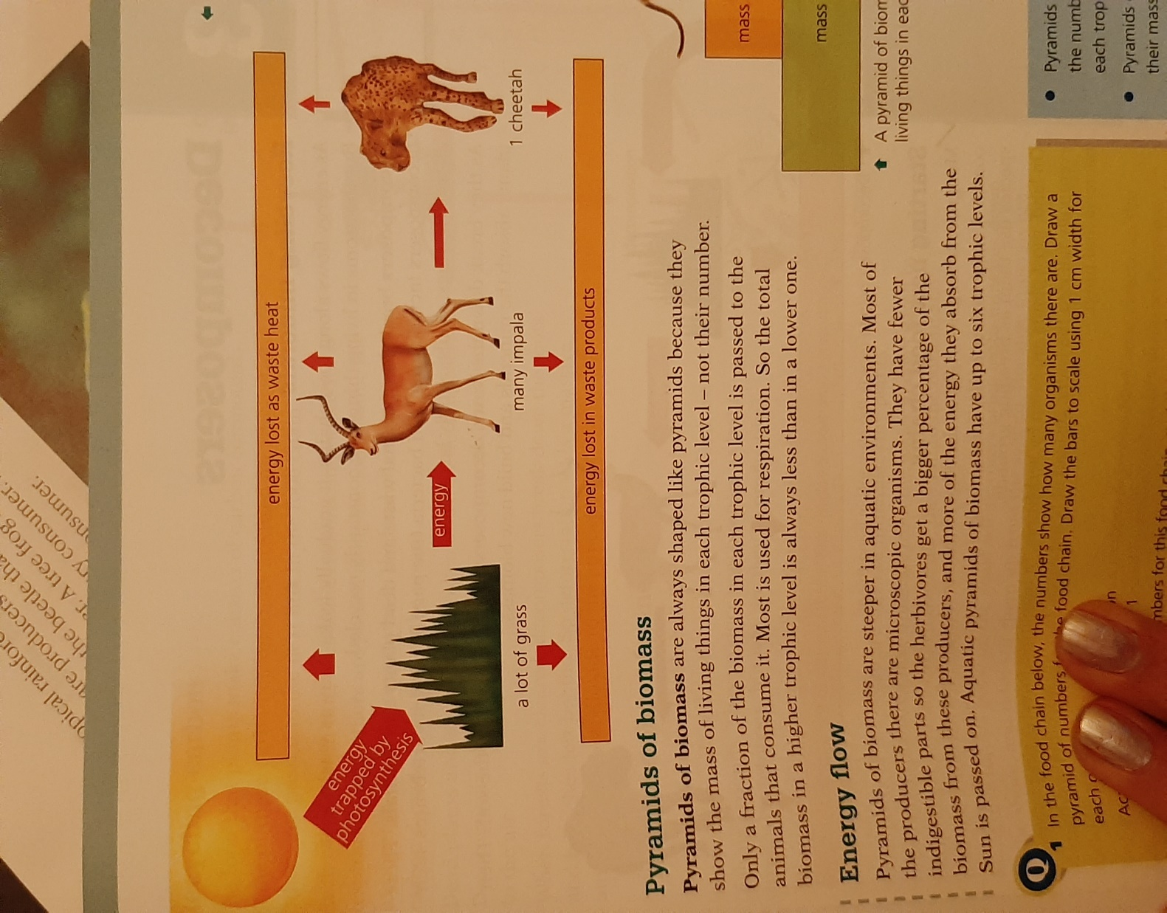
Energy is lost at each level in a food chain or a food web as shown in the figure below: (observe the change in size of the arrows)

Slide 31
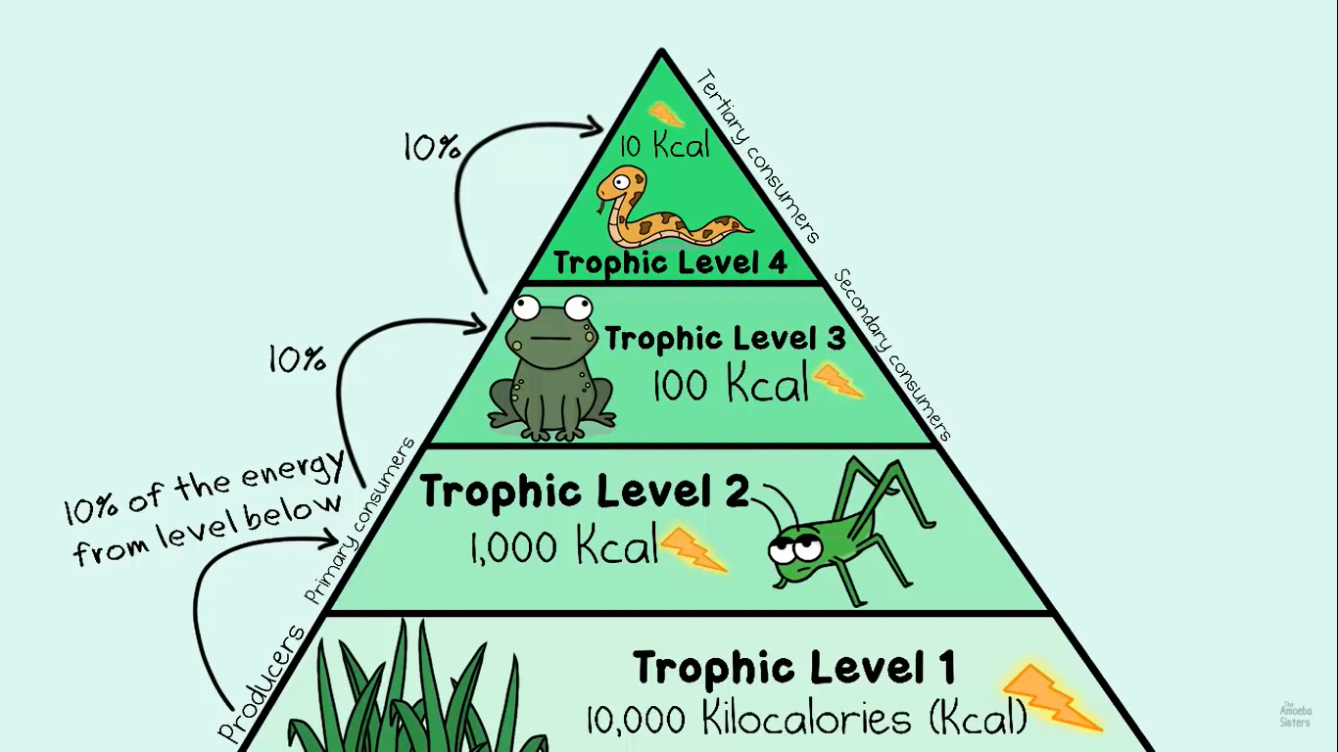

Slide 32
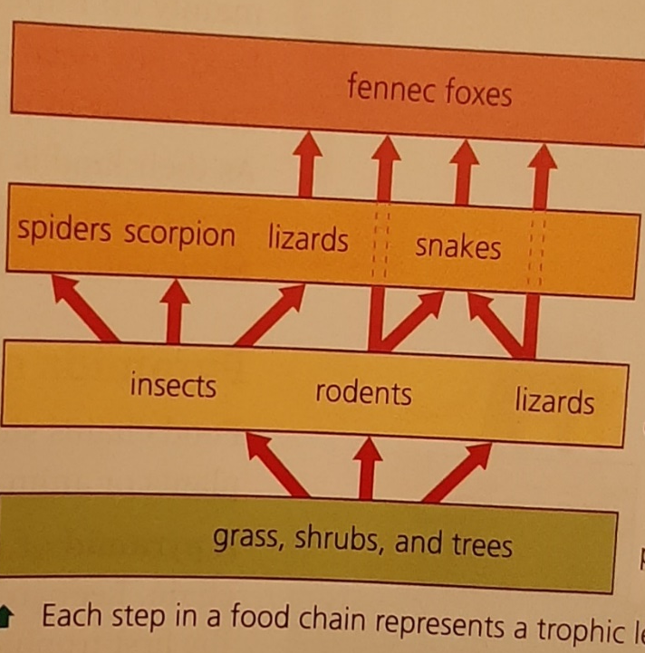
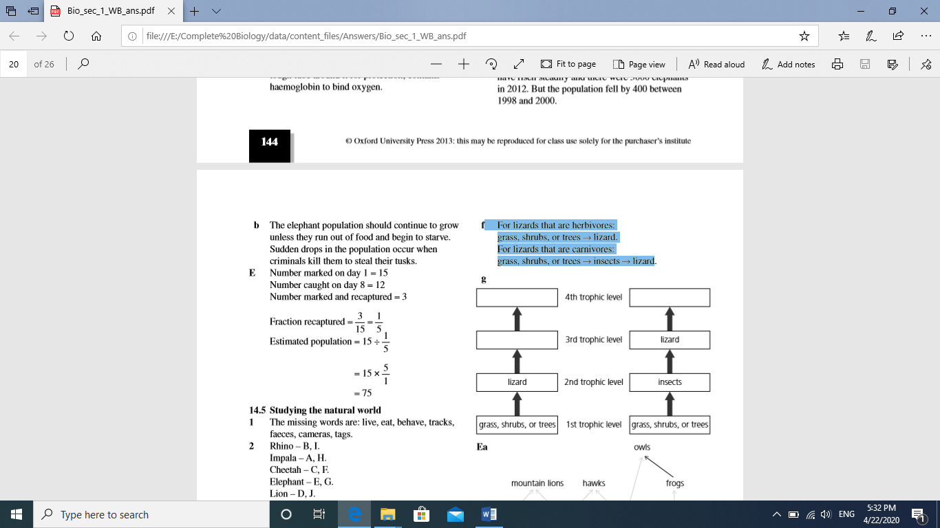
Question : Complete the diagram below by putting each organism in each lizard’s food chain in the correct trophic level.
Fennec foxes
Fennec foxes
Snakes

Slide 33
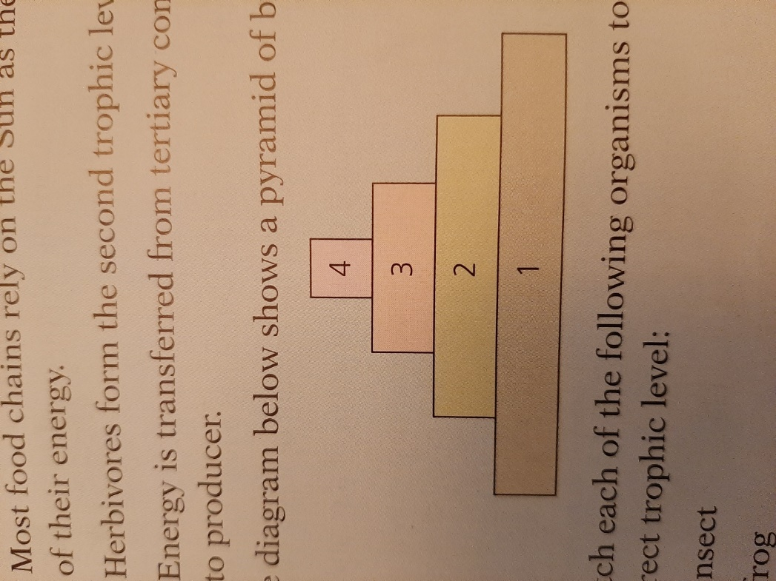
Question : The diagram below shows a pyramid of biomass .
Match each of the following organisms to the correct trophic level :
Insect
frog
snake
Grass

Slide 34
Question : The diagram below shows a pyramid of biomass .
Match each of the following organisms to the correct trophic level :
Insect / 2
frog / 3
snake / 4
Grass / 1

Slide 35
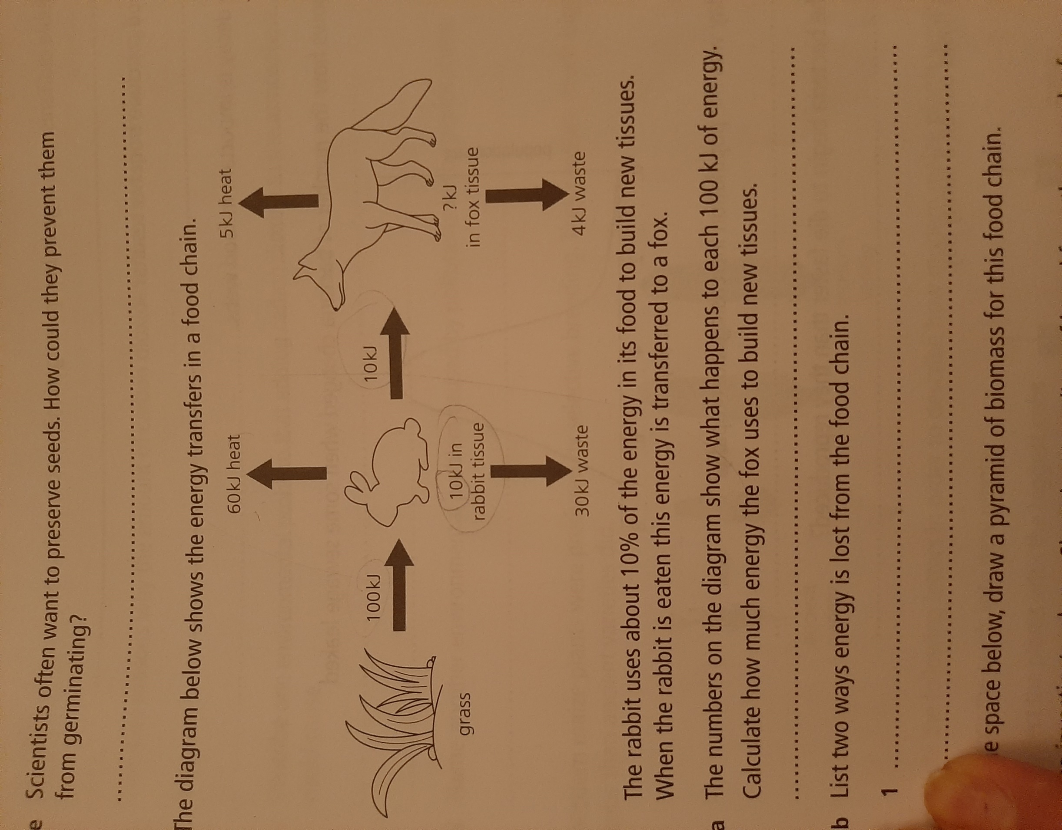
Example 1 :The diagram below shows the energy transfer in a food chain :
Calculate how much energy the fox uses to build new tissues .

Slide 36
Example 1 :The diagram below shows the energy transfer in a food chain :
Calculate how much energy the fox uses to build new tissues .
1kJ

Slide 37
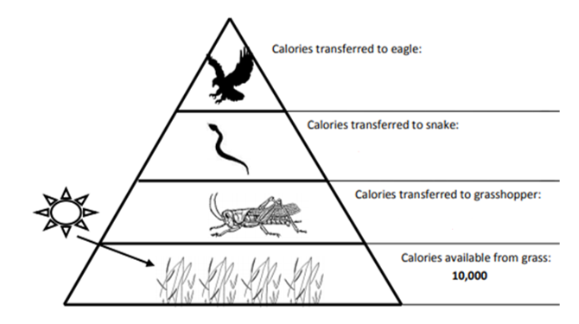
Example 2:
The diagram shows an energy pyramid which represents the amount of energy available at each trophic level in this food chain .
1. Name the producer:
2. Name the animal in the 3rd trophic level :
3. Name the top carnivore :
4. Calculate the amount of energy that will be transferred in each level ?

Slide 38
Example 2:
The diagram shows an energy pyramid which represents the amount of energy available at each trophic level in this food chain .
1. Name the producer: Grass
2. Name the animal in the 3rd trophic level : snake
3. Name the top carnivore : eagle
4. Calculate the amount of energy that will be transferred in each level ?
on the diagram
10
100
1000

Slide 39
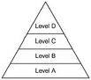
Question :Use the pyramid to answer the following questions.
1. Which level contains the organisms with the highest amount of energy?
2. Top predators are found in level .
3. Which level contains herbivores?
4. How does the amount of energy changes as you move from level A to level D?
5. In a community of grass, rabbit, fox and eagle, which organism will fill level C?

Slide 40
Question :Use the pyramid to answer the following questions.
1. Which level contains the organisms with the highest amount of energy? A
2. Top predators are found in level . D
3. Which level contains herbivores? B
4. How does the amount of energy changes as you move from level A to level D? it will Decrease
5. In a community of grass, rabbit, fox and eagle, which organism will fill level C? fox

Slide 41
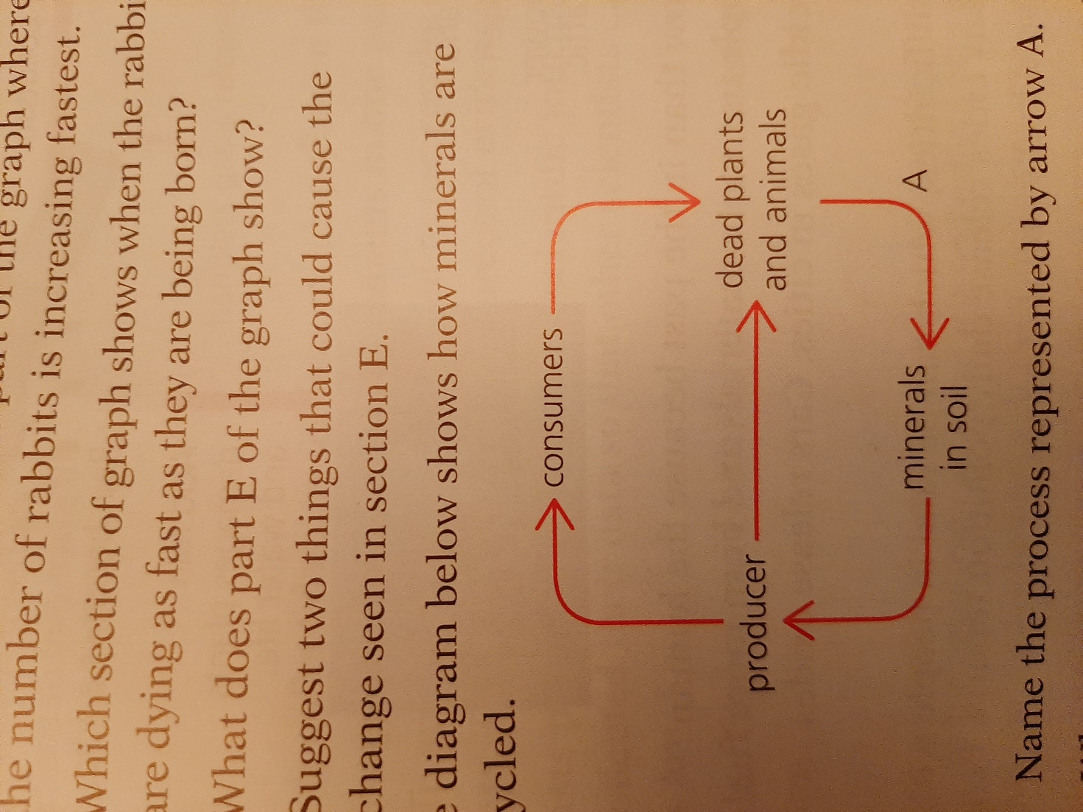
Question :The diagram below shows how minerals are recycled .
1.Name the process represented by arrow A .
2. What type of organism carries out process A ?
3. Name two examples of this type of organism
4. Explain why process A is vital to life in earth

Slide 42
Question :The diagram below shows how minerals are recycled .
1. Name the process represented by arrow A Decomposition
2. What type of organism carries out process A ? Decomposers
3. Name two examples of this type of organism fungi and bacteria
4. Explain why process A is vital to life in earth they add minerals to the soil

