Slide 2
bee

Slide 3
balloon

Slide 4
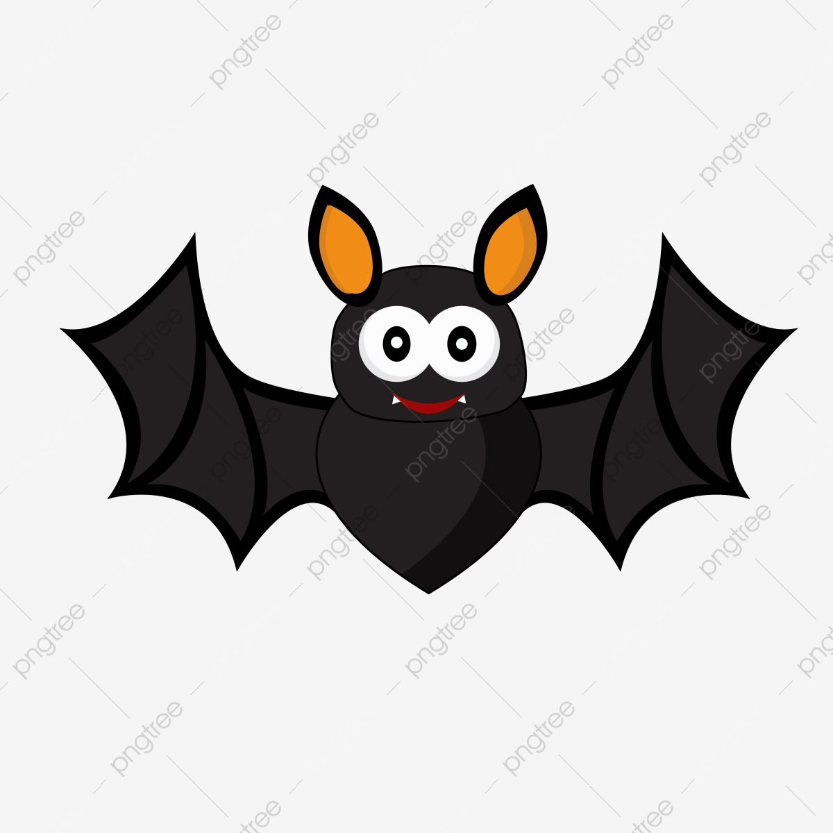
bat

Slide 5
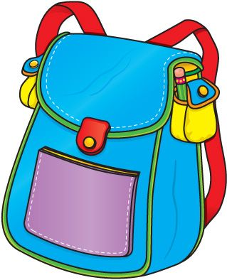
bag

Slide 6
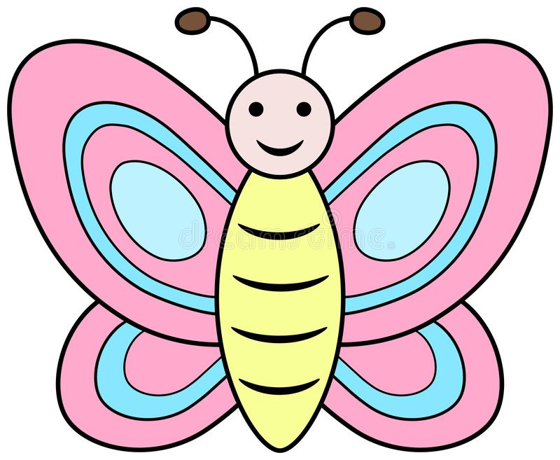
butterfly

