Slide 1
Asking for advice letter

Slide 2
Formal

Slide 3
Semi-formal

Slide 4
Informal

Slide 7
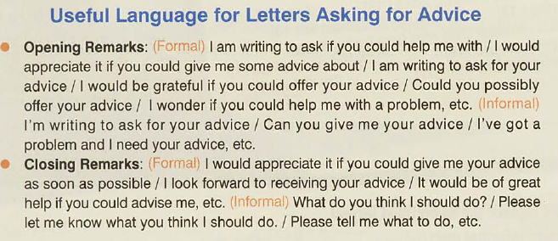

Slide 10
Closing Remarks
I trust you accept this advice.
I hope this will be of help.
I would very much like to know if this was helpful.
Hope this has helped.
Let me know what happens.

Slide 12
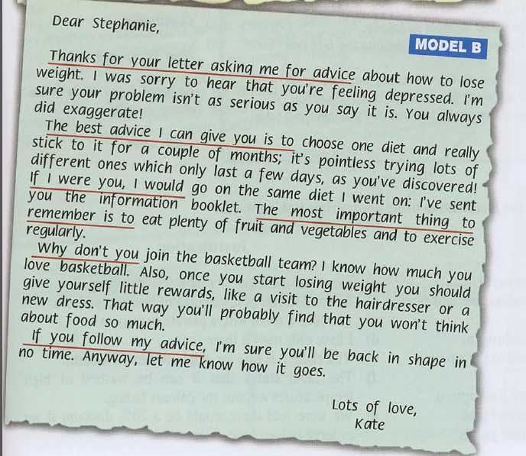

Slide 13
Learn the Top 10 Ways to Give Advice in English
https://www.youtube.com/watch?v=f0mnx0_LWko

Slide 14
Group Work:

Slide 15
Classwork/ Group work Your friend wants some advice on what she should take with her on her first trip abroad.

Slide 16
Your parents will not let you go on holiday as they want you study for your exams. Write a letter to a friend asking for her/ his advice on that matter.

