Slide 1
Nouns Grade 2

Slide 2
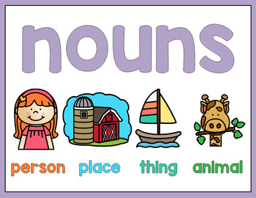

Slide 3
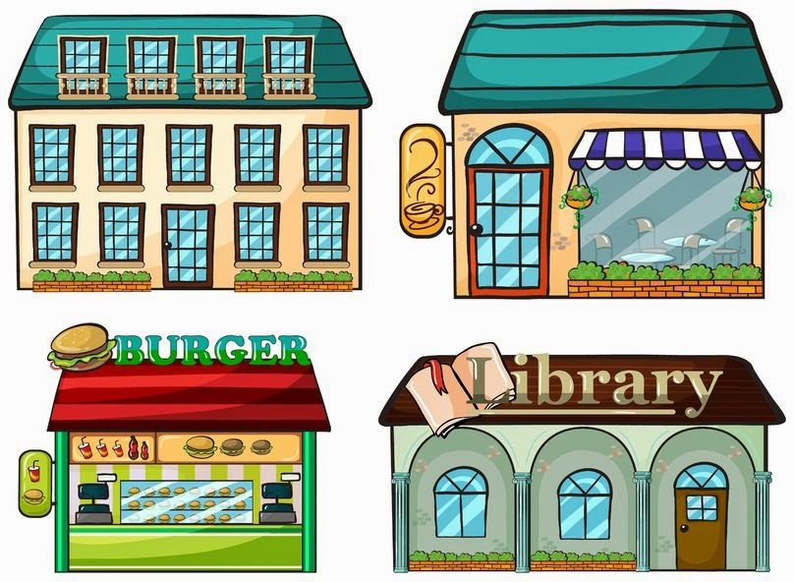
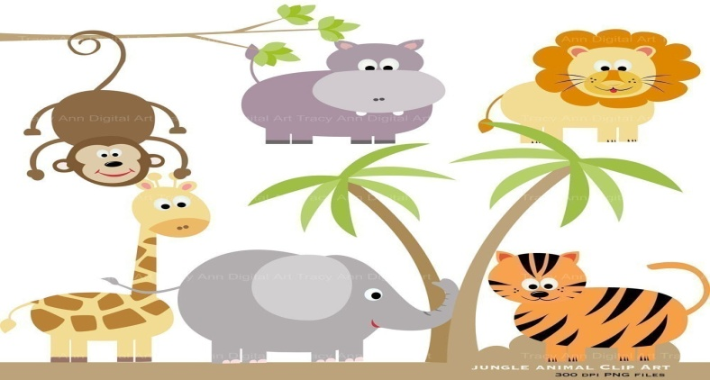
Nouns are
Names of people Names of places
Names of things Names of animals

Slide 4
Nouns for people
sister
mom
doctor
Ramez
teacher

Slide 5
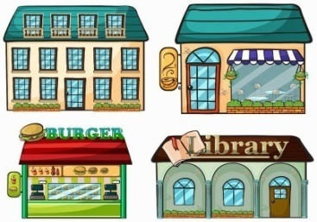
Nouns for places
school
house
zoo
garden

Slide 6
Nouns for things
pen
ball
fireworks
book
chair

Slide 7
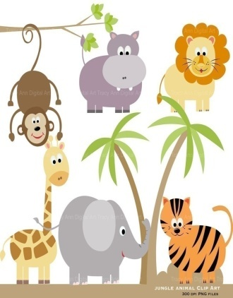
Nouns for animals
cat
frog
horse
dog

Slide 8
Home is a name of
Place?
People?

Slide 9
Which noun is a name of an animal?
mat
hat
cat

