Slide 1
Vocabulary Ex. E page 7

Slide 2
attractive/ embarrassed/ aggressive/ trustworthy/ depressed

Slide 3
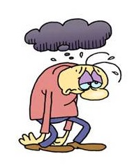
attractive/ embarrassed/ aggressive/ trustworthy/ depressed

Slide 4
depressed

Slide 5
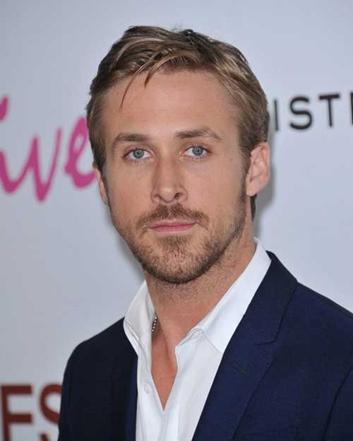
attractive/ embarrassed/ aggressive/ trustworthy/ depressed

Slide 6
attractive

Slide 7
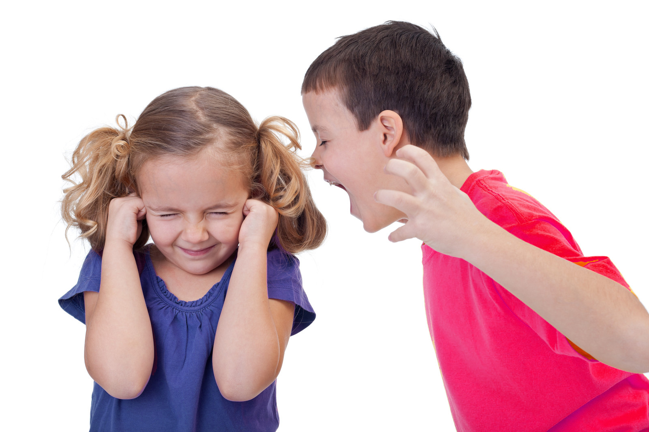
attractive/ embarrassed/ aggressive/ trustworthy/ depressed

Slide 8
aggressive

Slide 9
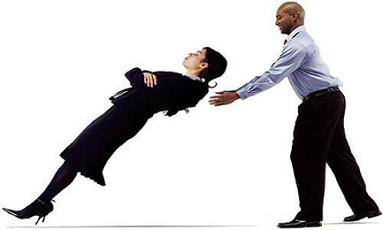
attractive/ embarrassed/ aggressive/ trustworthy/ depressed

Slide 10
trustworthy

Slide 11
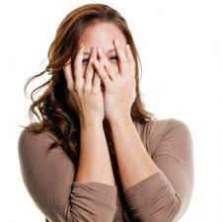
attractive/ embarrassed/ aggressive/ trustworthy/ depressed

Slide 12
embarrassed

Slide 13
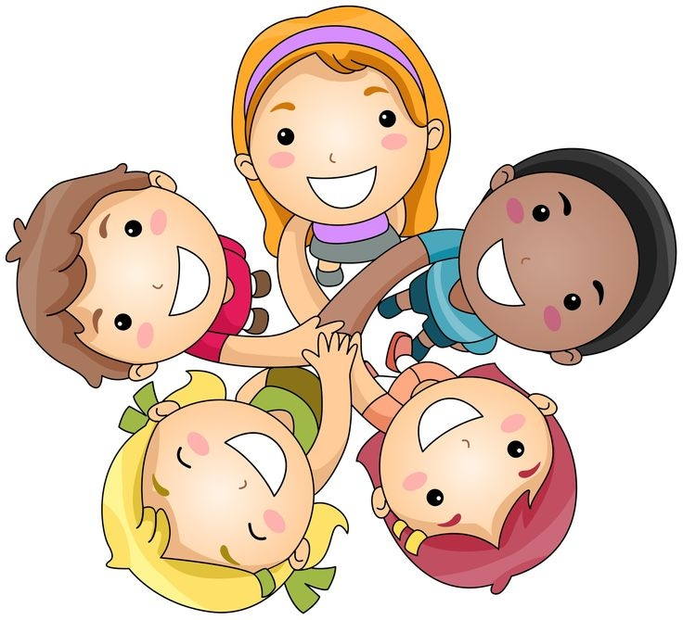
Group work Put the above words in meaningful sentences.

