Slide 1
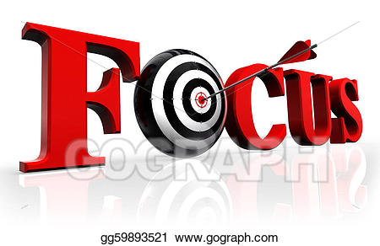
Vocabulary ( word Focus)

Slide 2
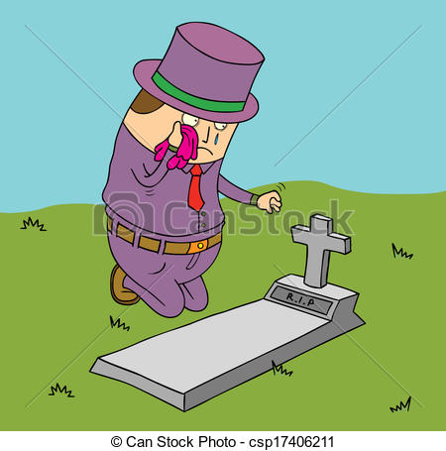
Synthetic dye/ dominance/ stimulant/ stability/ mourning

Slide 3
Sadness that you show and feel when somebody dies.

Slide 4
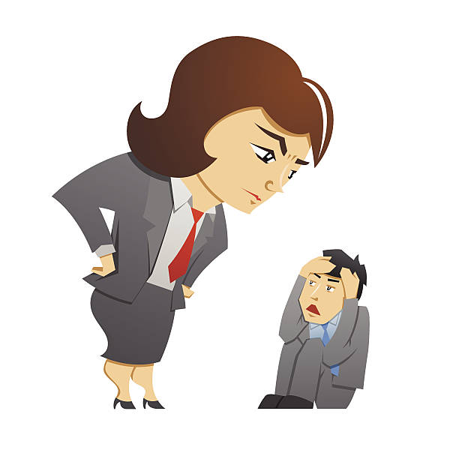
Synthetic dye/ dominance/ stimulant/ stability/ mourning

Slide 5
Being more important or powerful than other people.

Slide 6
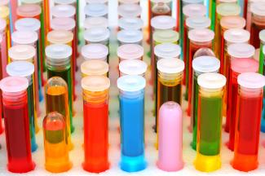
Synthetic dye/ dominance/ stimulant/ stability/ mourning

Slide 7
A man- made substance that changes the colour of something.

Slide 8
Synthetic dye/ dominance/ stimulant/ stability/ mourning

Slide 9
Something that makes the mind or body more active.

Slide 10
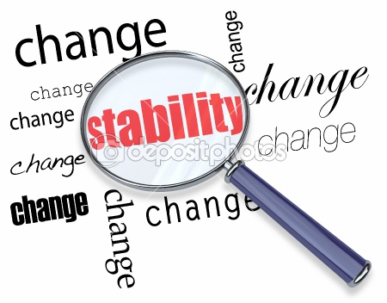
Synthetic dye/ dominance/ stimulant/ stability/ mourning

Slide 11
When something is not likely to change.

