Slide 1
What is a business
A business is an organization that provides a service or produces and sells goods which satisfy people needs and wants.
Book pg.31

Slide 2
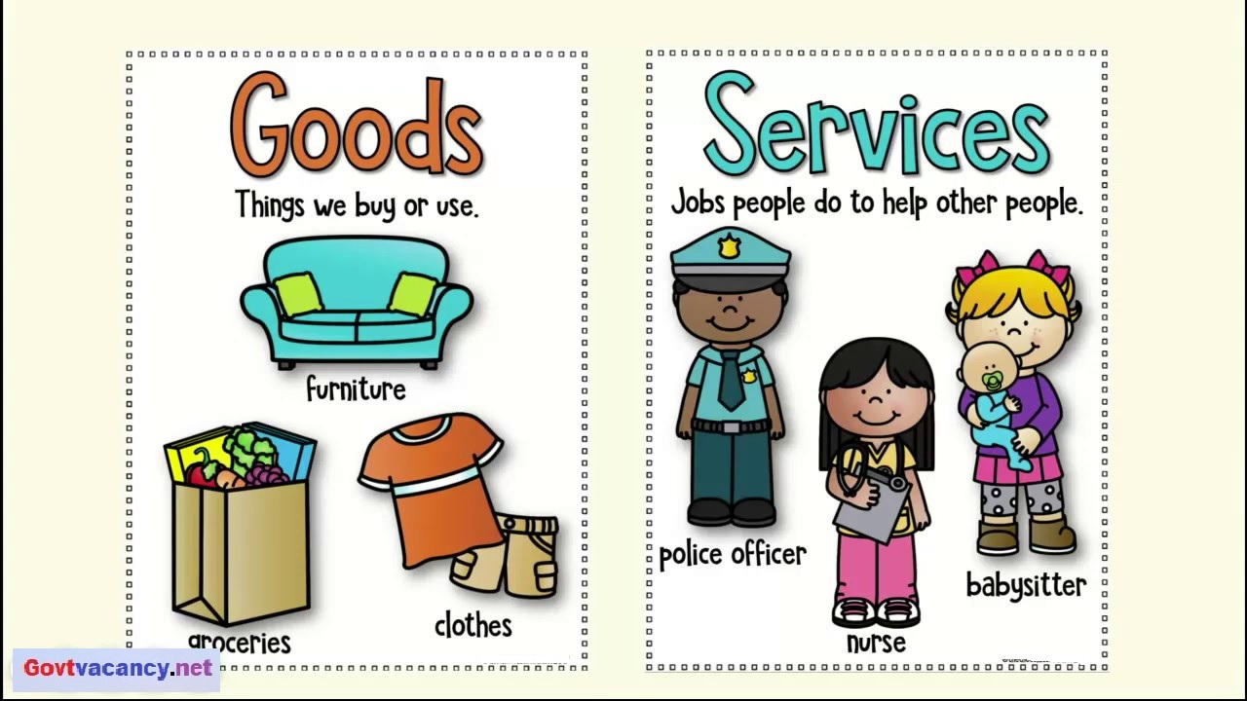
What do you think is the difference between goods and services??
Goods
tangible , produced.
Services
intangible , provided.

Slide 3
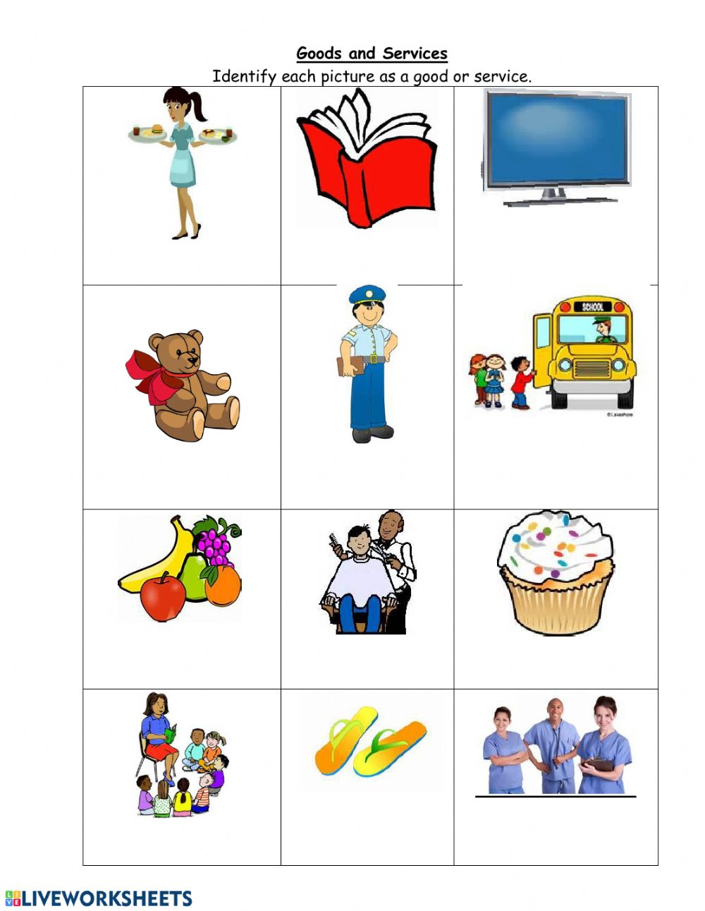

Slide 4
Definitions to learn : book pg.31
Goods: tangible items for sale.
Services: work done for someone by someone else ,usually for pay.
Consumers: a buyer of goods and services.
Consume: to use up goods and services .

Slide 5
What do you think is the difference between needs and wants??
Needs: Are things essential for living.
Water
Clothing
Warmth
Protection
Food

Slide 6
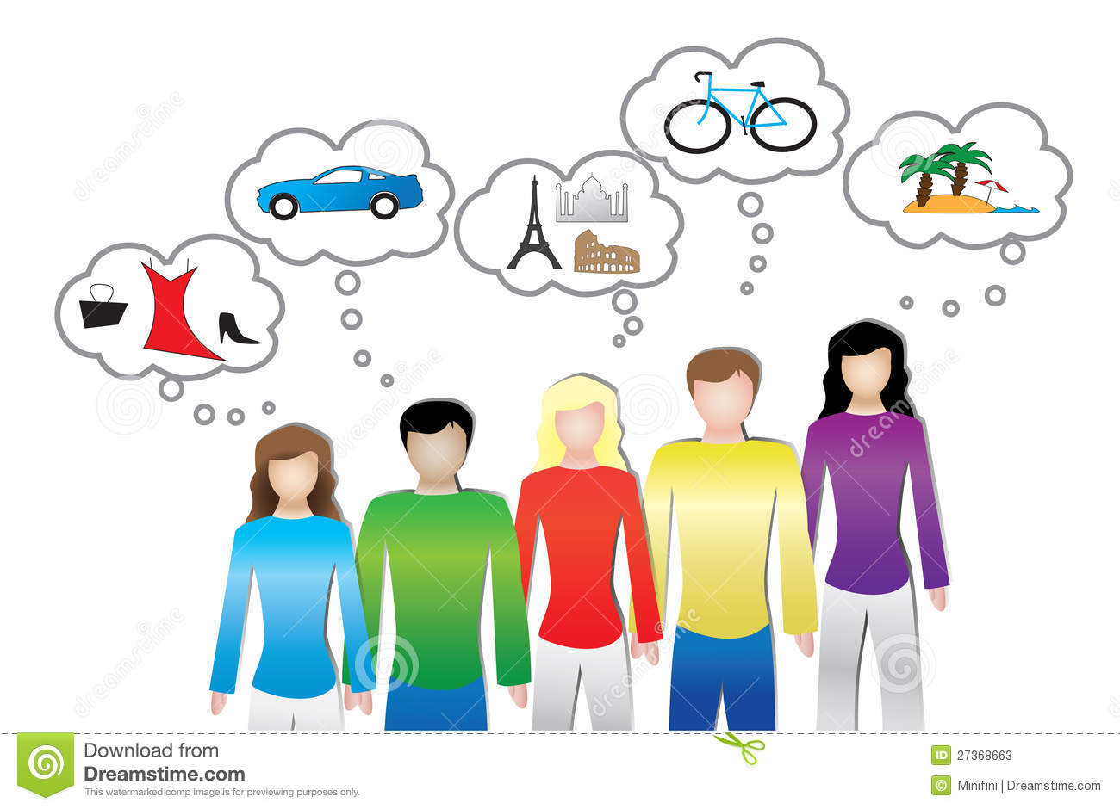
Wants: Are goods or services which people would like to have, but which are not essential for living.

Slide 7
How do people start a business??

Slide 8
Step 1 : choosing a business
You need :
To be passionate about it
To have the knowledge that enables you to do it.
To think of problems you want to solve
Book pg.37

Slide 9
Step 2: name your business
choosing a business is only the beginning, now you need to build your plan .
Start by describing you business . It should have a name :
A name that reflects the type of business
A name that is not related to the type of business
Ex : something that means a great deal to you or a family name .
Book pg.40

Slide 10
Step 3: what are you selling ?
At this stage You have :
To decide and describe what are going to do
(sell goods or provide services)
To determine what people want and prefer?
To research for available competition .
To give your customers a good reason to buy your products. what can you do better ?

Slide 11
Step 4: The resources you need (Factors of production)
Are those resources needed to produce goods or services. And there are 4 factors of production:
Land
The natural resources provided by nature and includes fields and forests, oil, gas, metals and other mineral resources.
Labour
The number of people available to make products.
Capital
The finance, machinery and equipment needed for the manufacture of goods.
Enterprise
The skill and risk-taking ability of the person who brings the other resources or factors of production together to produce a good or service, for example the owner of the business.

