Slide 1
The National Orthodox School
2023 - 2024
Parents’ Orientation Meeting
Grade 10 IGCSE

Slide 2
Congratulations!

Slide 3
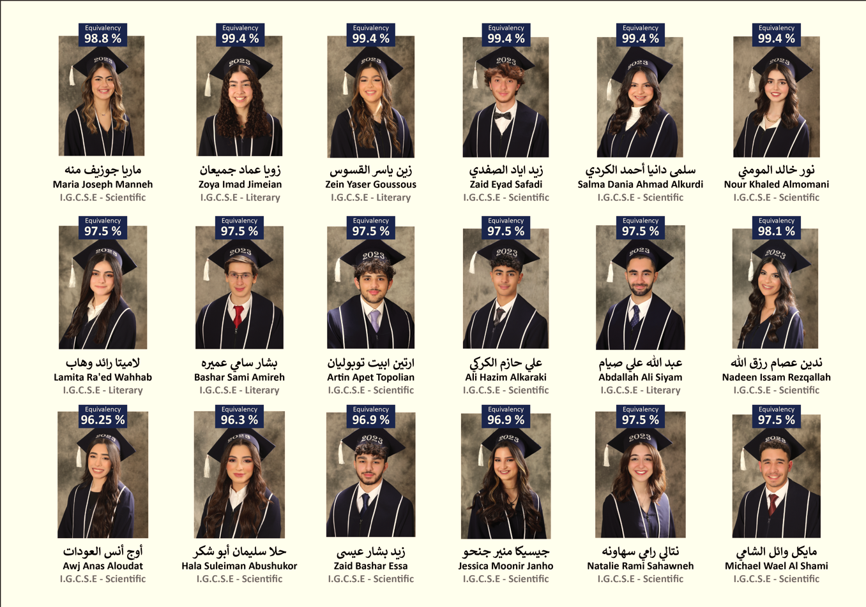
Congratulations!

Slide 4
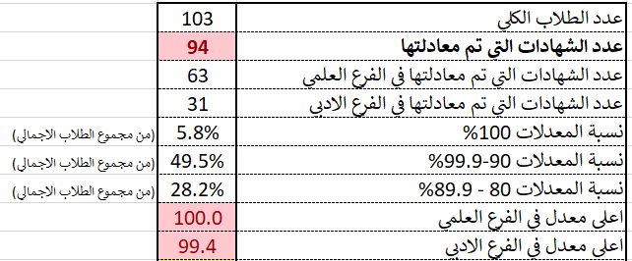

Slide 5
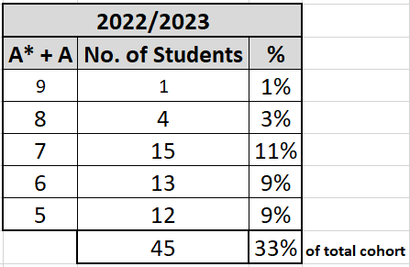
OUR IGCSE STUDENTS 2022/2023

Slide 6
IGCSE/IAL Program
Grade 9 + 10
IGCSE
Grade 11
IAS
Grade 12
IA2
Is a 4-year program
FULL A LEVEL

Slide 7
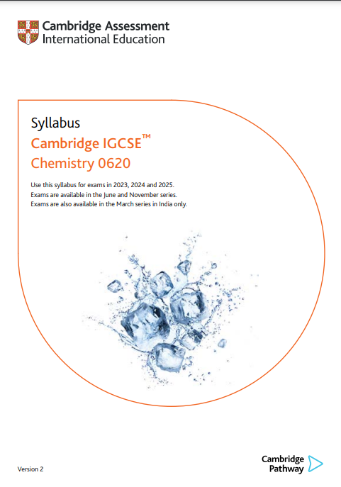
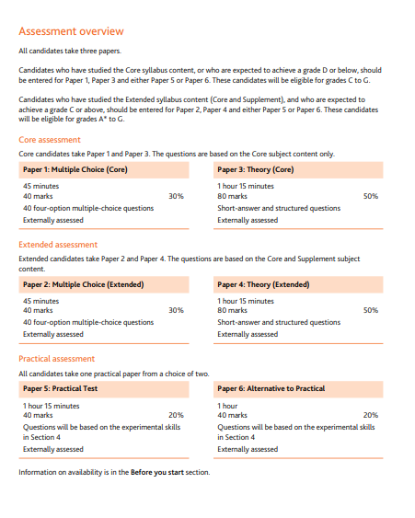
IGCSE (GRADE 9 + 10)
IGCSE syllabus is covered over 2 years

Slide 8
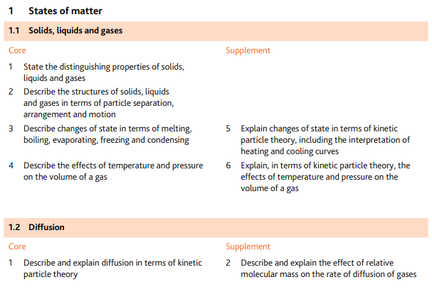
IGCSE SYLLABUS
ASSESSMENT OBJECTIVES

Slide 9
Requirements of the Jordanian equivalency in IGCSE level:
Six IGCSE/O-level subjects – A*, A, B, C, and D (passing grades)
Scientific stream equivalency:
6 passing grades in IGCSE or O-level exams including:
at least two scientific subjects
Arabic
Literary stream equivalency:
6 passing grades in IGCSE or O-level exams including:
at least two scientific subjects

Slide 10
OPTIONS GUIDE

Slide 11
OPTIONS GUIDE
IGCSE & IAL subject options
Jordanian Equivalency Requirements
The MoE rules and regulations
Latest Announcements

Slide 12
IGCSE Subject Options:
IGCSE / O-level subjects | Board | Code
Mathematics* | Cambridge | 0580
ICT* | Cambridge | 0417
English* | Cambridge | 0510/0511
Arabic* | Cambridge | 3180
Physics | Cambridge | 0625
Chemistry | Cambridge | 0620
Biology | Cambridge | 0610
Travel and Tourism | Cambridge | 0471
Business studies | Cambridge | 0450
Food and Nutrition | Cambridge | 0648
French | Cambridge | 0520
Global Perspectives | Cambridge | 0457

Slide 13
IGCSE Subject Options:
Students can choose one subject from each given option based on student’s interests, future study plans, and with regard to the scientific or literary equivalency:
Subject Options
Physics | vs | Travel and Tourism
Biology | vs | Food and Nutrition
Chemistry | vs | Business Studies
French or Global Perspectives (Externals) | vs | Social studies & PE (School subjects)

Slide 14
Important Notes:
Changing subject options is NOT allowed in Grade 10. The student only has the option to change from extended to core syllabus.
Students are not allowed to drop any selected subject in grade 10. However, if a student decides not to sit for the external exam of a specific subject, s/he has the choice not to register as long as s/he has a minimum of 6 IGCSE subjects.

Slide 15
Important Notes:
Students’ academic performance will be closely monitored, should any student need a remedial plan &/or to change options or even programs.
The ONLY official communication channel between the students/parents and the department is the student/family’s school EMAIL.

Slide 16
Extended vs Core Syllabus (CAMBRIDGE)
Extended syllabus:
Core curriculum + Supplement
Grading A* - D
Available for all IGCSE subjects
Core syllabus – Core curriculum only
Core curriculum ONLY
Grading C – D
Available for a number of subjects

Slide 17
Core Option (Syllabus)
Available for Mathematics, Physics, Chemistry, Biology, & English as a second language
Highest passing grade is a “C”
Only the core syllabus is studied
Different exam papers
Different registration option codes
Example: June 2023
BIOLOGY Extended: 0610CY
BIOLOGY Core: 0610GY

Slide 18
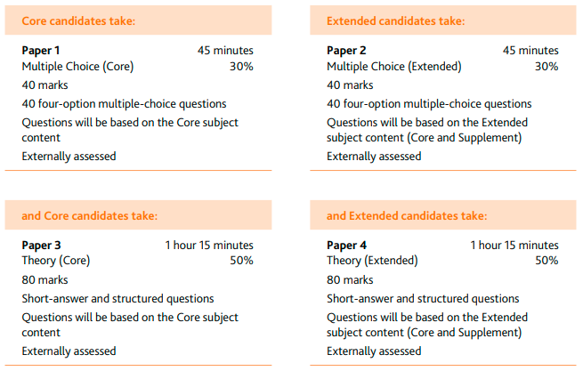
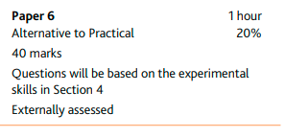
Core Option: Sciences

Slide 19
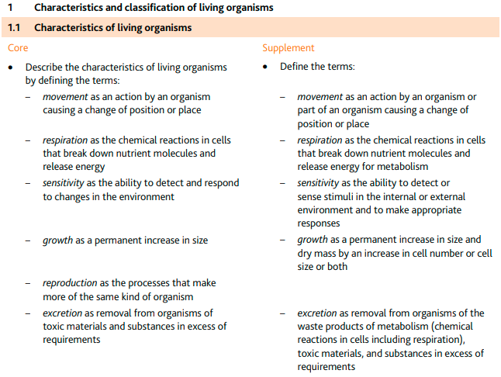
Core Option: Sciences

Slide 20
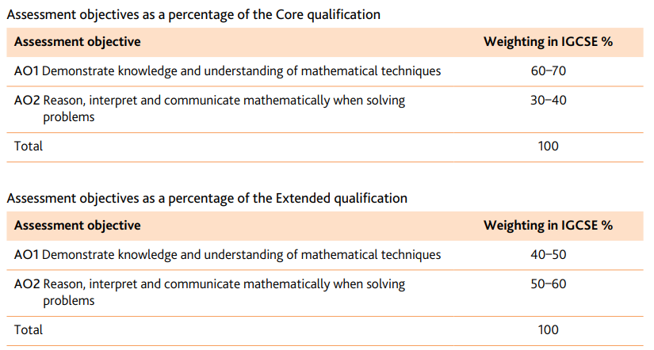
Mathematics: Extended Vs. Core Syllabus

Slide 21
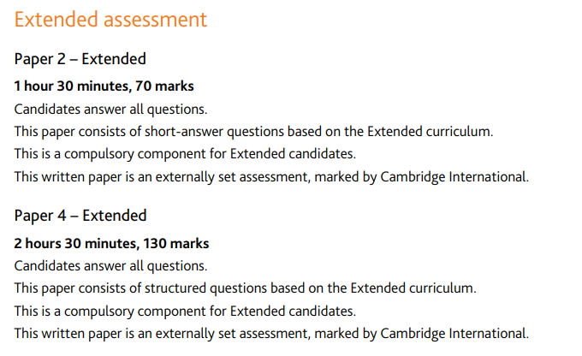
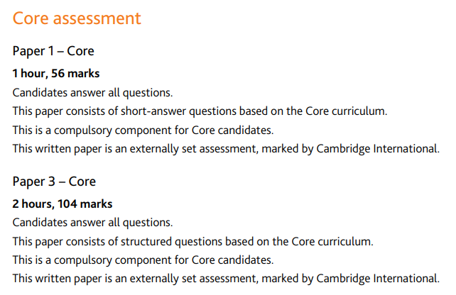
Mathematics: Extended Vs. Core Syllabus

Slide 22
Core Option
Who Decides??
Students/Parents
&/OR
School
Based on the student’s academic performance & teachers’ recommendations

Slide 23
Calculation of final Mark
Raw Marks vs. Weighted Marks
Example 1:
Maths 0580 (Extended)
Paper 2 – Raw mark out of 70 / Weight: 35%
Paper 4 – Raw mark out of 130 / Weight: 65%
Final mark is out of 200

Slide 24
Calculation of final Mark
Raw Marks vs. Weighted Marks
Example 2:
Chemistry 0620 (Extended)
Paper 2 – Raw mark out of 40 / Weight: 30%
Paper 4 – Raw mark out of 80 / Weight: 50%
Paper 6 – Raw mark out of 40 / Weight: 20%
Final mark is out of 200, therefore:
Paper 2 = 40 X 1.5 = 60
Paper 4 = 80 X 1.25 = 100
Paper 6 = 40 X 1 = 40

Slide 25
Grade Boundaries: We Are Almost Back to the Pre-COVID Levels!

Slide 26
Grade Boundaries: We Are Almost Back to the Pre-COVID Levels!

Slide 27
Grade Boundaries: We Are Almost Back to the Pre-COVID Levels!

Slide 28
Jordanian Equivalency
The final GPA is calculated based on the below formula:
Average of 6 IGCSE’s + Average of 2 AS’s or 1Full A-level + Full A-level (following the MoE subject requirements based on the stream)
IGCSE
A*= 100
A = 95
B = 85
C = 75
D = 65
AS
A = 95
B = 85
C = 75
D = 65
E = 55
FULL A-LEVEL
A*= 100
A = 95
B = 85
C = 75
D = 65
E = 55

Slide 29
For subject-specific academic inquiries please contact:
Bassam Abbas - Head of Maths Dept.
b.abbas@nos.edu.jo
Muna Ayyash – Head of Arabic Dept.
m.ayyash@nos.edu.jo
Rania Khalilieh – Head of English Dept.
r.khalilieh@nos.edu.jo
Rafi’ AlMashne – Physics Coordinator
r.mashne@nos.edu.jo
Fadi AlFar – Chemistry Coordinator
f.alfar@nos.edu.jo
Riham Awwad – Biology Coordinator
r.awad@nos.edu.jo
Wesam Abu-Khader – IT Coordinator
w.abukhader@nos.edu.jo
Doris Ghattas – Global Perspectives Coordinator
d.ghattas@nos.edu.jo
Marian Shakori – Business Coordinator
m.shakori@nos.edu.jo

Slide 30
For inquiries during school hours please contact us at
Sophie Sammour - Head of stage 9-12
s.sammour@nos.edu.jo
Nancy Zabaneh – IGCSE Coordiantor
n.zabaneh@nos.edu.jo
Peter Abu Naffa' – Assistant IGCSE Coordinator
p.abunaffa@nos.edu.jo
Jwana Al-Bay – Administrative Officer
j.albay@nos.edu.jo
Shireen Dababneh – Counselor
s.Dababneh@nos.edu.jo
Sabrina Salameh – College Counselor
s.salameh@nos.edu.jo
Ibrahim Alsmairat - Discipline Supervisor
i.alsmairat@nos.edu.jo

Slide 31
NOS Updates:
CIS visit will be between 16/02/2024 – 22/02/2024
We have built an academic leadership team to provide other members of the school with direction and guidance and to support their professional levels.
We have amended and added new school policies such as:
Academic Integrity
Assessment
Language
High quality Teaching & Learning definition

Slide 32
شكرًا
Thank you

