Slide 1
Popular clothes in cities from Jordan
By: Roy, Rakan.m, Masa and Maya

Slide 2
Introduction
Women’s clothing (Thawb) Jordanian women's traditional clothing consists of a thawb (a dress). On the front of the dress, there is usually a decorative panel made from embroidery or what we call tatreez. Women frequently wear handcrafted embroidered dresses with red, gold or green accents and a headscarf in the hues of black and red. However, the colors and embroidery style differ in different parts of Jordan.
For example, Shirsh is the name for clothing in northern Jordan (in Irbid). They typically have long, tight sleeves and a low, embroidered neckline, and are the same length all around. The sides and hem of the outfit are also elaborate embroidered with lovely motifs.

Slide 3
Introduction
Men’s Traditional Clothing (Dishdashah)
Jordanian men’s traditional clothing consists of the dishdashah, a long-sleeved one-piece robe that covers the entire body. The dishdashah is made of white or grey cotton in the summer to reflect sunlight. And darker, thicker textiles keep people warmer in the winter.
As for headwear, men wear a three-piece headcover in addition to their dishdashah. The first piece is the thagiyah, the foundation of this head covering, is a white hat that is used to keep the hair in place. The second piece is either one of two different styles of headscarves that are worn on top of the thagiyah. The summertime headdress known as the gutrah, which is white, the shmagh, or kuffiyeh, a heavy red and white checkered head covering for winter. Last piece to keep the scarf in place is the Agal or (I’gal), is a black doubled cord worn on top of the man’s choice of scarf, and it is traditionally made from goat hair. Traditionally in Jordanian tribes, if a man’s Agal is not placed straight but rather slanted to the right, it means he is a leader of the tribe or a Sheikh.

Slide 4
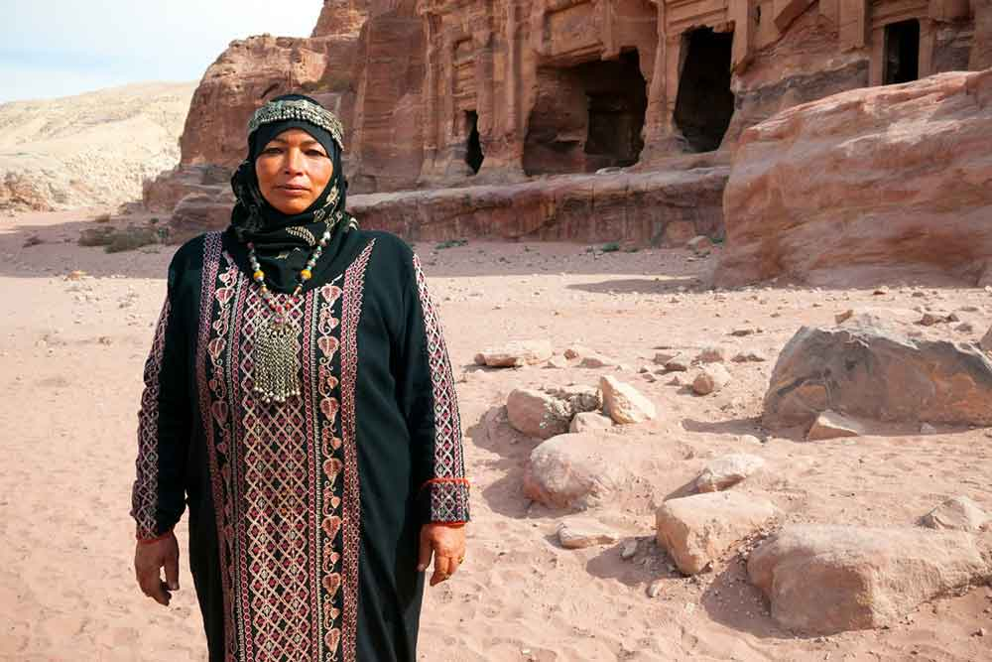
Petra Cloths
What Are Traditional Clothes In Petra
Petra is an ancient city where the Bedouin people used to live. They were nomads who moved around the desert. Petra’s traditional clothing were made for the desert weather.
For men and women, the robes were referred to “throbes”. Men tended to dress in white or beige, and wore headscarves called “kufeya“. Women wore more colourful dresses with embroidery and jewellery.
Now, most people in Petra wear modern clothes, but sometimes you can see traditional Bedouin clothes at festivals and events. You’ll also find these traditional Petra gowns for sale in the souvenir shops around the area.

Slide 5
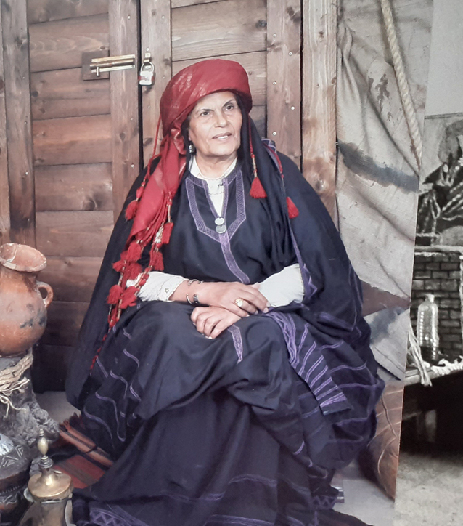
As-Salt Clothes
On 26 September of this year the TRC in Leiden published a blog about traditional dresses in Jordan. Continuing with the series, we want to present a particular dress from the Al Balqa region, more precisely from the town of Al Salt. The TRC in Leiden is fortunate in housing one of these exceptional (and very large) dresses (TRC 2005.0248). We also have a replica, which the TRC uses for demonstration purposes.
Al Salt lies 28 km from Amman. The town has a rich and unique artistic-architectural style, bringing together European and Arabic elements. Situated on the highlands of western Jordan and close to the Jordan valley, its land is characterized by its Mediterranean vegetation of olive trees, figs, vineyards and other fruit trees, which are being harvested and exported throughout the area.

Slide 6
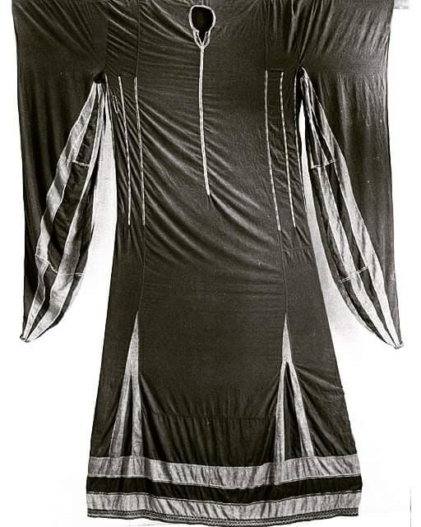
As-Salt Clothes
Al Salt has always been famous for its wool, the threads that are spun and the red dyes that are being used (due to the presence of sumac trees), but above all the city was known for its unique and admired women's dresses. The traditional dress is called “Khalaga” and requires almost sixteen meters of black cotton (dubeit) fabric. The dresses are decorated with a little embroidery, usually concentrated around the neck opening, along the seam lines and the sleeves. Blue indigo-dyed bands are applied vertically on the sleeves and around the hem.
The sleeves (irdan) are very long and have a triangular shape. They are pulled over the headband (asba) to form a sort of head covering. The asba is a very large, rectangular piece of red or black silk. It is folded to form a long rectangular band which crowns the woman's head, but its main purpose is to keep the sleeves in place. The TRC Collection houses two of these head bands (TRC 2005.0164; TRC 2011.0481).

Slide 7
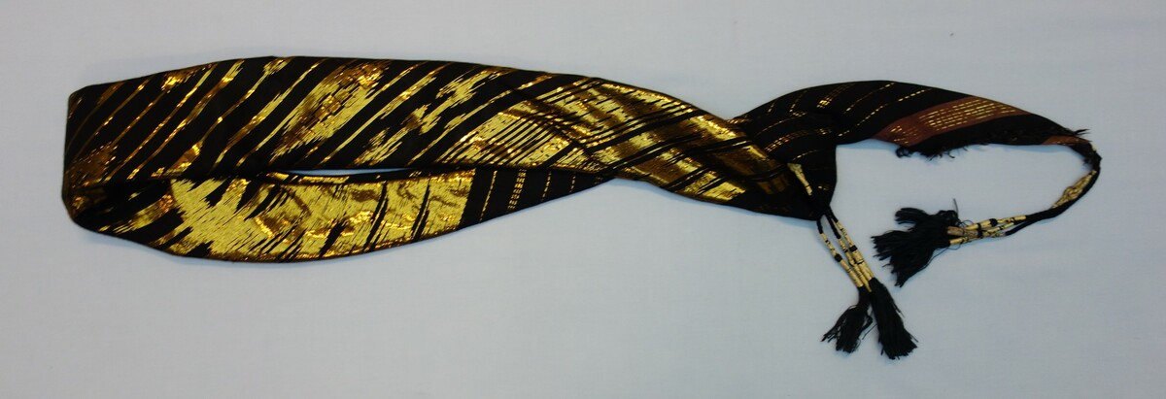
As-Salt Clothes
Wearing this three-metre long dress might at first cause some hassle to put it on. The dress is pulled all the way up and fastened at the waist with a woolen belt. It is then left to drape over the belt creating in this way a folded layer effect.
The reasons for wearing such a long dress is little known, but there is a popular story that efers back to the Ottoman period, when women used to smuggle and hide valuable stuff from the tax collectors inside her dress.
Nowadays the use of the Khalaga dress has completely disappeared from women’s daily life. And yet, there is a long standing tradition for women of various ages to make their way to downtown Al Salt, to the photo studio and have a picture taken wearing a rented Khalaga dress. This photograph is then framed and displayed inside the house as a symbol of pride, vanity and belonging to this city.
Recently, I was very pleased to discover a small group of local women from Al Salt who decided to revive the use of the Khalaga dress in a renewed form. They made the dress smaller and more suitable for modern daily life. They maintained some basic elements, such as the blue bands and the long pointed sleeves, but also introduced a new embroidered motif to the dress.

Slide 9
Recources
www.amideastedabroad.org
https://meetmeindepartures.com/what-to-wear-in-petra-jordan/
https://www.trc-leiden.nl/trc/index.php/en/blog/1131-embroidered-dresses-from-jordan-al-salt-city

