Slide 1
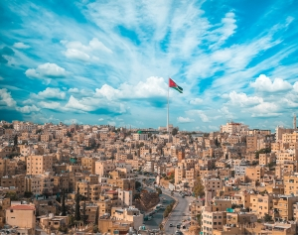
Traditional foods in Jordan
BY: Joseph, Eila, Jad and Celine.
DATE: November 08, 2023

Slide 2
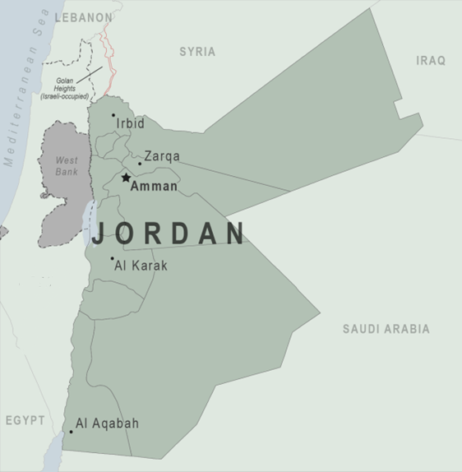
Jordan Traditional Food
Traditional foods are food and dishes that are passed on through generations, or that have been consumed for many generations.
Traditional foods and dishes are traditional in nature and may have a historic precedent in a national dish, regional cuisine, or local cuisine.
In Jordan there are quite some traditional dishes that have the Jordanian signature. Mansaf, Makmoura, and Rashoof will be introduced in this project.

Slide 3
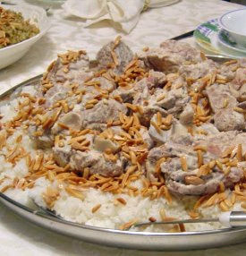
Mansaf
“Mansaf” is the traditional signature dish of Jordan, made of lamb cooked in a sauce of fermented dried yogurt called “Jameed” and served with rice or bulgur.
"Mansaf" is historically linked to Jordan through an incident narrated about King Mesha, one of the kings of the Kingdom of Moab, which was founded in the 13th century BC and lasted until 14 BC. Its borders extended along the eastern coast of the Dead Sea, from the north of the city of Karak to Shobak.

Slide 4
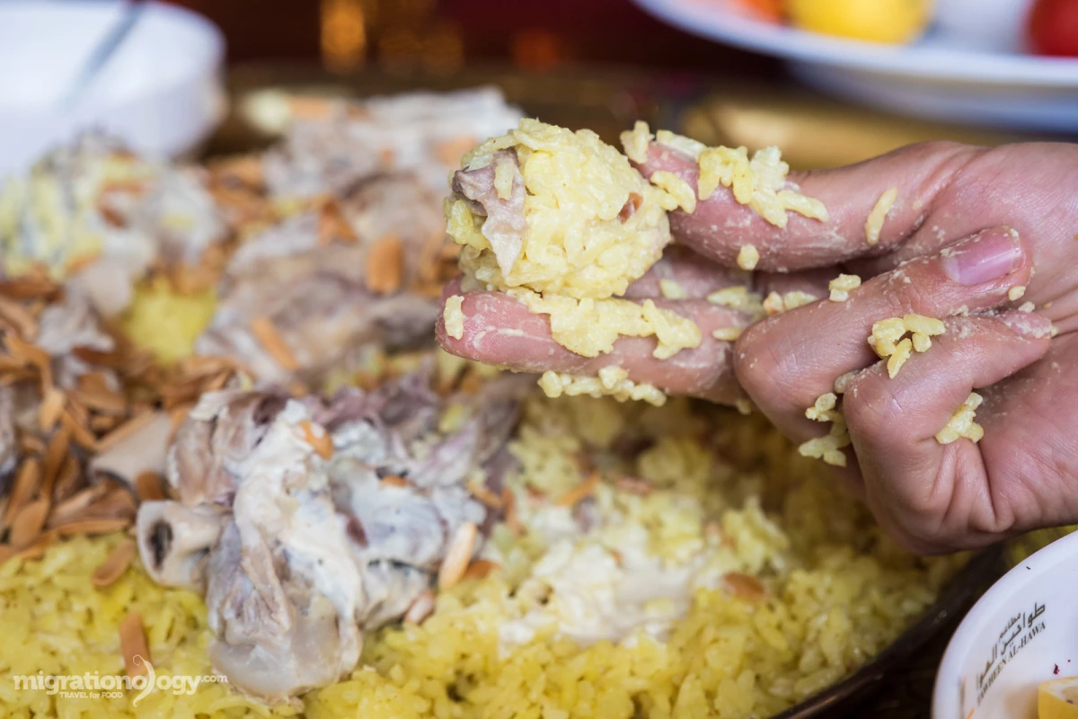
Mansaf
The most delicious Mansaf is made at Al Karak.
Jordanians often eat Mansaf on special occasions such as weddings births funerals to honor a guest and major holidays. Mansaf is more than just a dish-it’s a cultural symbol that encapsulates Jordanian traditions and hospitality.
Fun fact: Mansaf is traditionally eaten by hand.

Slide 5
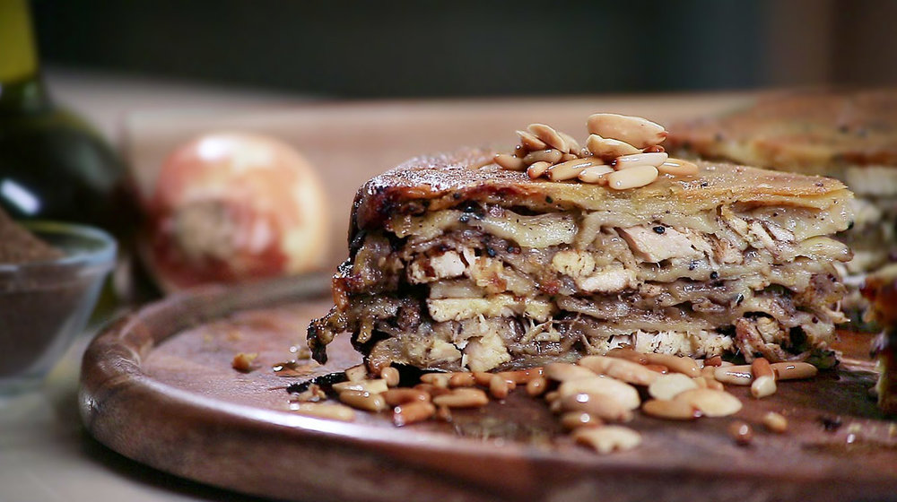
Makmoura
"Makmoura” is one of the many traditional dishes in Irbid, It was created in ancient Irbid where each family would add its own special touch which has been passed down over the decades, Makmoura is often served in the winter.
It is cooked with local flour and meat with mashed onions and olive oil, in many layers.
Fun fact: In November people pluck olives to use in the Makmoura.

Slide 6
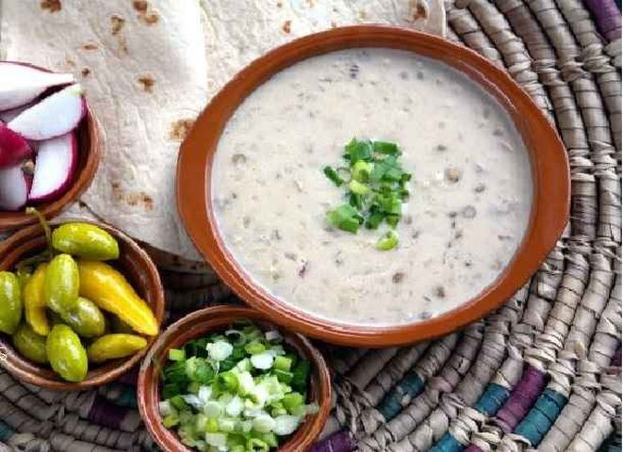
Rashouf
“Rashouf” is often made in the winter to help warm people, it was made a few thousand years ago and is made up of coarse wheat flour, lentils, and yogurt.
It originated from Balqa, where it is eaten a lot in the winter to give them energy and not for a long time.
Fun fact: Rashouf is often served alongside Mansaf.

Slide 7

Interview

Slide 8
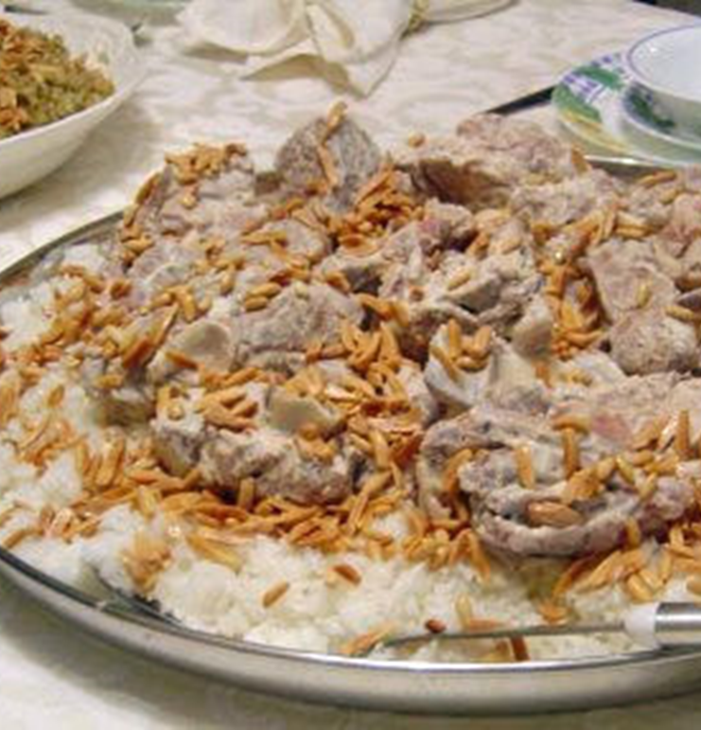
References
المعزب رباح مداخل إلى تراث الإنتاج الفلاحي - البدوي وتقاليد الغذاء في الأردن لـ ناهض حتر، أحمد أبو خليل، مؤسسة الإنتشار العربي، 2014.
https://ich.unesco.org/en/RL/al-mansaf-in-jordan-a-festive-banquet-and-its-social-and-cultural-meanings-01849

