Slide 1
Jordanian customs
Taleen, Yousef, hashem, karam h

Slide 2
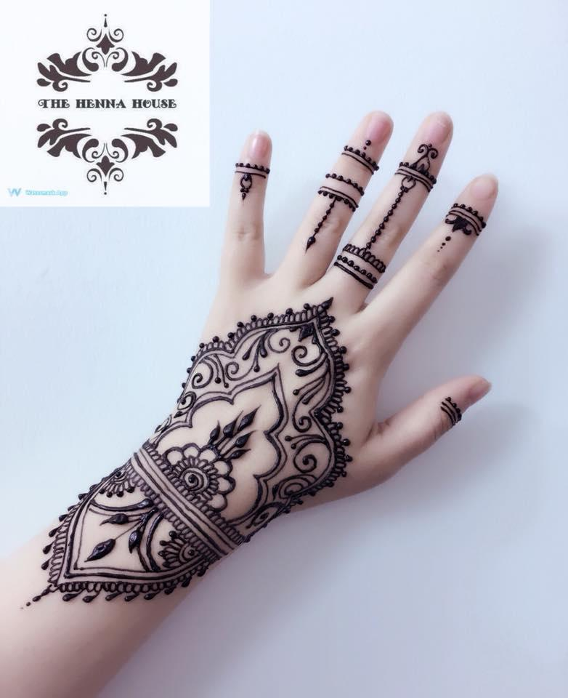
Jordanian weddings
One of the Jordanian customs in Jordan at weddings, is the bride’s henna ceremony, the bride invites all the women of the family and her friends, and they sing folk songs.

Slide 3
Bride’s hand in marriage
The bride’s proposal is one of the most famous Jordanian customs and traditions, in which the groom’s family attends, accompanied by his family, and their clan elders may attend with them, to ask for the bride’s hand in the presence of her family and relatives. The customs of the bride’s proposal vary according to the family or clan, and may be limited to the presence of the bride’s family or a larger number of guests.
http://ammannet.net

Slide 4
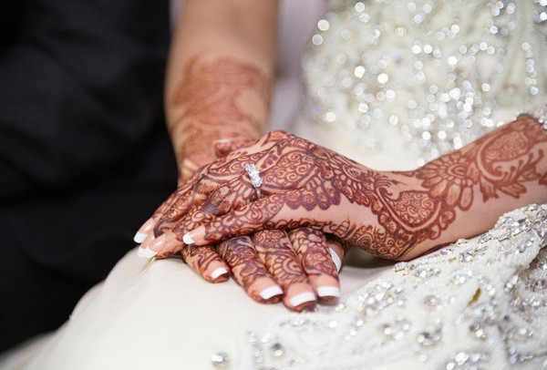
Bride’s henna
Henna is a night in which joy and happiness spread in the bride’s home, and it is her last night in her family’s home before she bids farewell to the marital home. Therefore, it is a special night for every bride, where only female relatives, friends, and neighbors gather to surround her and rejoice with her
https://english.alarabiya.net

Slide 5
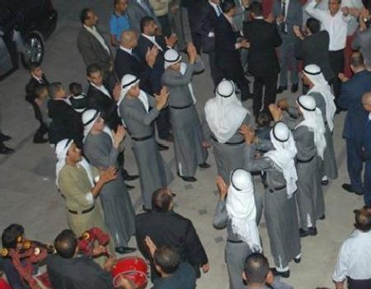
A weddings zeffah
A zeffah is where the bride would leave her family’s house to accompany her groom to the hall. On the wedding day, music would be played and the groom’s family would dance in front of the house - which is similar to celebrating marriage at home, as the zeffah has become here. As if it were from those days - before moving to the hall. As for the wedding in Saudi weddings, it begins with a wedding studio in Mecca that makes arrangements for the wedding at the hall.
https://findaperformer.net/search/zaffa-groups/

