Slide 1
Stress
By: Zeid Nino & Khalil Shtaiwy

Slide 2
What is Stress?
Stress is our body’s response to pressure. Many different situations or life events can cause stress. It is often triggered when we experience something new or unexpected that threatens our sense of self or when we feel we have little control over a situation. It usually happens when we are in a situation that we don't feel we can manage or control.
Whether you’ve just narrowly avoided a car accident or are worried about losing your job, stressful situations trigger a release of hormones known as the “fight-or-flight response. Stress helps the body face stressful situations.

Slide 3
What Causes Stress?
This automatic response developed in our ancient ancestors as a way to protect them from predators and other threats.
When you are in danger, your body kicks into gear, flooding the body with stress hormones such as adrenaline and cortisol that elevate your heart rate, increase your blood pressure, boost your energy, and prepare you to deal with the problem.

Slide 4
What are The Consequences of Stress?
Stress that's not dealt with, can lead to many health problems, such as high blood pressure, heart disease, stroke, obesity and diabetes.
Sometimes, a small amount of stress can help us to complete tasks and feel more energized. But stress can become a problem when it lasts for a long time or is very intense. In some cases, stress can affect our physical and mental health.
The body’s autonomic nervous system controls your heart rate, breathing, vision changes and more, It’s a built-in stress response.

Slide 5
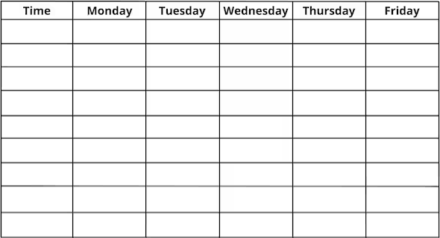
Stress Solutions:
Be sure to make time for things you enjoy, like playing music, working out, playing with a pet, or spending time with friends. Even if it’s only a few minutes, daily time to relax and recharge lowers your stress.
Keep track of your daily schedule. Fill in your class times, tests, and when assignments are due. Add your activities to your schedule leave some time to study for tests and work on assignments and sometimes do things you enjoy. Having a plan and a daily routine lowers stress.
Schoolwork, grades, and tests are a big source of stress for many people. Keeping on top of it all isn’t always easy. If you need help preparing for tests, planning projects, or getting things done, ask a teacher or parent to coach you.

Slide 6
Cross-Checking:
https://my.clevelandclinic.org/health/articles/11874-stress
https://medlineplus.gov/ency/article/003211.htm
https://www.helpguide.org/articles/stress/stress-symptoms-signs-and-causes.htm
https://www.healthdirect.gov.au/stress
https://www.geisinger.org/health-and-wellness/wellness-articles/2020/02/06/21/08/how-stress-affects-your-body
https://www.hse.gov.uk/index.htm
https://www.ncbi.nlm.nih.gov/pmc/articles/PMC3341916/
https://www.cigna.com/knowledge-center/effects-of-stress-and-their-impact-on-your-health
https://www.betterhealth.vic.gov.au/health/healthyliving/stress
https://www.mentalhealth.org.uk/explore-mental-health/a-z-topics/stress
https://kidshealth.org/en/teens/stress-tips.html
https://www.heart.org/en/healthy-living/healthy-lifestyle/stress-management/3-tips-to-manage-stress

Slide 7
Thank You For Listening! 😄

