Slide 1
Obesity
Done by: Nadeen Theodory, Sadeen Abu Taa, Joyce Zananiri, Elias Mouasher, Yousef Rantissi.

Slide 2
What is obesity?
Obesity is a complex health issue with various causes. This presentation will explore the health risks, prevention strategies, and the role of diet and exercise in managing obesity.

Slide 3
What are the causes of obesity?
Unhealthy eating habits.
Consuming excessive calories, sugary drinks, and processed foods contribute to weight gain.
Genetics.
Genetic factors can predispose some individuals to obesity
01
03
Inactivity.
Sedentary lifestyles, lack of physical activity, and prolonged screen time can lead to weight gain.
Psychological Factors.
Emotional eating, stress, and depression can contribute to weight gain.
02
04

Slide 4
What are the health risks of obesity?
Joint problems.
Excess weight puts strain on joints, leading to conditions such as osteoarthritis.
Cardiovascular disease.
Obesity increases the risk of heart disease, high blood pressure, and stroke.
Diabetes.
Obesity is a major risk factor for developing type 2 diabetes.
Mental health issues.
Obesity is linked to increased rates of depression, anxiety, and low self-esteem.

Slide 5
Prevention and treatment of obesity
Healthy diet.
Eat a balanced diet rich in fruits, vegetables, whole grains, and lean proteins.
Behavioral changes.
Adopting healthier habits, setting realistic goals, and seeking support.
Regular exercise.
Incorporate physical activity into daily routines to maintain a healthy weight.
Medical Intervention.
In some cases, medication or weight-loss surgery may be necessary.

Slide 6
The role of diet in managing obesity
Calorie control.
Monitoring calorie intake and portion sizes are crucial for weight management.
Reducing added sugars.
Avoid sugary drinks and limit consumption of sweets and processed foods.
Nutrient-Dense foods.
Eat foods that are rich in nutrients, such as fruits, vegetables, and whole grains.

Slide 7
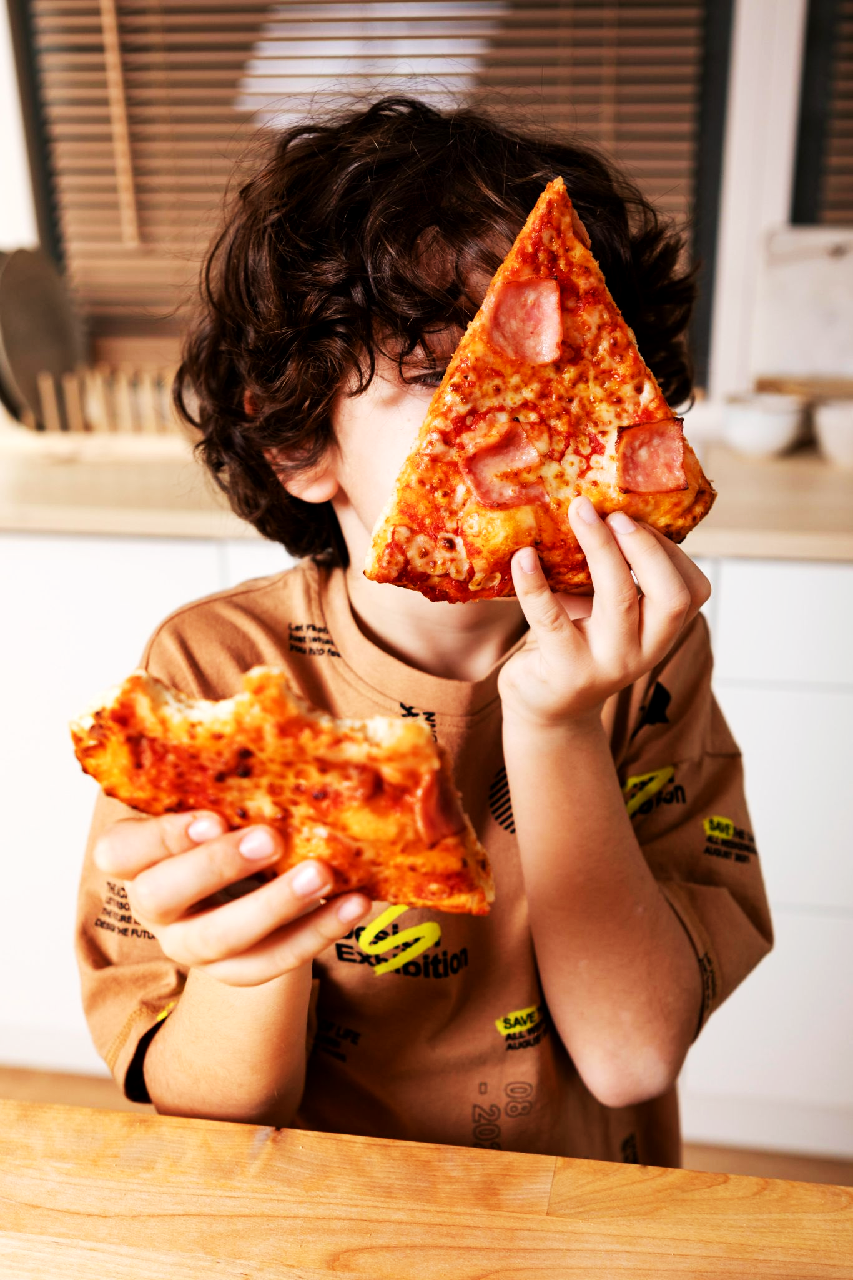
The role of exercise in managing obesity
Aerobic exercise.
Engage in activities like brisk walking, jogging, cycling, or swimming for cardiovascular health.
Strength Training
Build muscle mass to increase metabolism and improve body composition.
Physical activity for all ages.
Encourage regular exercise for both children and adults to maintain a healthy weight.

Slide 8
Psychological factors related to obesity
Emotional eating.
Food can be used as a coping mechanism for stress, boredom, or other emotional triggers.
Body image and Self-esteem.
Low self-esteem and negative body image can contribute to overeating and weight gain.
Mental health support.
Addressing underlying emotional issues through therapy and support systems.

Slide 9
Interview with Dr. Dina Abbasi

Slide 10
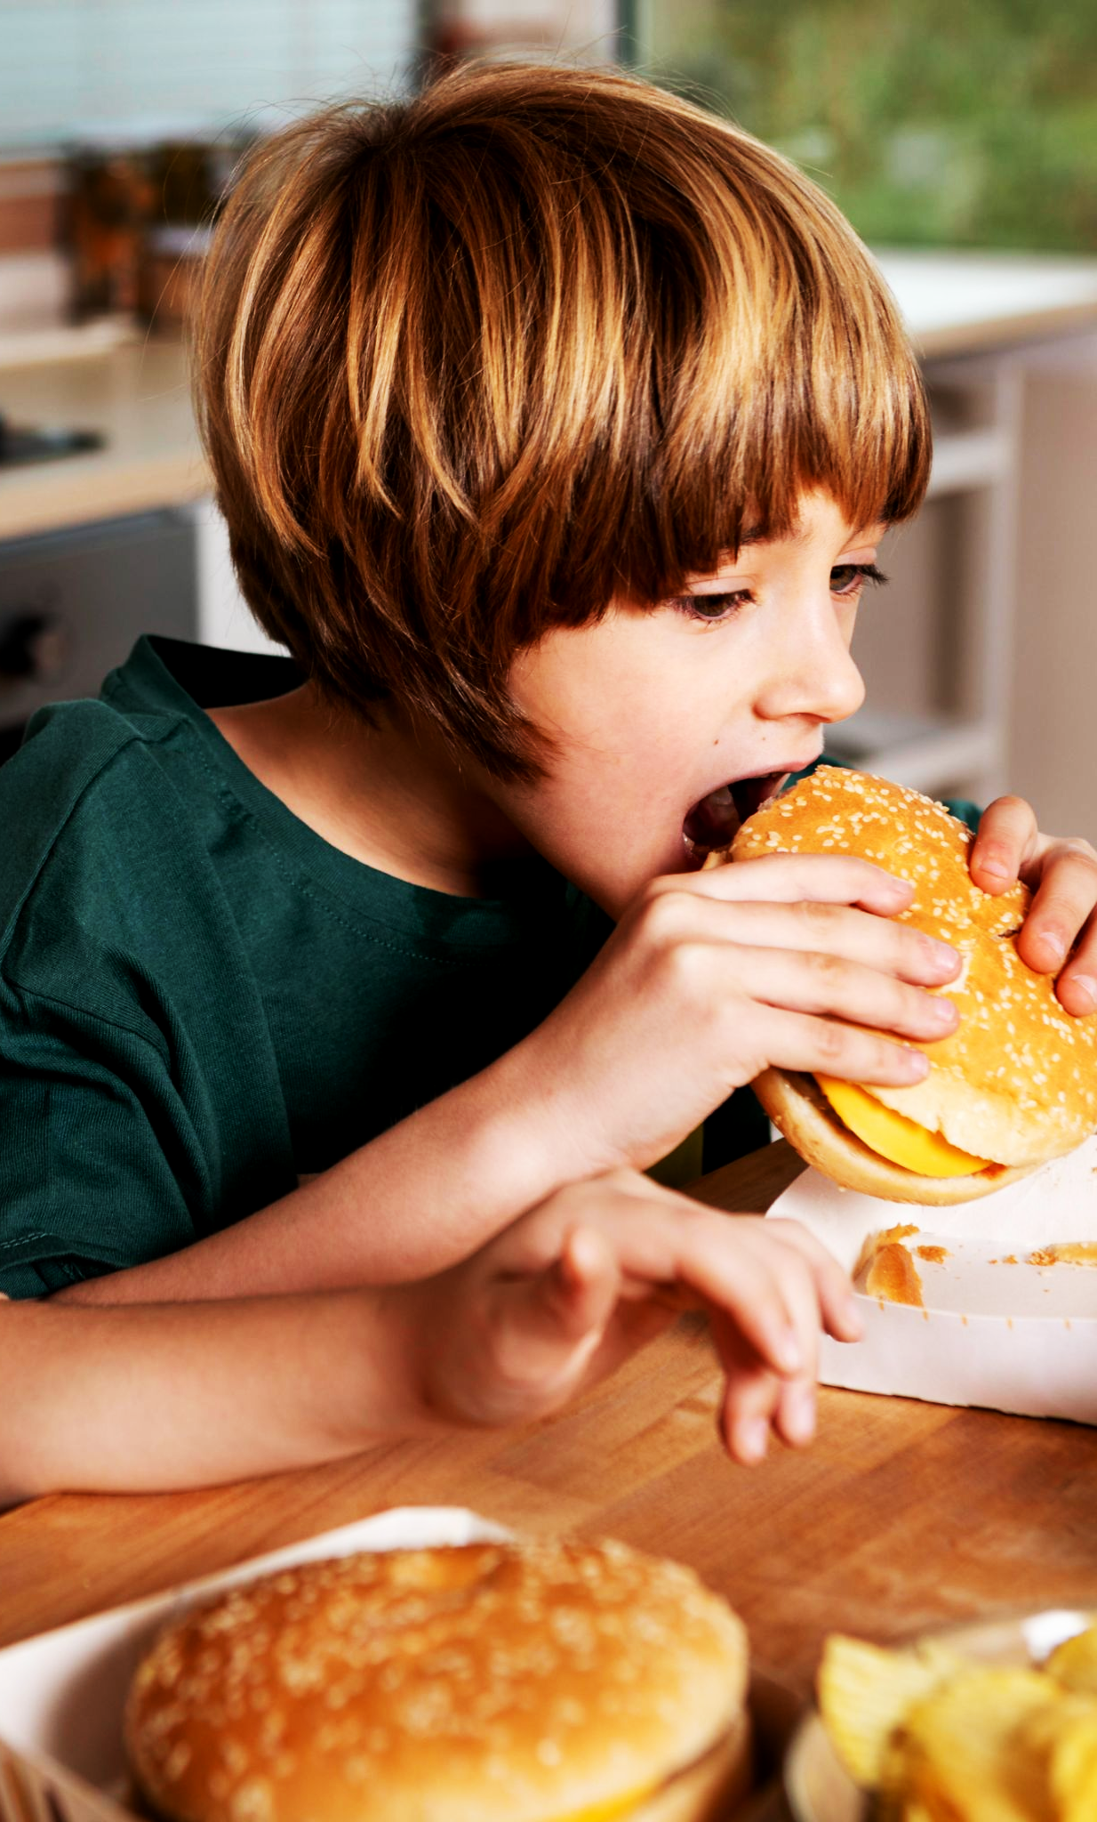
Information about losing weight safely
“To lose weight safely, aim for a deficit of 500 calories per day to lose 0.5 kilograms weekly, or 1000 calories for a 1-kilogram loss. Achieve this through reduced calorie intake, increased physical activity, or a combination of both.”

Slide 11
Advice for vegetarians
“For vegetarians, consider supplementing nutrients like Vitamin B-12 due to the absence of animal proteins. To support immune function, incorporate nutrient-rich foods like dairy, bell peppers, citrus, kiwi, fish, broccoli, and spinach. A healthy diet involves a balance of essential nutrients from various food groups, limiting fats, sugar, salt, and alcohol. The number of servings depends on individual calorie needs. To burn off stored body fat, focus on calorie reduction, increased physical activity, and a behavior change plan.”

Slide 12
Conclusion
Obesity is a multifaceted issue requiring a holistic approach. By understanding its causes, health risks, and effective strategies, we can work towards a healthier future.

Slide 13
Thank you for listening.

Slide 14
Links:
https://www.mayoclinic.org/diseases-conditions/obesity/symptoms-causes/syc-20375742
https://www.hsph.harvard.edu/obesity-prevention-source/obesity-prevention/#:~:text=Increasing%20physical%20activity,Improving%20sleep
https://www.cdc.gov/obesity/basics/consequences.html#:~:text=Adults%20with%20obesity%20have%20higher,as%20clinical%20depression%20and%20anxiety

