Slide 1
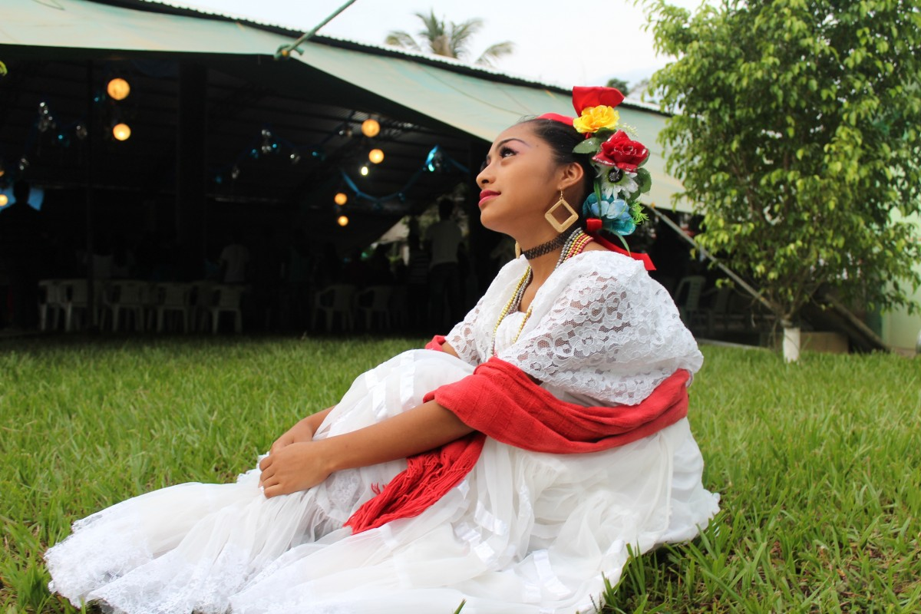
Clothing traditions
By: Karam, Maya, Darah, Fouad

Slide 2
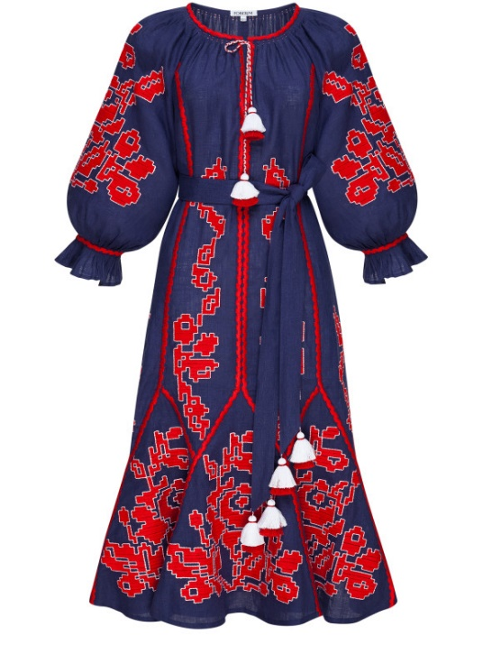
Ma’an
In ma’an however the dress style is different significantly interns of fabric colours and designs.
The hormozidress was worn by women all economic strata.
Jordanian traditional attire in ma’an they where in womens age, a red band for a young women a black band for an older women.
A married women would wear a differently cloured dress compared to a single women.

Slide 3
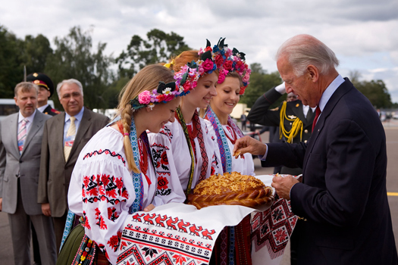
Salt
The salt women's costume has a high Aesthetic Features and in signifintly different from the rest of the traditional costumes known in Jordan. According to Aljazeera they Monitored different models of it to learn about its patterns and historical features and to add light in particular on the Salt brides dress known as the khalqa, which with its amazing and ingrowing constitutes a creative work.
In conclusion
the women of authority excelled in making it and exelled in the ways of wearing it.

Slide 4
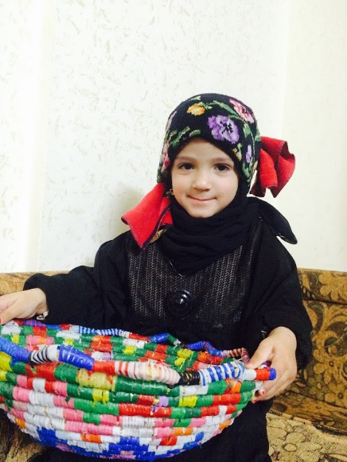
Al Ramtha
The german Bashkir is also considered a kind of luxury for those who wear it,especially since its price is many times higher than the price is many times higher than the price of traditional head coverings, and its price reaches 50 Jordanian dinars (70 us dollars).
The german Bashkir is a distinctive mark for the women of ramtha and the surrounding villages. When any women is seen wearing it on her head, she is “immediately known as” Ramthawi

Slide 5

Watch this video

