Slide 1
Addictive Gaming On Grades 6-8
Done By:Majed Abu Barham, Rami Sunna , Nizar Billeh

Slide 2
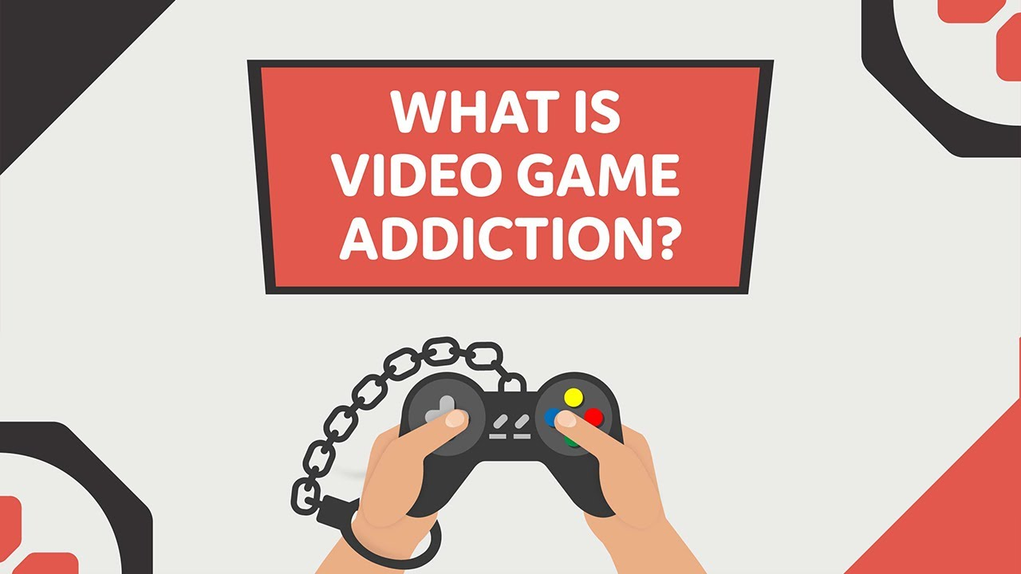
What is Addictive Gaming?
Video game addiction (internet gaming disorder) is characterized by severely reduced control over gaming habits, resulting in negative impacts on daily functioning, including personal, social, educational and occupational responsibilities. While millions of people play video games, only a small percentage develop video game addiction.

Slide 3
What causes gaming to become addictive?
An addiction is defined as a person's inability to control use of a substance or behavior, despite negative consequences. Some people who are engrossed in screen time or video games while ignoring other normal activities could be close to meeting this definition.
So why does this happen? The reward center in the brain releases dopamine in response to a pleasurable experience or hyper arousal. If a person experiences hyper arousal while playing video games, the brain associates the activity with dopamine. The person develops a strong drive to seek out that same pleasure again and again.

Slide 4
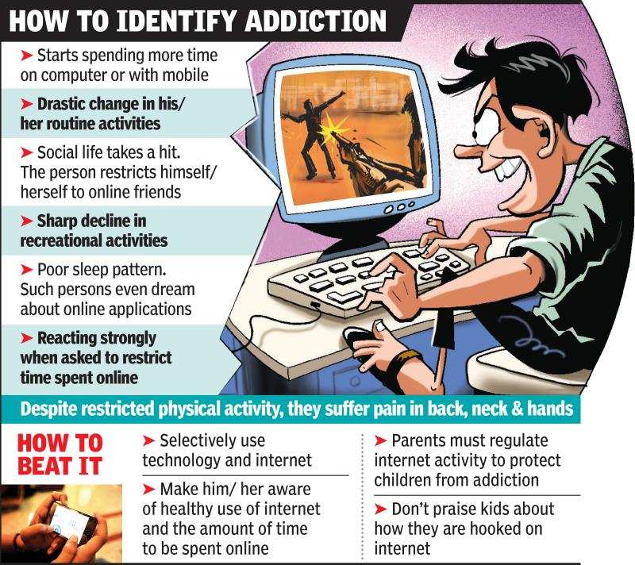
Symptoms of addictive gaming
Lack of control over time spent gaming
prioritizing gaming over other interests, important tasks, and daily responsibilities
continued or escalated gaming despite negative consequences
obsessive thinking about video or internet games
loss of interest in other hobbies or activities
poor concentration or motivation
decline in physical health and hygiene

Slide 5
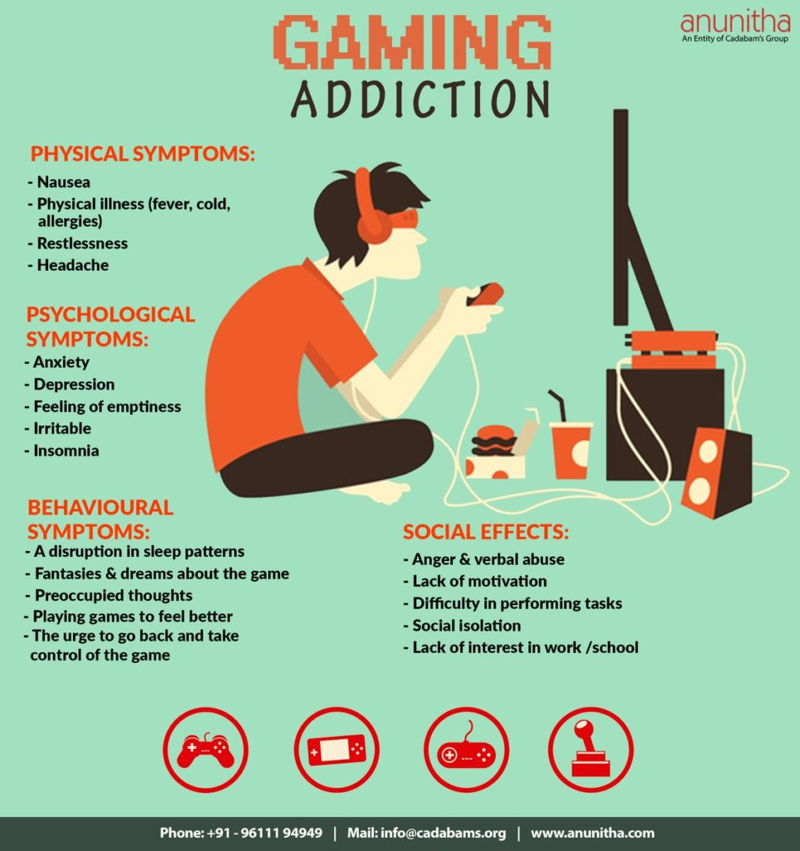
Consequences of Addictive Gaming
It's difficult to avoid screens completely, especially with their importance at work and school. However, excessive screen time can affect a persons mental, social and physical health.
Too much screen time has been linked to:
Obesity
Poor sleep or insomnia
Behavioral problems, including impulsive actions
Loss of social skills
Violence
Less time for play
Eye strain
Neck and back problems
Anxiety
Depression
Difficulties with work or school

Slide 6
How to prevent and solve a gaming addiction?
Preventing a Gaming Problem
To keep the amount of time spent gaming under control, try these tips for adults and kids alike:
Set time limits for play and stick to them.
Keep phones and other gadgets out of the bedroom so you won’t play into the night.
Do other activities every day, including exercise. This will lower the health risks of sitting and playing for long stretches of time.
Video

Slide 7
Citations
professional, C. C. medical. (n.d.). Video game addiction: What it is, symptoms & treatment. Cleveland Clinic. https://my.clevelandclinic.org/health/diseases/23124-video-game-addiction
Edward Luker, L. P. C. (2022, August 25). Video games and screen addiction. Mayo Clinic Health System. https://www.mayoclinichealthsystem.org/hometown-health/speaking-of-health/are-video-games-and-screens-another-addiction
Mandriota, M. (2022, January 5). Gaming disorder: Symptoms, causes, and treatments. Psych Central. https://psychcentral.com/addictions/gaming-disorder#symptoms

Slide 8
Citations
WebMD. (n.d.). Video game addiction: Symptoms, treatment, and prevention. WebMD. https://www.webmd.com/mental-health/addiction/video-game-addiction
Survey

