Slide 1
Chronic respiratory disease
Done by:Yasmeen , Marah, Talia, Leith, Fares kh

Slide 2
Chronic respiratory disease
Breath is important in our life. So why isn’t lung health well recognized as a critical health factor?

Slide 3
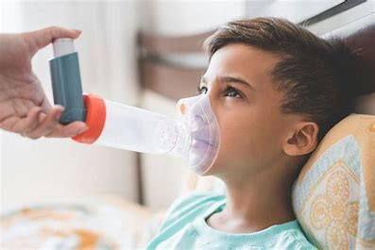
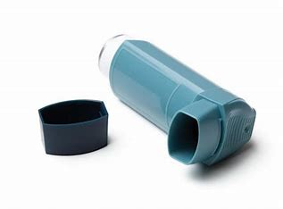
Asthma
One of the diseases that chronic respiratory disease includes is asthma.
Asthma is a chronic (long-term) condition that affects the lungs. It makes it harder for air to flow out of your airways when you breathe out.

Slide 4
How does asthma happen?
Asthma happens when an individual is exposed to certain triggers, the immune system reacts by the following:
Airway Inflammation
Airway Constriction
Airway Hyper-responsiveness

Slide 5
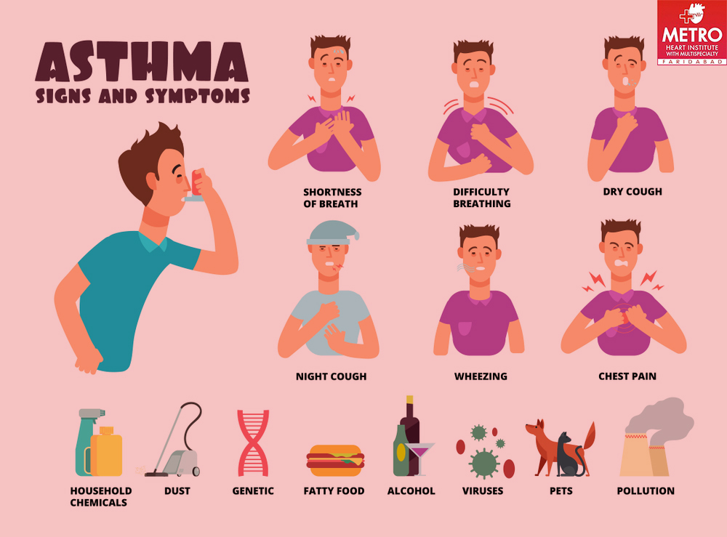
Symptoms of asthma
Some of the symptoms you might get if you have asthma include continuous episodes of:
Coughing
Wheezing(a whistling sound during breathing)
Shortness of breath
Chest tightness

Slide 6
What are the causes of asthma?
Air pollution
Smoking
Allergies
Family history
Respiratory infections
Obesity(being overweight)

Slide 7
How does asthma affect people(consequences of asthma)
Asthma affects people in various ways, with symptoms ranging from mild to severe. The impact of asthma can be physical, emotional, and lifestyle-related.
This includes the following:
Breathing difficulties.
Limitations in physical activities
Ruining of sleep
Impact on daily life

Slide 8
Ways to prevent asthma
Be active
Exercise
Have a good sleep schedule

Slide 9
Here is a video that explains asthma:
https://youtu.be/MFwnTon4oDM?si=3qS-CUp6ezRQQHv6

Slide 10
Citation and recourses used:
Dr. Amjad Alississ Otolarygologist/Neuro Otologist
https://ncdalliance.org/
https://www.lung.org/
https://aafa.org/

