Slide 1
HEALTH CAMPAIGN By: Nadeem Wakileh, Nicola Shnoudi, Olivia Qudah Pro tip: Put it in Slide-Show!!!

Slide 2
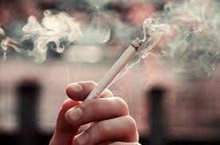
zzzzzzzzzzzz
What is smoking?
Breathing the fumes of burning plant material, especially tobacco, from a cigarette, cigar, or pipe. Despite social and medical arguments against tobacco use, smoking is widely practiced around the world. Nicotine is an alkaloid in tobacco that is addictive and can have both stimulating and tranquilizing psychoactive effects.

Slide 3
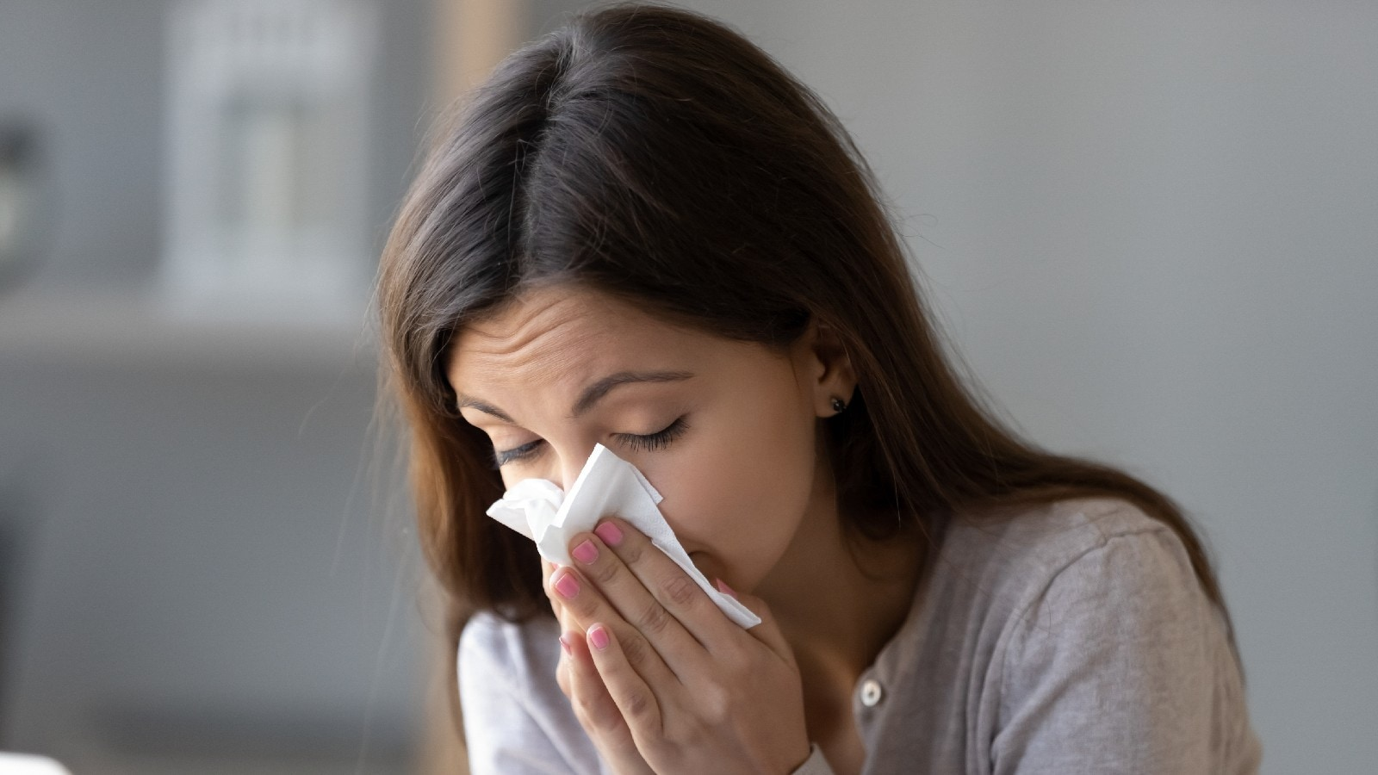
zzzzzzzzzzzz
What are the risks of smoking?
Within 10 seconds of your first puff, the toxic chemicals in tobacco smoke reach your brain, heart and other organs. Smoking harms almost every part of your body and increases your risk of many diseases. Smoking also affects how you look and feel, your finances and the people close to you.

Slide 4
zzzzzzzzzzzz
How do I reduce the risks of smoking?
There is no safe level of smoking.
To reduce your risk, the best option is to quit smoking. You’ll feel the health benefits almost straight away.

Slide 5
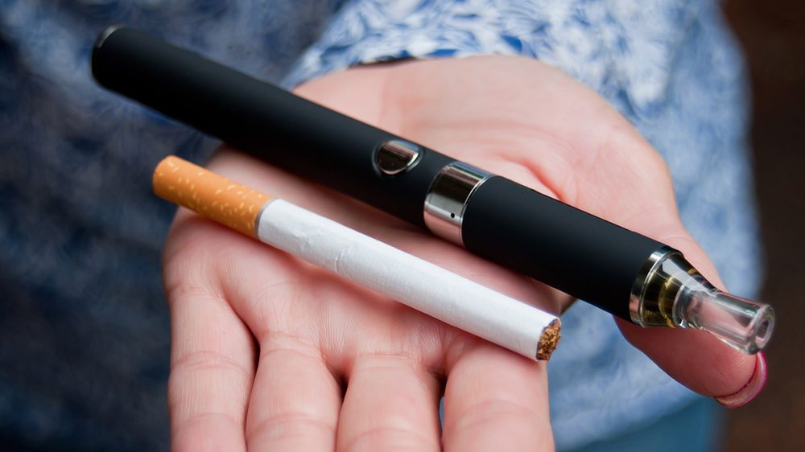
zzzzzzzzzzzz
Is vaping an alternative to smoking?
Our medical expert says otherwise. He said both are just as bad and have the same effects. Even the packaging boxes of both say it.

Slide 6
zzzzzzzzzzzz
Do people enjoy smoking?
Most certainly yes. Most people who were interviewed for smoking said they “ enjoyed the feeling “ when they smoke.

Slide 7
Citations: - Encyclopædia Britannica, inc. (n.d.). Smoking summary. Encyclopædia Britannica. https://www.britannica.com/summary/smoking-tobacco#:~:text=The%20tar%20(residue)%20and%20gases,risk%20factors%20(see%20asbestosis).
- Australian Government Department of Health and Aged Care. (2023, April 4). What are the effects of smoking and tobacco? https://www.health.gov.au/topics/smoking-and-tobacco/about-smoking-and-tobacco/what-are-the-effects-of-smoking-and-tobacco#reducing-the-effects The rest were from the interviews posted on the assignment.

