Slide 1
Chicken Pox
Done by: Eleanor, Helana, Angelina, Nadeen, Naya

Slide 2
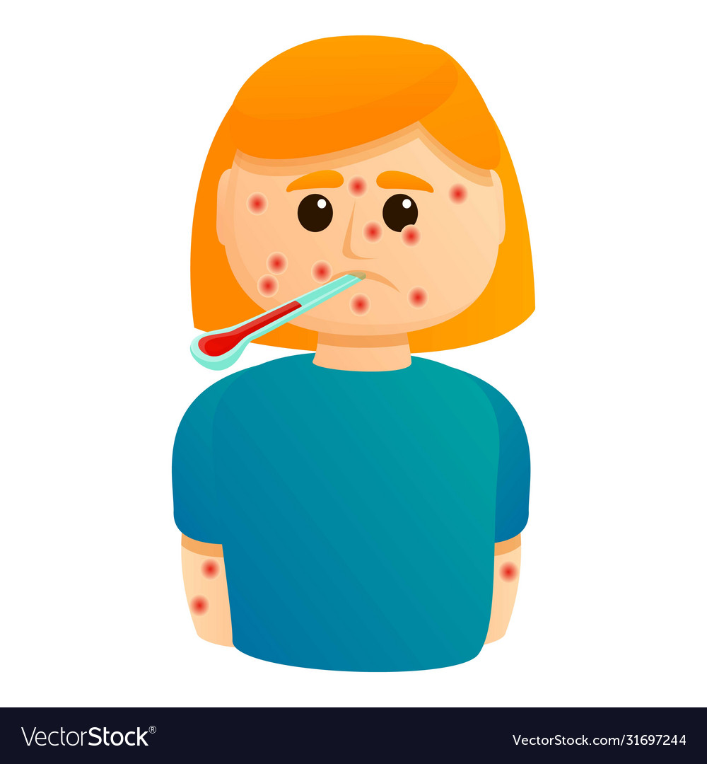
What is chicken pox?
Chicken pox is a viral infection that causes fevers, itchy rashes and stomach aches

Slide 3
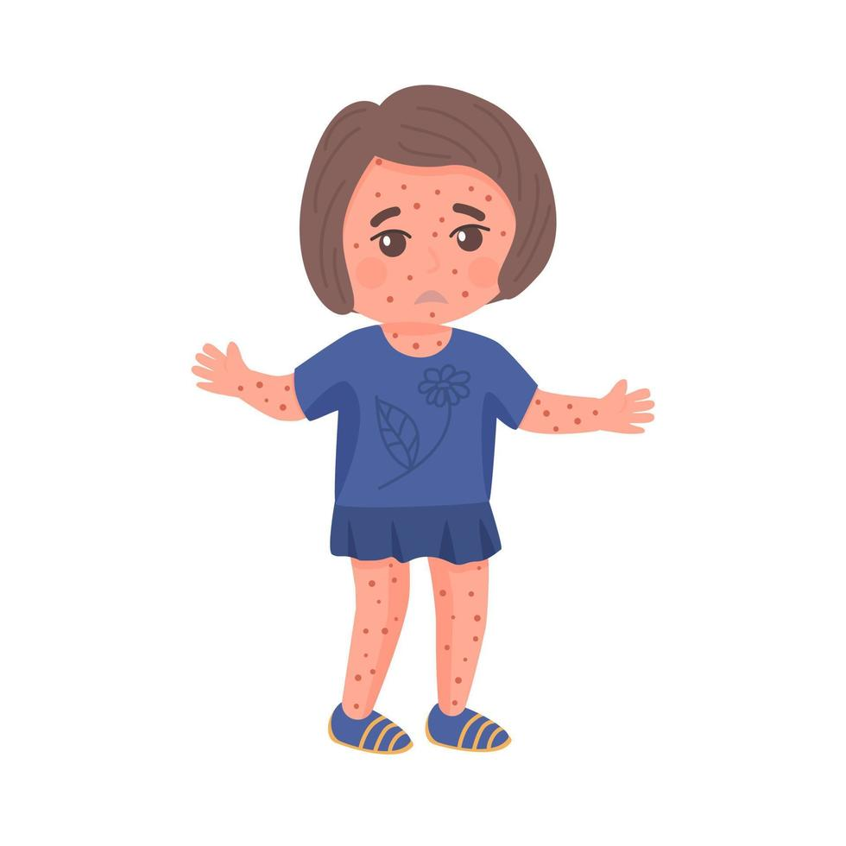
Causes of chicken pox
You can get it from touching the fluids from a chicken pox blister
If someone with the disease choughs or sneezes near you

Slide 4
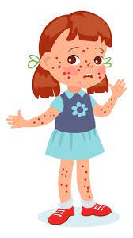
What are the symptoms of chicken pox
Fever
Tiredness
Loss of appetite
Headache
Itchy rashes

Slide 5
Signs of chicken pox
It may start out seeming like a cold, you might have a runny nose or a stuffy nose, sneezing or coughing. But 1-2 days the rash begins often red dots (body, face, chest) from there is can easily spread all over the body

Slide 6
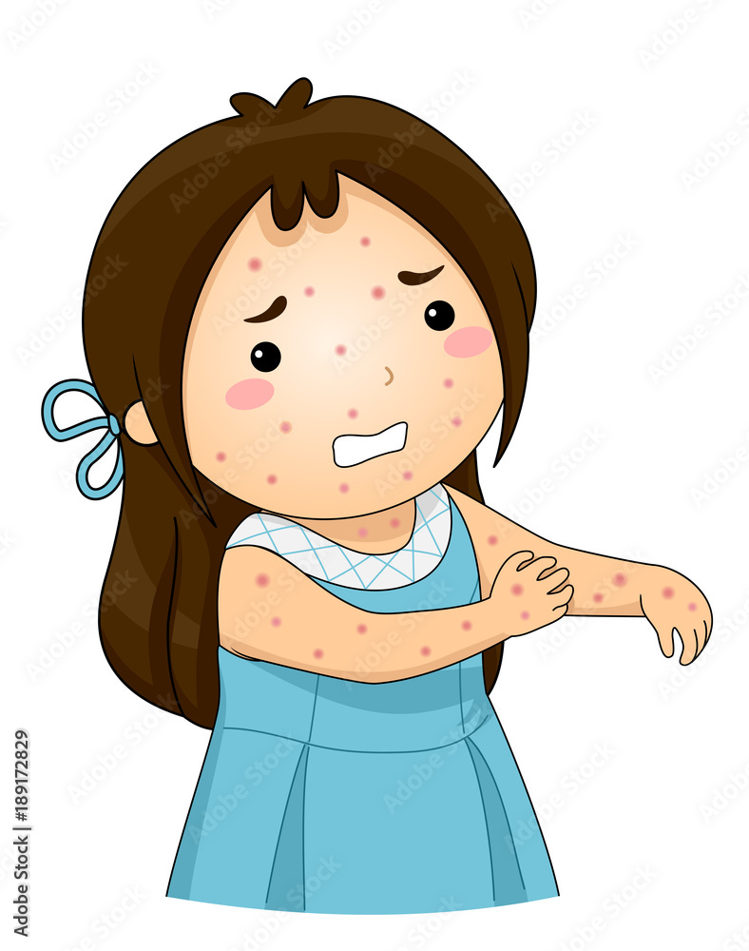
vaccines needed to prevent chicken pox
Two doses of the chicken pox vaccine are more than 90% effective at preventing the disease.
The MMRV vaccine protects children from measles, mumps, rubella, and chicken pox

Slide 7
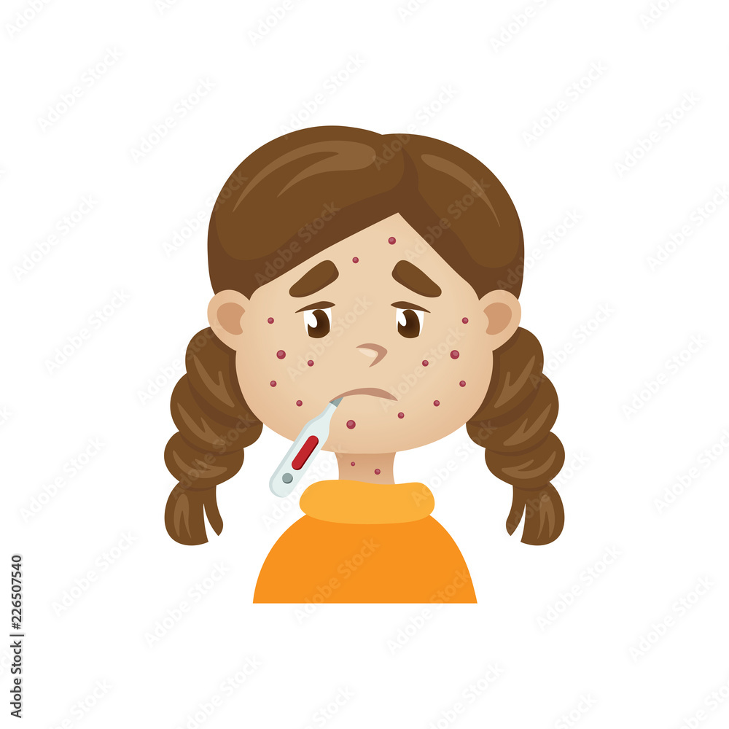
Serious complications from chicken pox
Bacterial infections of the skin and soft tissues in children.
Infection of the lungs
Infection or swelling of the brain

Slide 8
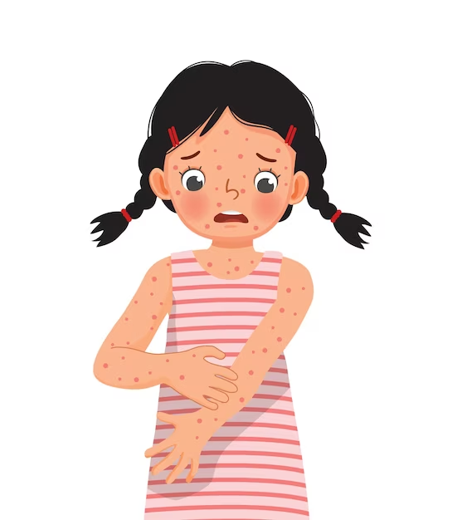
Anyone who has not had chicken pox or gotten the chicken pox vaccine can get the disease. Chicken pox illness usually lasts about 4 to 7

Slide 9
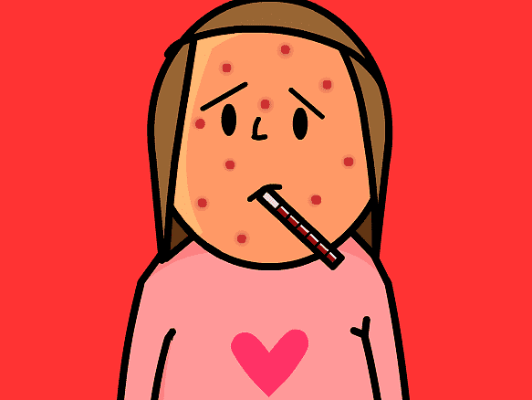
How do children take care of them selves from chicken pox?
They apply calamine lotion, petroleum jelly, or a fragrance-free anti-itch lotion

Slide 10
Interview with Dr.Nisreen Salita
Here is some feedback we got by an interview with doctor Nisreen Salita:
You can prevent it by taking you vaccinations. And it is unpredictable. You should visit a doctor if it get too extreme. And it recovers on it’s own

Slide 11
Conclusion
Finaly the best way to prevent chickenpox is to get the chickenpox vaccine. Everyone—including children, adolescents, and adults—should get two doses of chickenpox vaccine if they have never had chickenpox or were never vaccinated. Chickenpox vaccine is very safe and effective in preventing the disease.

Slide 12
Sites and Resources
DR. Nisreen Salita
https://www.cdc.gov/chickenpox/about/transmission.html#:~:text=The%20virus%20spreads%20mainly%20through,lesions%20that%20do%20not%20crust.
https://www.hhs.gov/immunization/diseases/chickenpox/index.html#:~:text=There%20are%202%20vaccines%20that,%2C%20mumps%2C%20rubella%2C%20and%20chickenpox
https://my.clevelandclinic.org/health/diseases/4017-chickenpox
https://www.aad.org/public/everyday-care/itchy-skin/rash/chicken-pox#:~:text=Apply%20calamine%20lotion%3B%20petroleum%20jelly,Relieve%20fever.
https://www.mayoclinic.org/diseases-conditions/chickenpox/symptoms-causes/syc-20351282
https://kidshealth.org/en/parents/chicken-pox.html#:~:text=The%20blister%20walls%20break%2C%20leaving,or%20skin%20disorders%20like%20eczema

